Slide 1
4th‒10th October, 2015
ŠTÚROVO, SLOVAKIA

Slide 2
INTRODUCTION OF THE HUNGARIAN TEAM

Slide 3
HUNGARIAN NATIONAL PARKS
AGGTELEK
NATIONAL PARK
BÜKK
NATIONAL
PARK
FERTŐ-HANSÁG
NATIONAL PARK
DUNA-IPOLY
NATONAL PARK
HORTOBÁGY
NATIONAL PARK
ŐRSÉG
NATIONAL PARK
BALATON
UPLANDS
NATIONAL PARK
KISKUNSÁG NATIONAL PARK
DUNA-DRÁVA
NATIONAL PARK
KÖRÖS-MAROS
NATIONAL PARK

Slide 4
BALATON UPLANDS NATIONAL PARK
TIHANY PENINSULA
PÉCSELY BASIN
KÁLI BASIN
TAPOLCA BASIN
KESZTHELY MOUNTIANS
SMALL BALATON
REGIONS

Slide 5
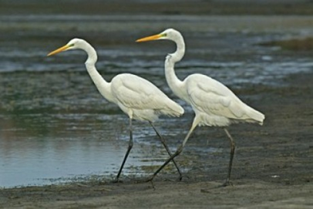
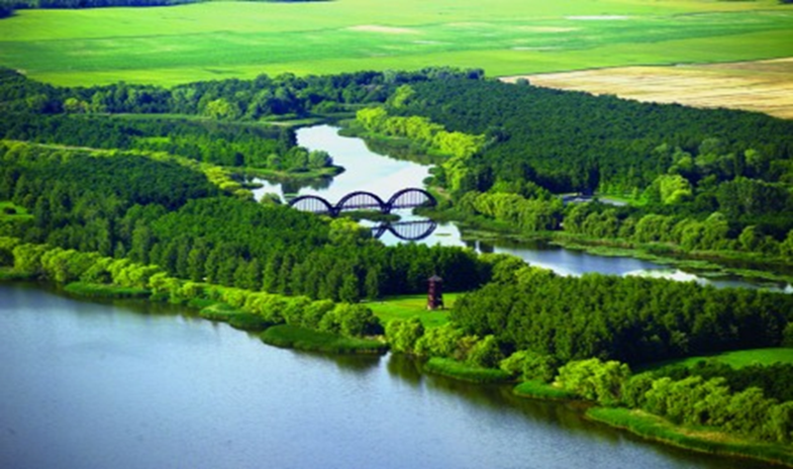
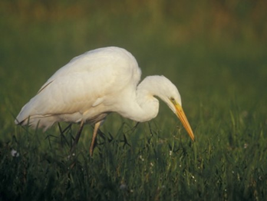
„SMALL” BALATON
HERONS

Slide 6
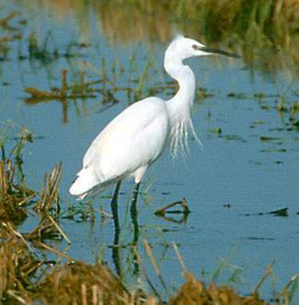
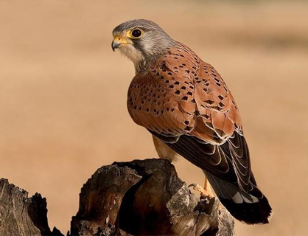
THE FAUNA of the BALATON UPLANDS NATIONAL PARK
WATER BUFFALO
GREAT EGRET
WINDHOVER

Slide 7
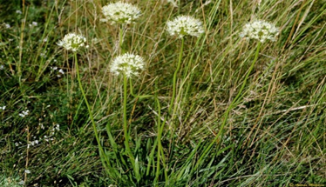
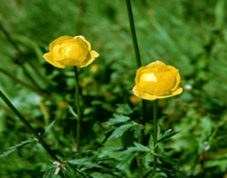
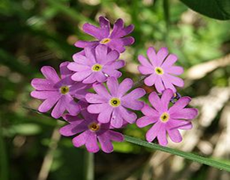
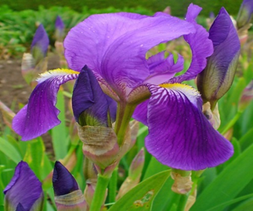
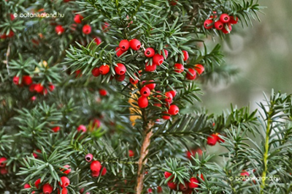
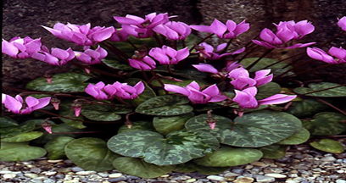
THE FLORA of the BALATON UPLANDS NATIONAL PARK
FRAGRANT ONION
PRIMROSE
GLOBEFLOWER
IRIS
YEW
FOREST CYCLAMEN

Slide 8
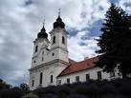
TOURISM: TIHANY PENINSULA
THE ABBEY

Slide 9
TOURISM: BADACSONY HILL

Slide 10
TOURISM: TAPOLCA LAKE CAVE

Slide 11
THANK YOU FOR
YOUR ATTENTION!

