Slide 1
Down the Blue Waterways
The Romanian Danube Delta, or where the Danube meets the Black Sea

Slide 2
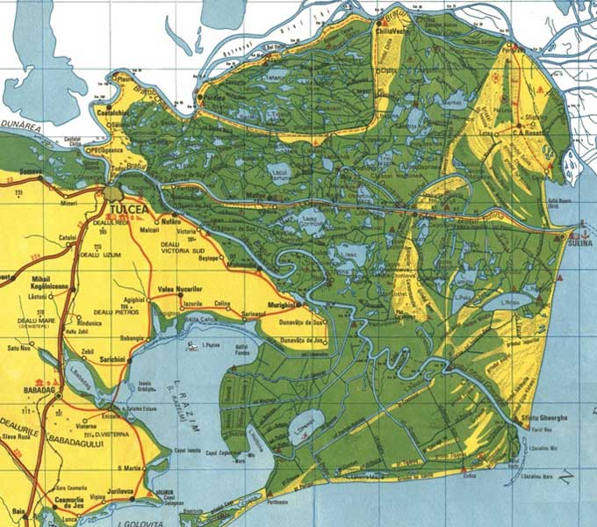
A Map of the Danube Delta

Slide 3
True or False?
The largest part of the Danube Delta lies in Romania.
The Danube Delta is the second largest delta in Europe and the best preserved on the continent.
3. The Danube Delta is not an inhabited area.
4. The Danube branches into three main channels to form the delta.
5. The Danube Delta is home to a wide variety of wildlife, especially birds.
6. The Danube Delta is a World Heritage Site.

Slide 4
Let’s take a quick look at the Danube Delta and at the same time enjoy the one and only The Waves of the Danube!

Slide 5


Slide 6
Answers
The greater part of the Danube Delta lies in Romania (Tulcea county), while its northern part, on the left bank of the Chilia arm, is situated in Ukraine. The approximate surface area is 4,152 km², and of that, 3,446 km² are in Romania. – Question 1 – True
The Danube Delta is the second largest river delta in Europe, after Volga Delta, and is the best preserved on the continent. – Question 2 – True
The Danube Delta is perhaps the least inhabited region of temperate Europe. In the Romanian side live about 20,000 people, of which 4,600 in the port of Sulina, which gives an average density of approx. 2 inhabitants per km². The rest is scattered in 27 villages, of which only three, all situated marginally, have more than 500 people (2002). – Question 3 – False

Slide 7
The Danube branches into three main distributaries into the delta, Chilia, Sulina, and Sfântul Gheorghe (Saint George). The last two branches form the Tulcea channel, which continues as a single body for several kilometers after the separation from the Chilia. At the mouths of each channel gradual formation of new land takes place, as the delta continues to expand. – Question 4 – True
Situated on major migratory routes, and providing adequate conditions for nesting and hatching, the Danube Delta is a magnet for birds from six major eco-regions of the world, including the Mongolian, Arctic and Siberian. There are over 320 species of birds found in the delta during summer. Over one million individuals (swans, wild ducks, bald coots, etc.) winter here. – Question 5 – True
In 1991, the Romanian part of the Danube Delta became part of the UNESCO list of World Heritage Sites. Around 2,733 km² of the delta are strictly protected areas. – Question 6 – True
(source Wikipedia)

Slide 8
Which of the following do you think you can do in the Danube Delta?
Go skiing
Go fishing
Enjoy traditional lifestyle
Participate at a film festival
Go mountain climbing
Go camping
Study and admire the wildlife
Windsurfing
Find a wide variety of accommodation
Enjoy the local cuisine

Slide 9
Watch the following video and see if you were right !

Slide 10
We hope you enjoyed our lesson!

