Slide 1
Concepts of the ideal teaching methods in Business Classes

Slide 2
Visits from successful businessmen
More visits.
Learn from experiences.
Invite them to classes.
Prepare for the future.

Slide 3
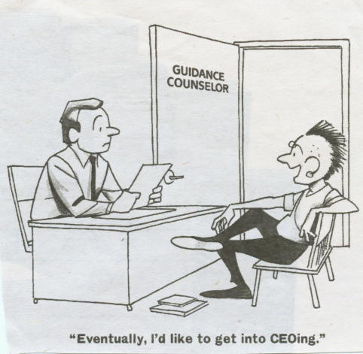
More visits to successful companies
Visit companies from Slovenia and abroad.
Observe workers and learn.
Work in real company.

Slide 4
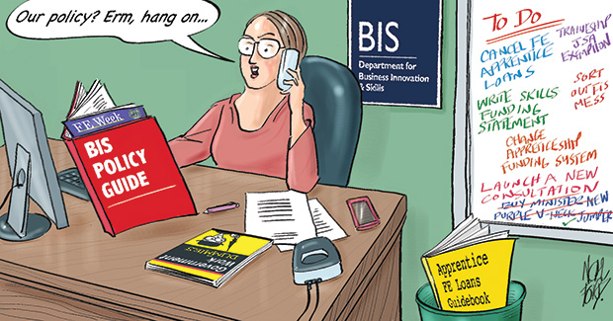
Traineeship
It lasts only 9 – 10 days per year.
Included in timetable.
We would improve our work.
More prepared for the job.

Slide 5
Practice firm
We learn how to work in a company.
Should be more realistic.
Problem: hard to find investors.

Slide 6
Teachers
Our final goal requires the interest and eagerness from both, teachers and students!
More fun and interesting.
Use of modern technology, practical example.

