Slide 1
RED GROUP
Esztergom and Bratislava

Slide 2
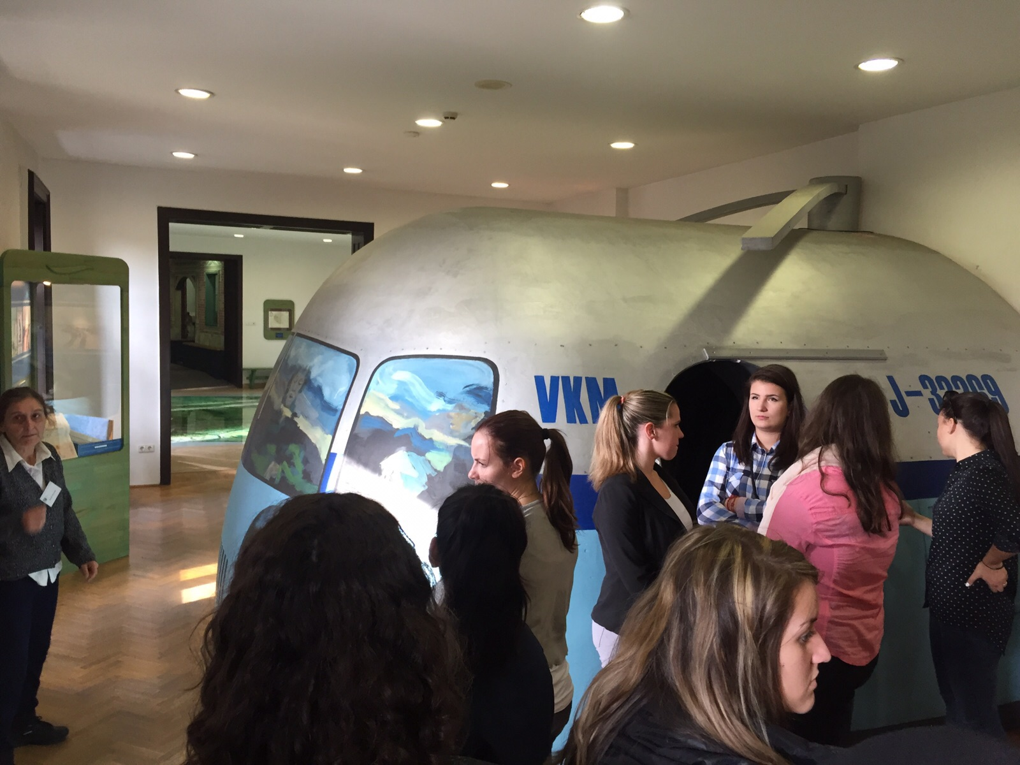
Esztergom
The bridge Maria Valeria, built in 19 century, connects Sturovo with Esztergom.
There we visited the Danube River Museum.
We stamped our cards with wooden hammer.
We were in a helicopter simulator and we watched there a short film about starting the plane and flying.
There was a big floor map where we could see the whole Hungary.
At the end we watched a short movie about water pumping.

Slide 3
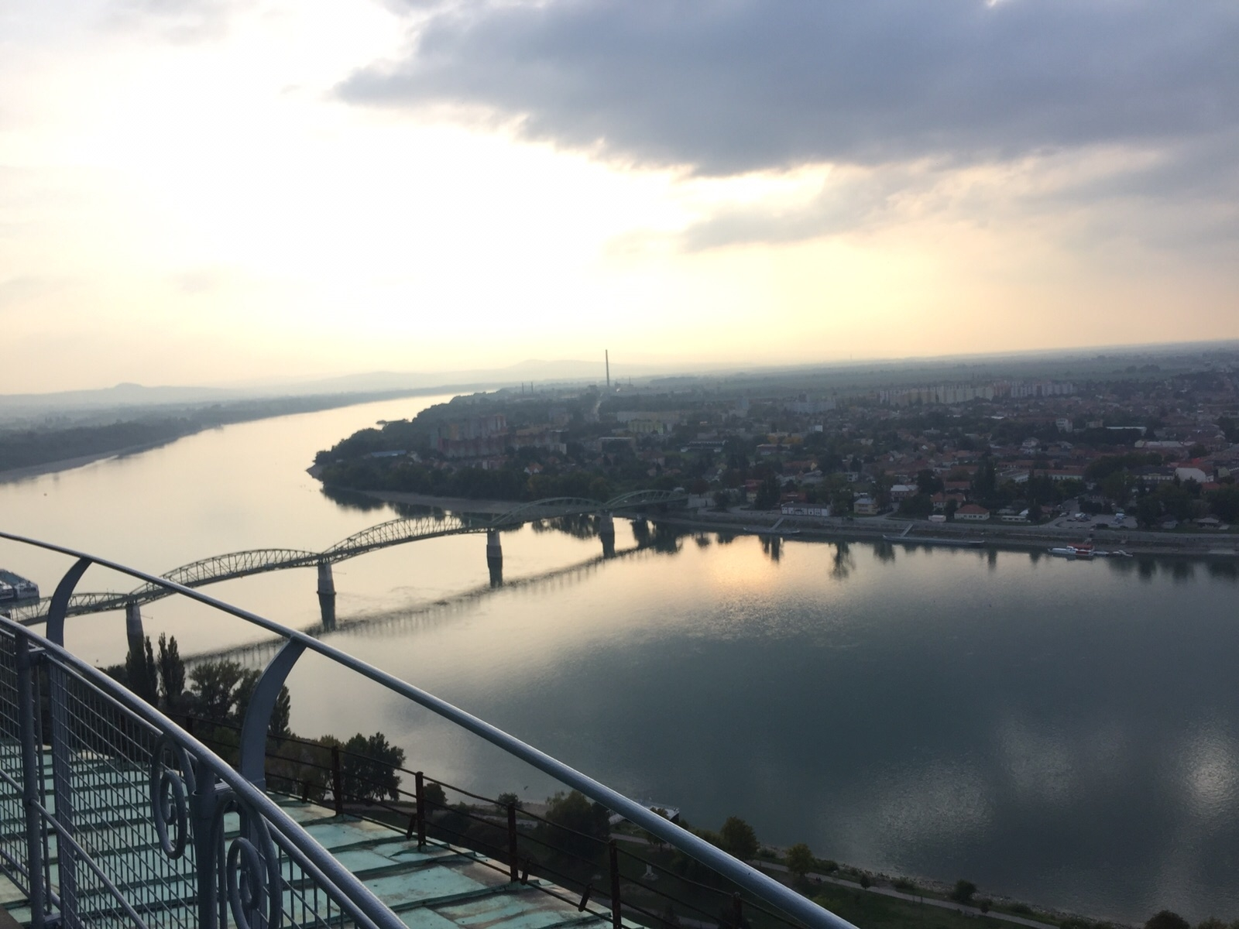
Esztergom
Later we went to the second biggest cathedral of Europe.
You could go up to the Dom and you had a great view of Sturovo there.
There was a statue about the Coronation of King Štephen.

Slide 4
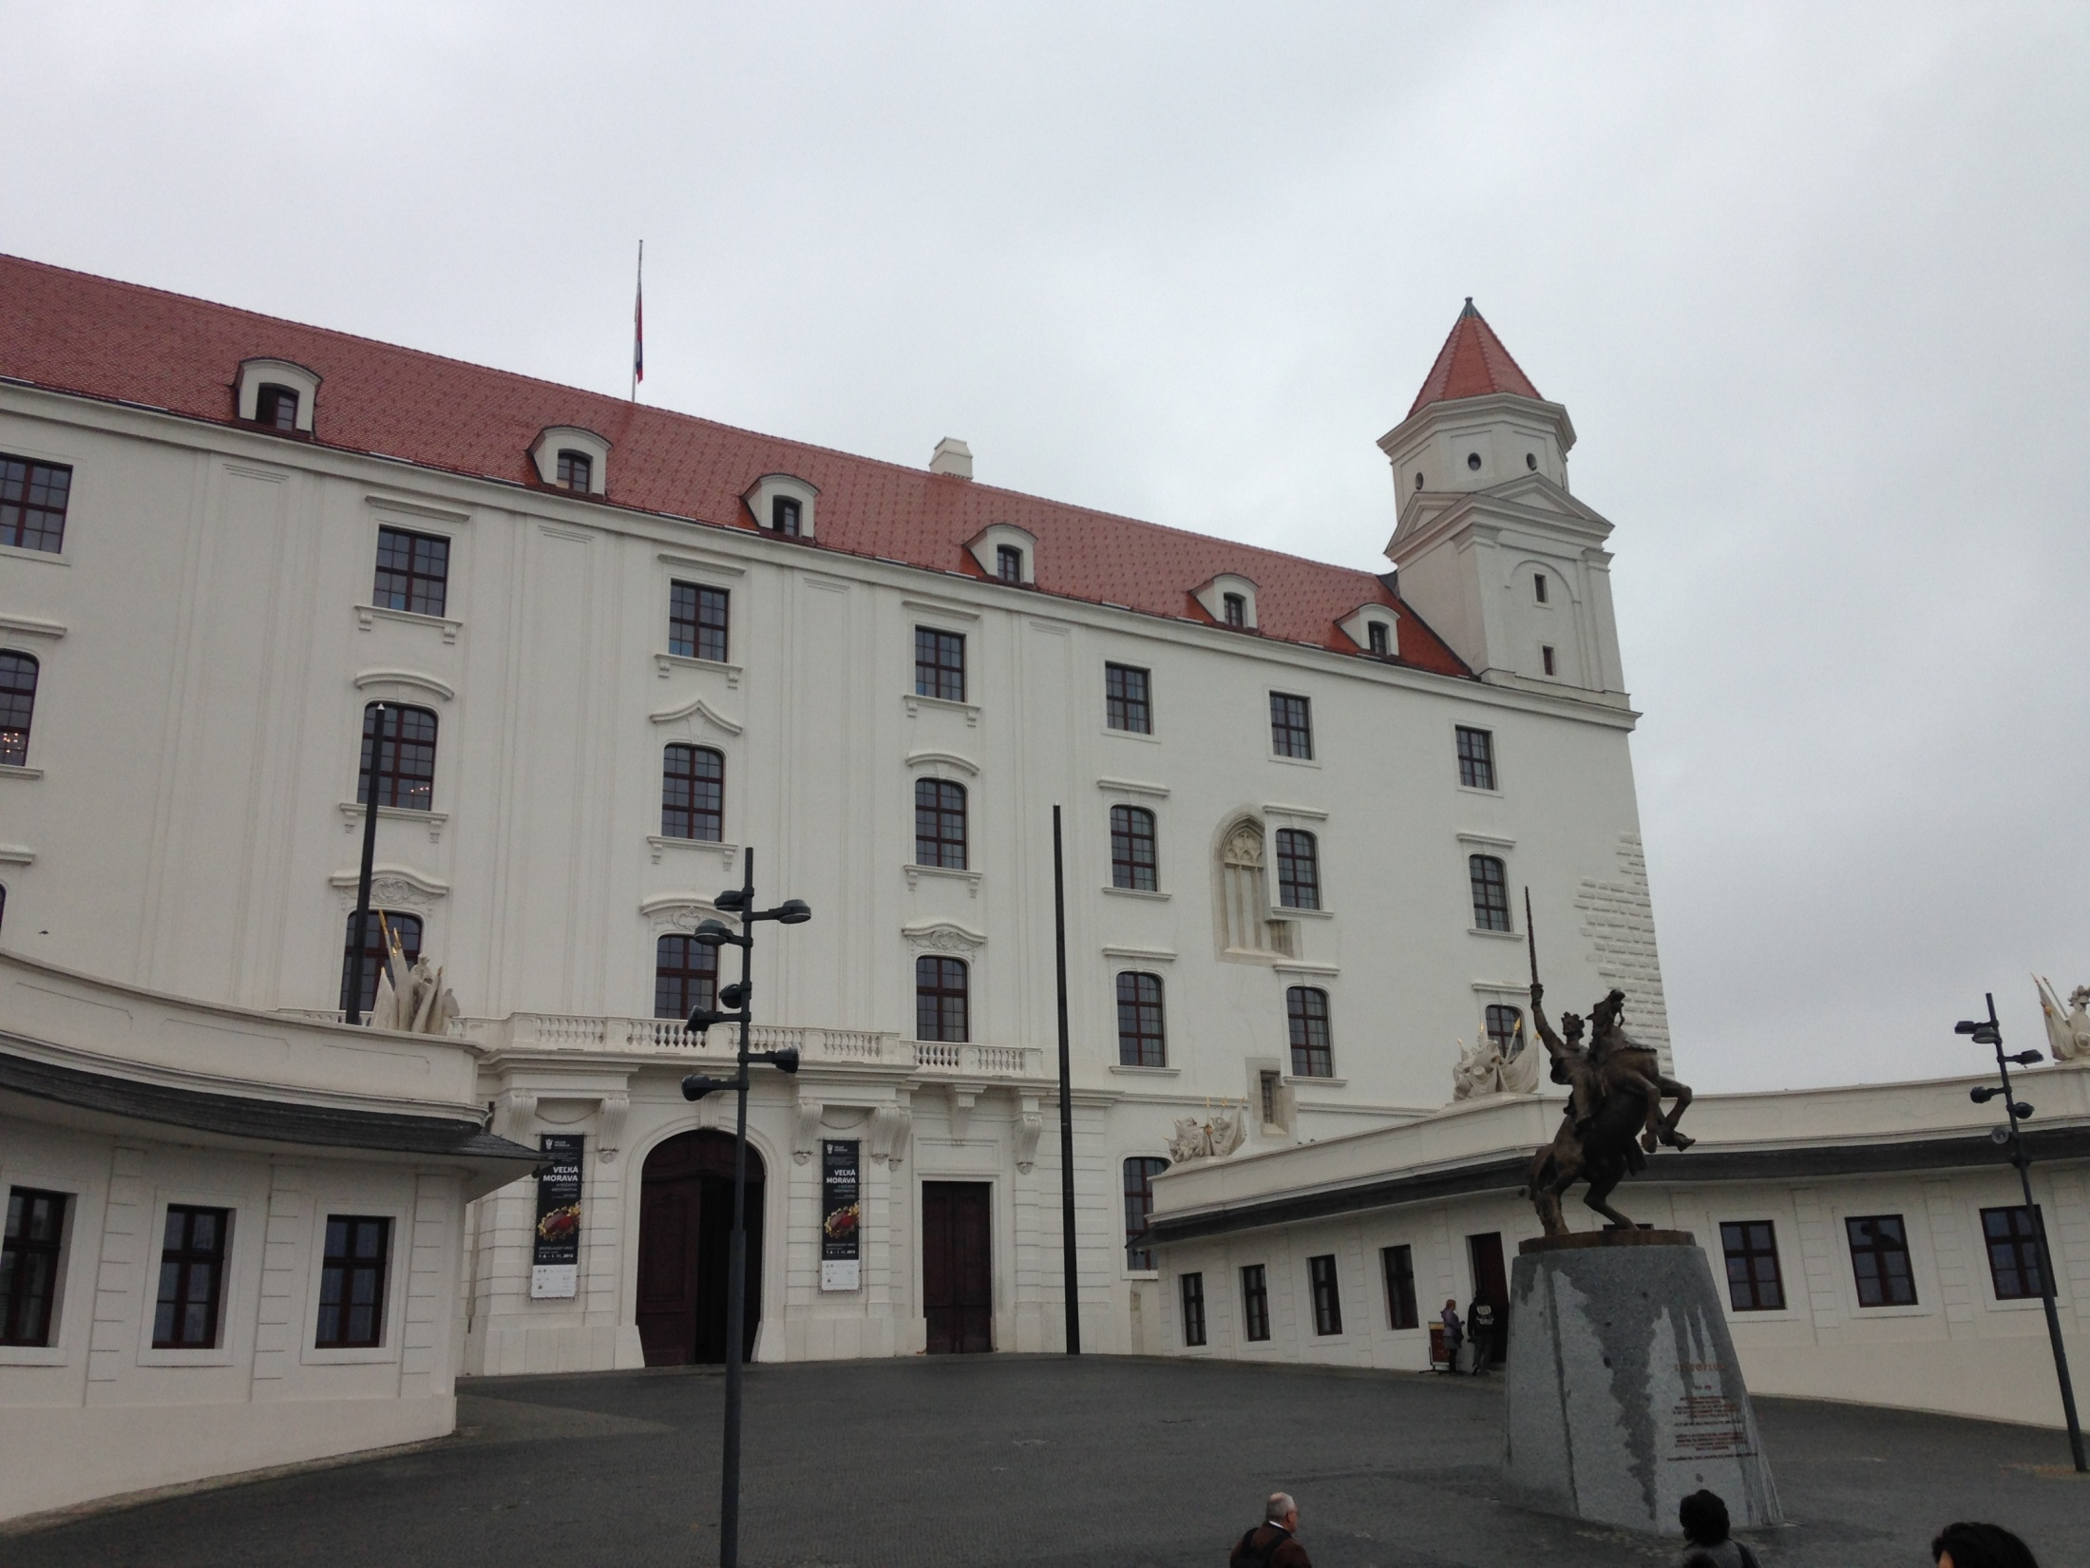
Bratislava
The next day we took a 3 hour drive to Bratislava.
There, we saw the castle of Bratislava and from the top we could see a view of the city and a bridge which has a restaurant on the top.

Slide 5
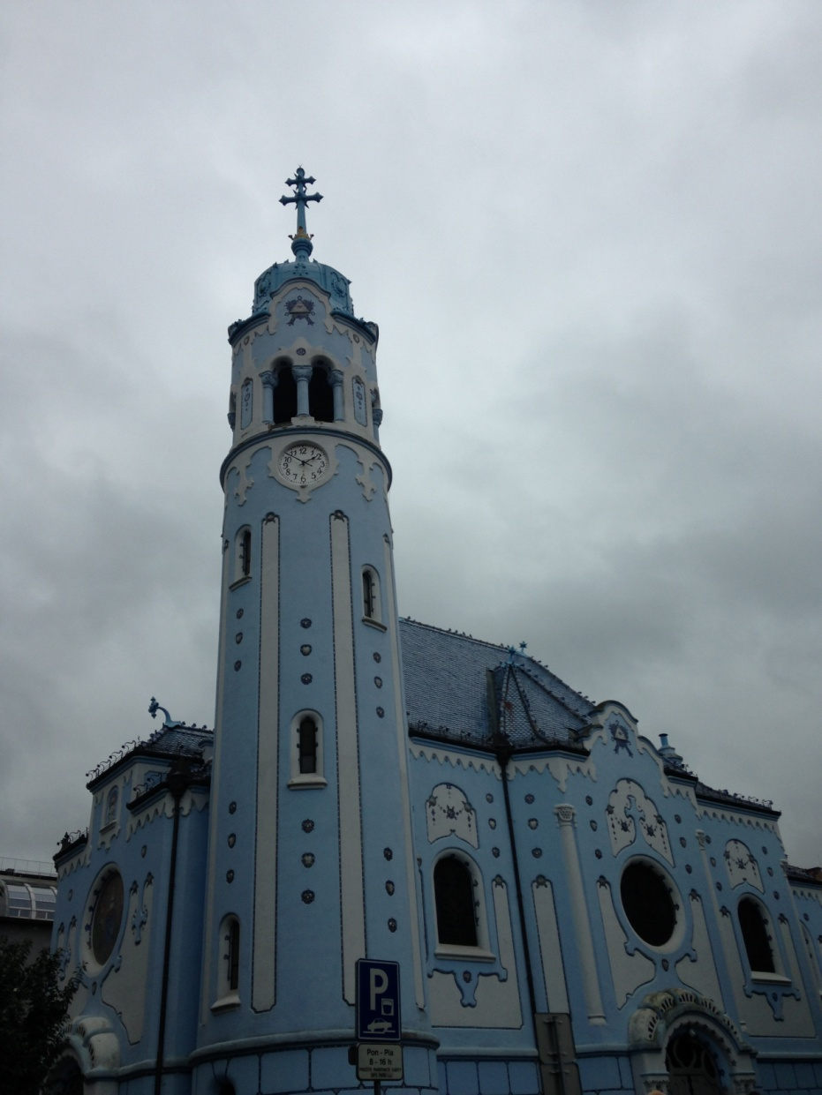
Bratislava
There was also a blue church.
We were in the old town of Bratislava and had some freetime there.
We went to the shopping center Eurovea and spent a lot of time and money there.

Slide 6
Thanks for your attention! ☺

