Slide 1
National parks in Slovakia

Slide 2
Content
The list of national parks
Map
TANAP
Slovak Paradise National Park
Gallery

Slide 3
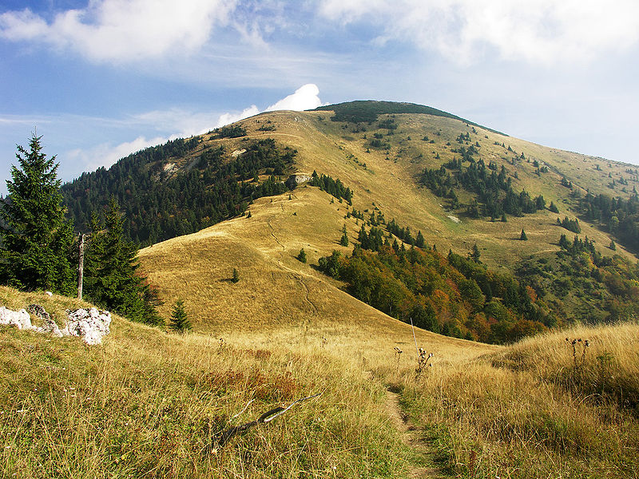
The list of national parks
Veľká Fatra National Park

Slide 4
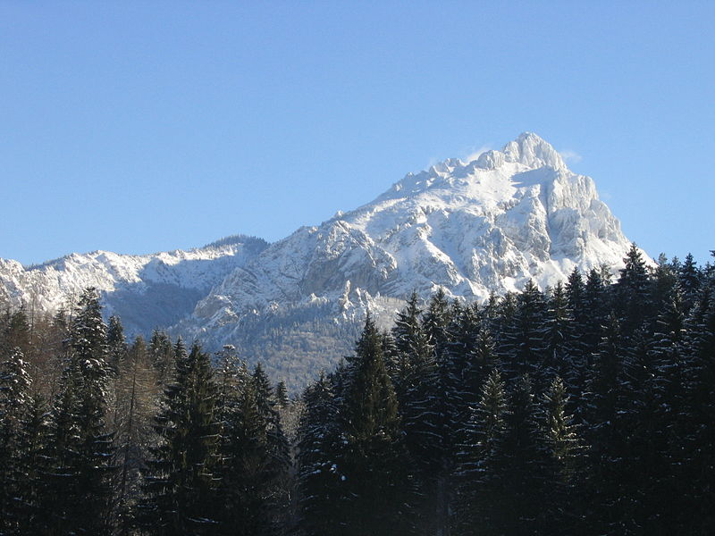
Malá Fatra National Park

Slide 5
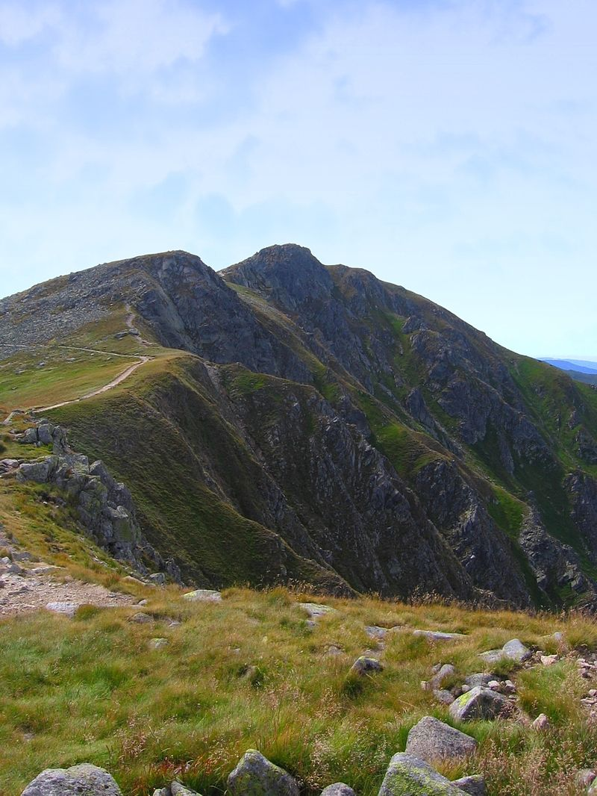
Low Tatras National Park

Slide 6
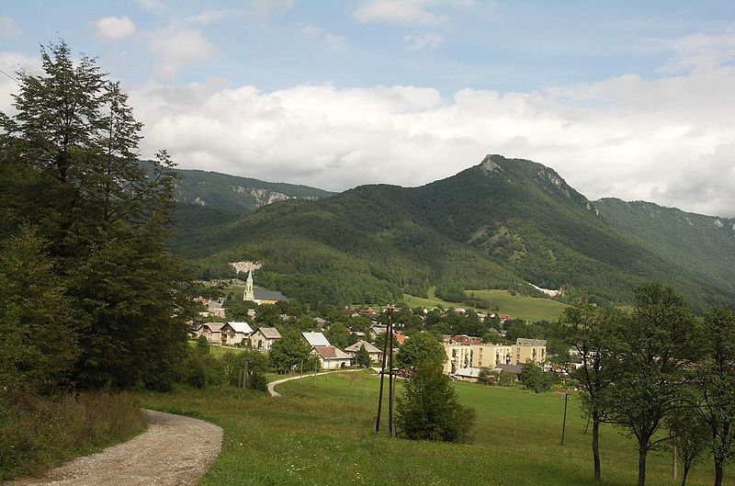
Muránska planina National Park

Slide 7
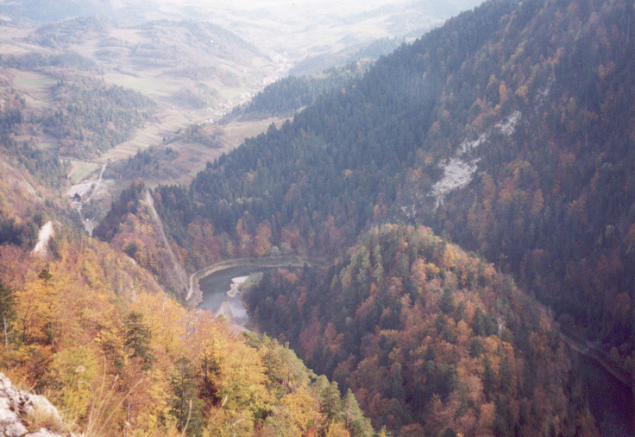
Pieniny National Park

Slide 8
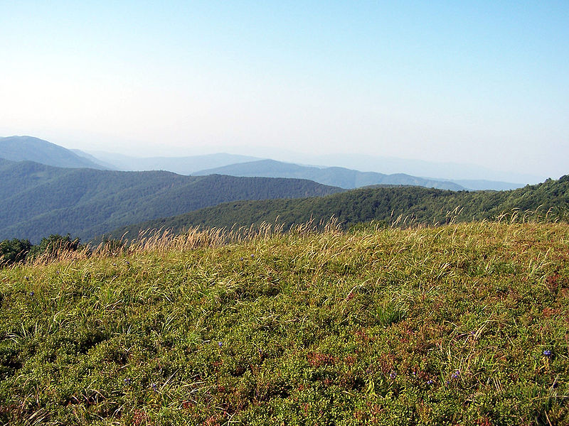
Poloniny National Park

Slide 9
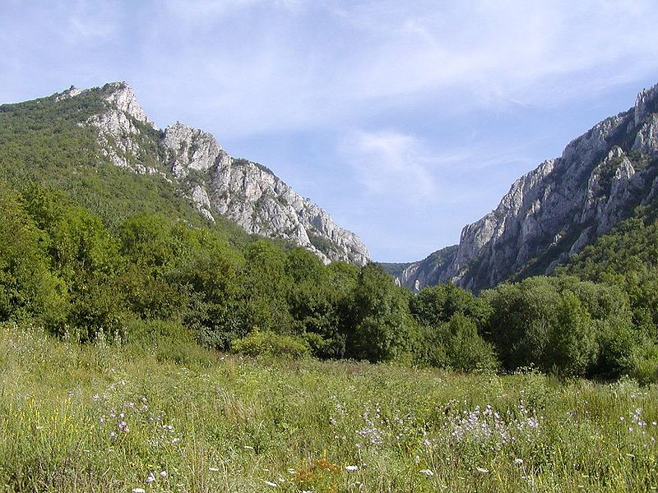
Slovak Karst National Park

Slide 10
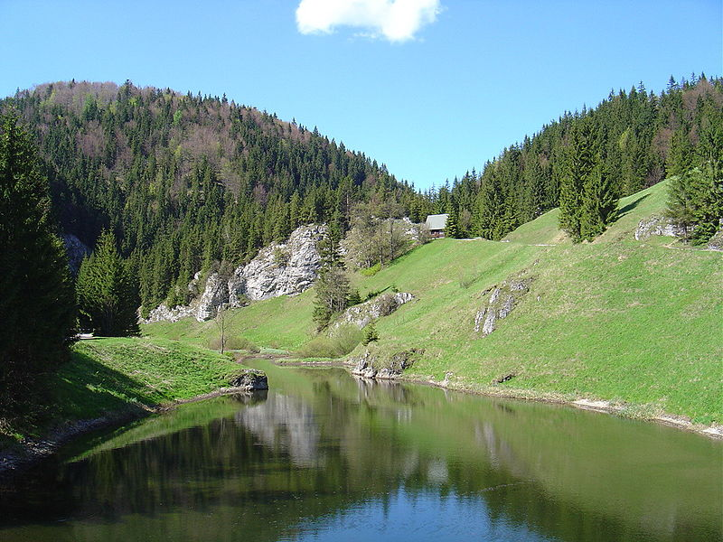
Slovak Paradise National Park

Slide 11
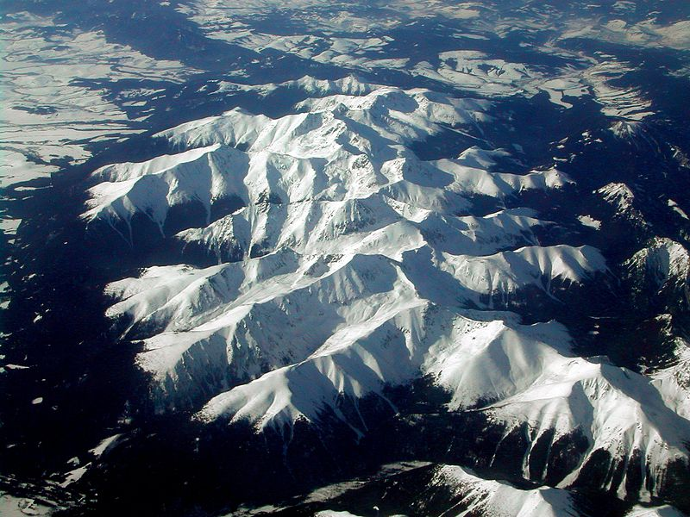
Tatra National Park

Slide 12
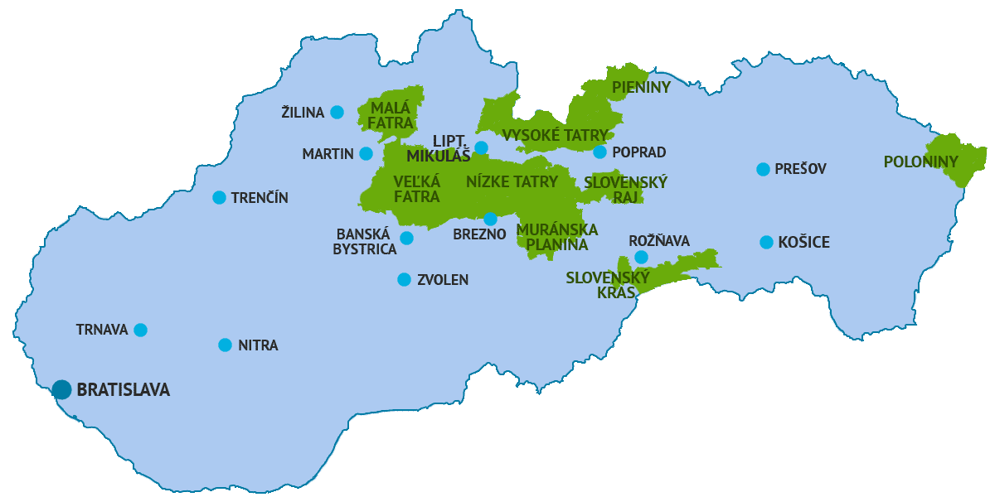
Map

Slide 13
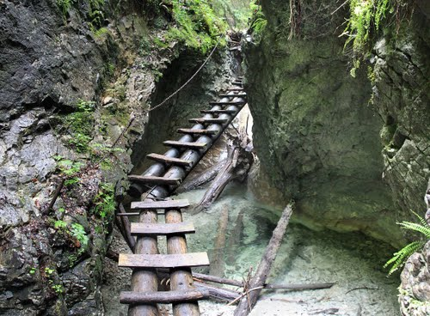
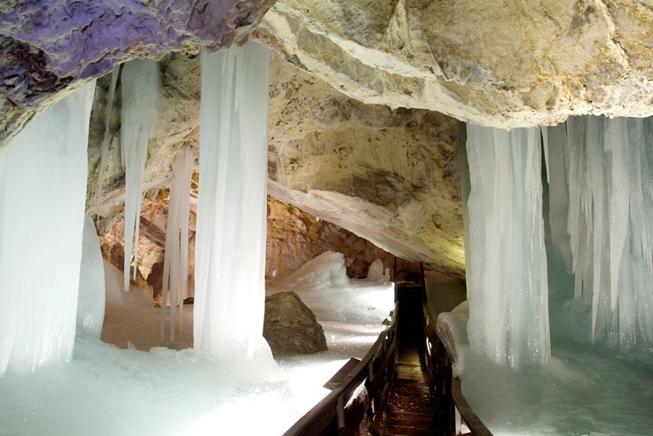
Slovak Paradise National Park
situated in East Slovakia
300 km of hiking trails
350 caves (Dobšinská Ice Cave - UNESCO World Heritage Site), waterfalls, endangered animals, plants

Slide 14
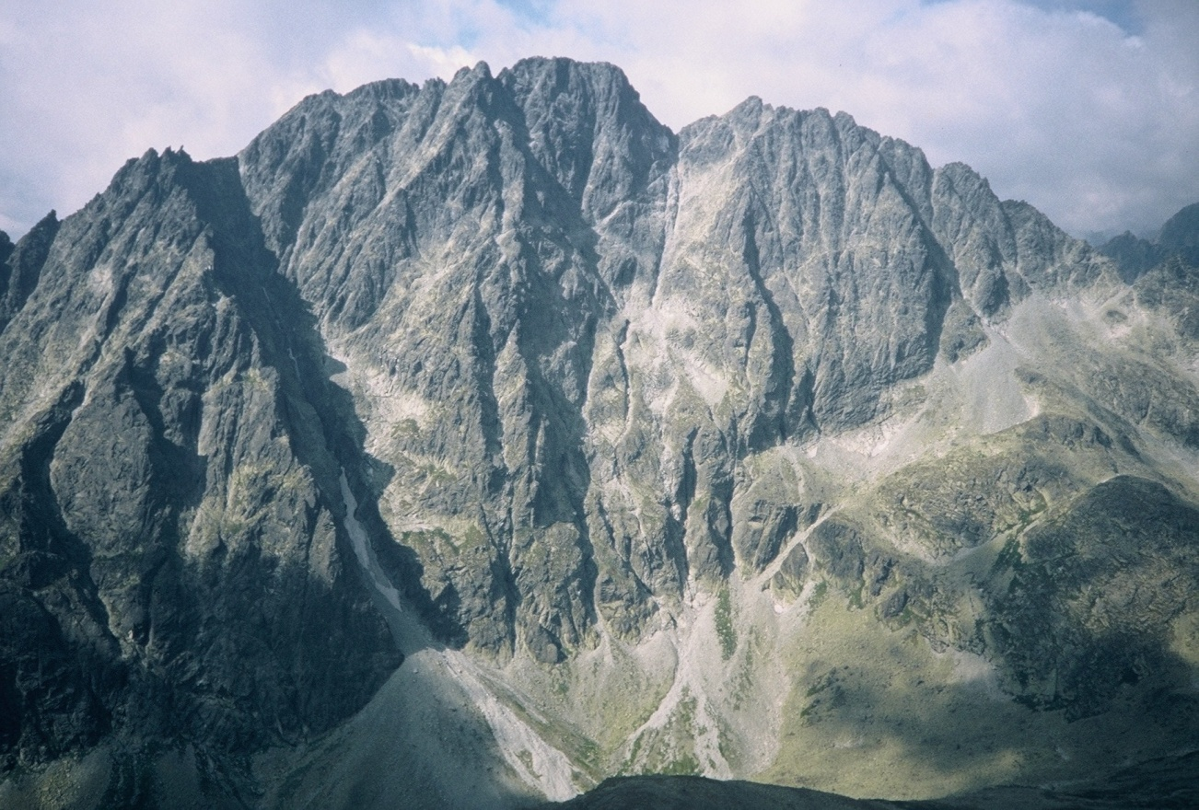
Tatra National Park
is important for protecting a diverse variety of flora and fauna
Gerlachovský štít is the highest peak (2655 m)

Slide 15
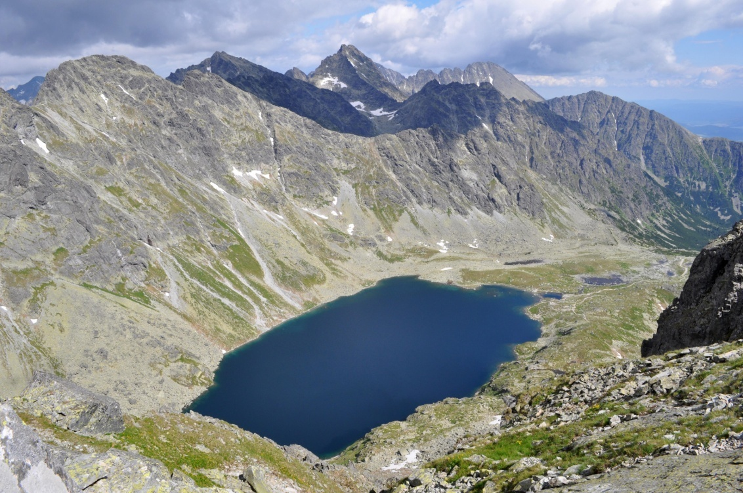
Lakes and streams
more than 100 trans, mountains lakes
streams, headwaters of the Poprad River, Baltic Sea, Black Sea
Veľké Hincovo pleso is the biggest

Slide 16
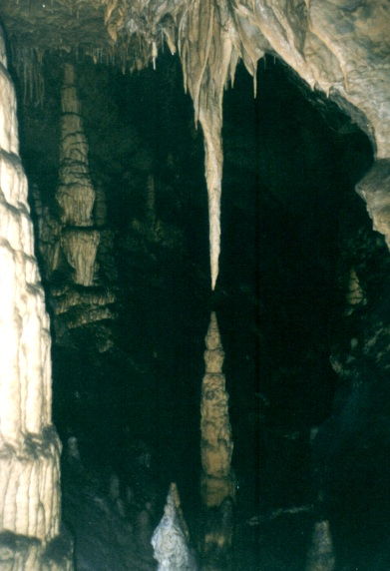
Caves
300 caves, Belianska Cave is the only open
the longest cave system is the Cave of Javornika

Slide 17
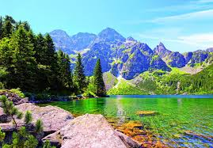
History
was established on 1 January 1949
oldest national park
it became a part of UNESCO Man and the Biosphere Programme

Slide 18
Thank you for paying attention!

