Slide 1
Our regional company – Budweiser Budvar
VendulaBocanova, Tereza Langová, Tereza Hukkelová, TÁBOR, CZE

Slide 2
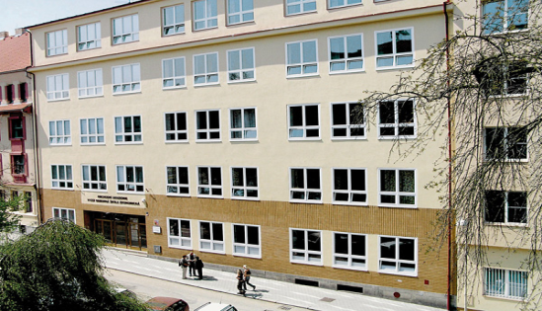
Our School
Commercial High School Tábor
the school started teaching in 1919
there are about 450 students at present
we learn English and 1 more foreign language (German, French, Russian)
2 branches of study:
economical lycée (graduates continue at universities or work in business or touristic areas)
business academy (graduates continue at universities or work in business areas)

Slide 3
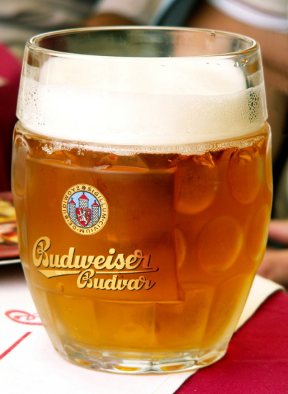
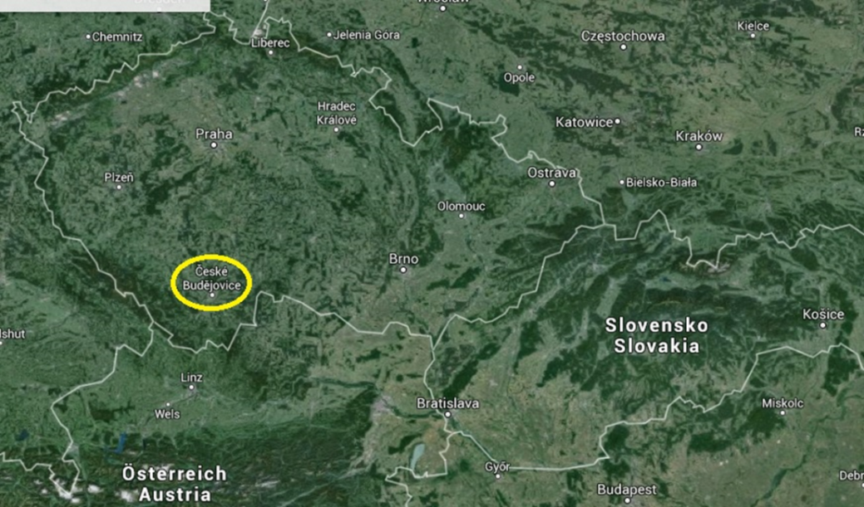
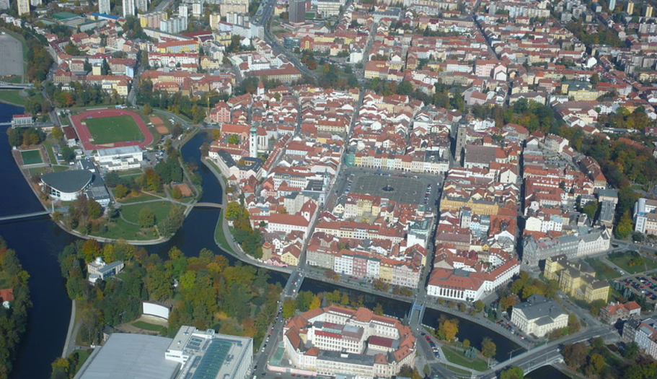
About company
it‘s a national corporation
located in South Bohemia, 150 km south of Prague
brews beer everybody likes in Czech Republic
exporting to 56 countries (Slovakia, Austria…)

Slide 4
History of Budvar:
1265 – brewing beer began in ČB (today it‘s 750 years)
1895 – Budweiser Budvar was founded
1930 – registration of first label
1942 – Nazi‘s occupation
1959 – first label with today‘s design
1967 – national corporation
2004 – confirmation of originality

Slide 5
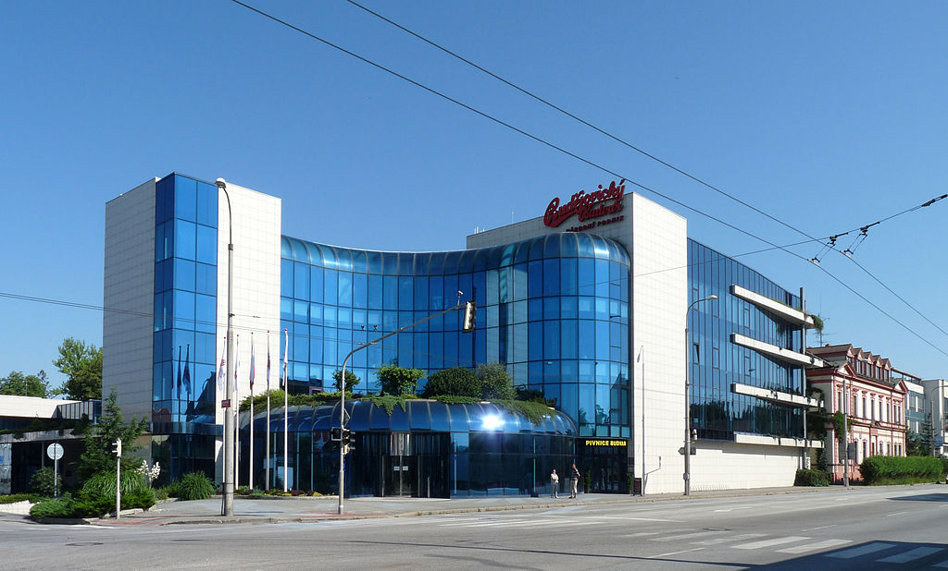
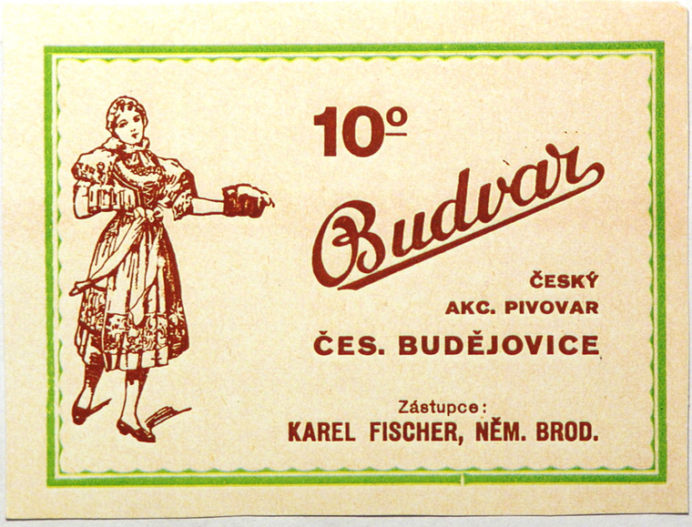
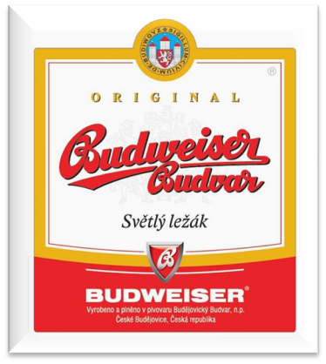
in 1895
Today
Today
First label
Label today

Slide 6
Products
18,4Kč
22,7Kč
13,20Kč
0,67€
0,83€
0,5€

Slide 7
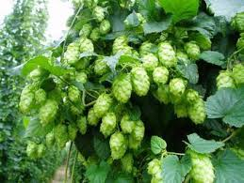
Ingredients for production of beer
Hops
is a highly important ingredient, the spice of beer
female heads of Žatec hops gives Budvar beer its inimitable taste
2. Water
pure clean natural water from our 300 metres deep artesian wells is of top quality and contributes to the characteristic taste of beer

Slide 8
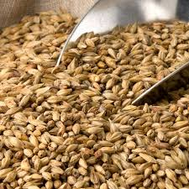
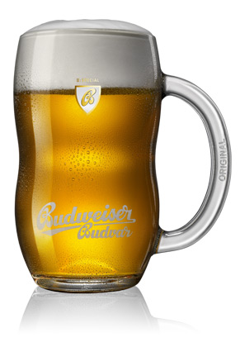
Ingredients for production of beer
3. Malt
good-quality malt is essential for anyone who wants to brew good beer
grains of the best Czech spring barley, which grow in Moravian region Haná, are used
it is the malt that provides beer with its inimitable golden colour and impeccable full flavour

Slide 9
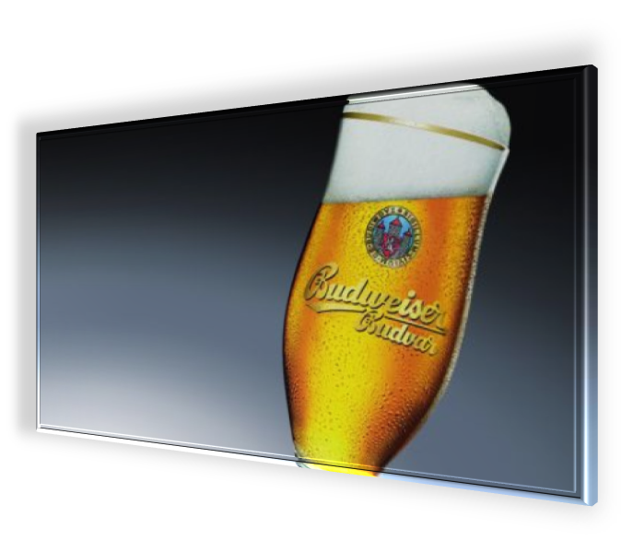
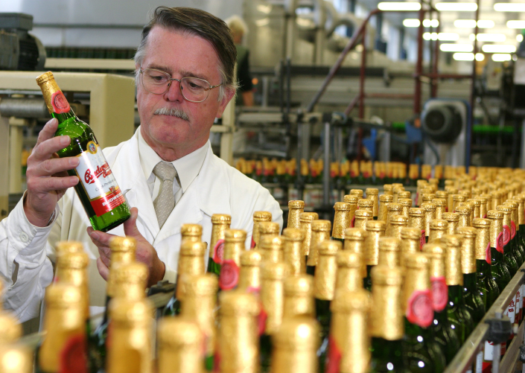
brewing Budvar
there are several steps in the brewing process, which include malting, mashing, lautering, boiling, fermenting, conditioning, filtering, and packaging

Slide 10
Budvar in numbers
in 2013 it made 1, 424, 000 hectolitres of beer
in 2012 the profit was about 222,6 mil CZK (8,2 mil EUR)
every year 40, 000 tourists visit the company
the most beer is exported to Germany (about 200, 000 hectolitres every year)

Slide 11
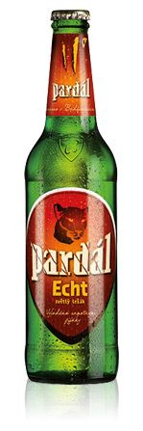
Changing budvar
Customer oriented
Pardál Echt created and tuned with beer lovers, fine 11º beer
Sold in bottles, cans and KEGs
Product web and eshop
Online game
Proud sponsor of - TV documentary - Rally DAKAR team - bikers - cyclocross - open air festivals TARGET CUSTOMERS: men 20 - 45 yrs old from cities

Slide 12
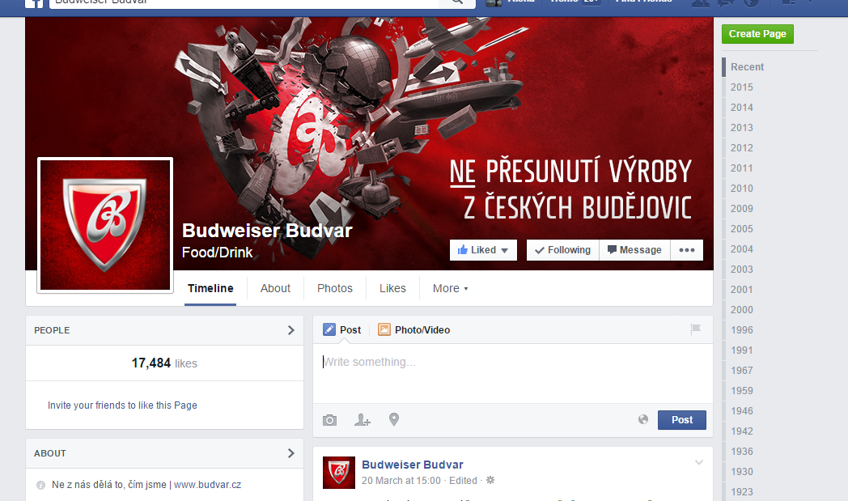
Going on social media

Slide 13
Thank you for your watching!

Slide 14
Resources:
https://www.google.cz/search?q=budvar&client=opera&hs=Nzt&source=lnms&tbm=isch&sa=X&ei=SHH4VPSRKceHPYOpgbgE&ved=0CAcQ_AUoAQ&biw=1366&bih=660
http://en.wikipedia.org/wiki/České_Budějovice
http://www.budejovickybudvar.cz/produkty/sortiment/cvikl.html
http://www.budvar.cz/en/our-beer/b-special

