Slide 1
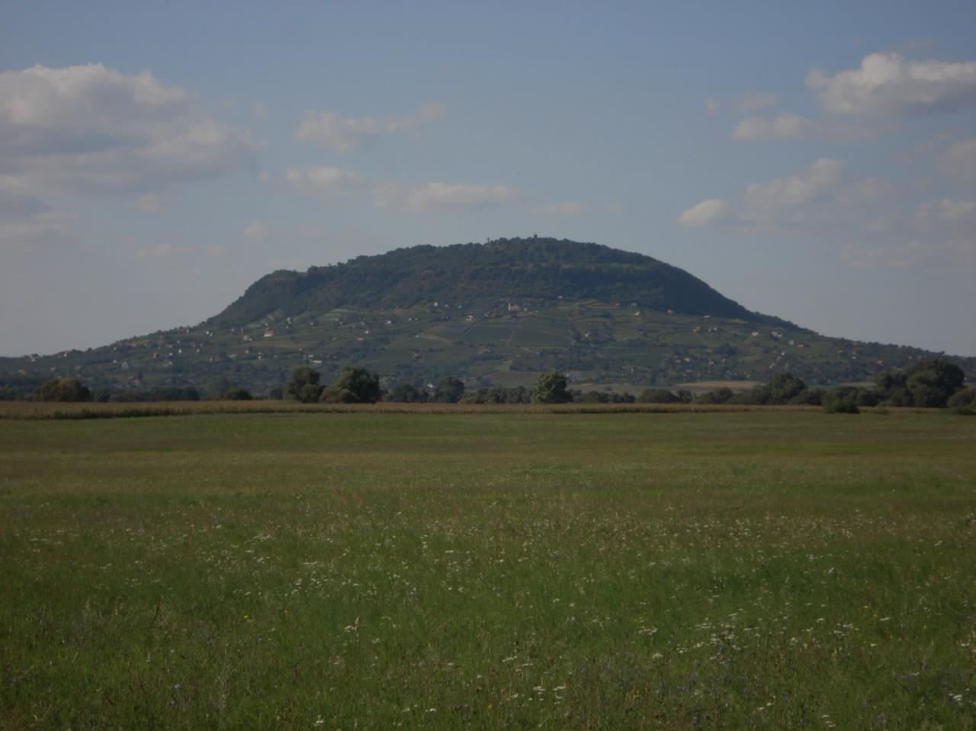
The wine of Somló
Geographical information
Northwestern Hungary, Veszprém county
30 kilometers from hometown, Pápa
1142 hectares (only 600 planted)
432 meters tall
Brown forest soil, volcanic rocks, loess, sand

Slide 2
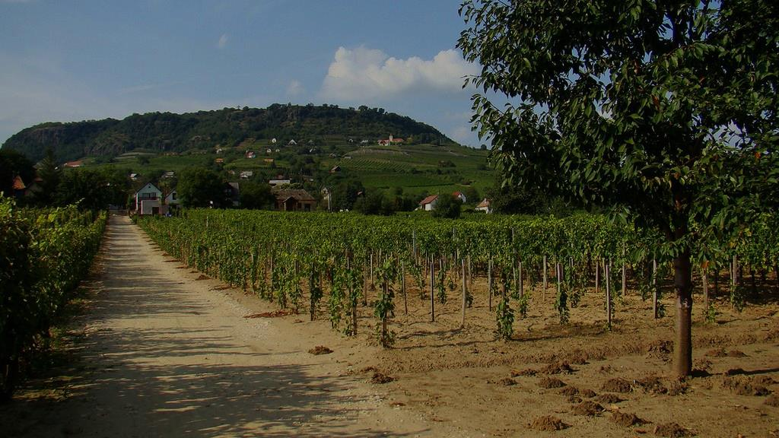
Production process
Harvest
Pressing
Splitting juice
Fermentation
Cleaning
Filtration
Cooling
Warming

Slide 3
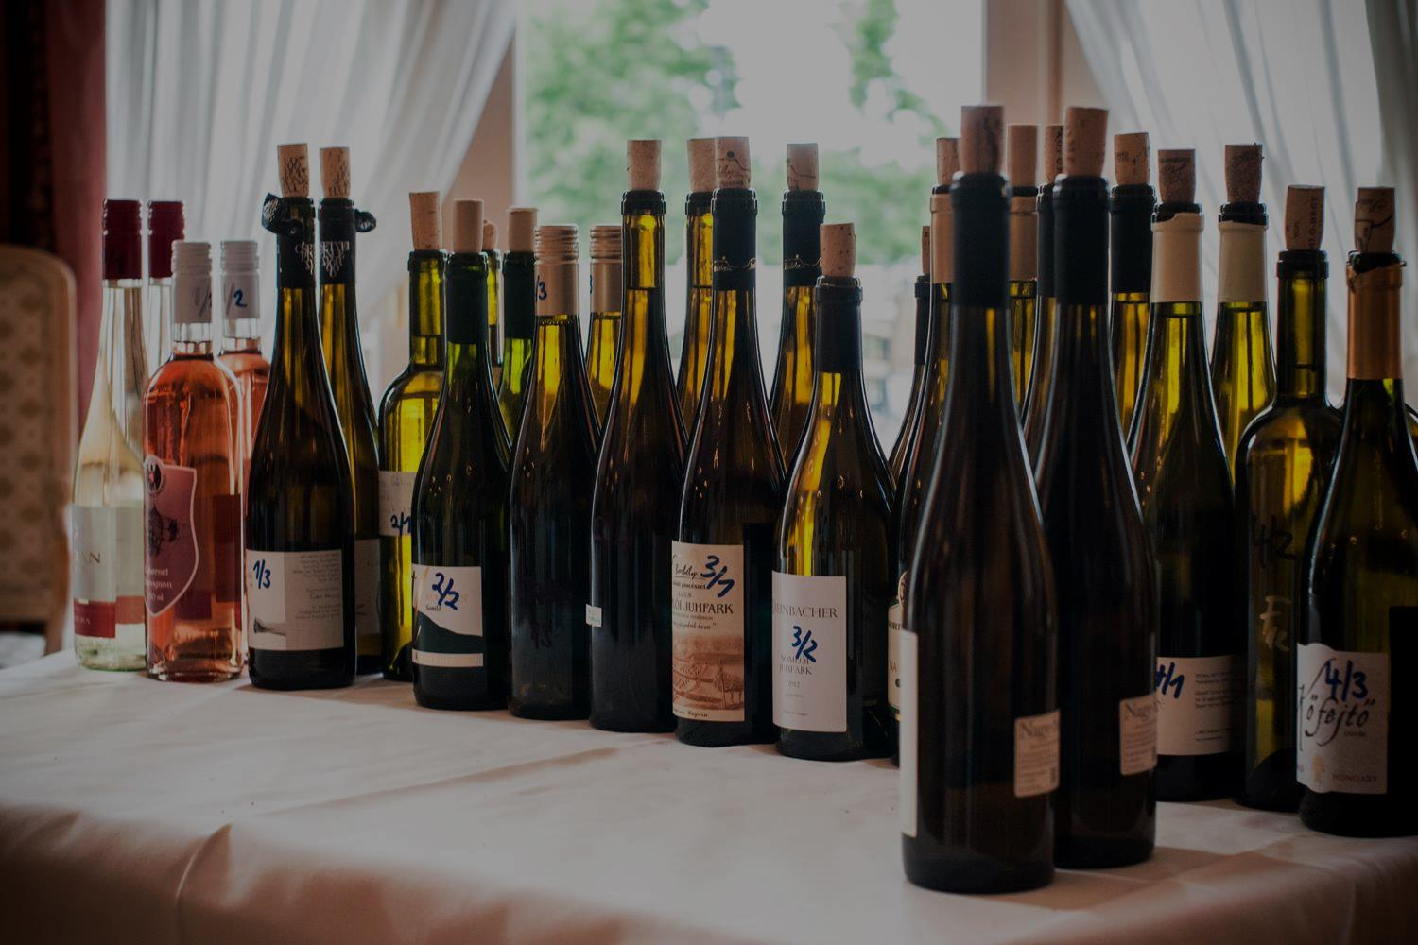
More information about the wine
More than 50 types of wines produced
Price is 10€-20€/bottle
2015 International Wine of The Year

