Slide 1
Conflict Management
Specimnen Lesson 8th Training Event
Elisabeth Hasiweder
BHAK Linz International Business School

Slide 2
Have you ever been in a conflict with sombody?
Who of you have ever been in a conflict?
Who of you have ever solved a conflict with a bad feeling afterwards?
Who of you have ever solved a conflict in a positive way?

Slide 3
Conflictmanagement
What is a conflict?
Why do we have conflicts?
Are there different kinds of conflicts?
How can conflicts be solved?

Slide 4
Conflict …
to come into collision or disagreement;
be contradictory
people feel tensions
A
B

Slide 5
Why do people not just talk about it?
Communication is more than talking!
“You cannot not communicate“ (Paul Watzlawick)
Communication = sending information
The reciever is the interpreter

Slide 6
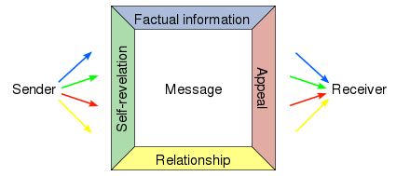
Four-sides model (Schulz von Thun)

Slide 7
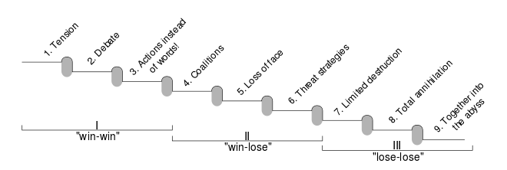
A Model of Conflict Escalation (Friedrich Glasl)
Stage 1–3: mediation
Stage 3–5: process guidance
Stage 4–6: sociotherapeutic process guidance
Stage 5–7: intercession, intermediation
Stage 6–8: arbitration, court action
Stage 7–9: forcible intervention

Slide 8
Why do we have conflict escalation?
We do not ask
We think we know …
We do not listen
We have to find arguments …
We do not see
We are focused on our needs …
We do not want to lose
We want to win!

Slide 9
How can a conflict be solved?
People have needs …
Talk about needs!
To be loved
To feel safe
To reach a goal
To be accepted
Te be free

Slide 10
That easy?
Take your time
Open your ears
Make a request
Invent strategies
Make a new decision
I would like to have …

Slide 11
List of Literature
http://www.dictionary.com/browse/conflict
https://en.wikipedia.org/wiki/Friedrich_Glasl%27s_model_of_conflict_escalation
https://en.wikipedia.org/wiki/Four-sides_model
https://www.experto.de/personal/mitarbeiterfuehrung/so-loesen-sie-konflikte.html

