Slide 1
Welcome to tábor, dear friends from Pápa
Bilateral Evaluation event Czechia – hungary Escape project, 2014 - 17

Slide 2
programme
Escape project EVALUATION (BY CZECH AND HUNGARIAN STUDENTS)
Introductory activities
Survival czech
„marshmallow challenge“

Slide 3
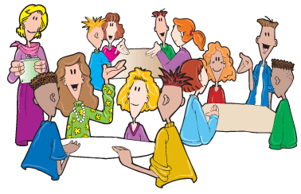
Introductory activities
Meet your partners, discuss different topics in 20 min
Present your group in 2 min

Slide 4
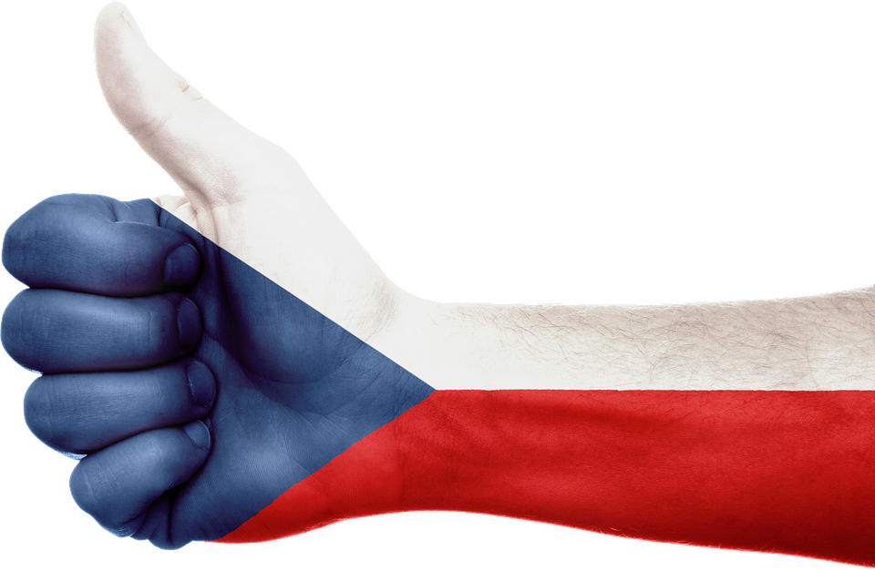
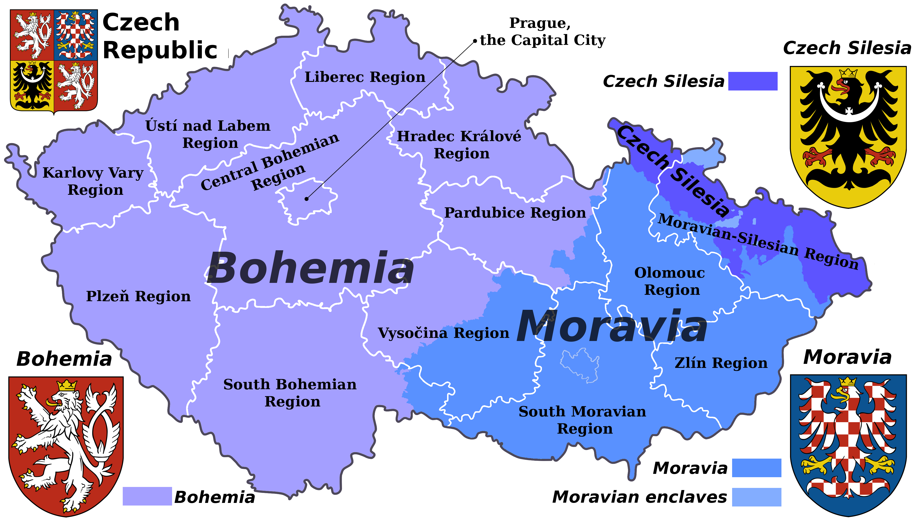
Survival czech
Czech students will teach hungarian partners basic czech words and phrases
Length of activity: 15 min + 10 min
Hungarian students will perform short dialogues in czech

Slide 5
„marshmallow challenge“
Build a tower, build a team in 30 min
Competition tasks: 1 build the tallest free standing structure 2 build the most interesting free standing structure
Choose one of the tasks and start, use spaghetti and marshmallows
Announcing winners

