Slide 1
My dream lesson of history
Vendula
Denisa
Simona
Czech team

Slide 2
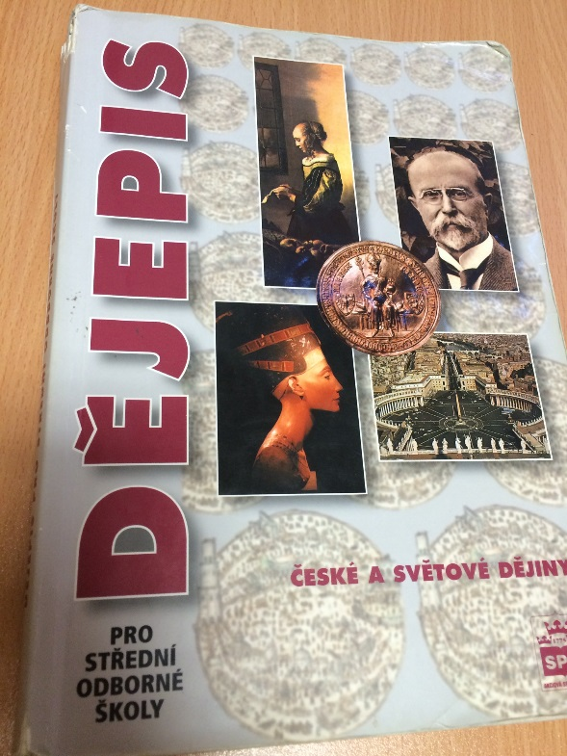
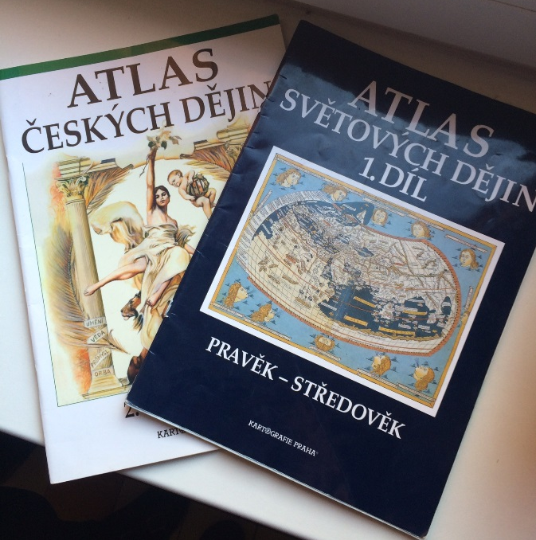
OUR LESSONS OF HISTORY
Two times a week
45 minutes
Three years
From prehistory to modern times
Examining every lesson
2 exams per semester

Slide 3
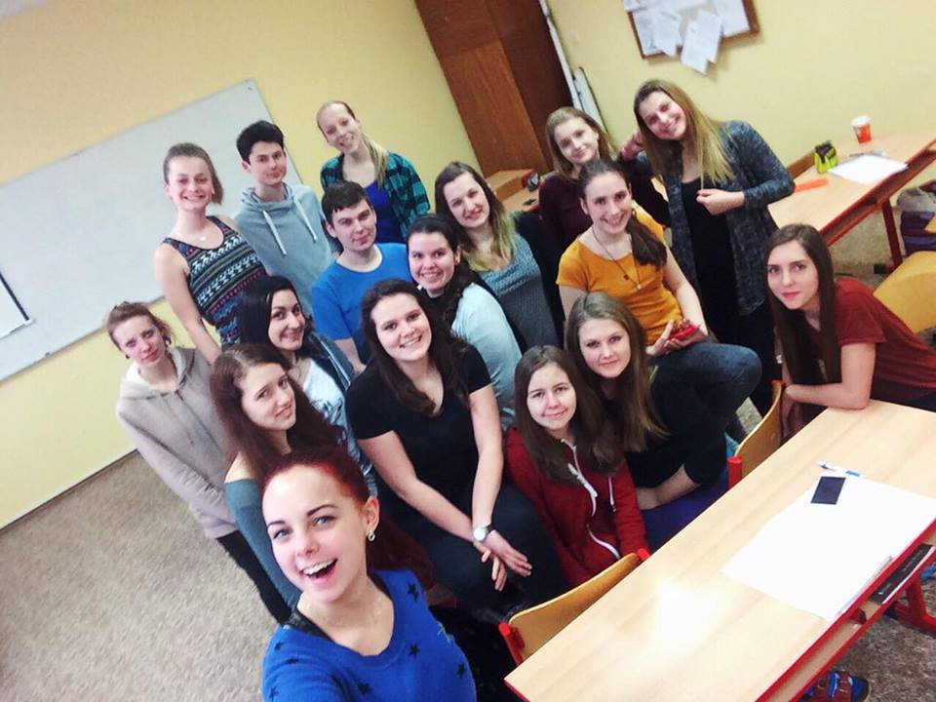
Popular Activities in our lessons
Watching videos and pictures
Playing games
Working in groups
Listening to a historical story about famous people

Slide 4
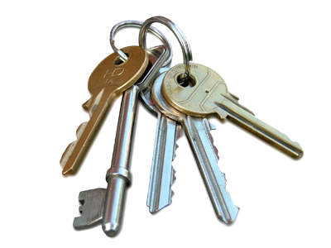
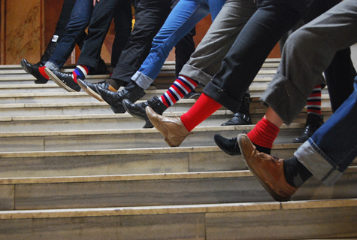
1989

Slide 5
Velvet Revolution
17th November 1989

Slide 7
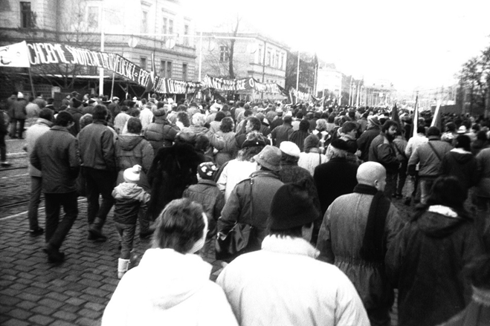
Velvet revolution
On 17th November 1989 students got together in Prague to honour Jan Opletal (student was killed by Nazis)
Then they revolted against communist regime:
we had shortage of goods
we weren´t free
we couldn´t travel

Slide 8
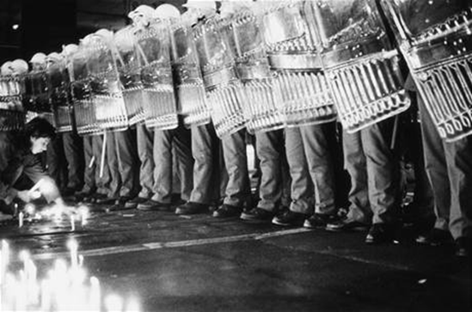
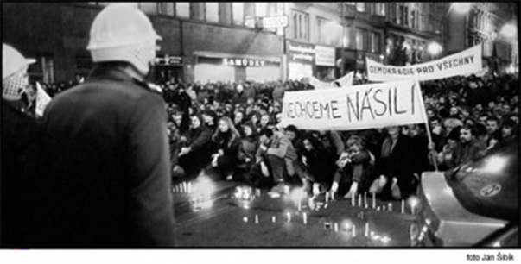
Start of the revolution
The students went along Národní street in Prague but police suppressed this riot
The demonstration was brutally dispersed
After this event started the Velvet revolution, which finished on 29th December 1989

Slide 10
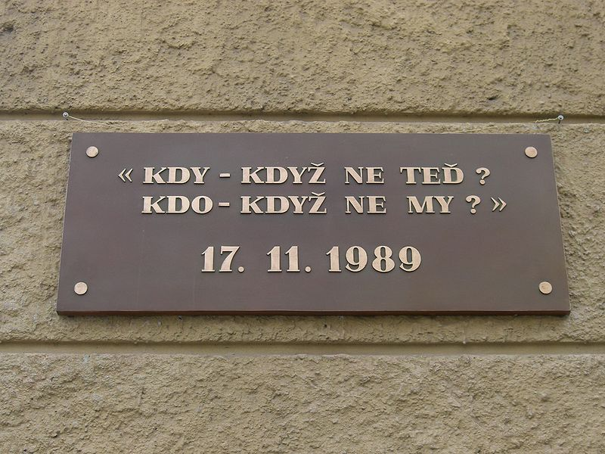
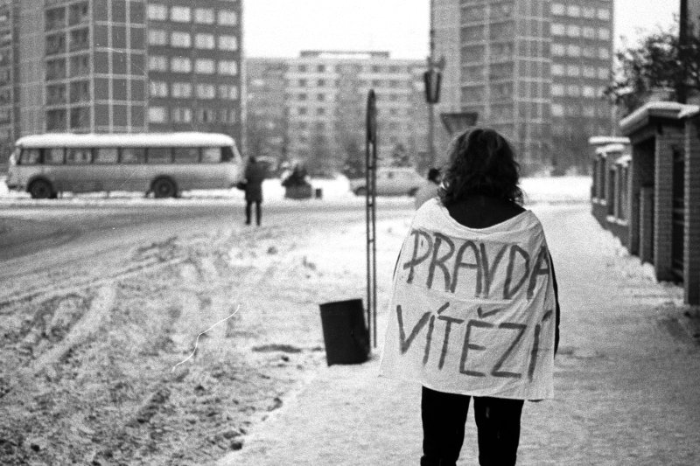
Velvet revolution
20th November a lot of people came to Wenceslas square and fought for justice

Slide 11
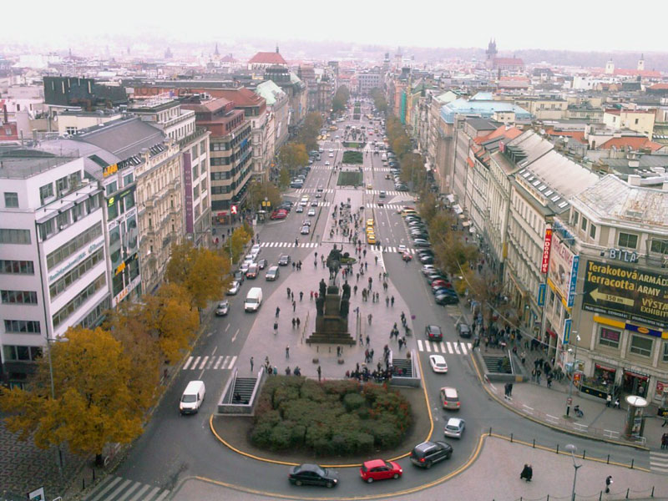
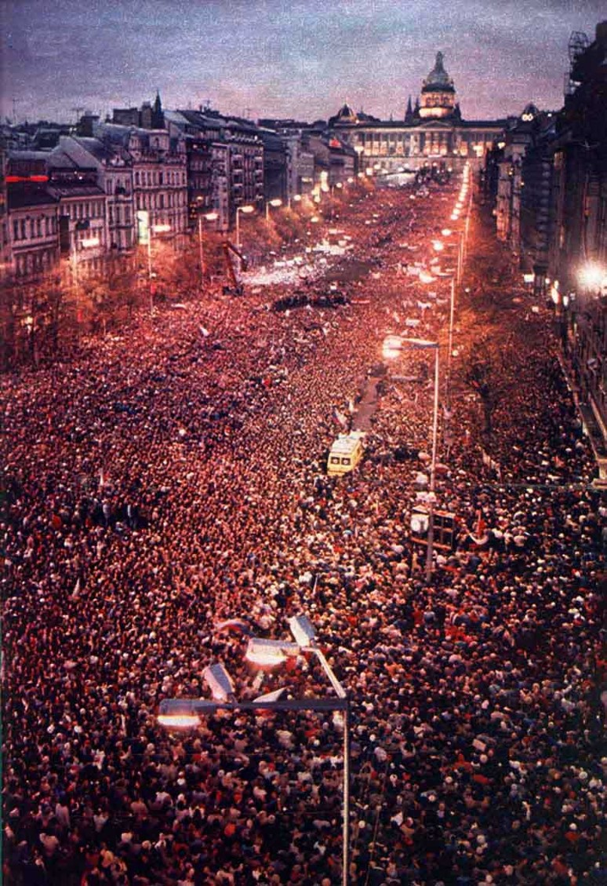

Slide 12
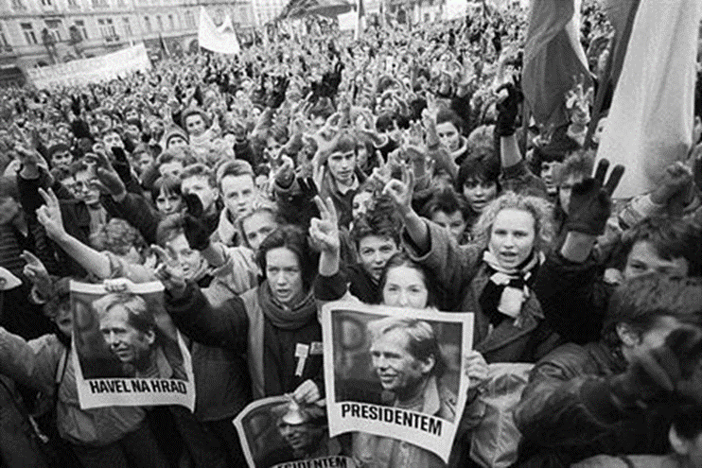
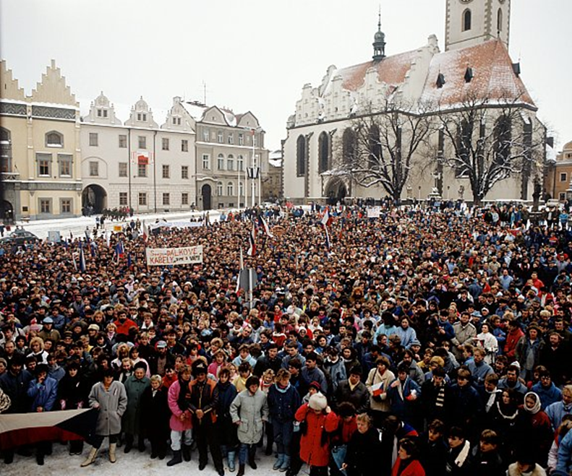
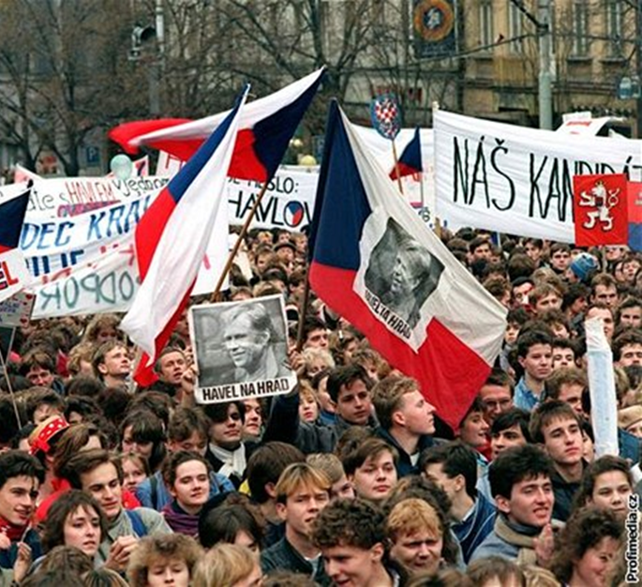
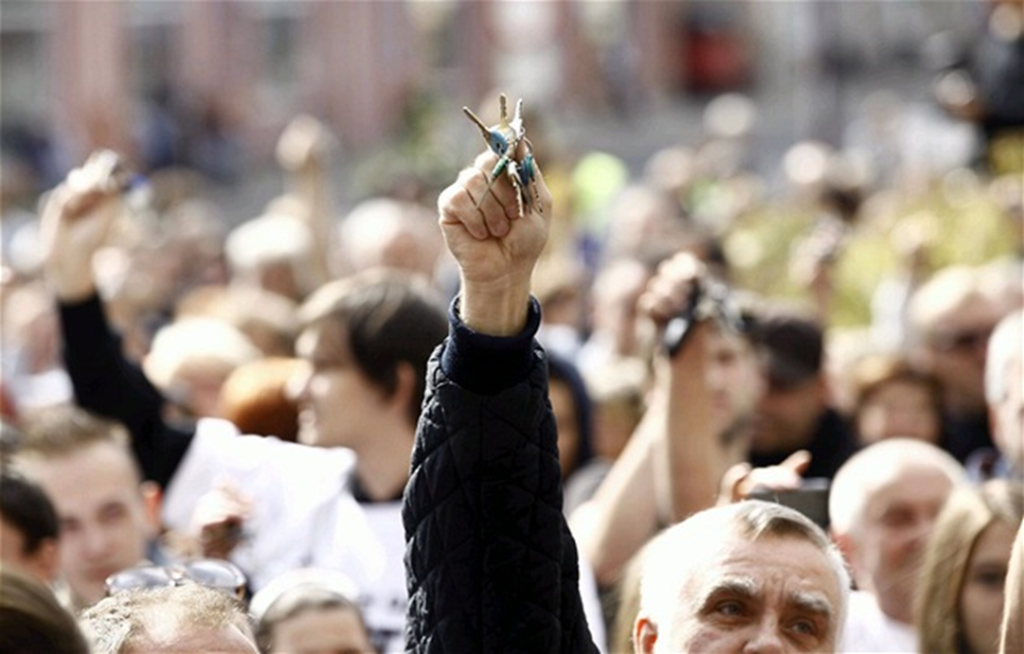
Velvet revolution
A brutal police action against students alerted the general public
Beginning the fall of comunism in Czechoslovakia
Then there were many other demonstrations against communism
Communism in Czechoslovakia ended

Slide 13
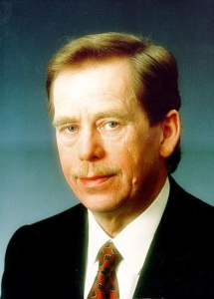
Personalities
All of the students are personalities, who helped overthrow the communism
The greatest personality is Václav Havel (5.10.1936-18.12.2011)
He was between the first authors of Charter 77 ─ against the violation of human rights and freedoms
After the revolution he was voted to the president (29.12.89)
He was the last president of Czechoslovakia (1989–1992) and the first president of Czech Republic (1993–2003)

Slide 14
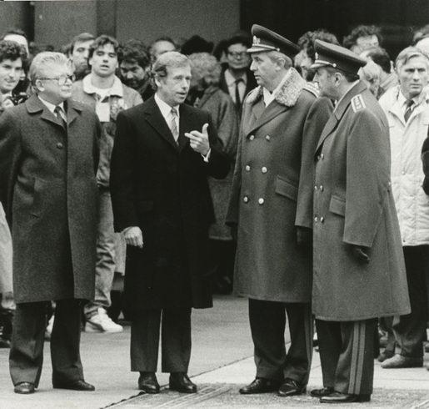

Slide 15
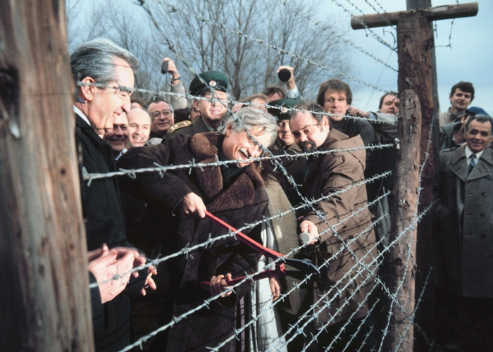
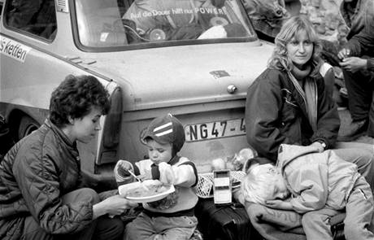
After - effects
Birth of Czech and Slovak federation republic, which brought together both nations
Democracy
Human rights
Freedom of speech
Freedom of enterprise
Free democratic elections
Opened borders again
Freedom of movement

Slide 16
song

Slide 17
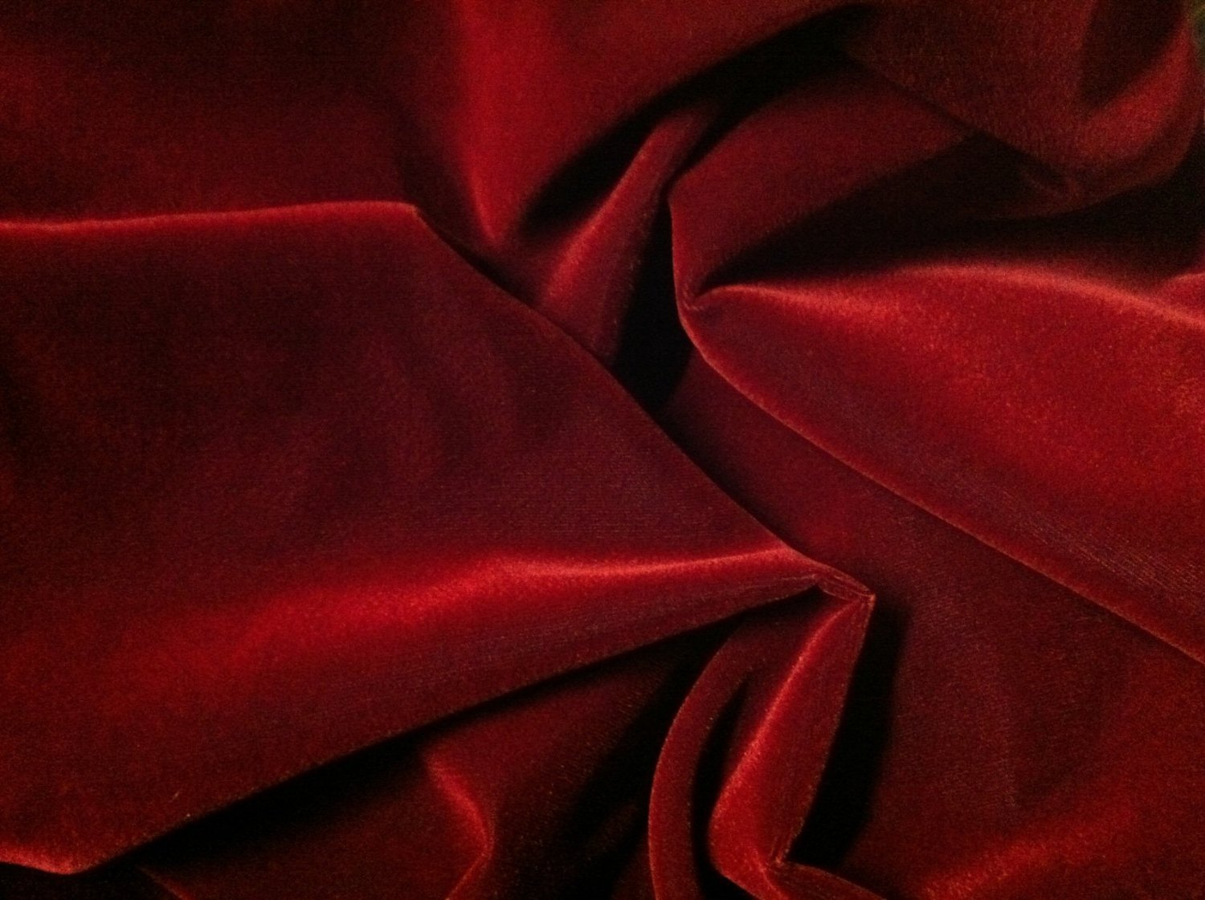
Thanks for your attention

