Slide 1
Business communication
through social networks
Stanko Levičar

Slide 2
Quick social media survey
http://bit.ly/2n5nJQB

Slide 3
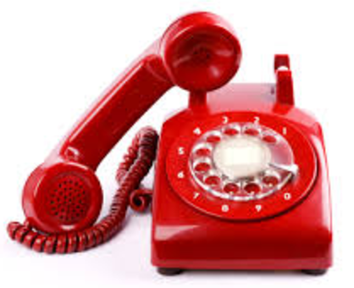
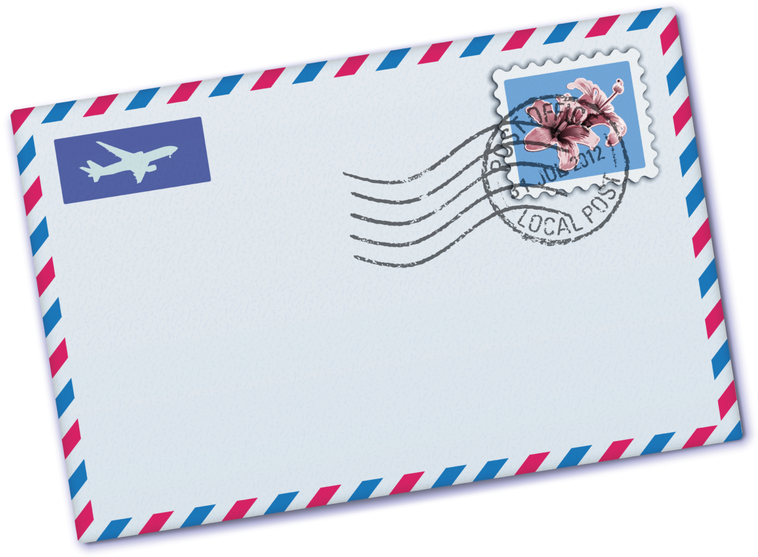
In 1977 Mr. John started a company

Slide 4
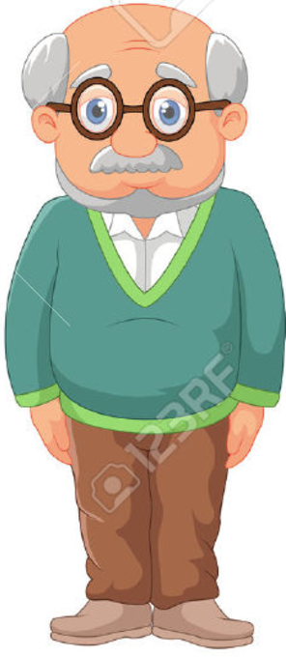
In 2017 his son Jason will take over the company

Slide 5
In 2017 his son Jason will take over the company

Slide 6
In 2017 his son Jason will take over the company

Slide 7
Types of business communication
Who is communicating to whom?
B2B → Business to Business
B2C → Business to Consumer
C2C → Consumers to Consumer
How many are participating in conversation?
one - one one - many one - infinite
individually group/community publicly/ads

Slide 8
Let’s dive a little deeper
What are the advantages and disadvantages of the most important social networks that serve businesses as communication channels.
Read the article:
http://bit.ly/2nbKLqq
kahoot.it

Slide 9
There is just too much work for Jason ...
… that is why he is going to employ you as his assistant!
But … do you have what it takes to be the social media manager for his company?
www.indeed.com
www.treegum.co.uk
EURES - The European Job Mobility Portal

Slide 10
Managing social communication channels feels like ...

Slide 11
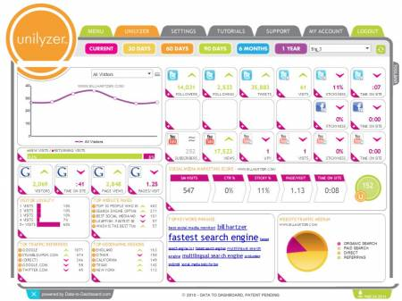
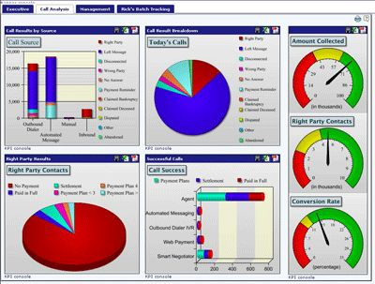
Business analytics

Slide 12
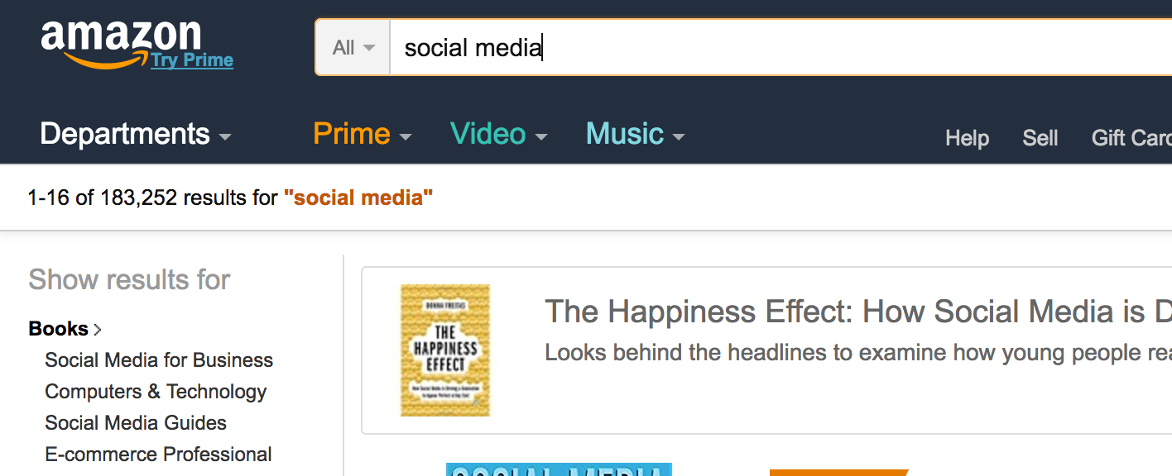
Such jobs didn’t exist 5 - 10 years ago
But how to make yourself a professional in this field?

