Slide 1
Our perfect biology lesson
Ricarda | Anamarija | SAndra

Slide 2
Grading
Just 1 test
Only optional repeats
Short presentations to get a better mark
Optional homework

Slide 3
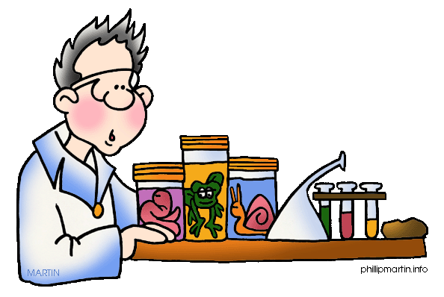
Lessons
Revise the material from the last lesson together
One short video about each new topic
Practical exercises
Experiments
Work with computers
Work with copies

Slide 4
Example
The human body:
Dissect some organs
To microscope
Visit a pathology center
Work in groups, e. g. 4 students in one group (24 people in one class)
Read some copies

Slide 5
Video about the Human Organs

Slide 6
Dream Classroom
Enter
Cupboard
Teacherdesk
Desk with tablets
Smartboard
Washbasin
Computer

Slide 7
„Dream Teacher“
Friendly
Always nice
Not be too strict
To be competent
Give fair marks
Able to explain good

Slide 8
Our perfect biology lesson
Ricarda | Anamarija | SAndra

