Slide 1
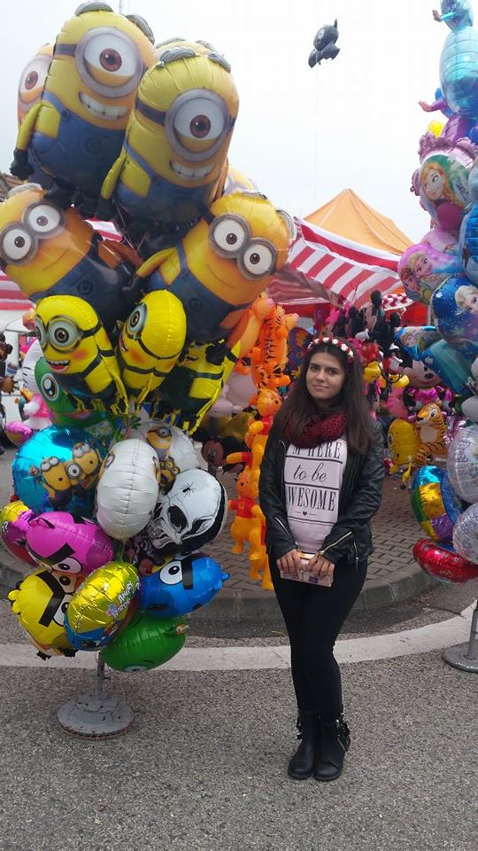
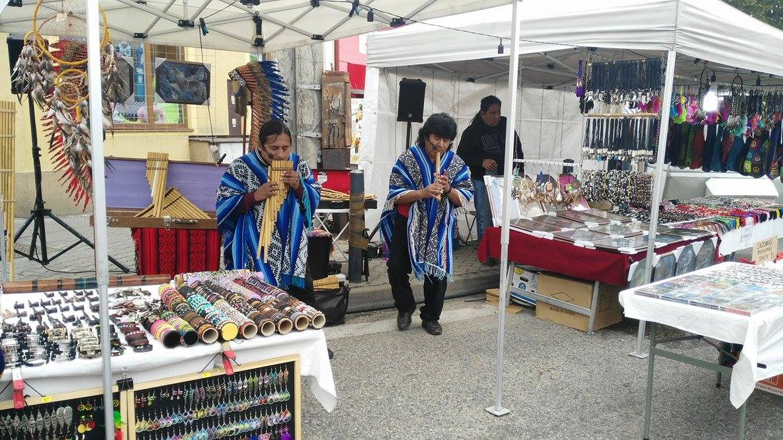
Autumn Fair in Sturovo

Slide 2
Autumn Days of Sturovo
By the autumn days, Sturovo celebrates the reconstruction of the Maria Valeria bridge. Programmes are held paralelly on both sides of the river Danube, also in Esztergom. The autumn days are usually organised at the end of September or beginning of October.

Slide 3
Typical Slovakian Products
Three of the typical Slovakian products we saw in the Fair are: Kofola, which is a drink similar to Coca-Cola including flavors like lemon, orange, vanilla and cinnamon; Trdelnik(found in the Romanian fairs too), which is a coiled baked dough wrapped with cinnamon, nuts, cocoa or powdered sugar; Medovina, which is an alcoholic drink made of fermented honey and water, sometimes with various fruits, spices and grains.

Slide 4
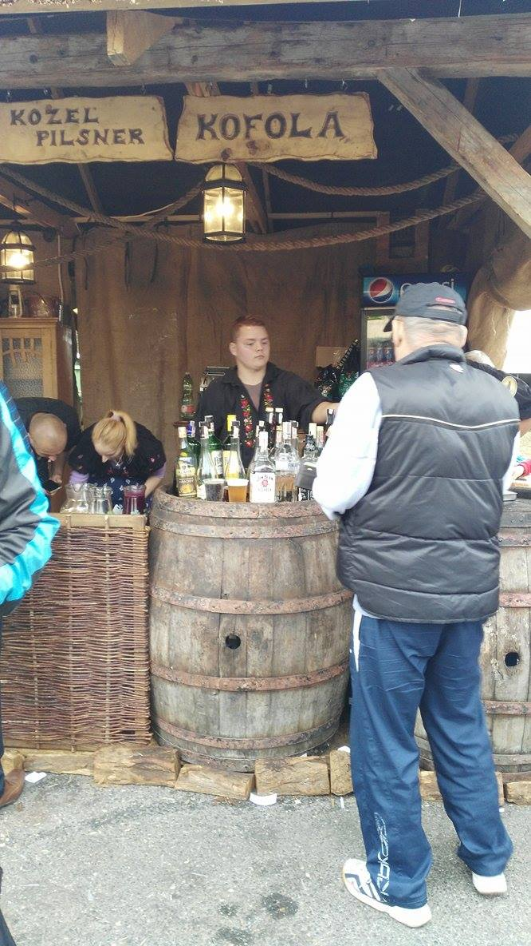
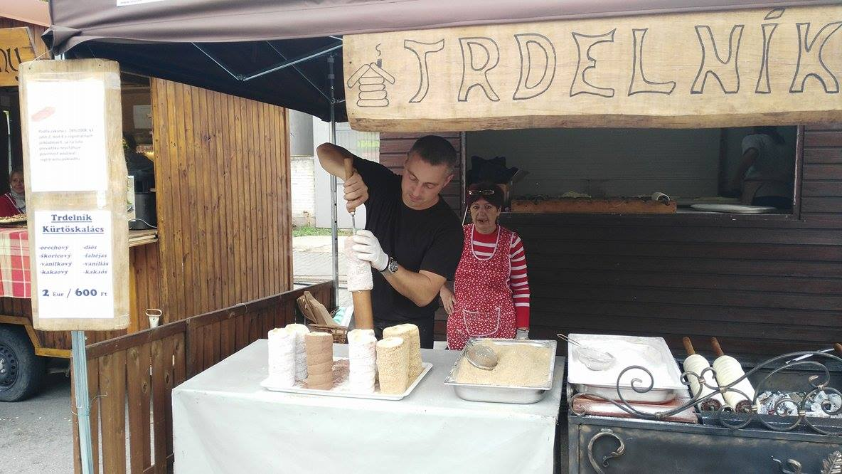

Slide 5
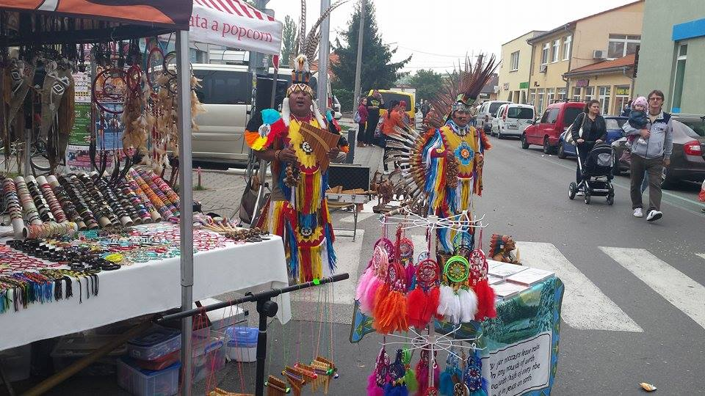
Foreigners in the Fair
On the whole, the exhibitions came from Slovakia but we could also see a few stands from Hungary and people from India, Africa or Korea. We saw Romanian cars, too.

Slide 6
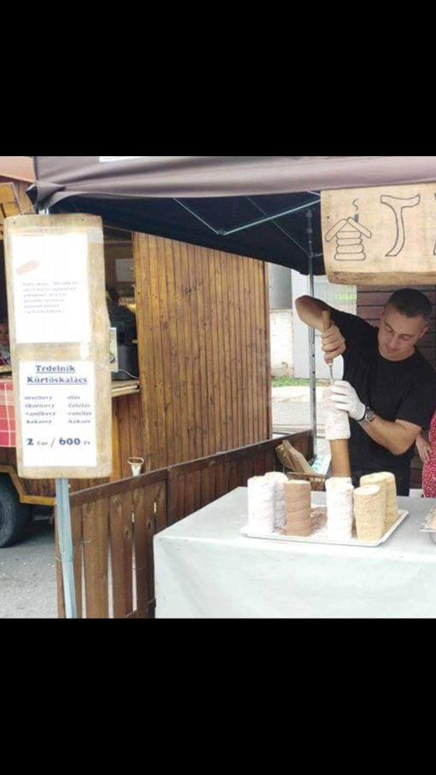
Prices
Trdelnik 2 € - Romania 7 Rons(1.5€) Jellies 2 €- Romania 3 Rons(0.70€)
Gingerbread 2€- Romania 3 Rons(0.70€) Candied Fruit 2€∕100gr- Romania 6 Rons(1.3€)
Chocolate box 2€- Romania 10 Rons(2.30€)
Cheese 6€∕Kg- Romania 15 Rons(3.4€)
Cotton Candy 2€- Romania 4 Rons(1€)
Palenka 2€∕100ml – Romania 3 Rons(0.70€)
Painted magnets 4€- Romania 3 Rons(1.70€)
Necklace 12€- Romania 20 Rons(4.5€)

Slide 7
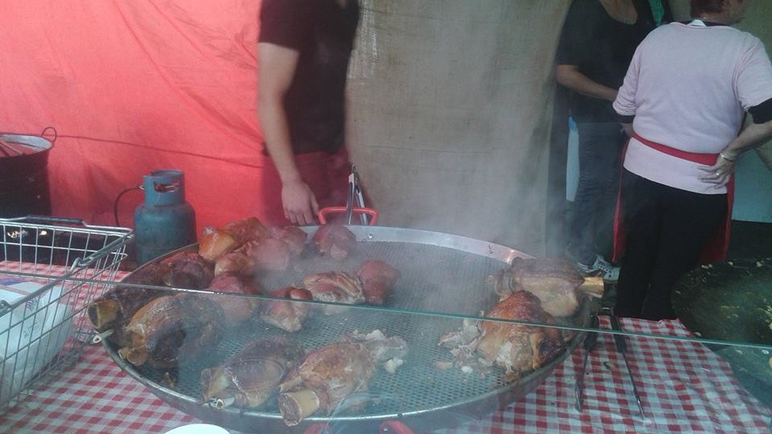
Influence on Enviroment
Such a fair brings happiness and satisfaction to all the people that take part in it, for sure. On the other hand, it is not really friendly with the environment because of all the pollution it causes. After a whole festive weekend, there is often a lot of rubbish and litter let on the ground. In the same time, the fume produced by the meal stands causes air pollution although everybody is lured by it’s smell.

