Slide 1
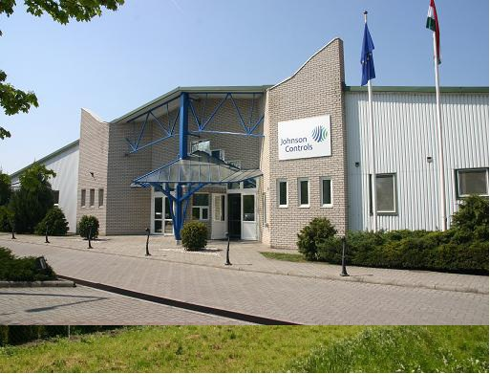
Anticipate. Innovate. Exceed.

Slide 2
Introduction
Johnson Controls is a global leader in facility management, energy management and building systems technology
Process 10M work orders per year globally
Located in more than 1300 places worldwide
Over 170,000 employees worldwide
Has been operating for over 125 years
Primary occupational areas
Building Efficiency
Automotive Experience
Power Solutions

Slide 3
Building Efficiency
500 branch offices in more than 150 countries
Involved in more than 500 renewable energy projects including solar, wind and geothermal technologies
Reduced carbon dioxide emissions by 15 million metric tons and generated savings of $7.5 billion since 2000
Manages the GHG (Greenhouse gas) emission of many large companies in over 90 countries

Slide 4
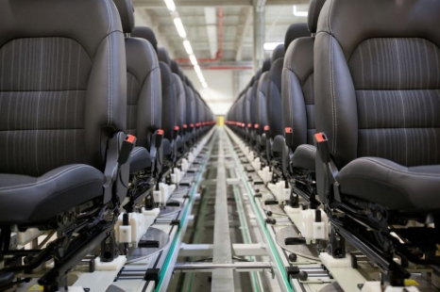
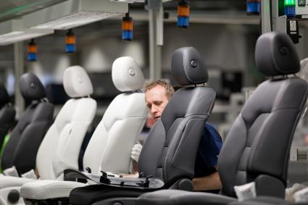
Automotive Experience
Global leader in automotive seating, overhead systems, floor consoles, door panels and instrument panels
240 plants worldwide
supplies more than 50 million cars per year from single components to complete interiors

Slide 5
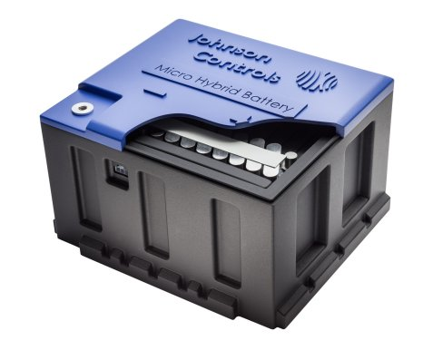
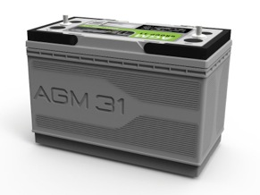
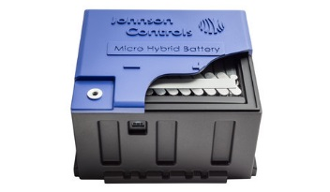
Power Solutions
Global leader in lead-acid automotive batteries and advanced batteries for Start-Stop, hybrid and electric vehicles
50 manufacturing, recycling and distribution centers supply more than one third of the world’s lead-acid batteries
First company in the world to produce lithium-ion batteries for mass-production hybrid vehicles

Slide 6
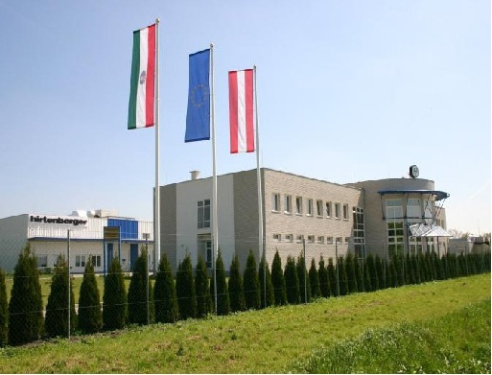
Johnson Controls Inc. Pápa
Joined in November 2010 as one of the Automotive Experience plants
Located on the outskirts of the city with multiple buildings (13-17. Juhar Street)
Working on three main product groups: - Doors and armrests - Dashboards - Center consoles
Over 900 workers ( 30+ disabled people)

Slide 7
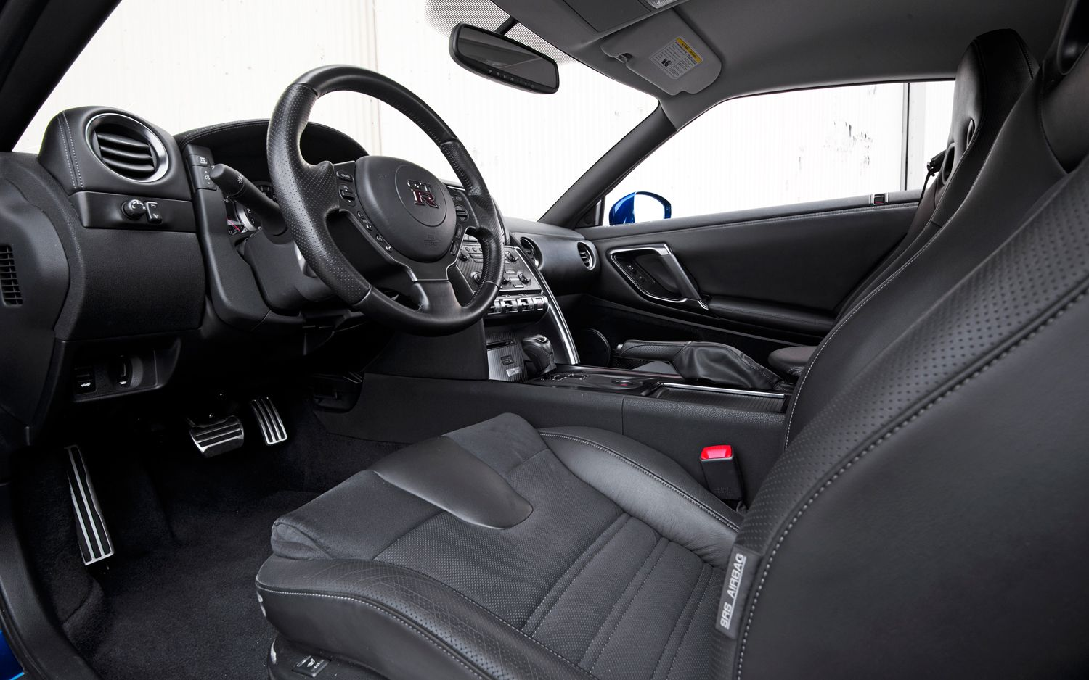
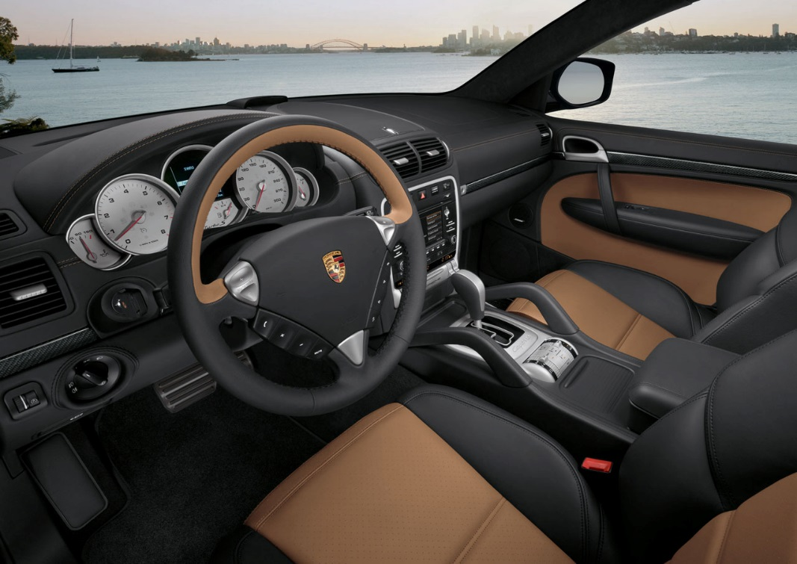
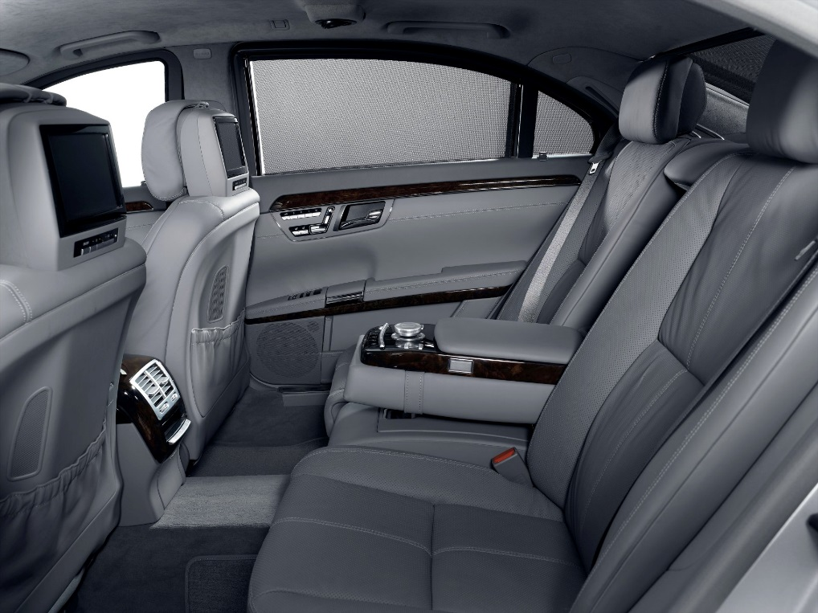
Customers of the plant
Mercedes (S- and E- class)
Porsche (Cayenne and Panamera)
Ferrari F142 and F149
Nissan GTR

Slide 8
What is being done here?
Workers of the plant in Pápa are working mostly three 8-hours- shifts everyday
There has also been a 12-hour-doubleshift introduced on weekends mostly for students to make money
This plant is doing the leathering, storing and quality control of the previously mentioned car parts
Faulty products are examined and repaired
If they fail the quality control tests and cant be repaired they are destroyed

Slide 9
Spirit of giving
Blue Sky Involve is a global volunteer program, encourages employees to form volunteer groups that work with local organizations to support environmental stewardship
Since the program was created in 2006, employees have volunteered more than 322,000 hours globally
In 2010 a natural disaster (red mud) killed many and destroyed the homes of even more and the damage appeared to be irreversible
But after 1350 hours of work from 170 workers Devecser historical park has been restored and a new playgrounds foundation has been created

Slide 10
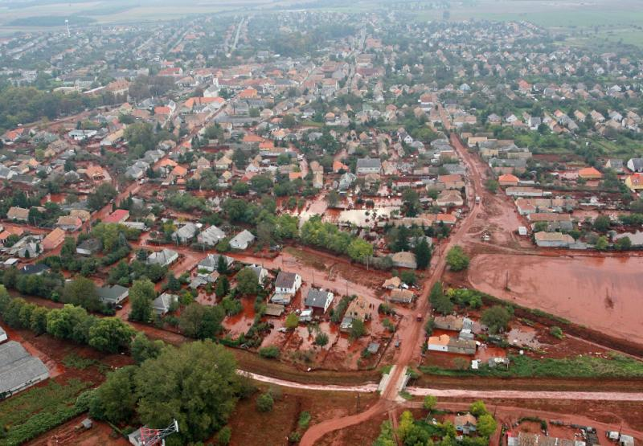
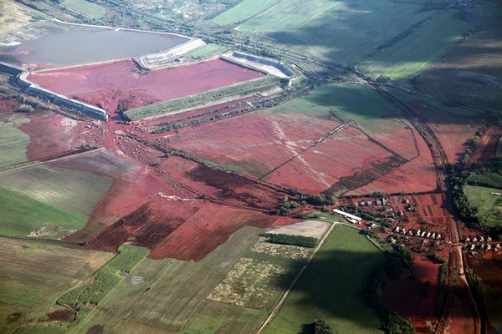

Slide 11
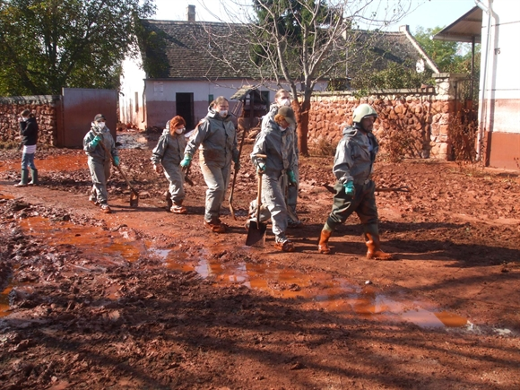
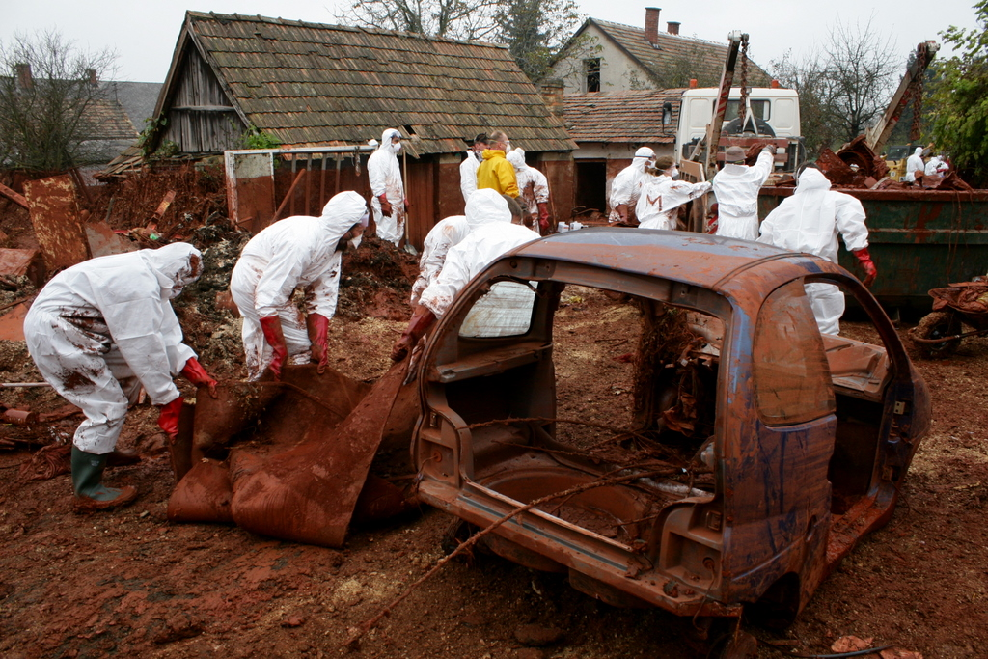

Slide 12
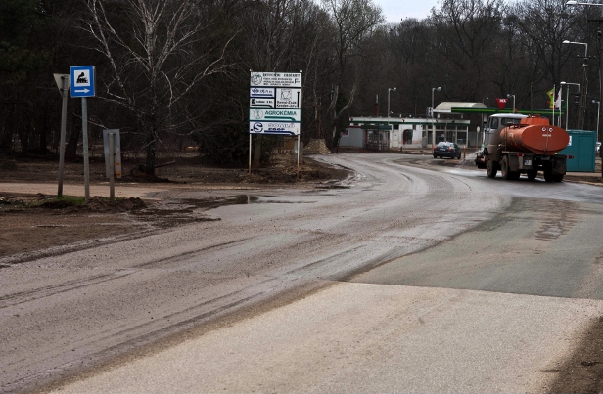
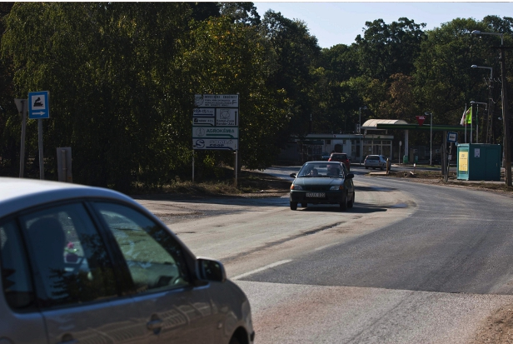
After the clean up

Slide 13
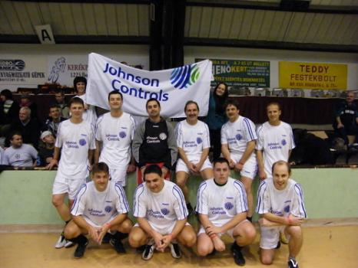
Football team! and other activities
Johnson Controls has its own football team in Hungary
The local football teams of Pápa,Mezőlak and Kecskemét compete againts them
A yearly Family day for the workers
Santa Claus also visits every December

Slide 14
Thanks for listening!

