Slide 1
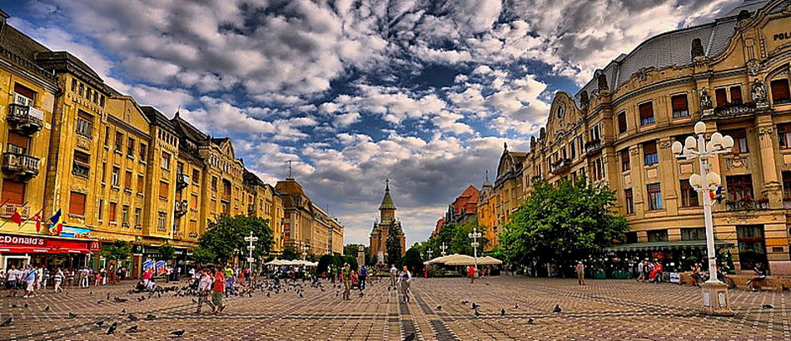
Timisoara

Slide 2
Important things about Timisoara
The capital city of Timis Country
The main social, economic and cultural centre in western Romania.
One of the largest cities
A population of 319.279 inhabitants.

Slide 3
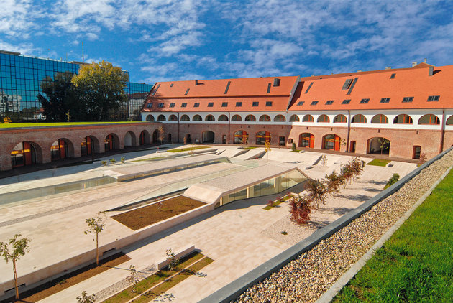
Maria Theresia Bastion
It was built between 1730-1735
Named after the Austrian Empress Maria Theresa

Slide 4
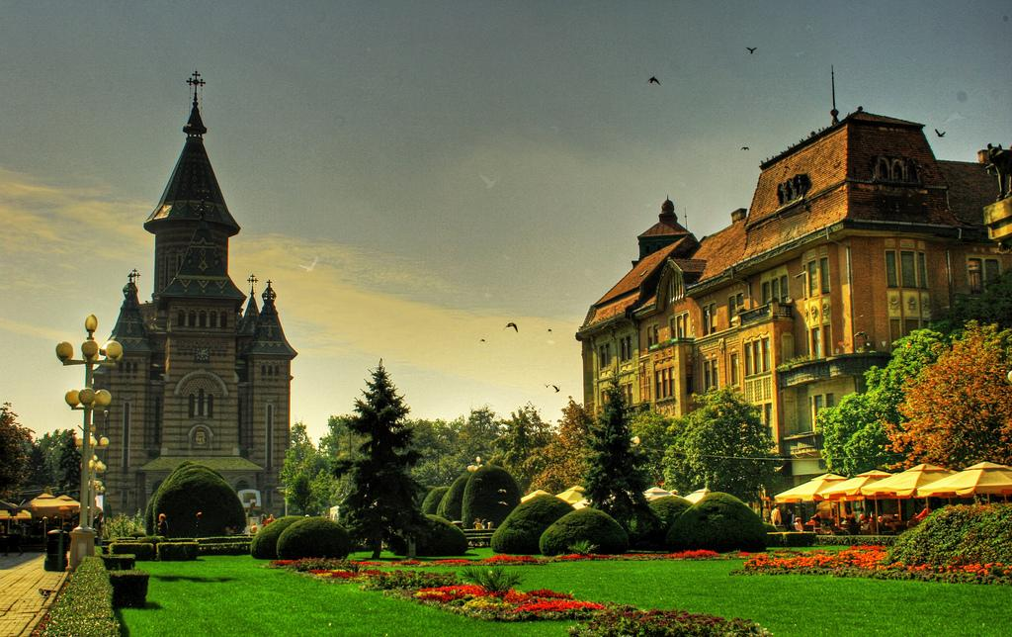
The city centre
built in a baroque style
the oldest place in Timisoara
Important historical atraction of the city

Slide 5
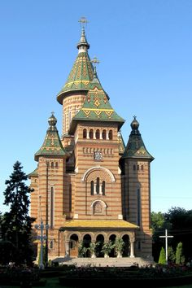
The Orthodox Cathedral
a great building
raised between 1936 and 1941
building`s style is Neo-Moldovian style

Slide 6
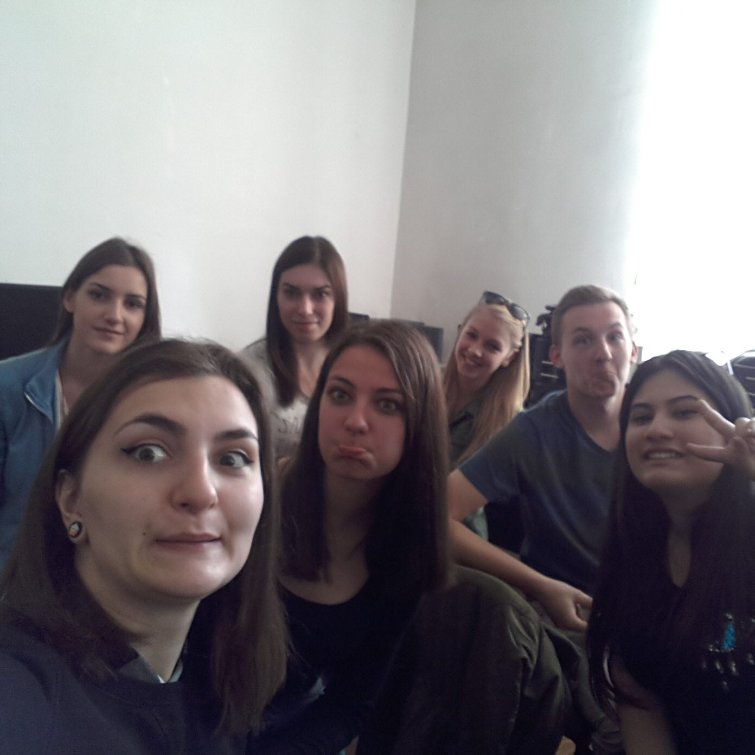
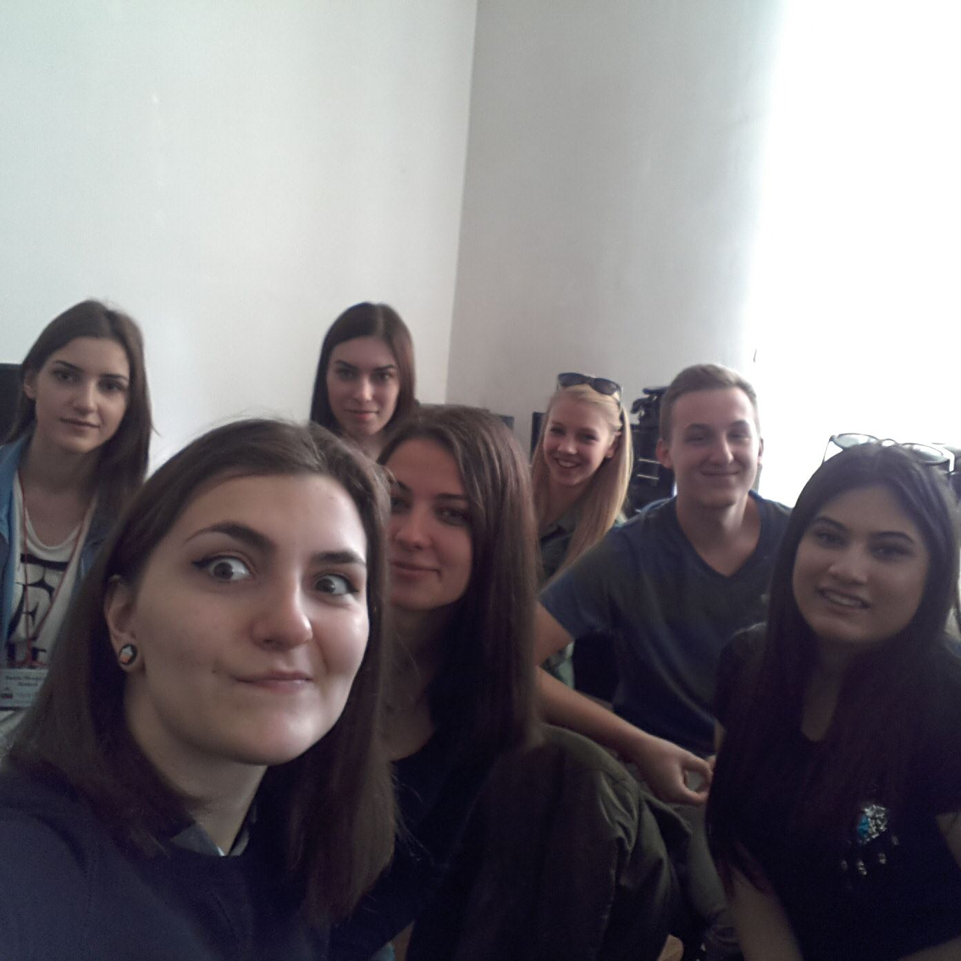
Thank you for your attention!

