Slide 1
National initiatives taken to fight unemployment
Stanko Levičar

Slide 2
What % of people are actually working?

Slide 3
First things first: who is considered unemployed?

Slide 4
How many people are actually working?
Total population: 2.064.188 100 %
Inactive population: 1.246.388 60 %
Active population: 817.800 40 %
Employed 732.200 35 %
Unemployed 85.600 5 %
Rate of unemployment = (unemployed / active population) * 100 = 10 %

Slide 5
35 %

Slide 6
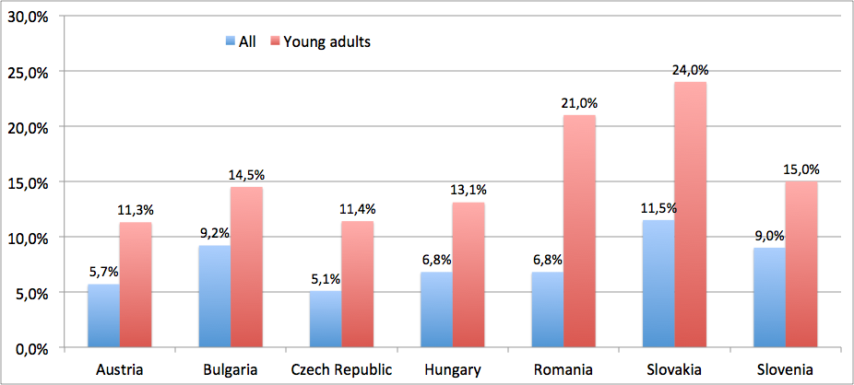
Unemployment rates across Danube region

Slide 7
What can YOU do to avoid being unemployed?

Slide 8
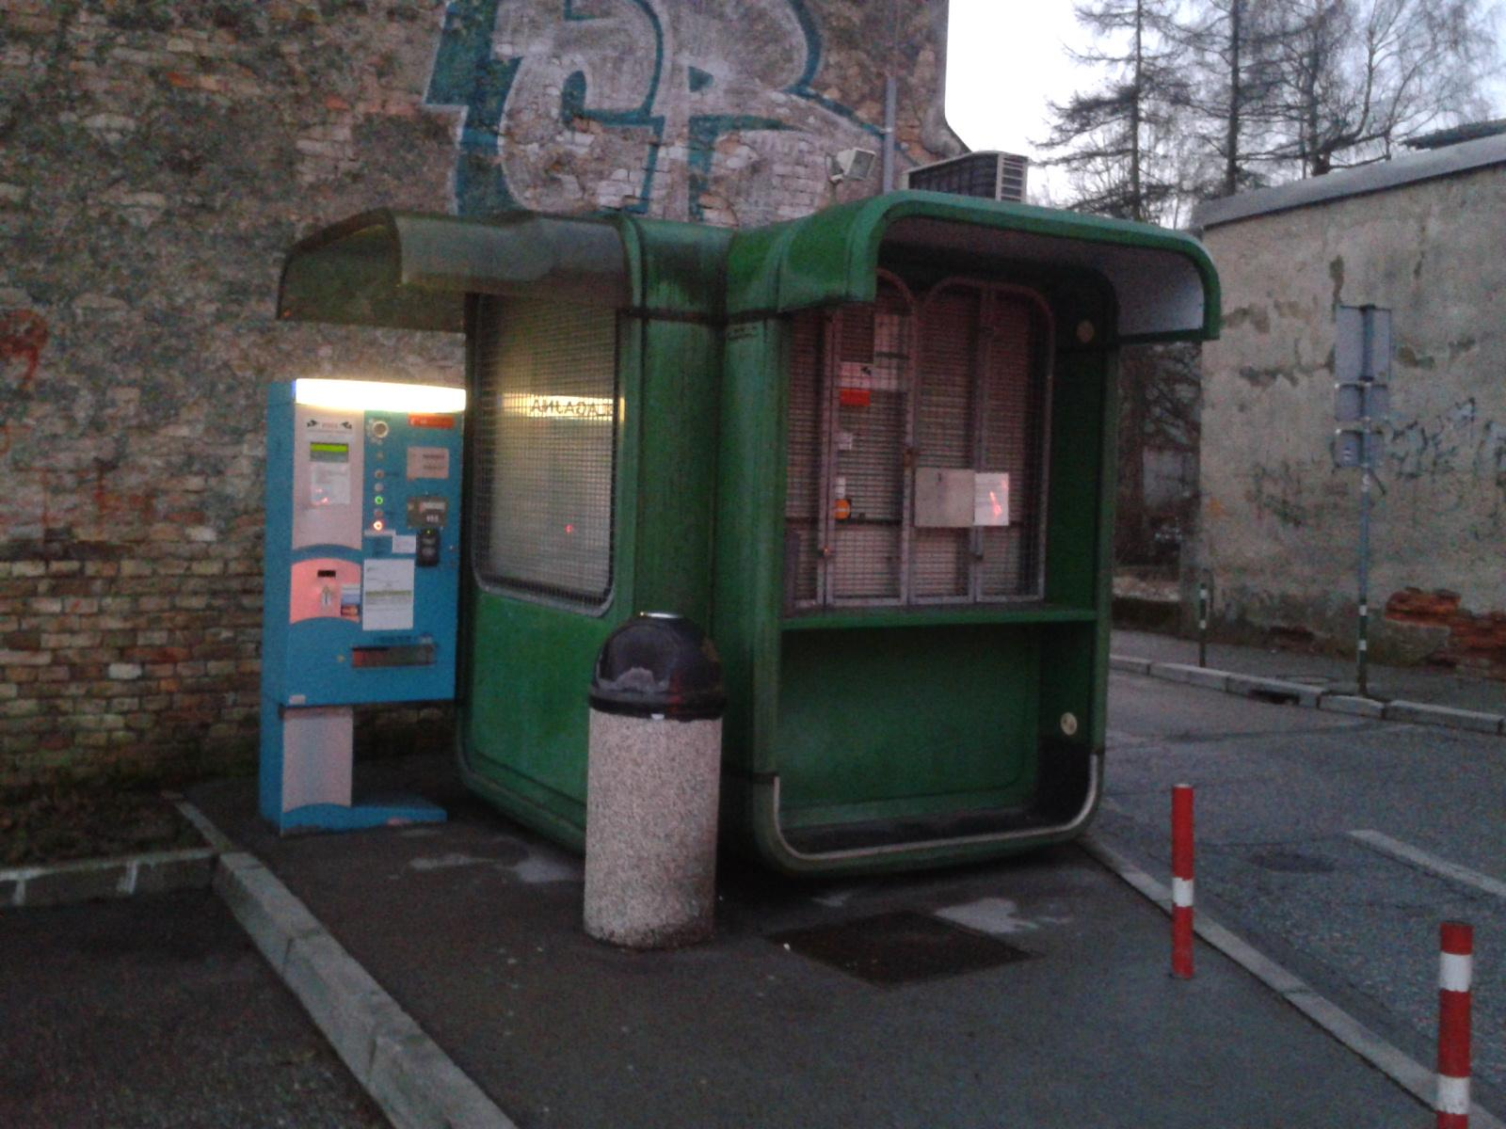

Slide 9
Rise of the precarious work
Poorly paid
Unprotected
Insecure
Cannot support a household

Slide 10
What can be done to fight unemployment?
Subsidized salaries for certain groups of employees.
Education and training to reduce structural unemployment.
State aid for certain companies.
Geographical subsidies to help firms invest in depressed areas.
Lower minimum wage to reduce real wage unemployment.
More flexible labour markets, to make it easier to hire and fire workers.

Slide 11
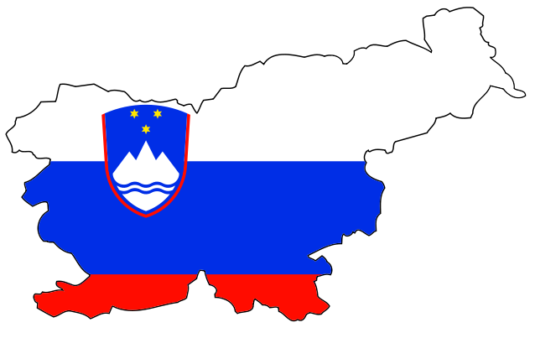
What can be done to fight unemployment?
Subsidized salaries for certain groups of employees.
Education and training to reduce structural unemployment.
State aid for certain companies.
Geographical subsidies to help firms invest in depressed areas.
Lower minimum wage to reduce real wage unemployment.
More flexible labour markets, to make it easier to hire and fire workers.
How did Slovenian government fight unemployment?

Slide 12
www.kahoot.it

