Slide 1
CZECH & IMPORTED PRODUCTS COMPARISON
Vendula Voláková, Tereza Ptáčková

Slide 2
Content
1 Fruit and vegetables
2 Milk products
3 Other products
4 Czech Product
5 Questionaire

Slide 3
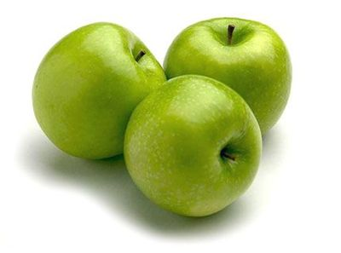
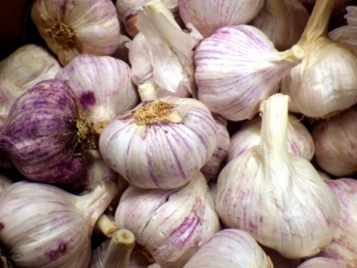
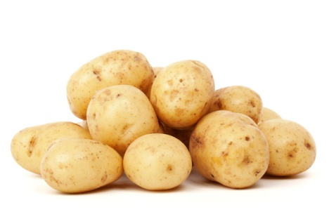
Fruit / vegetables
Apple Golden | Price | Quality
Czech Republic | 0.74 €/kg | Tastier, healthier ← Less chemicals
Italy | 0.48 €/kg | Look nicer ← More chemicals, sprays
Garlic | Price | Quality
Czech Republic | 6.16 €/kg | Bigger, stronger, better taste
China | 4.03 €/kg | Smaller, less cloves, cheaper
Potatoes | Price | Quality
Czech Republic | 0.44 €/kg | Very healthy, superior quality, durable
France | 0.73 €/kg | Good quality, look nice

Slide 4
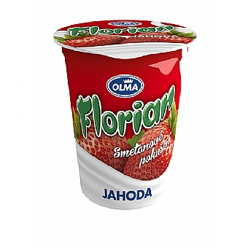
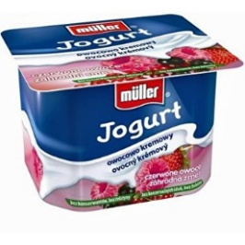
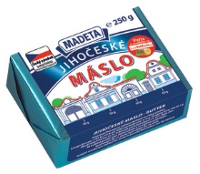
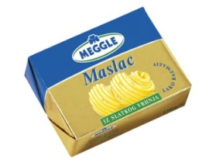
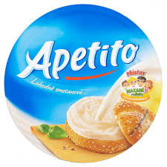
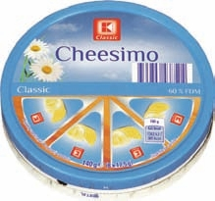
Milk products
Yoghurt | Brand | Price | Quality
Czech Republic | Florian | 0.37 € | 8 % fat, pieces of fruit
Germany | Műller | 0.29 € | 1.4 % fat, fruit puree, unhealthy syrup
Butter | Brand | Price | Quality
Czech Republic | Madeta | 1.48 € | 82 % fat, more protein, salt
Germany | Meggle | 1.48 € | 82 % fat, worse taste
Cream cheese | Brand | Price | Quality
Czech Republic | Apetito | 0.74 € | 49 % fat, made of milk and cream
Poland | Chessimo | 0.59 € | 60 % fat, made of skimmed milk

Slide 5
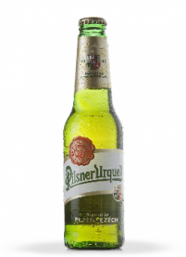
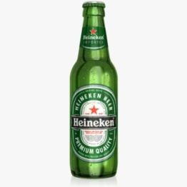
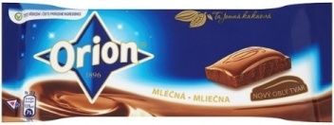
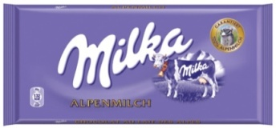
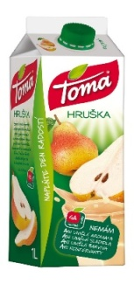
Other products
Beer | Brand | Price | Quality
Czech Republic | Pilsner Urquell | 1.77 €/litre | 4,4 % alcohol
Netherlands | Heineken | 1.75 €/litre | 5,0 % alcohol
Chocolate | Brand | Price | Quality
Czech Republic | Orion | 1.00 €/100 g | 12 % fat, 5 % sugar, 25 % cocoa
Germany | Milka | 1.18 €/100 g | 7 % fat, 4 % sugar, 30 % cocoa
Juice (pear) | Brand | Price | Quality
Czech Republic | Toma | 1.18 €/litre | 50 % fruit, 12 g sugar
Austria | Pfanner | 1.11 €/litre | 30 % fruit, 20 g sugar

Slide 6
Czech Product logo
This logo guarantees:
Product is made in Czech Republic
Manufacturer guarantees quality and safety of the product
Manufacturer meets environmental standards
Manufacturer respects consumer protection rights
And what about consumers?
87 % prefer Czech products
92 % would buy a product with a Czech Product
logo as oppose to a product without the logo

Slide 7
Our research
1 When shopping for food do you pay attention to its origin?
YES 72.7 %
NO 27.3 %
2 What is more important for you the origin or
the price of the food?
ORIGIN 52.7 %
PRICE 47.3 %
3 Do you rather prefer Czech food?
YES 78.2 %
NO 21.8 %

Slide 8
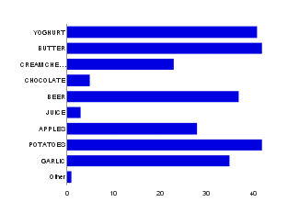
4 Do you ever buy food from farmers?
YES 65.2 %
NO 34.8 %
5 Which of the following do you mostly buy from Czech producers?
Yoghurt 74.5 %
Butter 76.4 %
Cream cheese 41.8 %
Chocolate 9.1 %
Beer 67.3 %
Juice 5.5 %
Apples 50.9 %
Potatoes 76.4 %
Garlic 63.6 %
Other 1.8 %

Slide 9
Thank you for your attention ☺

