Slide 1
Slovak Team
Gymnázium-Gimnázium Štúrovo

Slide 2
Sheep cheese
soft , kneading and salted sheep cheese made ​​from lump sheep's cheese
Feta from Greece, Ricotta from Italy
Strained yogurts
Agricultural Cooperative Kľačianska Magura , Turčianske Kľačany

Slide 3
Nutrition and production
Richer in fat, solids and minerals
Fresh form
Far smaller volume of milk than cows
Good for health
Shed – cheese gets mature, then the cheese is treated, sliced and pressed than later for 2-3 days it is mold – it is by-product is whey

Slide 4
Sheep cheese dumplings

Slide 5
Koliba - Chalet

Slide 6
Cheese
Calcium,
phosporus,
Sodium

Slide 7
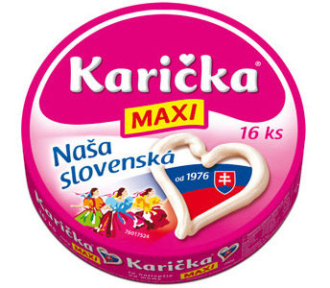
Well- known companies

Slide 8
Grilled cheese

Slide 9
Korbáčiky

Slide 10
Forms for oštiepok – smoked cheese

Slide 11
Žinčica
boiled sheep's milk whey
by-product of the processing of sheep's milk
Sheep´s butter
By mixing the sweet and old žinčica is created the sour žinčica

Slide 12
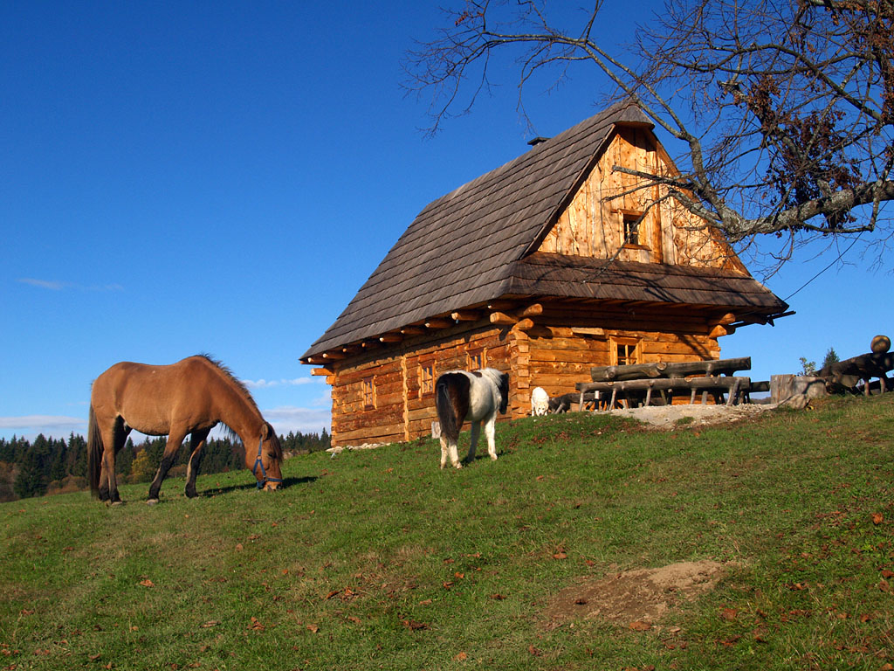
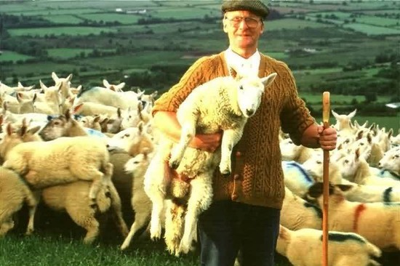
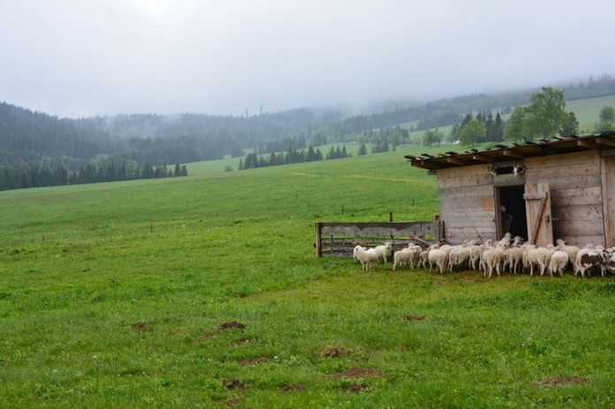
Spiš
Šariš
Šariš, Spiš
Šariš, Spiš
Spiš

Slide 14
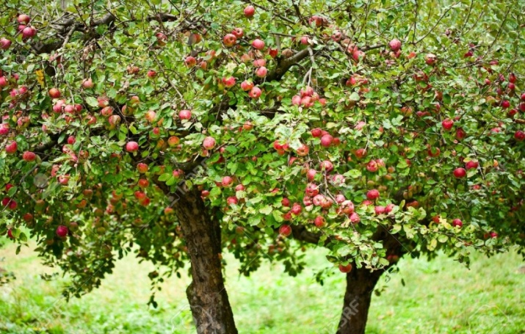
Apple
ÚKSÚP Bratislava workstation, registration of apple trees is in Veľké Ripňany
The apples are growing on 4826,3 hectares
Number of orchards: 10 065 hectares
Registered: 554 subjects
The most famous species: Golden Delicious, Idared, Jonathan, Ontario, Pinova, Jonagold…
The biggest company for processing of apples:
Novofruct Nové Zámky

Slide 15
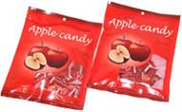
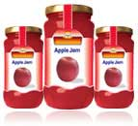
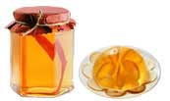
Products:
Apple candy
Apple jam
Apple jelly
Apple juice

Slide 16
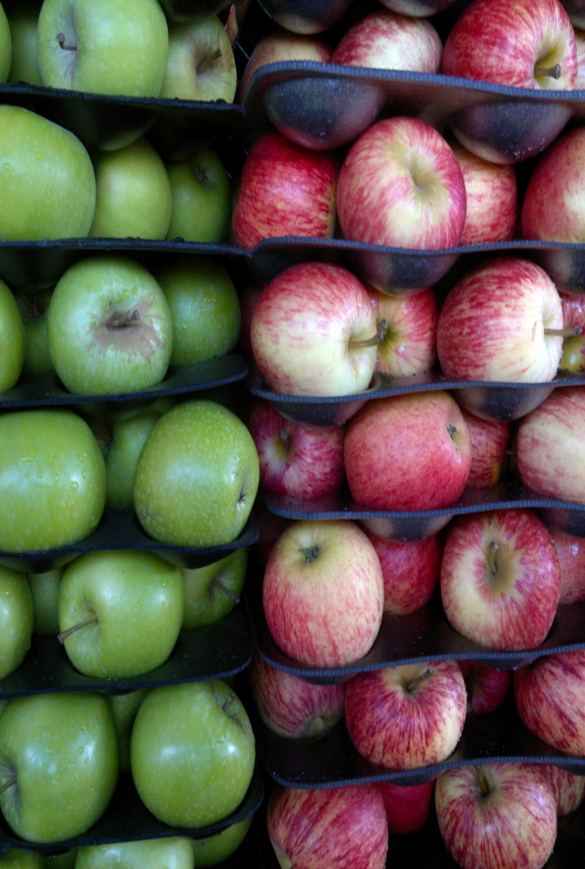
Price
Apple Fuji – 0,38€
Apple Golden delicious – 0,10€
Apple Red delicious – 0,13€
Apple Jonagold – 0,09€
Apple Granny smith – 0,26€
Apple Braeburn – 0,24€

Slide 18
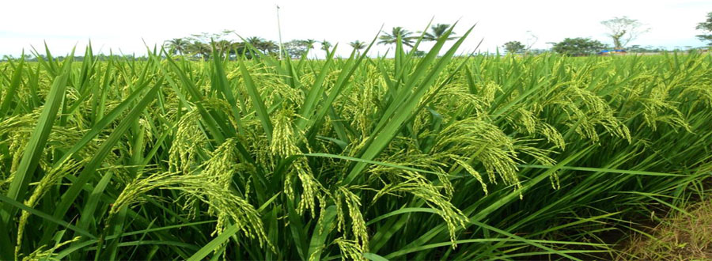
Corn
productional potential is balanced from 3,4 – 5,0 tons/hectare

Slide 19
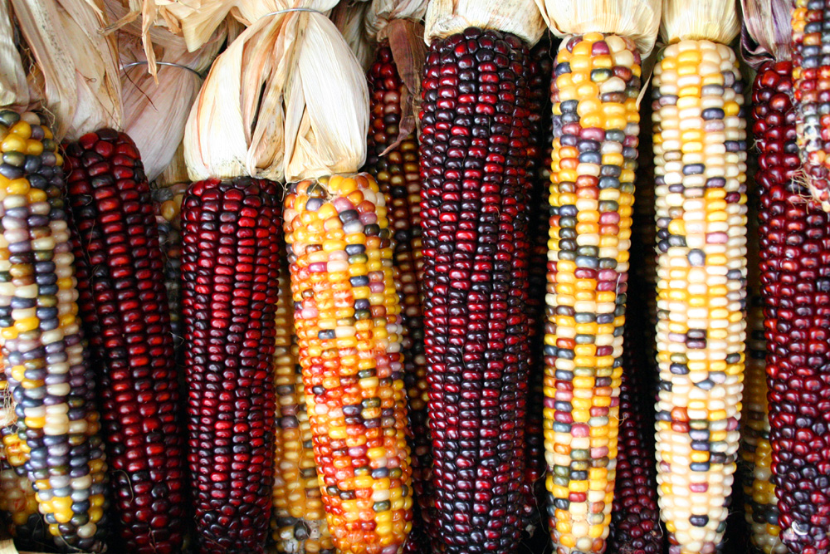
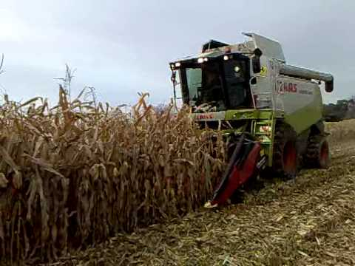
Harvest
Species – Maize

Slide 20
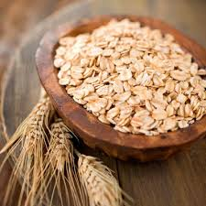
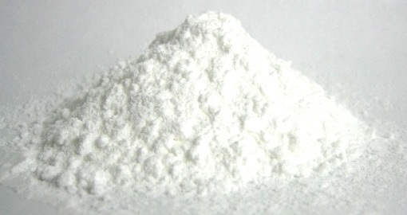
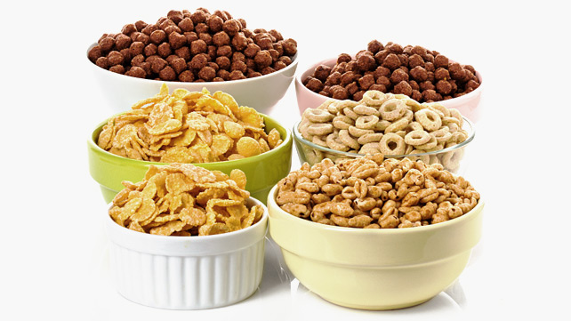
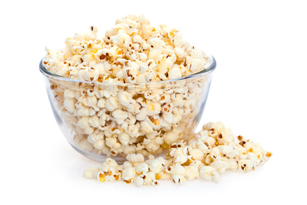
Products
Cereal
Corn starch
Corn flakes
Popcorn

Slide 21
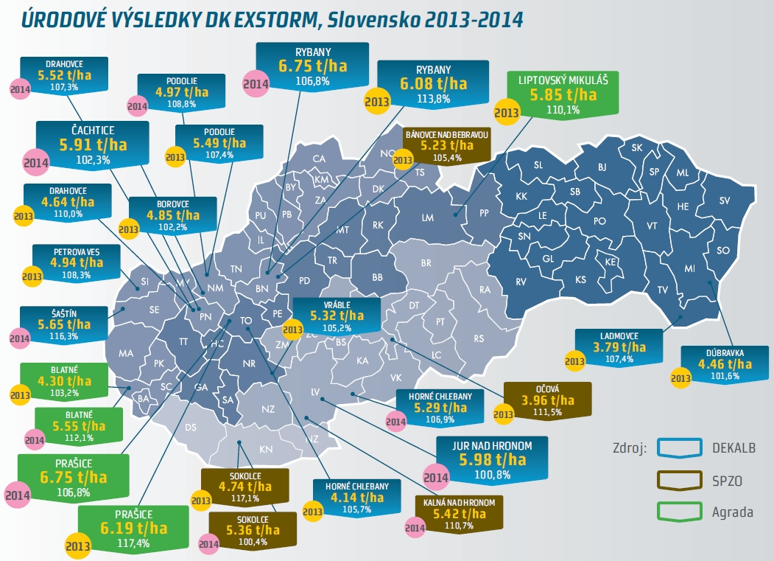
Corn
Monsanto SK, s.r.o. – DEKALB registration is in Bratislava, the capital city of Slovakia
In 2012 was the 100th anniversary of DEKALB

Slide 22
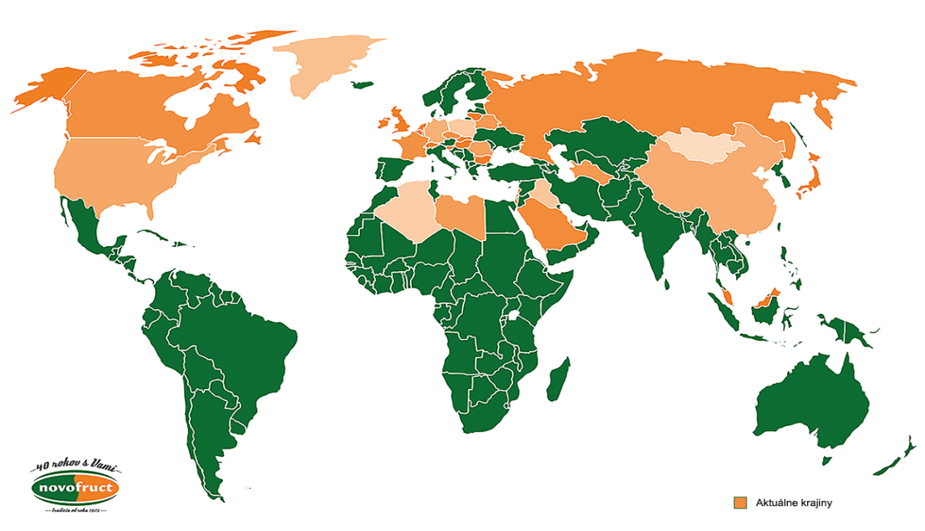
Tomato
Exporting to many countries: Czech Republic, Hungary, Poland, Russia, Bulgaria, Mongolia, Libya, SAE, China, Germany, Denmark, England, Ireland, Belgium, Algeria, Switzerland, France, Israel...

Slide 23
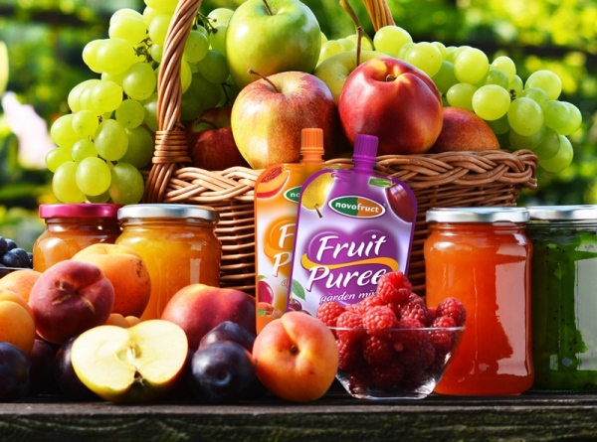
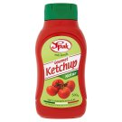
Products
Novofruct SK, s.r.o. is a worldwide company
Products :
Ketchup Fruit puree

Slide 24
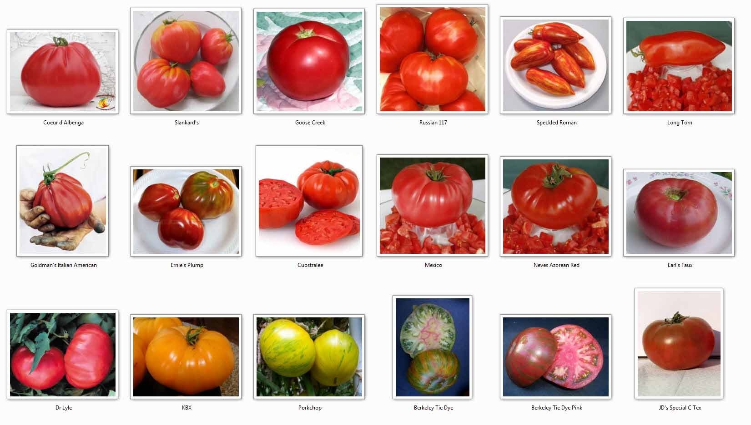

Slide 25
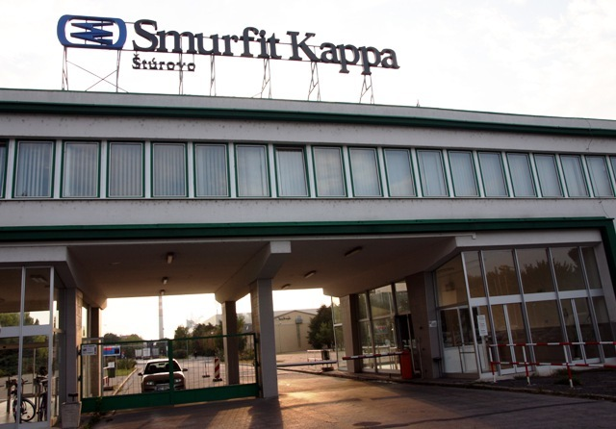
one of the leading providers of paper-based packaging solutions in the world
since 1973
around 45,000 employees across 34 countries
production of cardboard - millions of taps and bags every month

Slide 26
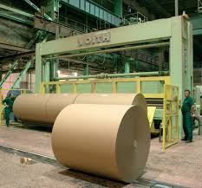
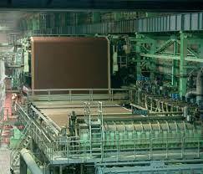
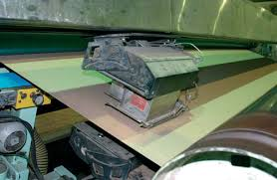
Paper producing

Slide 27
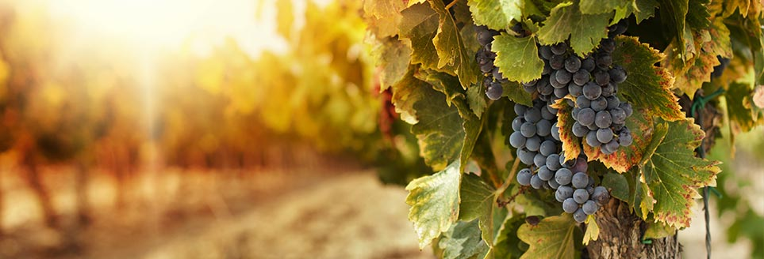
Slovakia is divided into 6 wine-growing areas: -40 wine areas -603 wine-growing villages

Slide 28
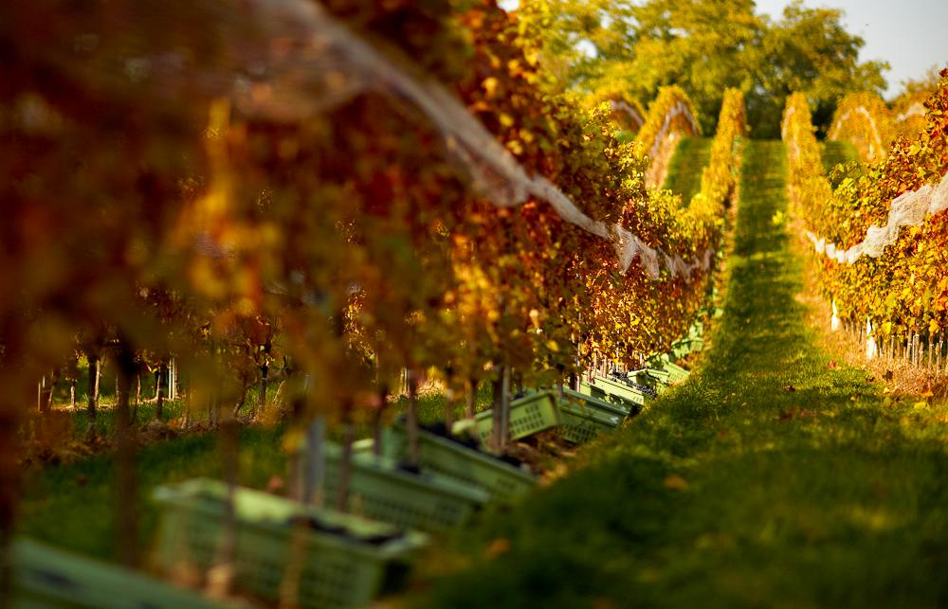
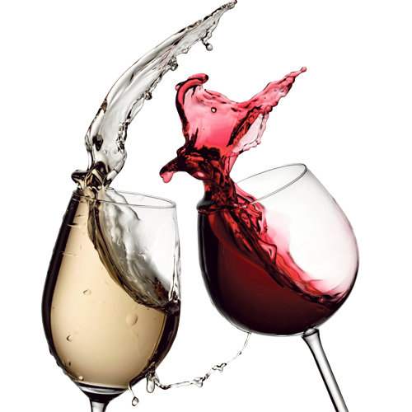
Southern Slovakia
There are clearly the best conditions for growing of grapes suitable for the production of high quality red wines, such as Cabernet Sauvignon, which requires a longer growing season

Slide 29
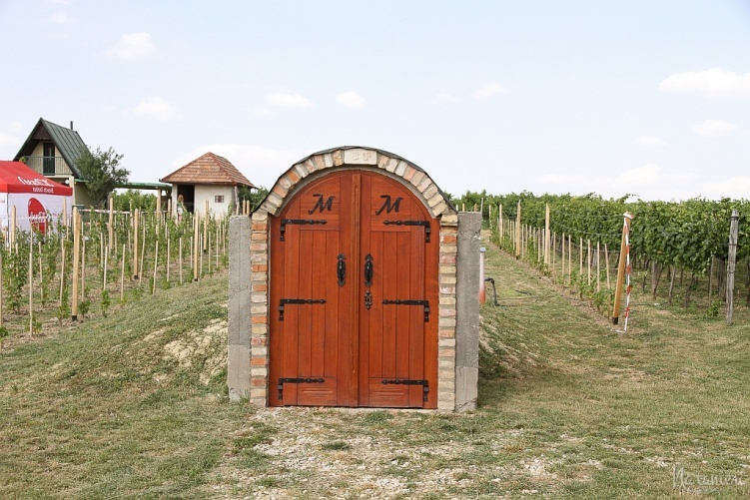
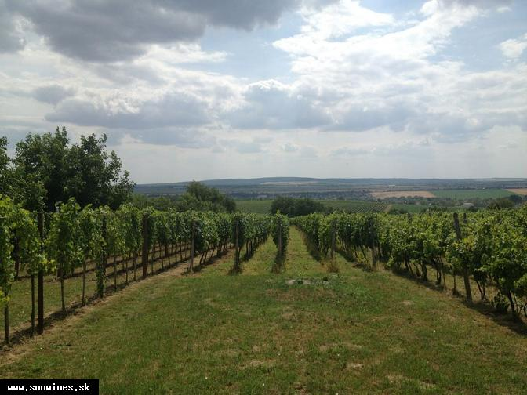
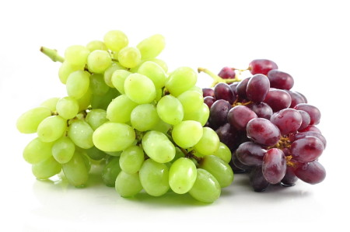
Our best wines
Red wines
Don Velder
Svätovavrinec
Frankovka modrá
Dunaj
Neronet
Retro 11
Alibernet
Pinot noir - Rulandské modré
Zweigeltrebe
Tereziánska frankovka
Redlefrod
Camelot
Vinum I (Dornfelder)

Slide 30
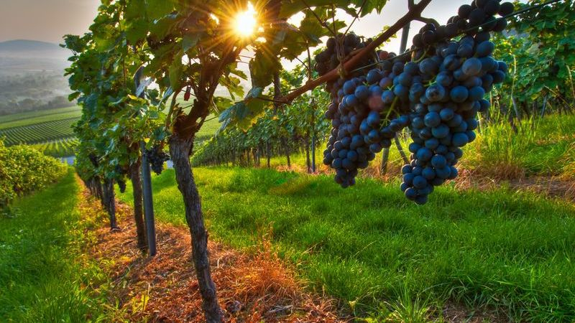
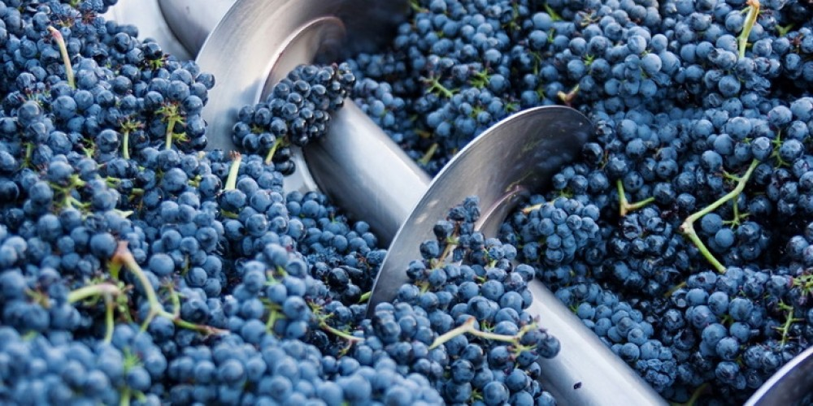
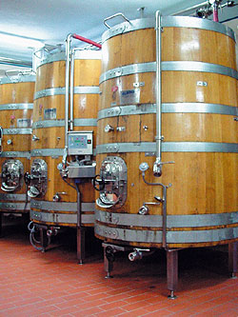
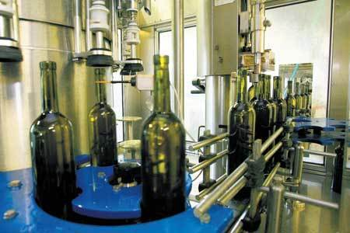
harvest
pressing
filling process
fermentation

Slide 31
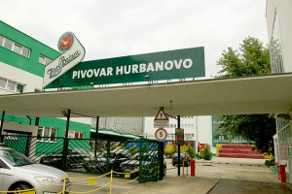
Brewery in Hurbanovo
established in 1964 November 1.
the first beer company to package their beer in cans
today Hurbanovo has one of the largest malting operations in Europe
brands: Zlatý Bažant Corgoň Kelt Gemer Martiner

Slide 32
Thank you for attention!

