Slide 1
Education on boat
Created by:
Nejc, Tereza, Loreta, Daniella

Slide 2
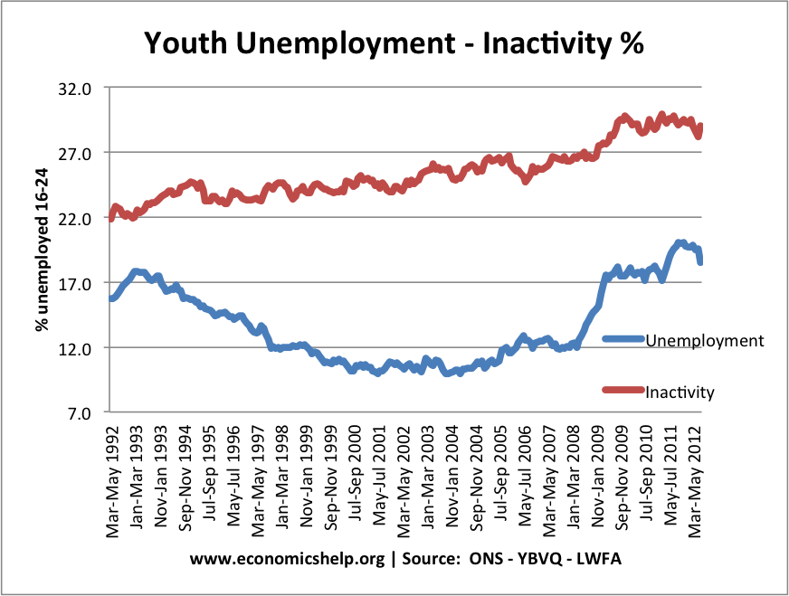
Why did we choose this idea?
There are currently more than 6.6 million unemployed young people in EU
Lack of Qualifications
Lack of work practice

Slide 3
What do we Offer?
The chance to improve your skills while you are studying
Seeing new places or foreign countries
Discovering new cultures
Earning money

Slide 4
About the students
There will be 200 students on the ship
The students themselves will be the staff on the ship, it will be their work practice.
The age of the students should be 18-25
The students can be from all the countries along the Danube river.

Slide 5
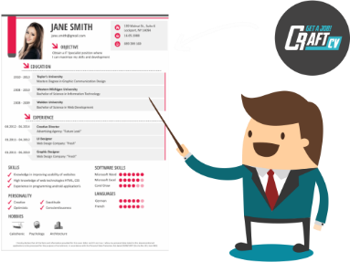
How can you Apply?
1. You have to send an application form ( CV)
2. You can get invited to an interview.
If they get accepted, they have to pay some taxes, so they can start their education.

Slide 6
Education technology
The students will learn the theory on the boat and will practice on different workplaces in towns along the Danube
Every stopover will last one week and the students would have provided bed and breakfast

Slide 7
Public benefits
More educated employers
Lowering the unemployment

Slide 8
Thanks for your attention!

