Slide 1
Work camp for students
Made by: Robert Bodov, Sabine Stummer, Tereza Krejcova, Simona Stoyanova

Slide 2
Main idea
We would like to teach them about the basics of work tasks, by showing them a different work experience during the summer.

Slide 3
Basic information about the work camp
The camp has to group up the people from age of 15 to 24 ,from the countries near Danube river.
It will teach them how to deal in work environment.
Before the start of camp there will be job interview, that way they will be taught how to act in such situation.
Work experience on a ship(waiters, chefs, barmen, etc.)
Work experience in agriculture and fishing.
The camp will give a certificate for graduating it.
It will be at the sphere of service

Slide 4
Main opportunities
Gives a chance to start a work career
By taking the certificate, students of the camp are one step ahead for taking their new job.
They can also improve their English skills.

Slide 5
Program
The camp will be 1 month long.
At the first two weeks they are going to study theory about their workplaces.
And at the other two weeks will come the practice of their education.

Slide 6
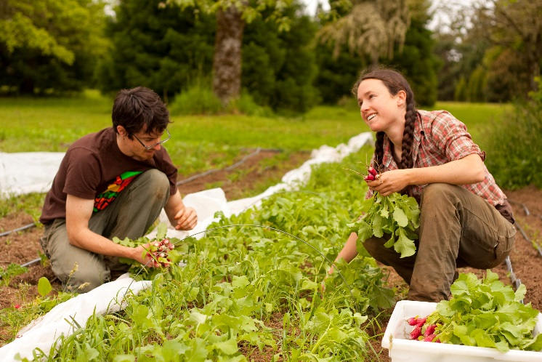
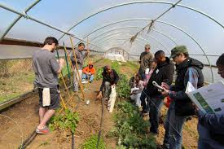
Agriculture

Slide 7
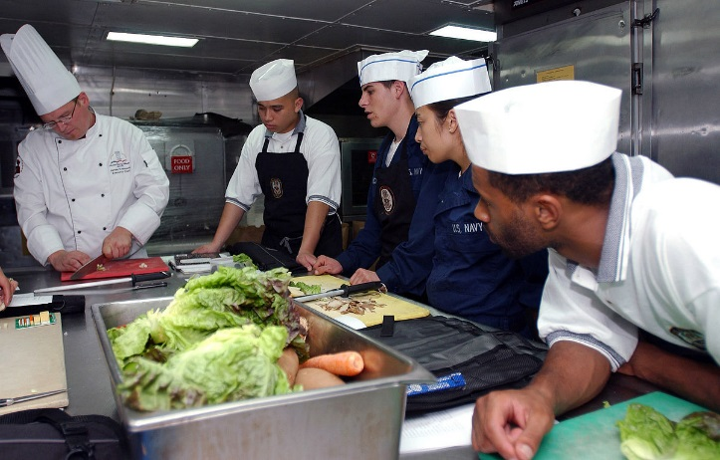
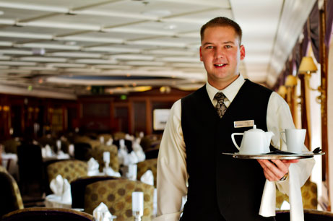
Barmen Chef Waiter

Slide 8
Thank you for your attention!

