Slide 1
Regional and international goods
Linz, Austria

Slide 2
Our topics
Vegetables and fruits
Dairy products
Sweets

Slide 3
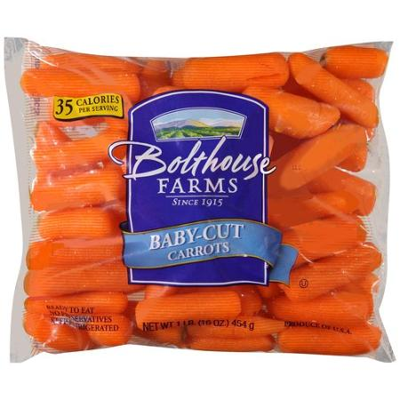
Vegetables and Fruits
Regional carrots
International carrots
Wunderlinge
cheap price, fresh, healthy
Bolthouse farms
Rooted in quality, creativity matters and motivated by the greater good
0,67 €/450g

Slide 4
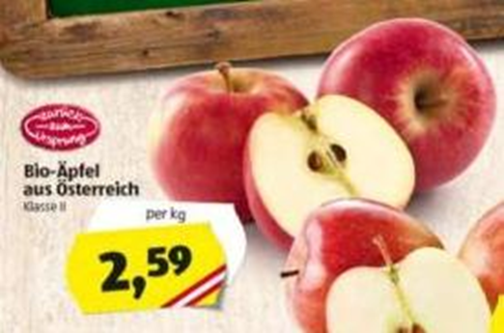
Vegetables and Fruits
Regional apples
International apples
Zurück zum Ursprung
16,3 % less CO₂
24,8 % less water
68 % natural diversity
Eva
First-class qualitiy, product safety
Price: 1,99 €/kg

Slide 5
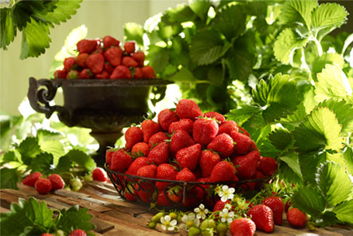
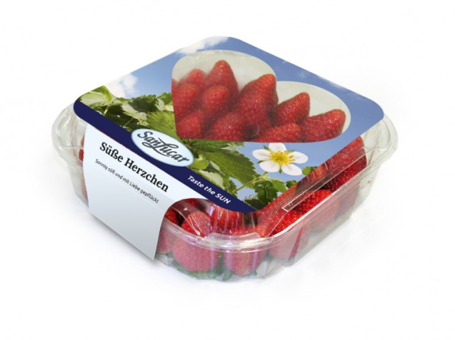
Vegetables and Fruit
Regional strawberries
International strawberries
Bauers Beeradies
Organic, solar energy is exploited
Price: 2,50 €/ 250g
SanLucar
Top quality, the ideal climate, tasty
Price: 2,80 €/400g

Slide 6
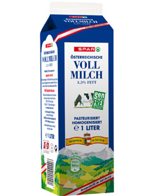
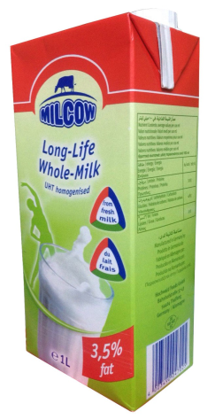
Dairy products
Regional milk
International Milk
SPAR Vollmilch
0,89 €
Good and proven quality
3,5 % less fat and GMO-free
Milcow
Rich in Calcium, vitamins and carbohydates
Are popular among the athletes and health conscious people
1,15 €

Slide 7
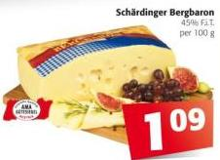
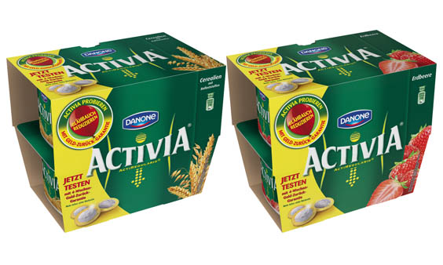
Dairy products
Regional product
International product
Bergbaron cheese
Spicy, tasty and delicate
Danone Activia Joghurt
1,99 €
Tasty, various flavours, delicate

Slide 8
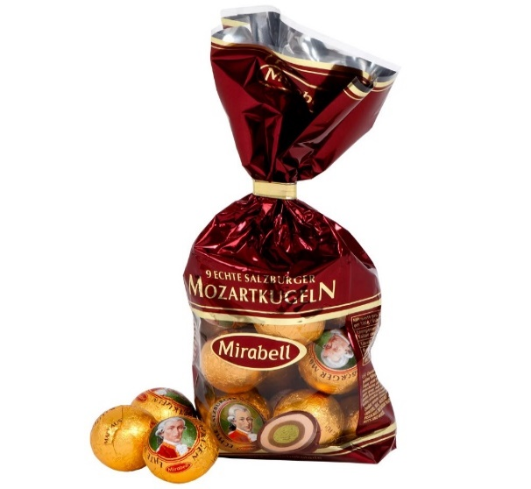
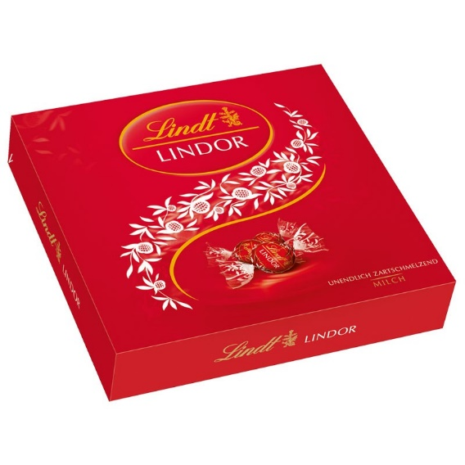
Sweets
Regional product
International product
Mozartkugeln
Typical Austrian sweet
3,19 €
Lindtkugeln
High quality product
3,99 €

Slide 9
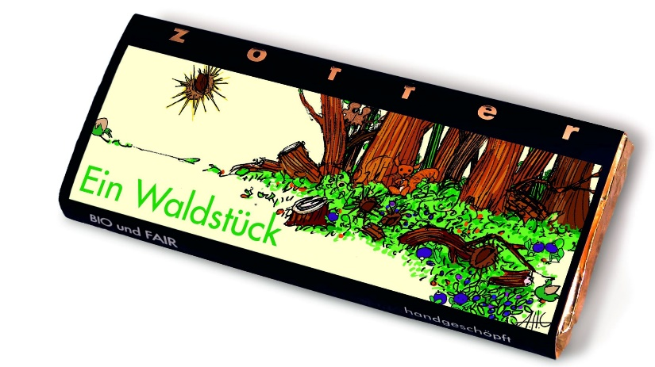
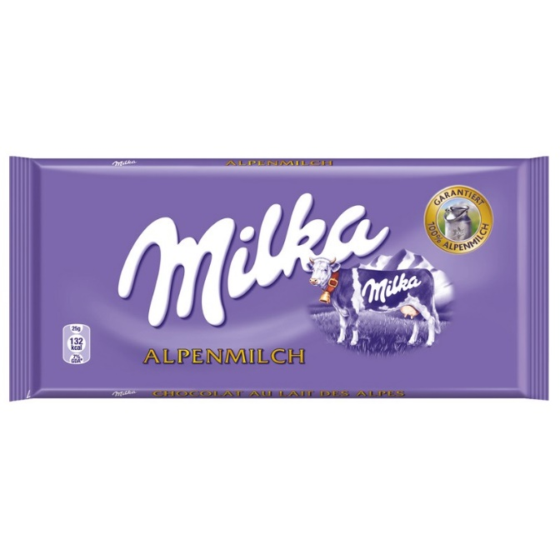
Sweets
Regional product
International product
Zotter
Fair trade
3,49 €
Milka
Very cheap and delicous
1,19 €

Slide 10
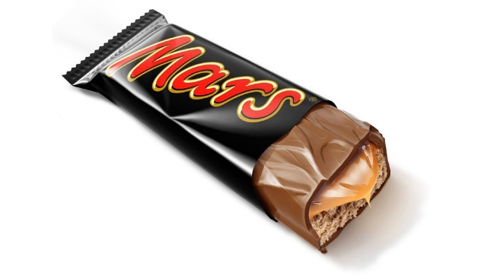
Sweets
Regional product
International product
Balisto
Different kind of tastes
0,83 €
Mars
Top quality and tasty
0,95 €

Slide 11
Regional and international goods
Linz, Austria

