Slide 1
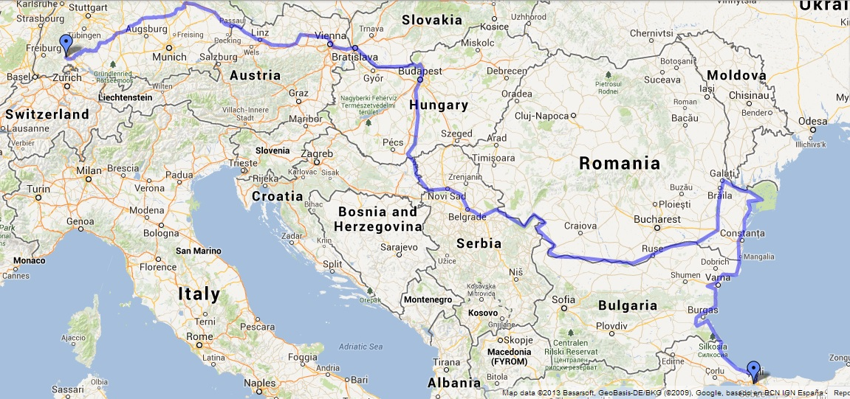
SHIP FOR LIFE
GROUP 5

Slide 2
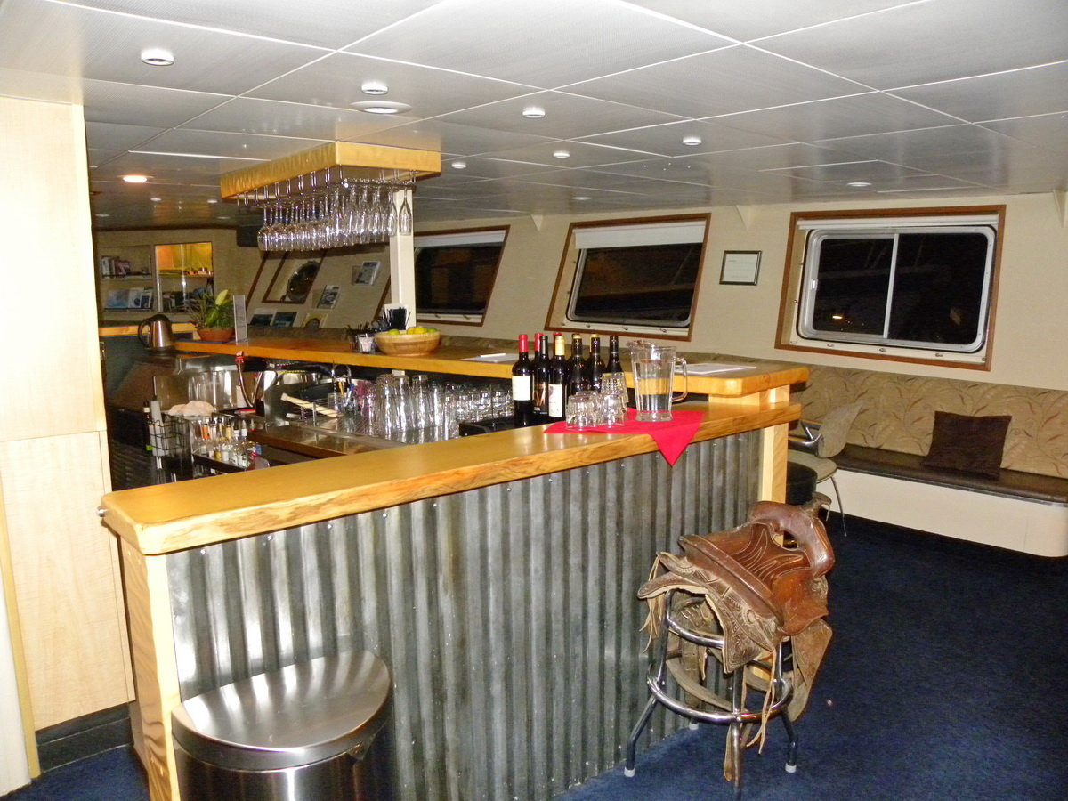
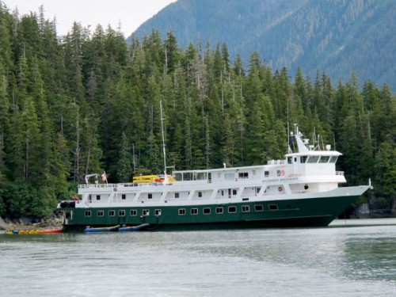
About the ship
Hotel and a school on the ship
Good place to learn how to live in the real life
For university students
Working on the ship with enjoy,
happiness
Have a great traveling on the river
Danube

Slide 3
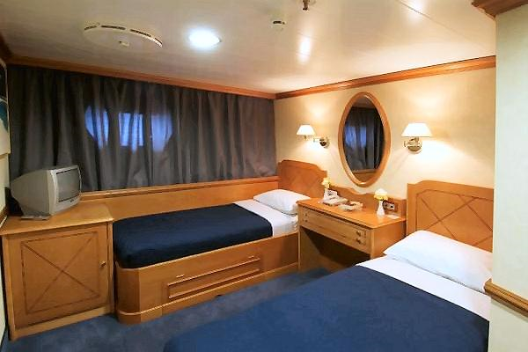
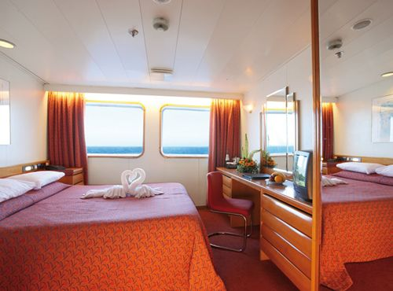
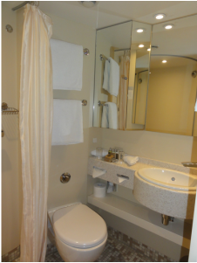
The ship inside
15 room for students
Every room have 2 beds, bathroom, TV
Free WIFI
5 rooms for personal
Restaurant
Gaming hall
Fitness hall

Slide 4
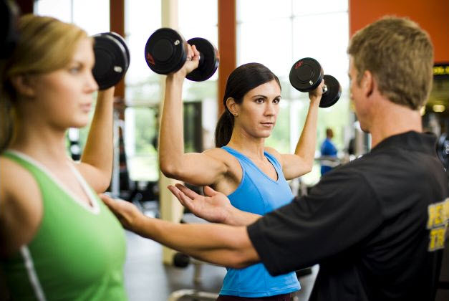
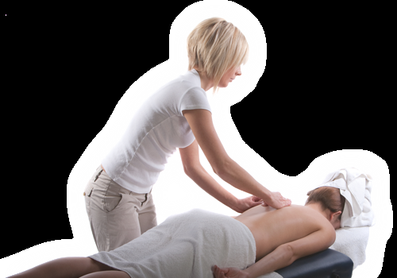
The school, job
Different specialisations
Studies:
Economist
Waitress,waiter/cook, chef
Trainer
Massage

Slide 5
Price
For students:
They pay just for the traveling
They have free meal, room and studies
They have to work 6 days at the week
For personal:
Adults: 45 Euro/night
Children: under 5 is free, from 6 years old: 20 Euro/night

Slide 6
Connection
You can find this trip on the internet: www.shipforlifedanubetrip.com
On facebook: www.facebook/shipforlifedanubetrip.com
In a magazines: JOBS
Mobile: 056781534965

Slide 7
Thanks for your attention!

