Slide 1
eTwinning project: “The tree of life” 11 Primary School of Ilion Athens – Greece 2014 - 2015

Slide 2
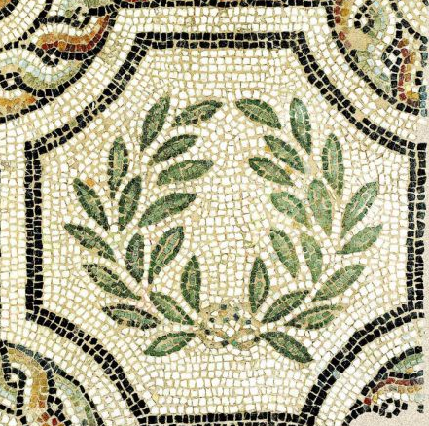
The pupils of D1 Class, Level 4,
present
their work about Greek Monasteries.
They searched on Internet about photos,
wrote compositions and
created paintings and mosaics
in the Visual Arts lesson.

Slide 3
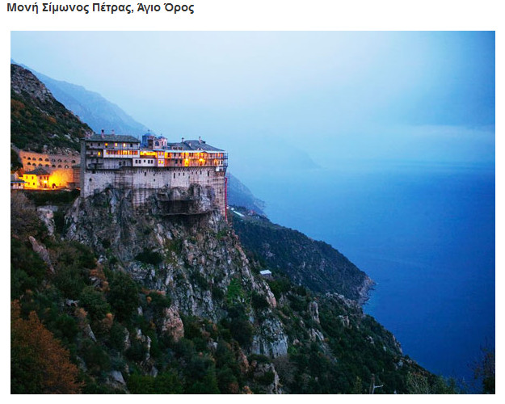

Slide 4
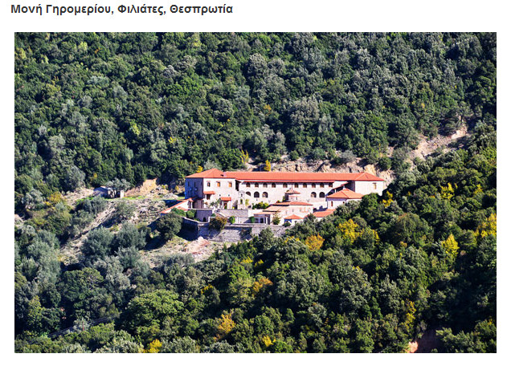

Slide 5
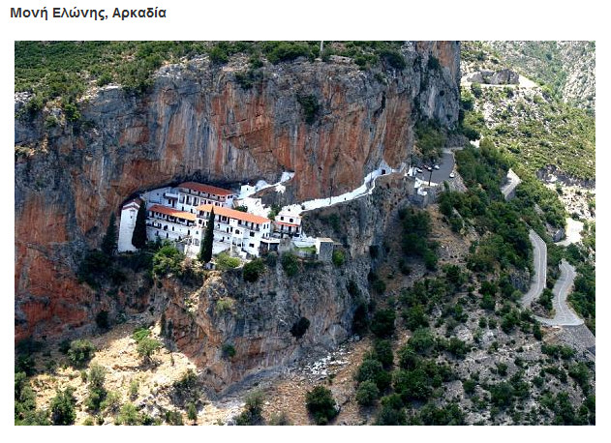

Slide 6
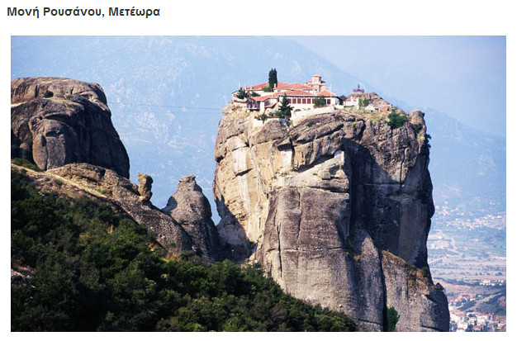

Slide 7
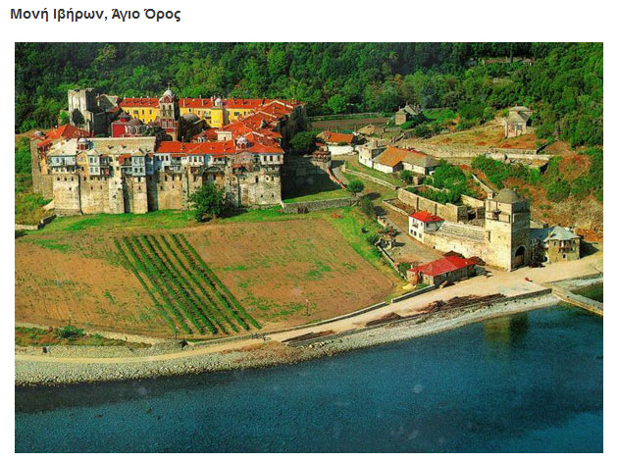

Slide 8
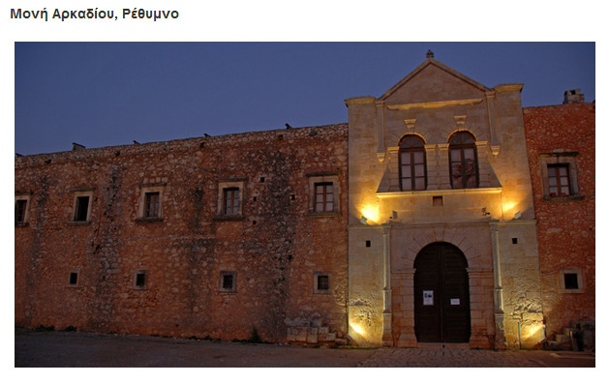

Slide 9
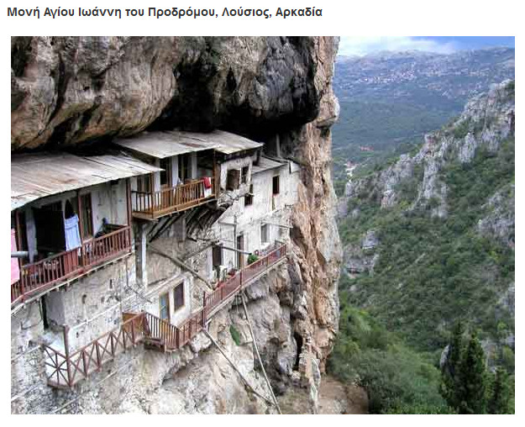

Slide 10
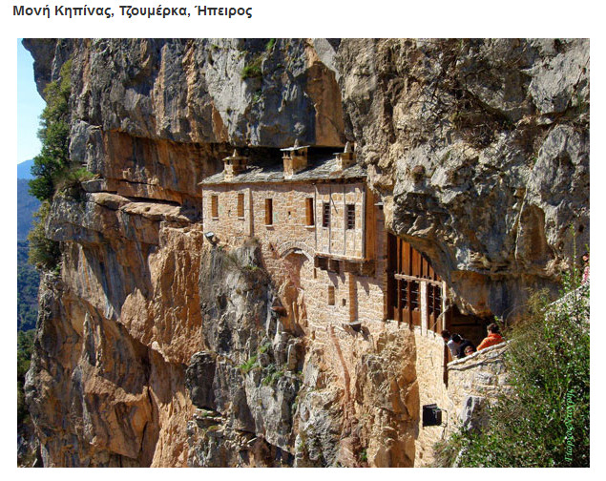

Slide 11
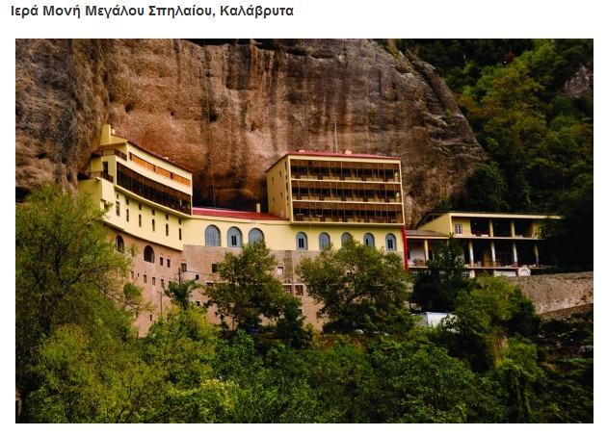

Slide 12
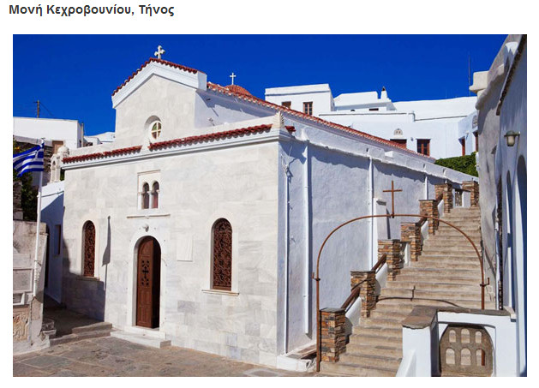

Slide 13
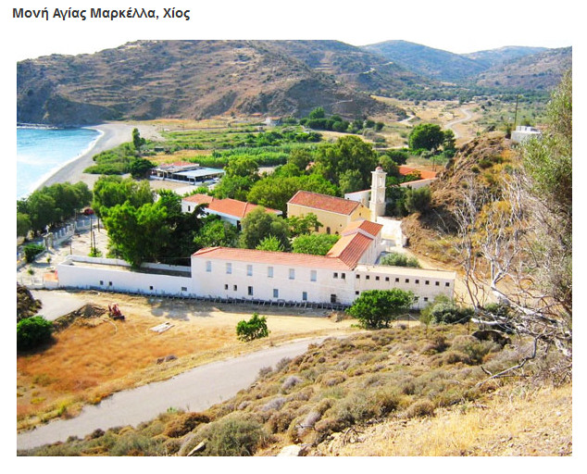

Slide 14
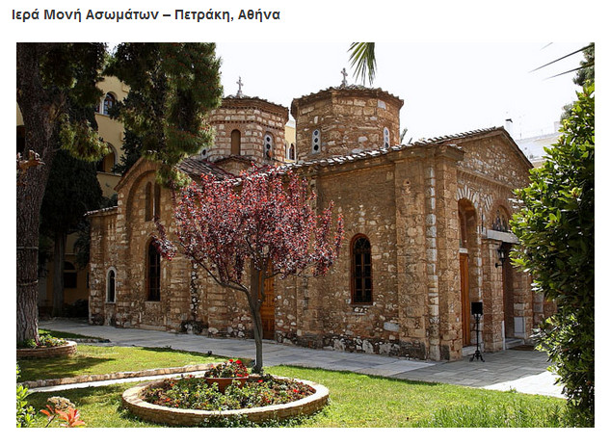

Slide 15
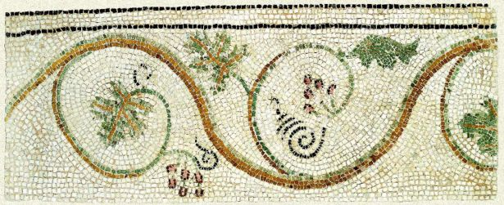
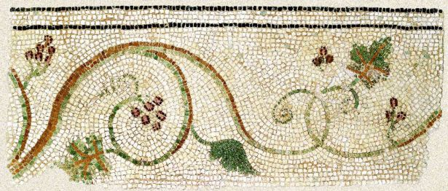
Sources
Internet:
http://perierga.gr/
(άρθρο: Μοναστήρια της Ελλάδας χάρμα οφθαλμών!)
Byzantine and Christian Museum
http://www.byzantinemuseum.gr/en/collections/

Slide 16
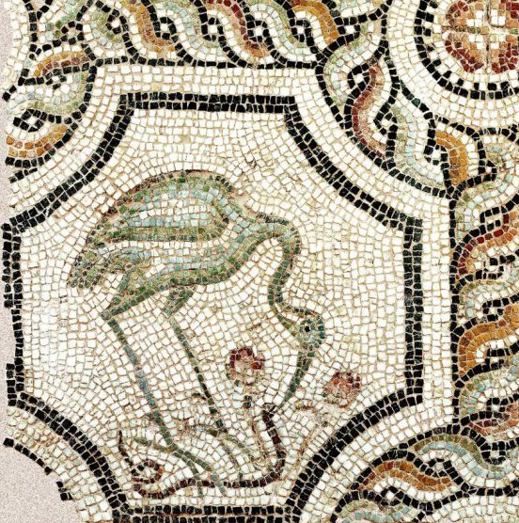
Thanks to the pupils of D1 Class that presented
their work about Greek Monasteries.
Thanks to the Visual Arts teacher:
Theodora Chandrinou.
The Teacher of D1 class: Ioannis Stathas.

