Slide 1
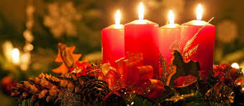
Christmas
Inéza Kinčovská
II.A

Slide 2
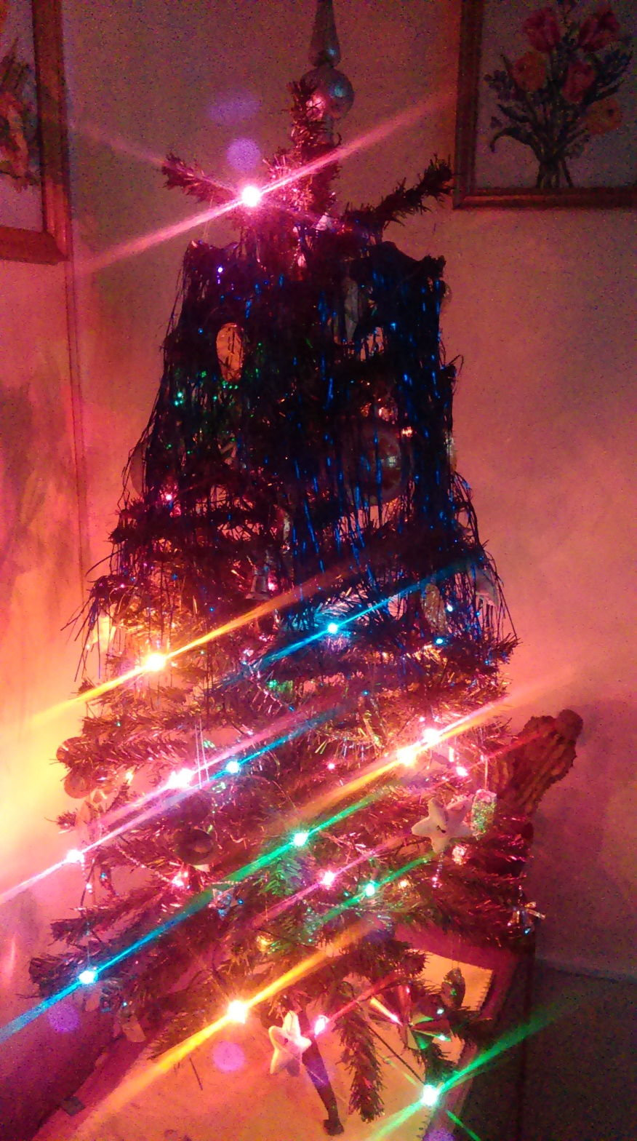
At Christmas we have a really colourful tree which me adore.

Slide 3
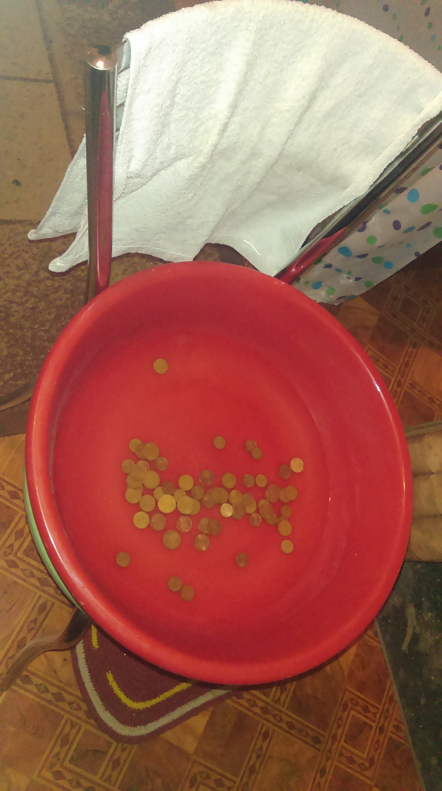
Before Christmas dinner everybody washes in water with coins which are afterwords put under tablecloth for good luck.

Slide 4
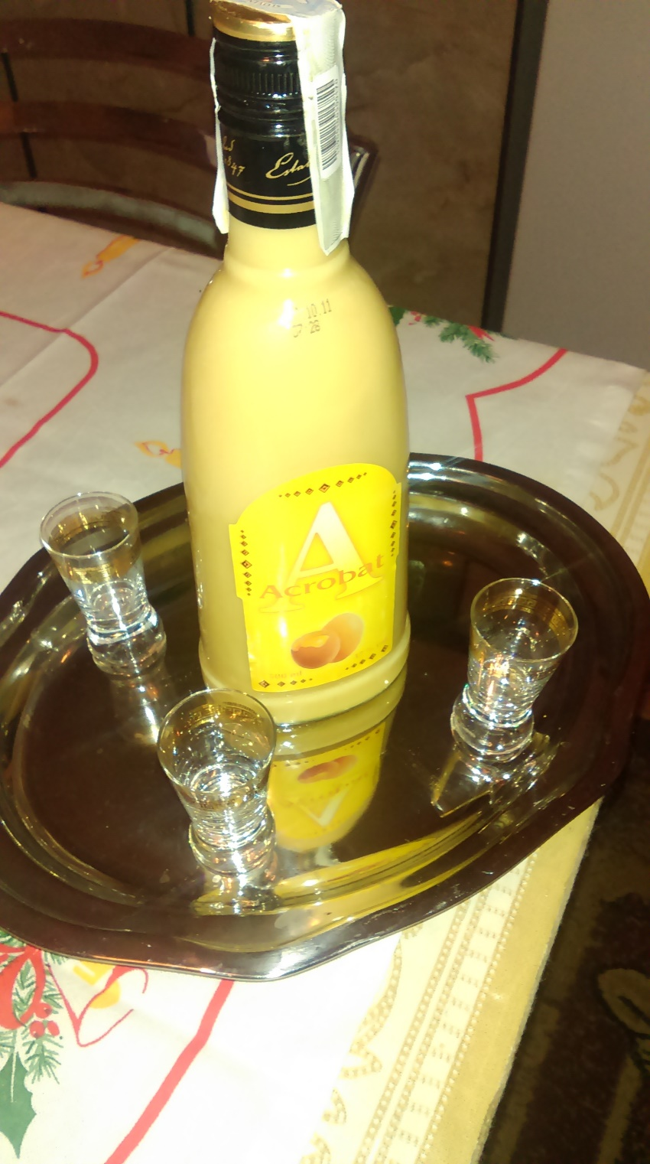
Before sitting at the table togetherwe have a toast – with Egg cognac.

Slide 5
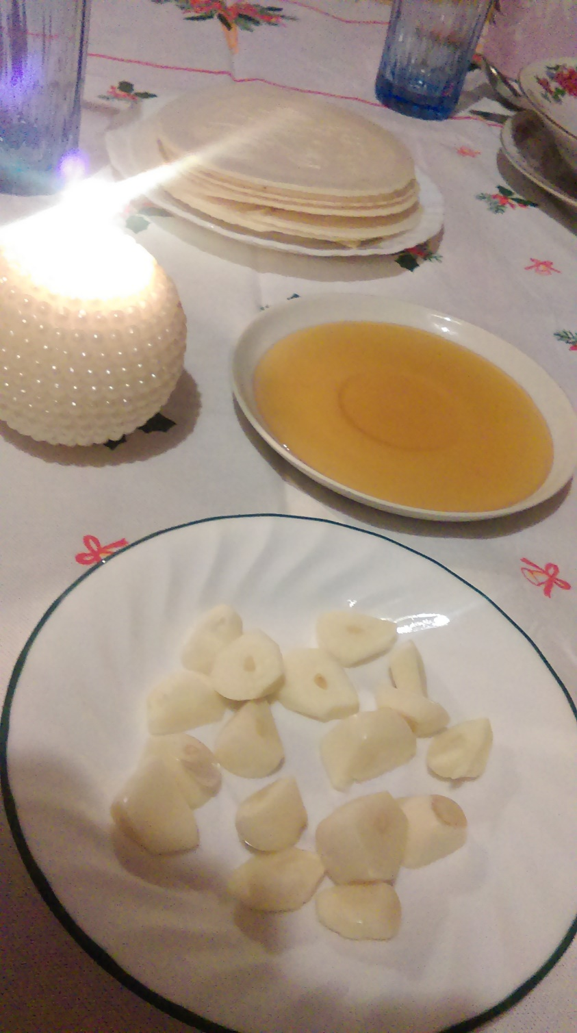
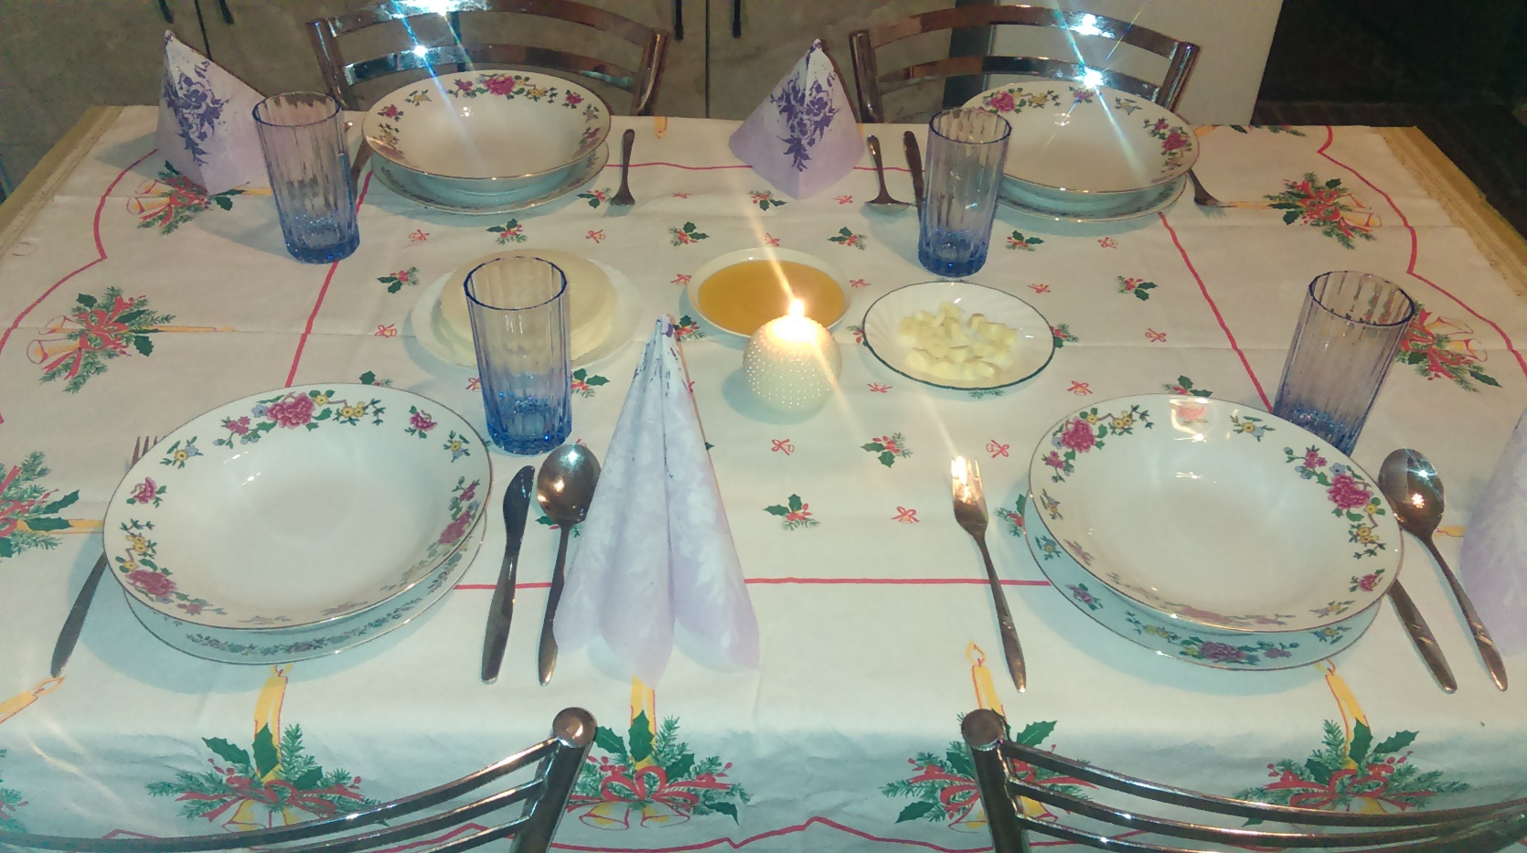
When we sit at the table we start eating Christmas dinner. The starter is – Christmas wafers with honey and garlic.

Slide 6
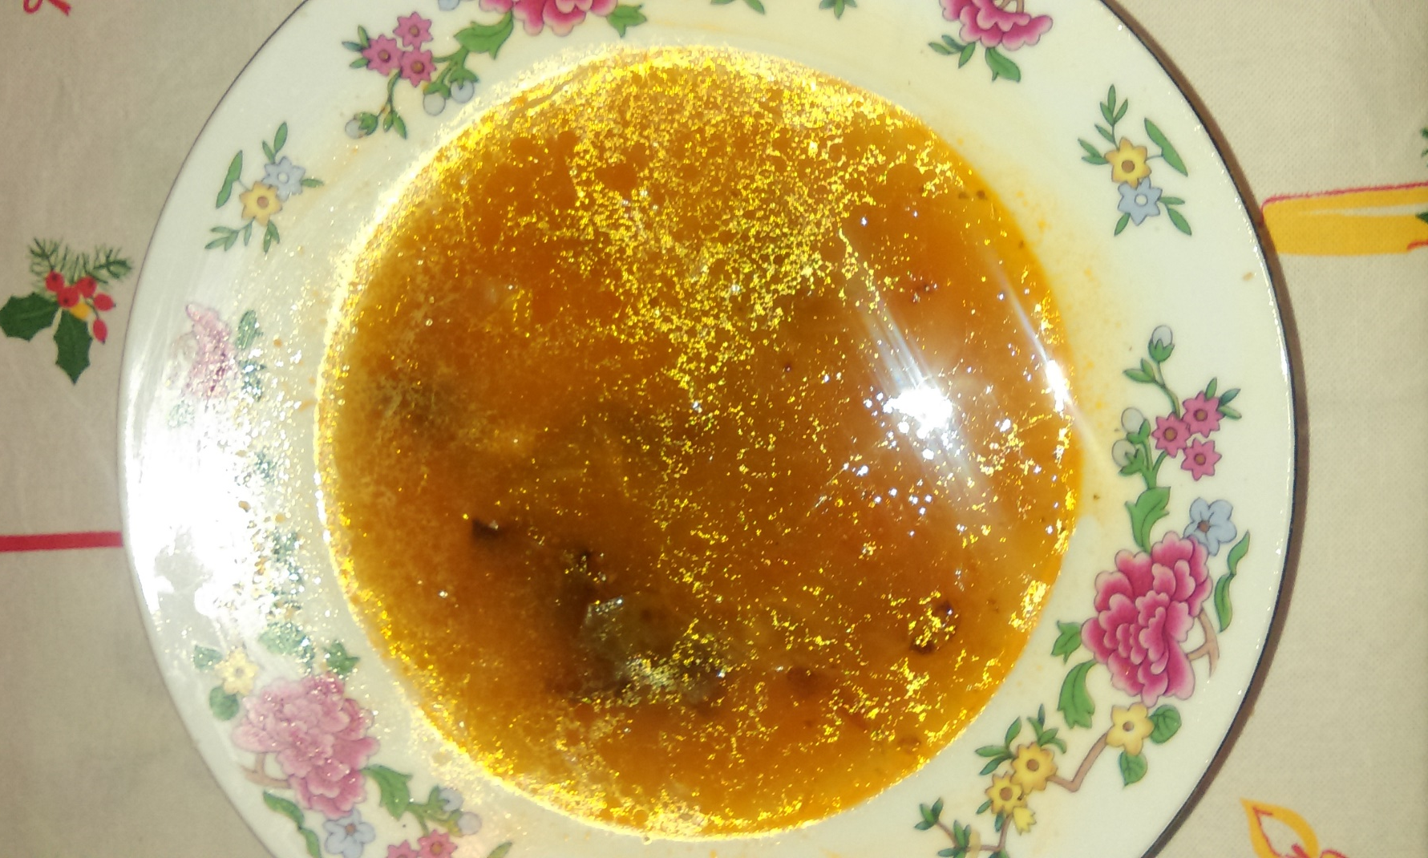
The second course is Cabbage soup with sausages, mushrooms and rice.

Slide 7
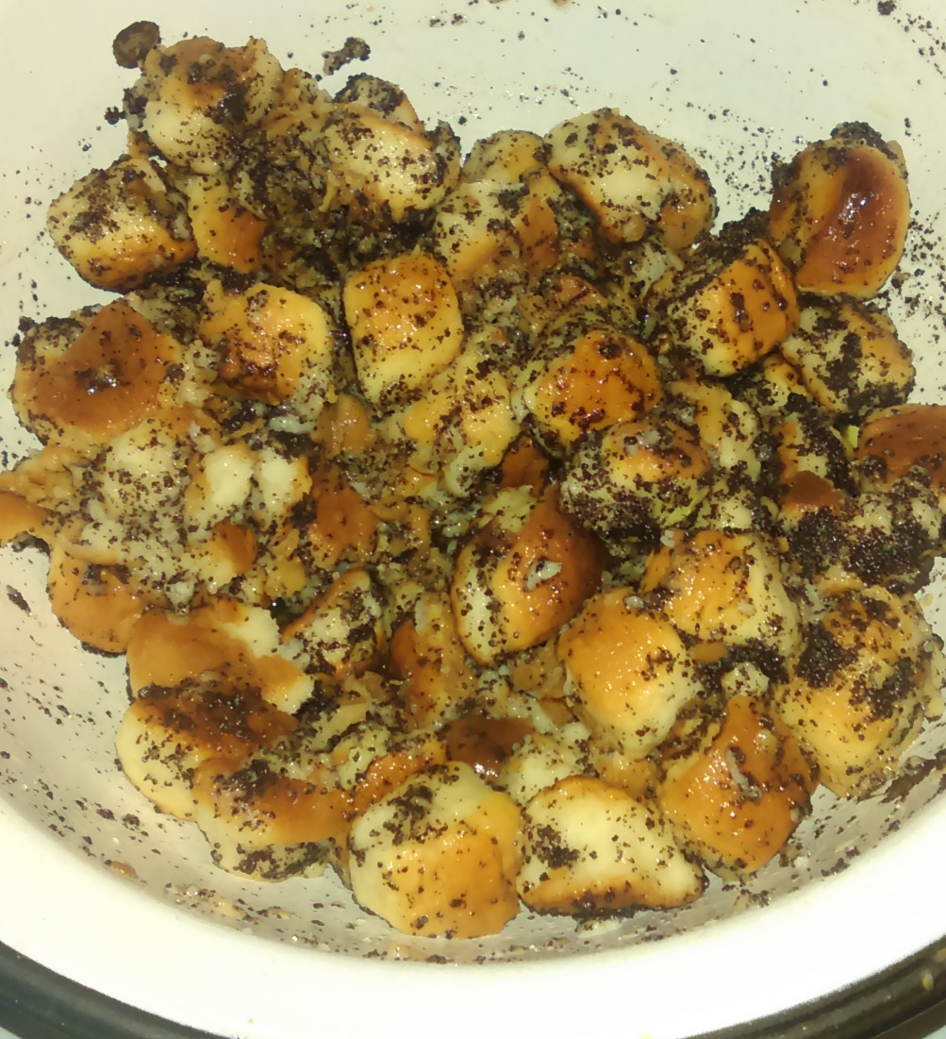
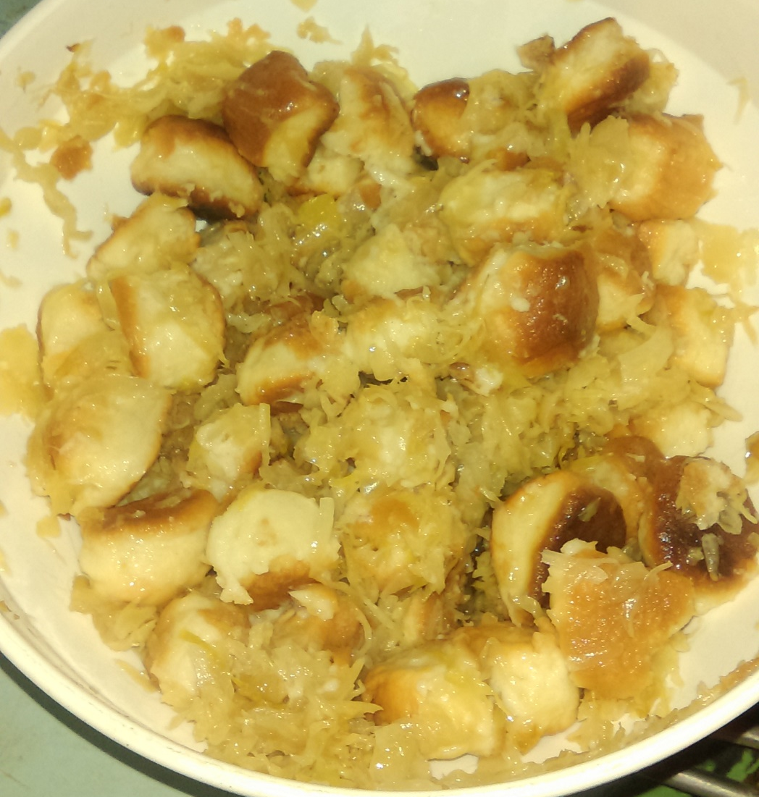
Next course in our area is „bobalky“, small pieces of dough served with cabbage or poppies.

Slide 8
The last course of our Christmas dinner is fried fish with mayonnaise potato salad.

Slide 9
The End Thank you for watching

