Slide 1
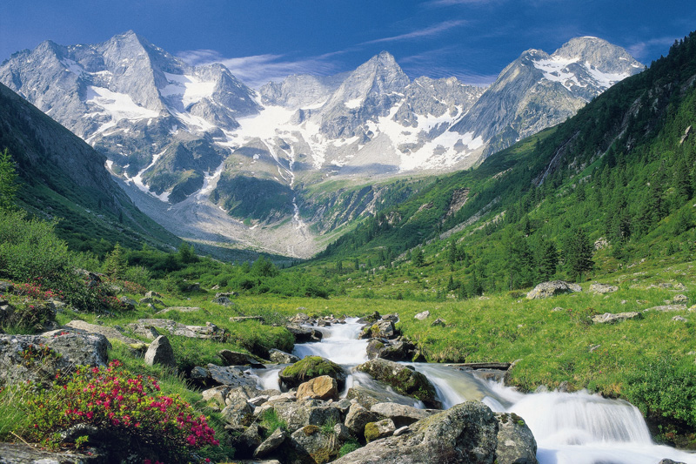
Endangered Animals / Species in Austria

Slide 3
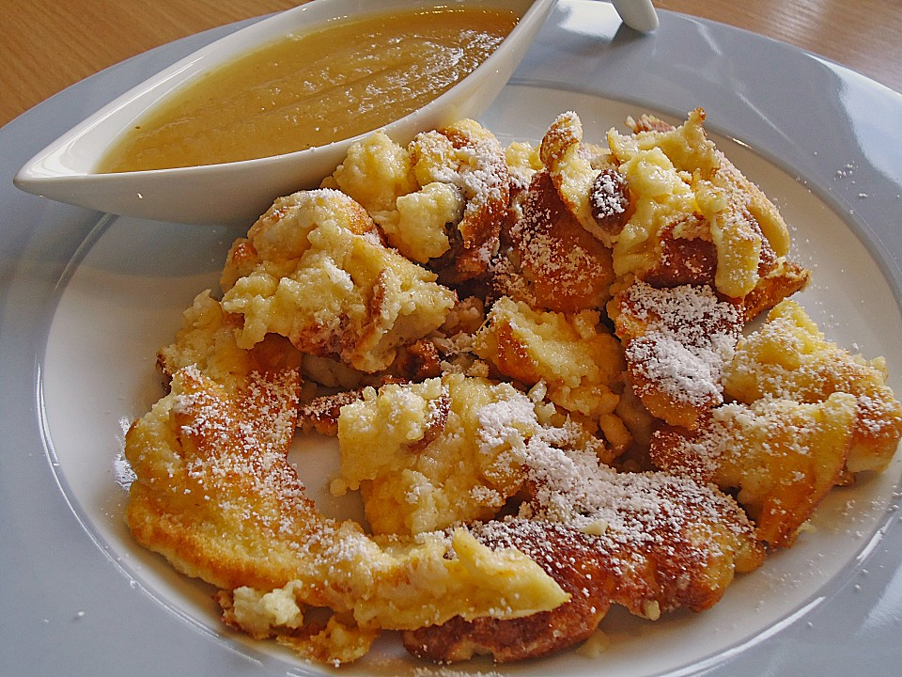

Slide 5
The Barn Owl

Slide 6
Most wildly distributed species of owl.
Nocturnal
Consumes more rodents than any other creature
Body length: 33 – 39 cm
Wingspan: 80 – 95 cm
Weight: 260 – 550 grams

Slide 7
Habitat

Slide 8
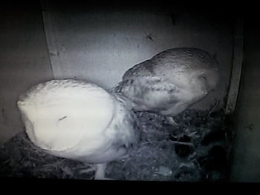
Solution
Species conservation projects
Marten-proof nesting boxes
Friendlier farmers.

Slide 9
Fire Salamander

Slide 10
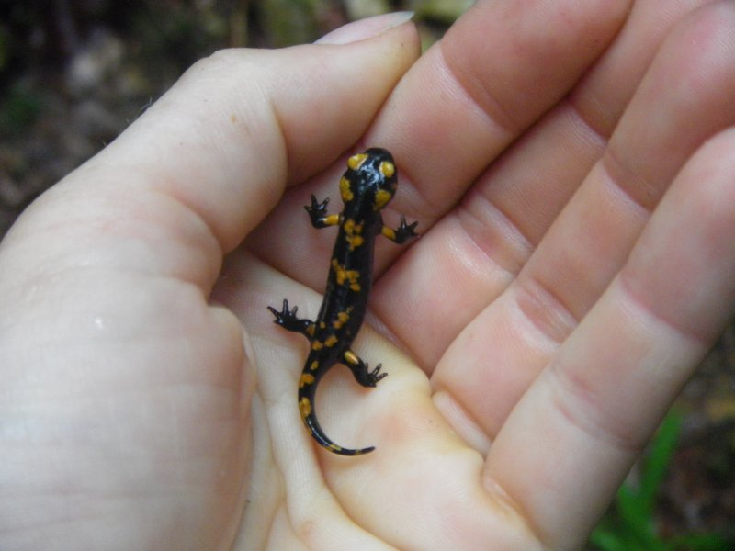
best-known salamander in Europe
In Switzerland and Austria widely distributed
suffer from severe habitat destruction brought about by modern agriculture, road building and river regulation.
Fire Salamanders are amphibians

Slide 11
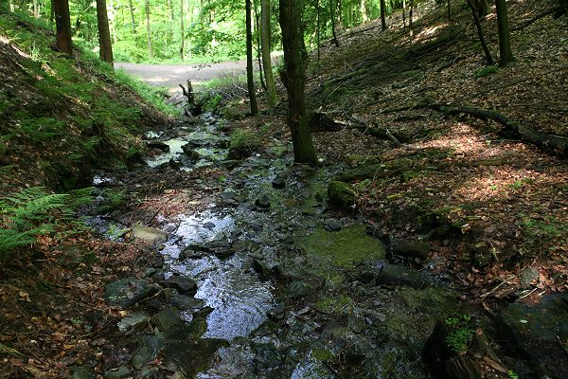
Habitat
Hilly areas
Hide in fallen leaves
Near ponds
Mostly nocturnal

Slide 12
European Ground Squirrel

Slide 13
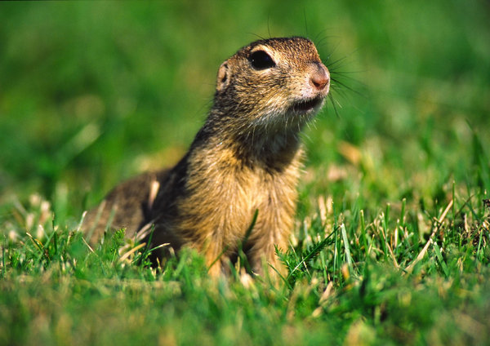
Without Tail 18-23 cm
22 teeth
Nutrition: Insekts, Seeds, Onions
Enemies: Raptors

Slide 14
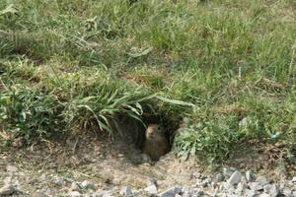
Habitats
Near the wood or on the fields
Home: Buildings in the earth

Slide 15
Meadow Viper

Slide 16
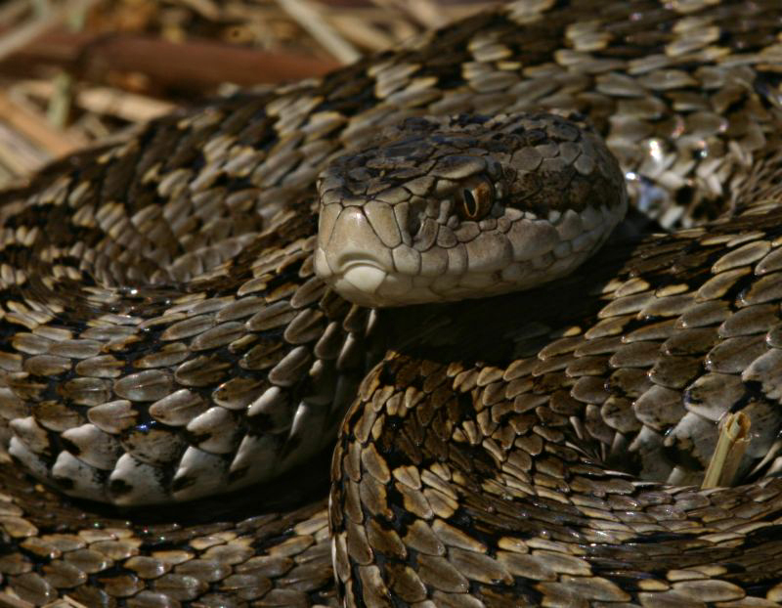
Smallest poisonous snake in Europe
insect-eating
Body length: Half a meter
Colour: brown, grey, yellow, dark green

Slide 17
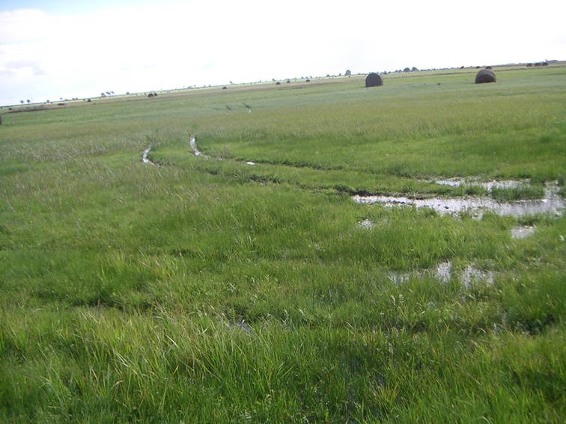
Habitat
Warm and dry grass-lawn
Alluvium
Flat land

Slide 18
The Eurasian Beaver

Slide 19
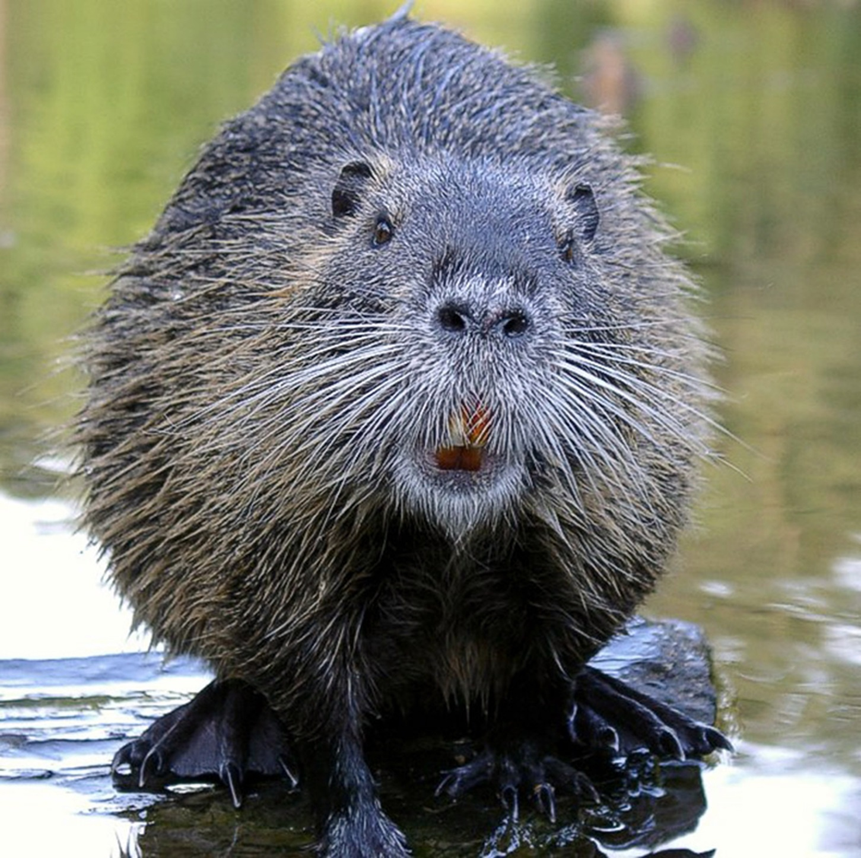
Primarily nocturnal
Large, semiaquatic rodent
Second largest rodent in the world
Have long fossil history in the Northern Hemisphere
Mostly vegetarian

Slide 20
Build dams and canals
Use their powerful front teeth to cut trees and other plants
Have warning signals, such as forcefully slapping the water with its broad tail to warn other beavers of danger

Slide 21
The Beaver Map

Slide 22
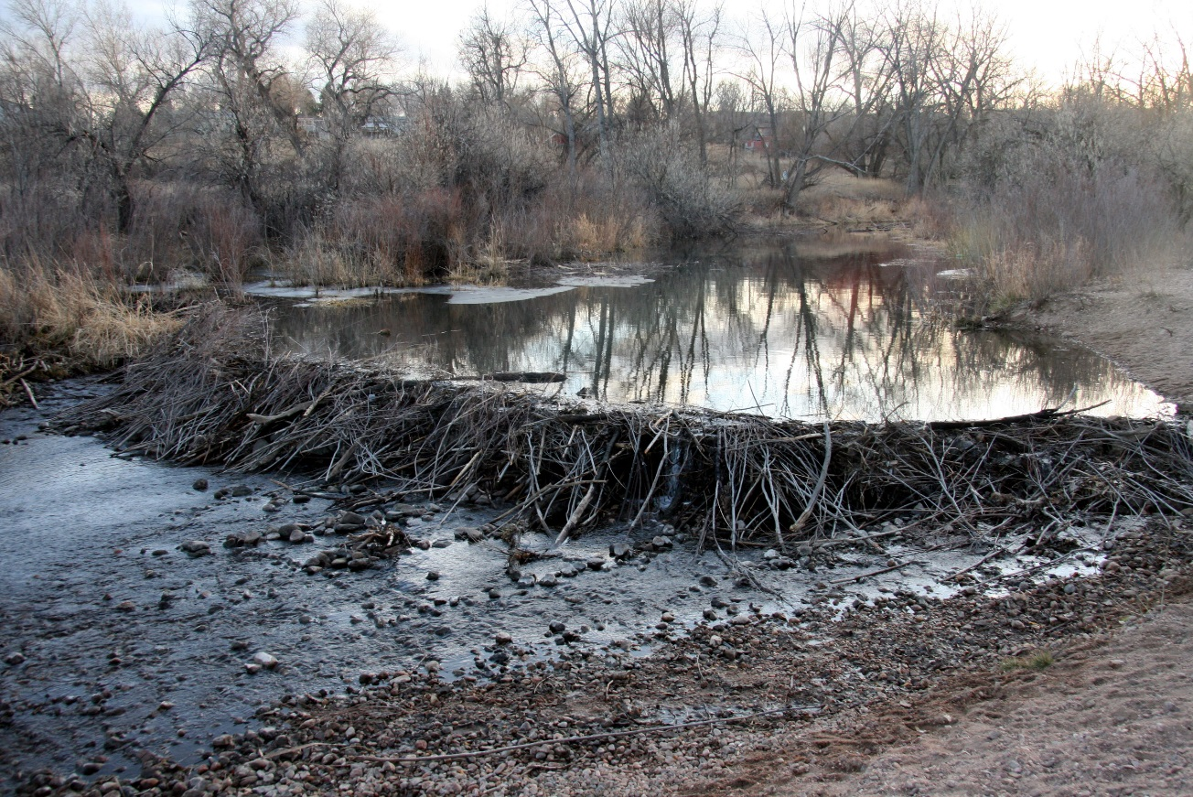
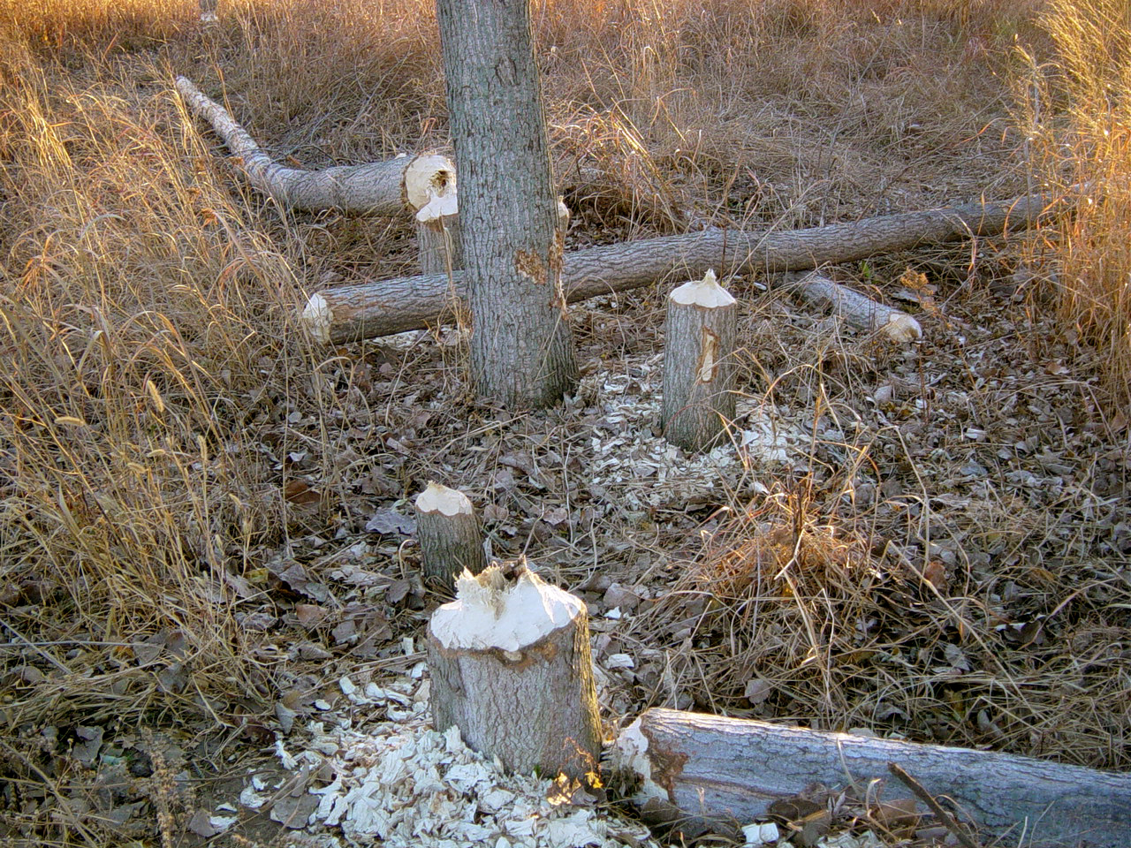
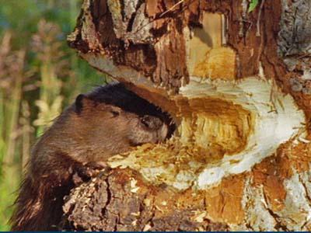
Signs of beaver activity

Slide 23
Habitat
On rivers or streams
Build canals to haul
heavy things onto land
In the absence of
existing ponds, beavers
must construct dams
before building their
lodges.

Slide 24
Causes of death
Roadkills
Floods
Dams

Slide 25
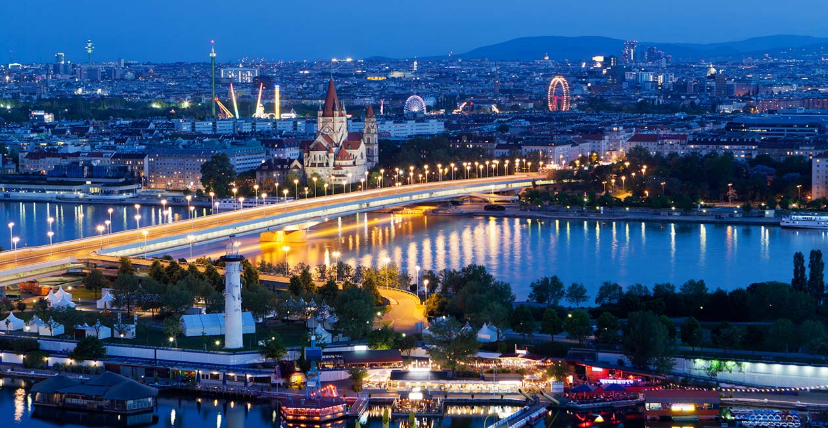
D‘akujeme za vaší pozornost‘
Thank you for your attention!

