Slide 1
Exhibition for parents
by Primary School No 10 Rzeszów, Poland

Slide 2
On April 5 2017, during a meeting with my students' parents, I summarized the past activities of Read and Share eTwinning project and made an exhibition in the school corridor, where parents could see their children's works and photos of various activities in our project. Parents were delighted and congratulated us on such effects. Here are a few photos from that day

Slide 3
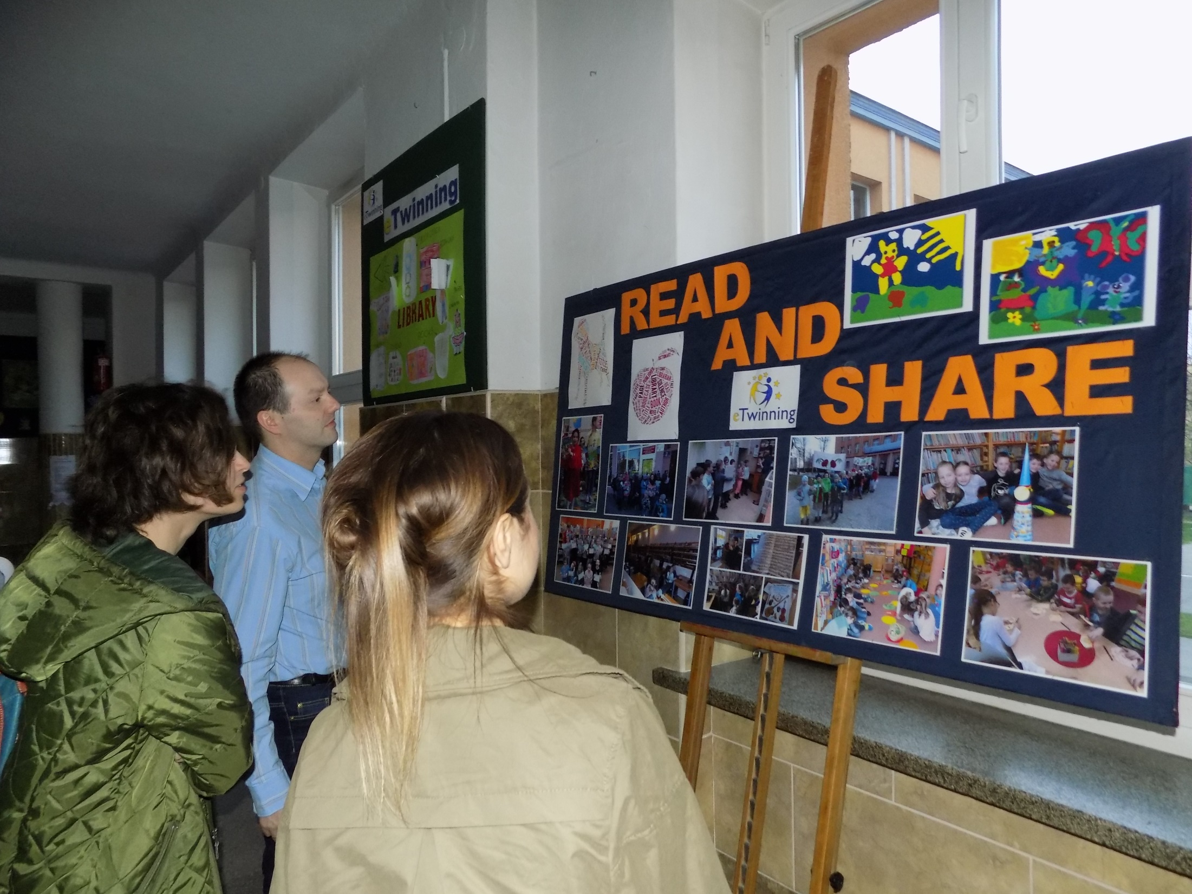

Slide 4
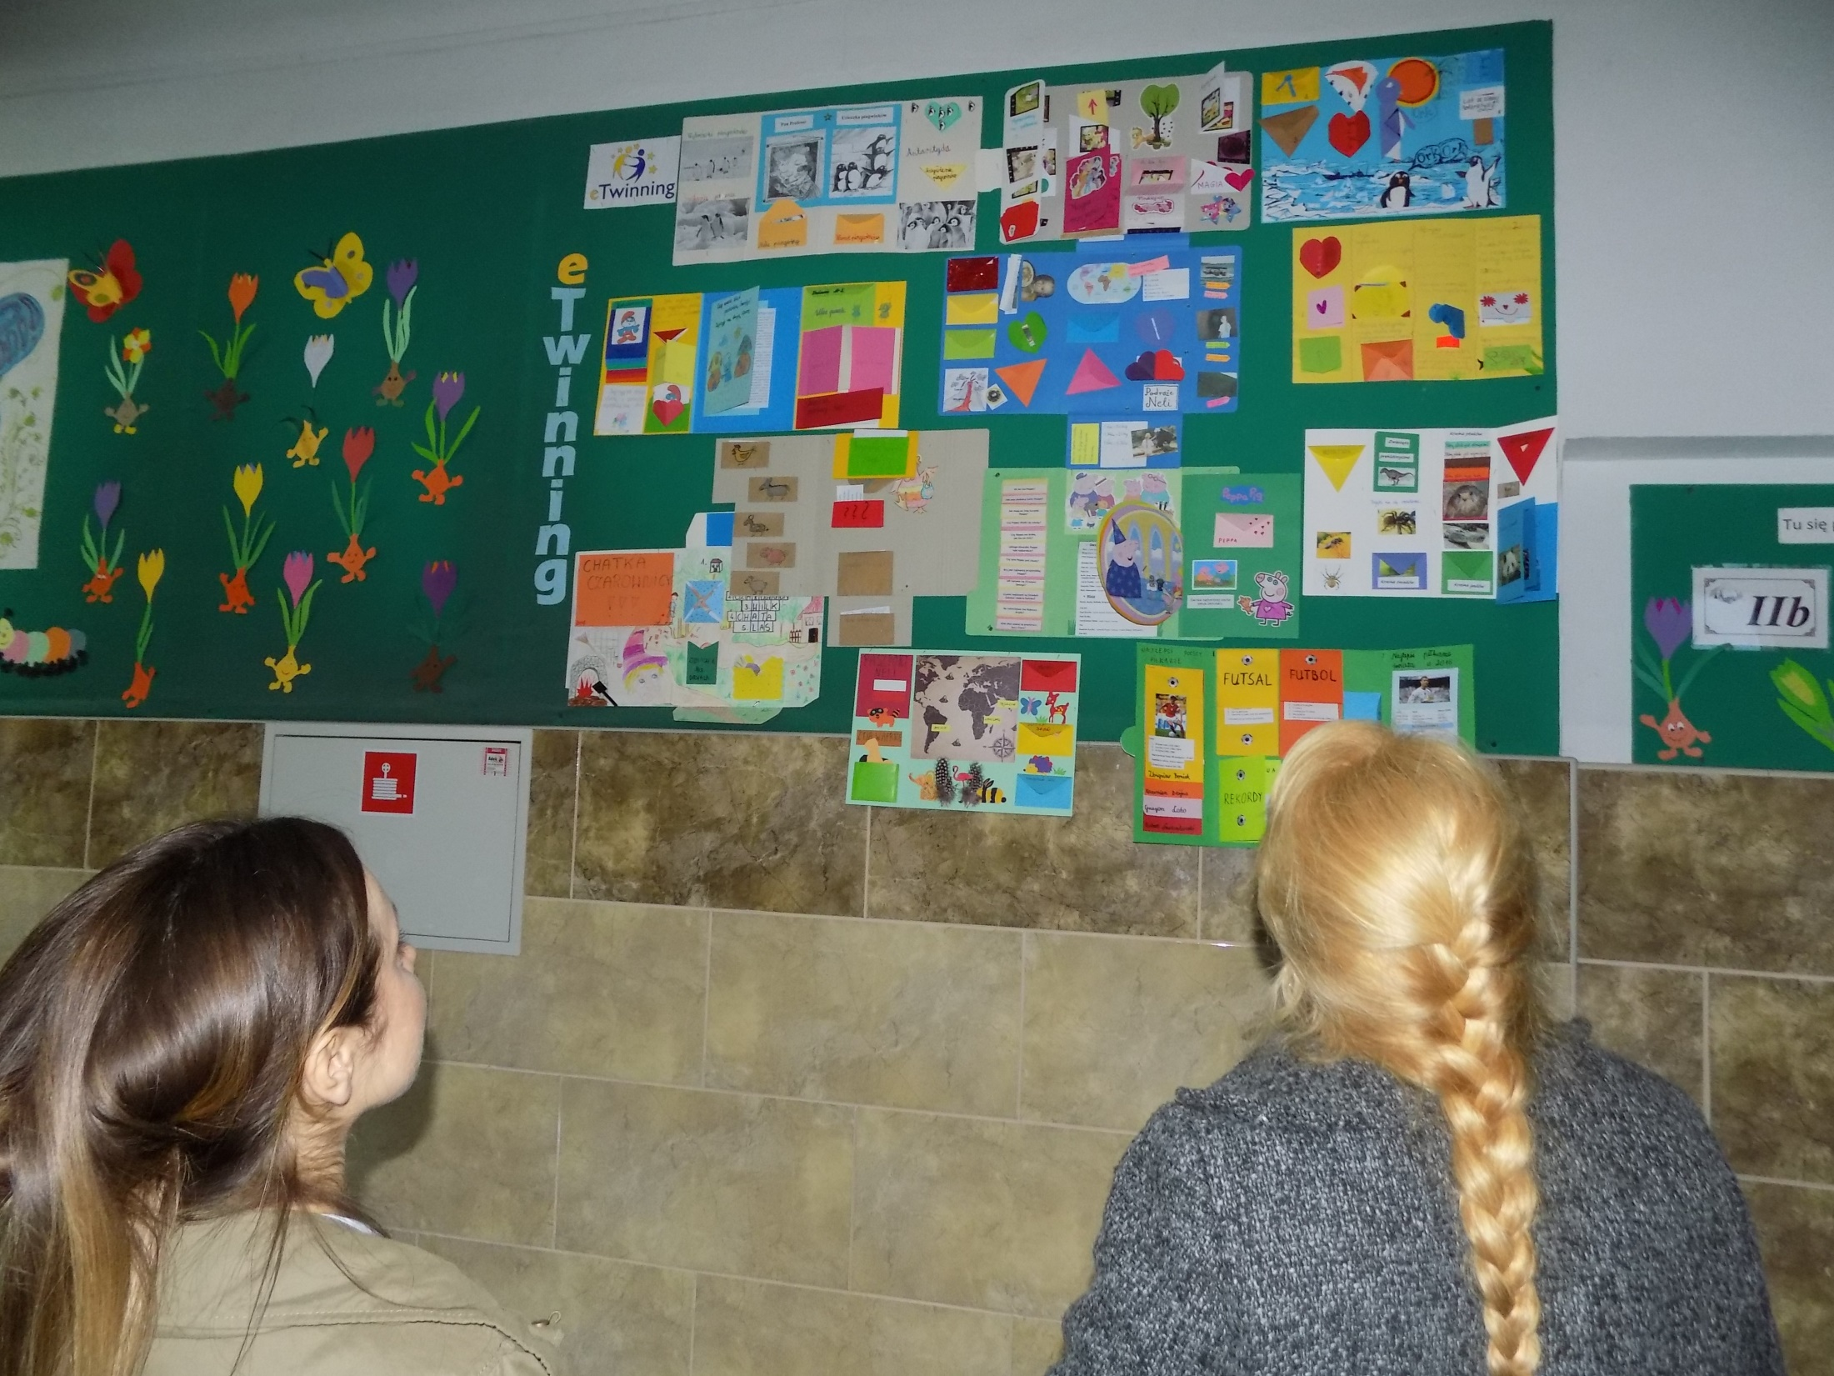

Slide 5
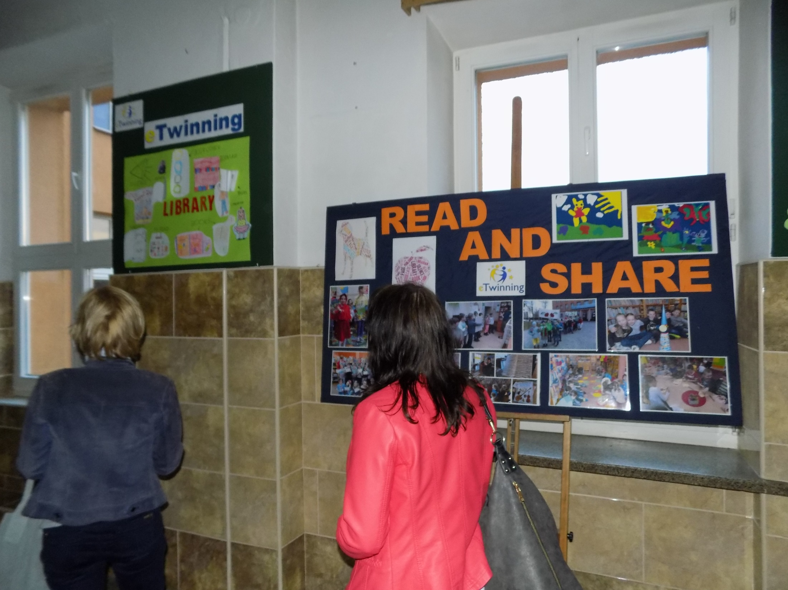

Slide 6
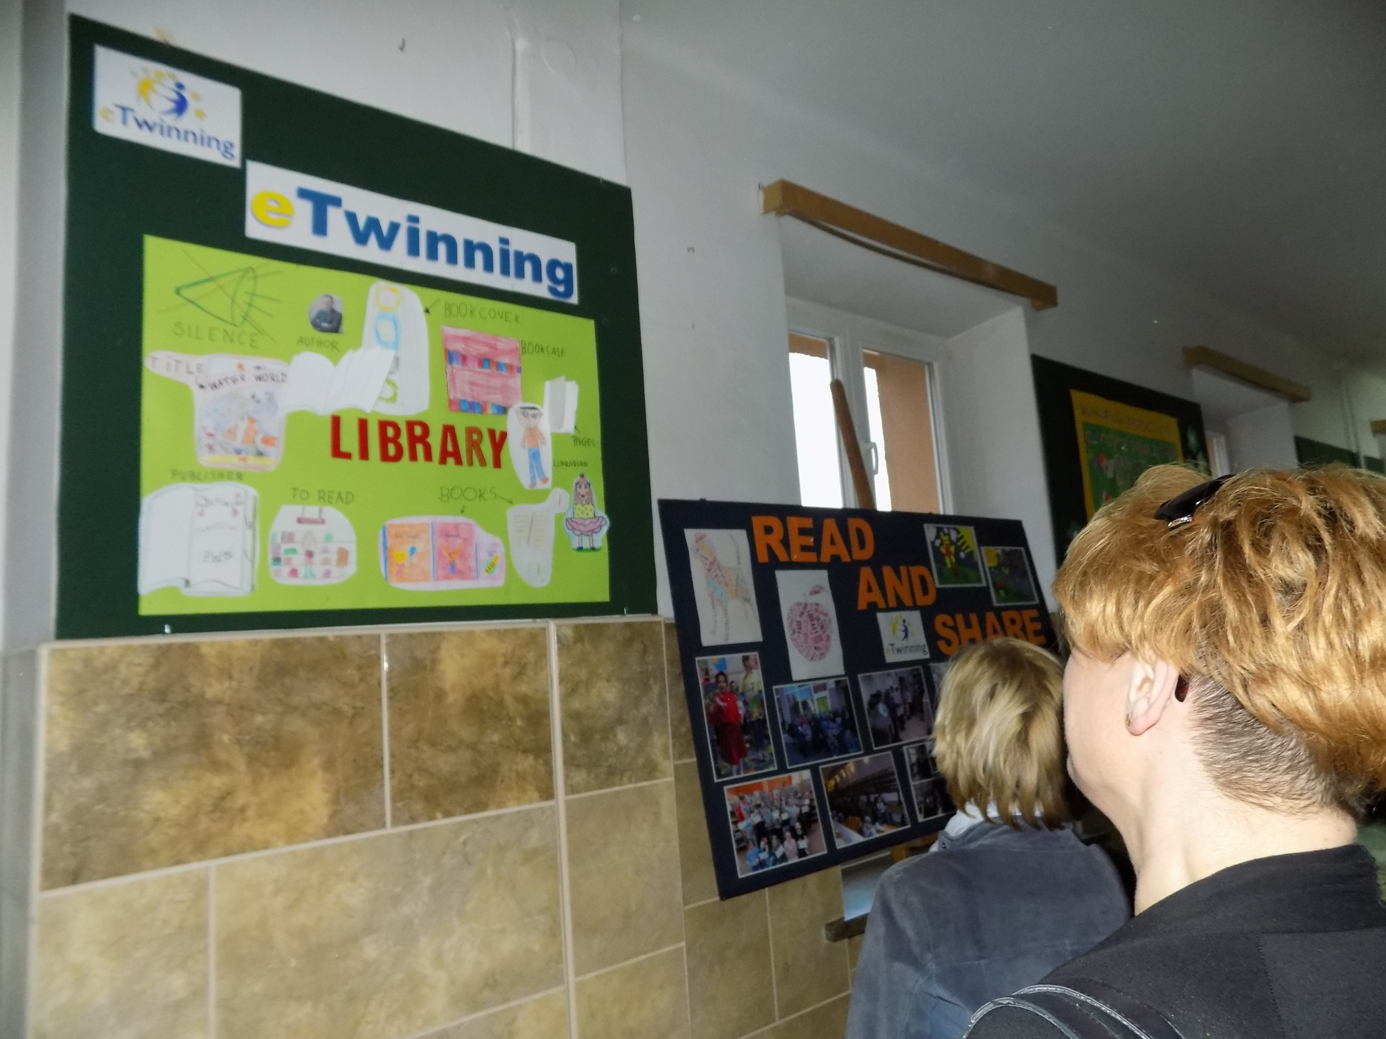

Slide 7
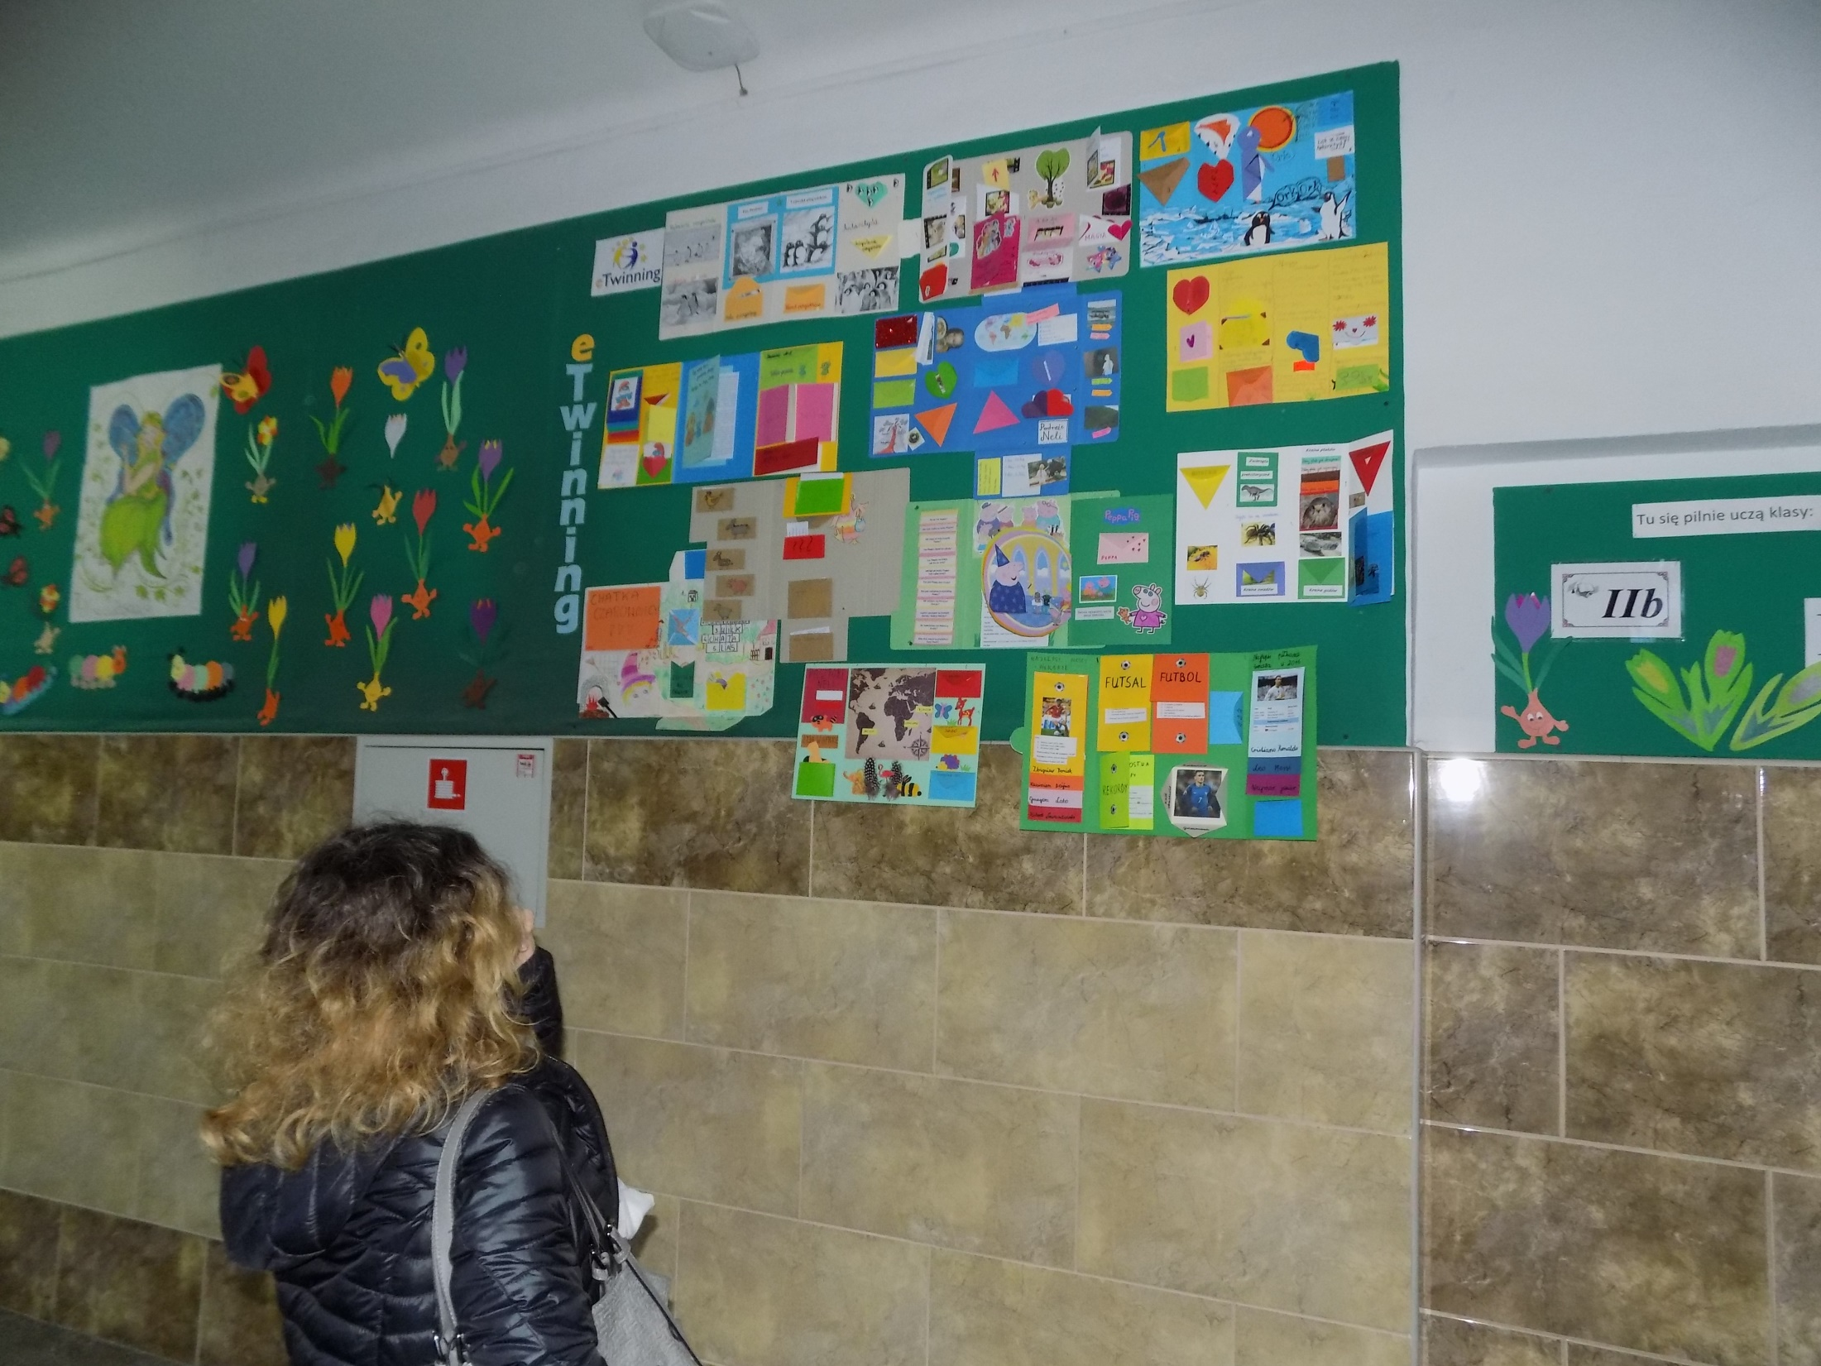

Slide 8
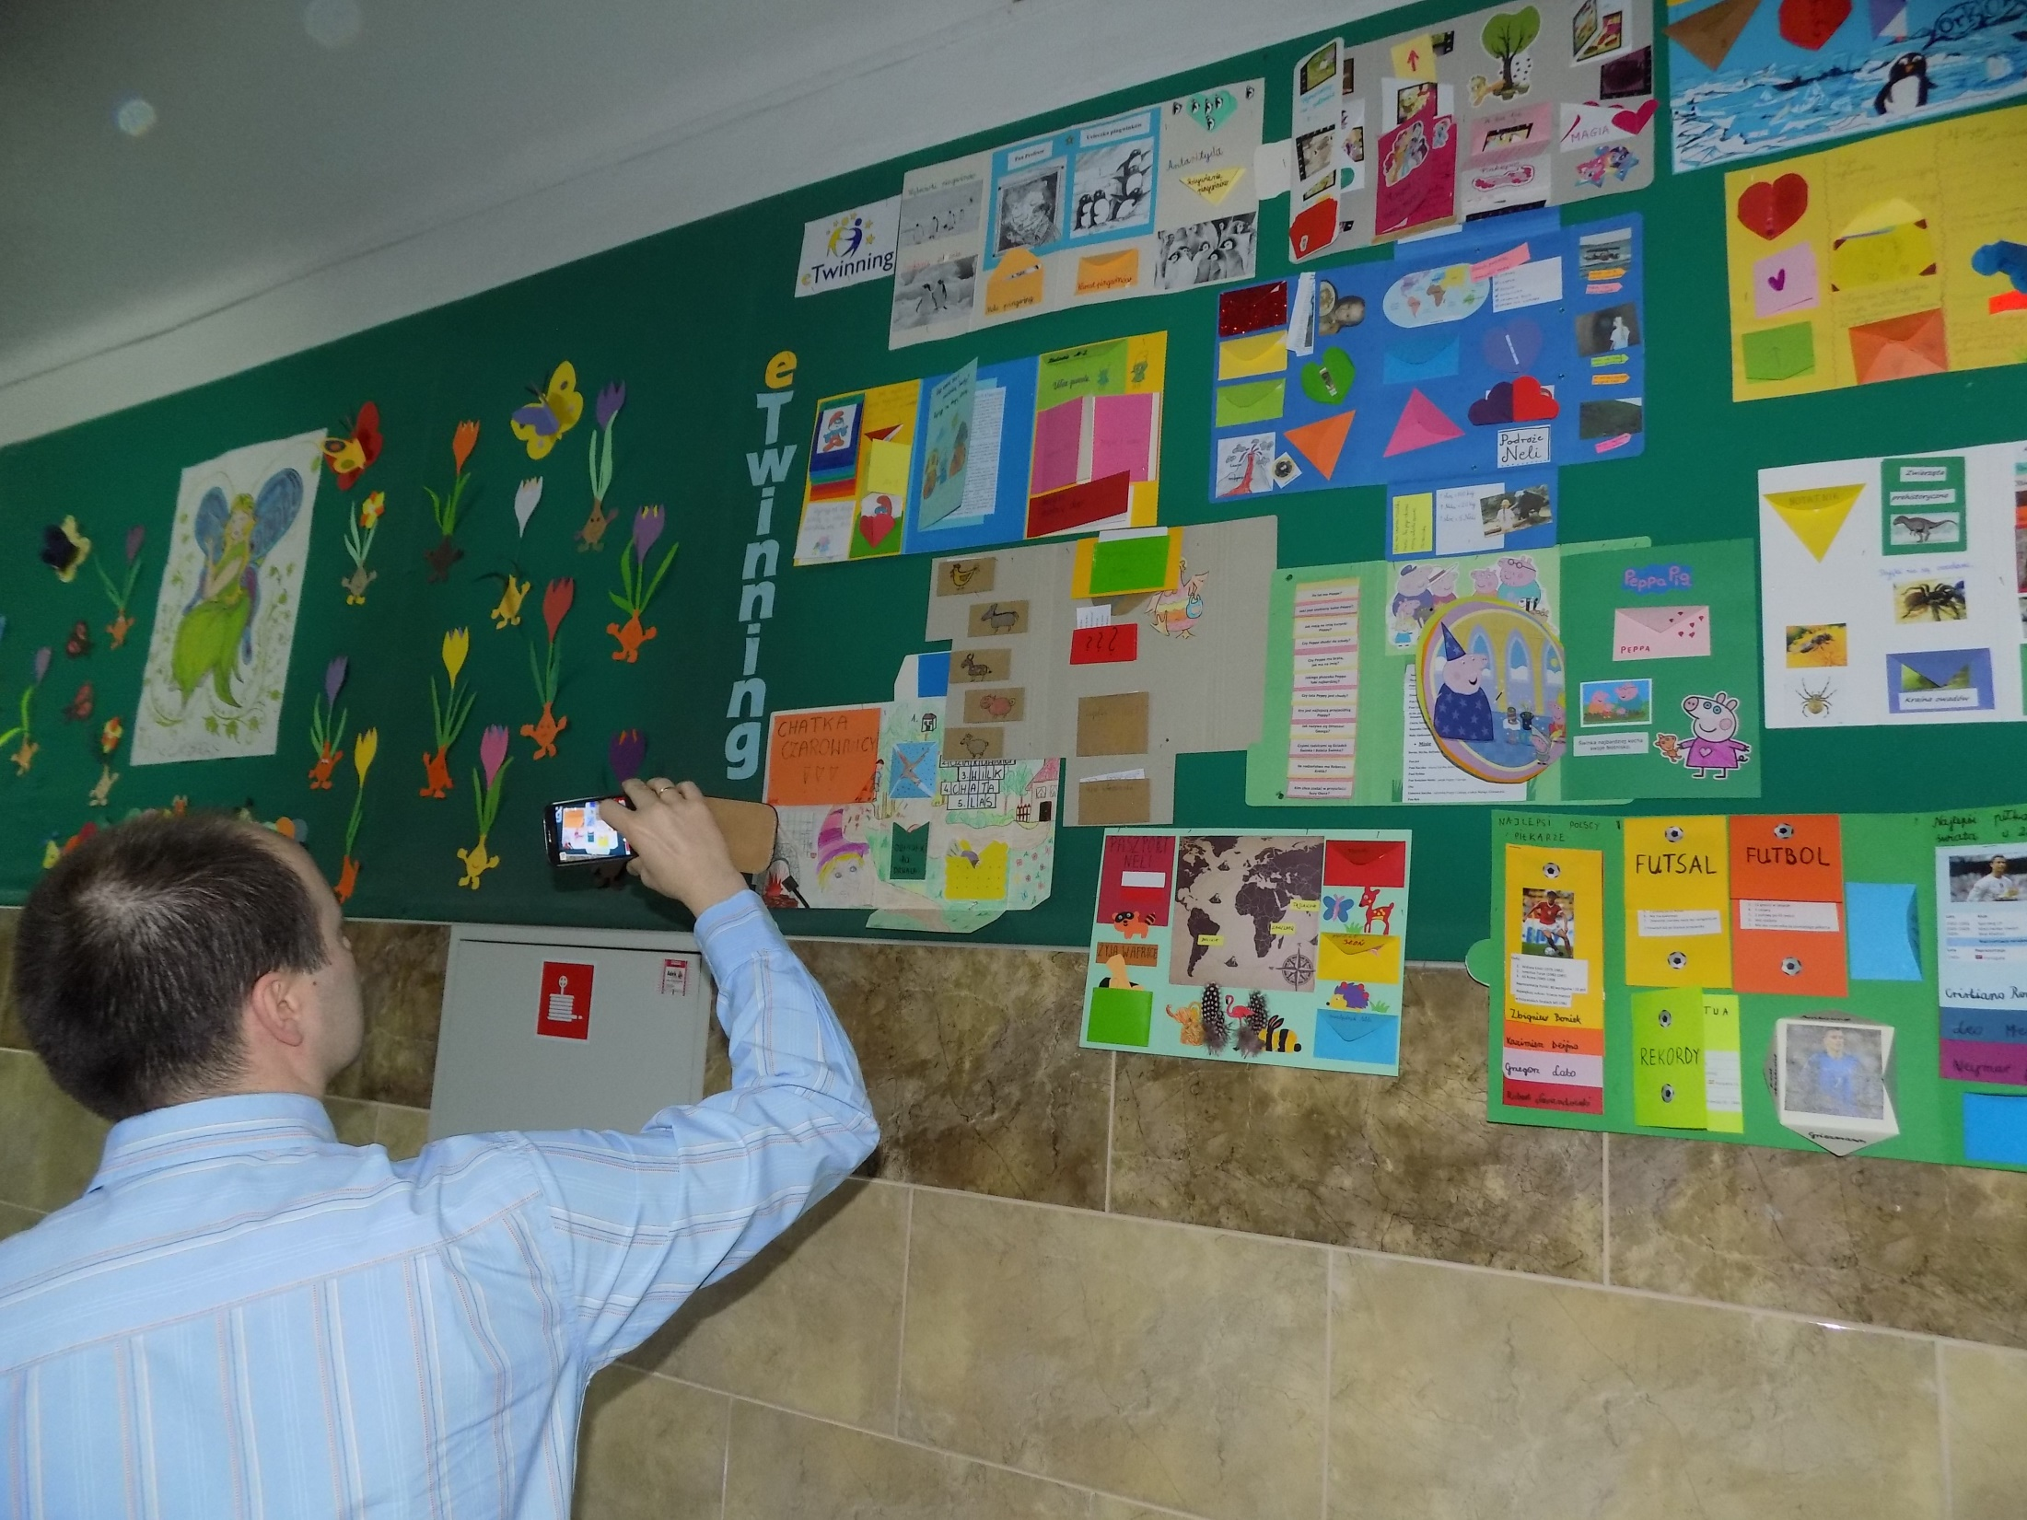

Slide 9
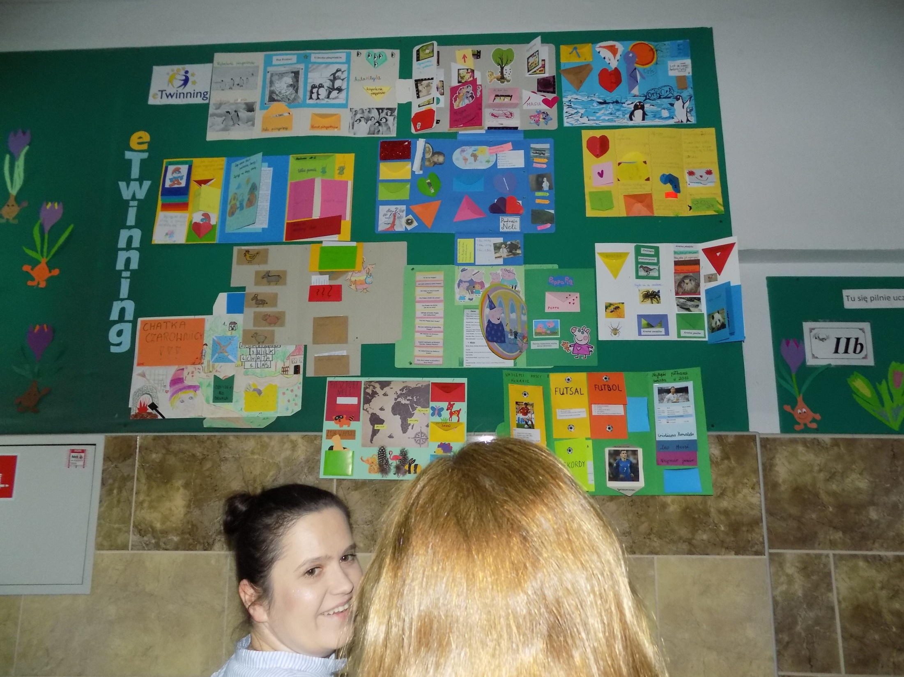

Slide 10
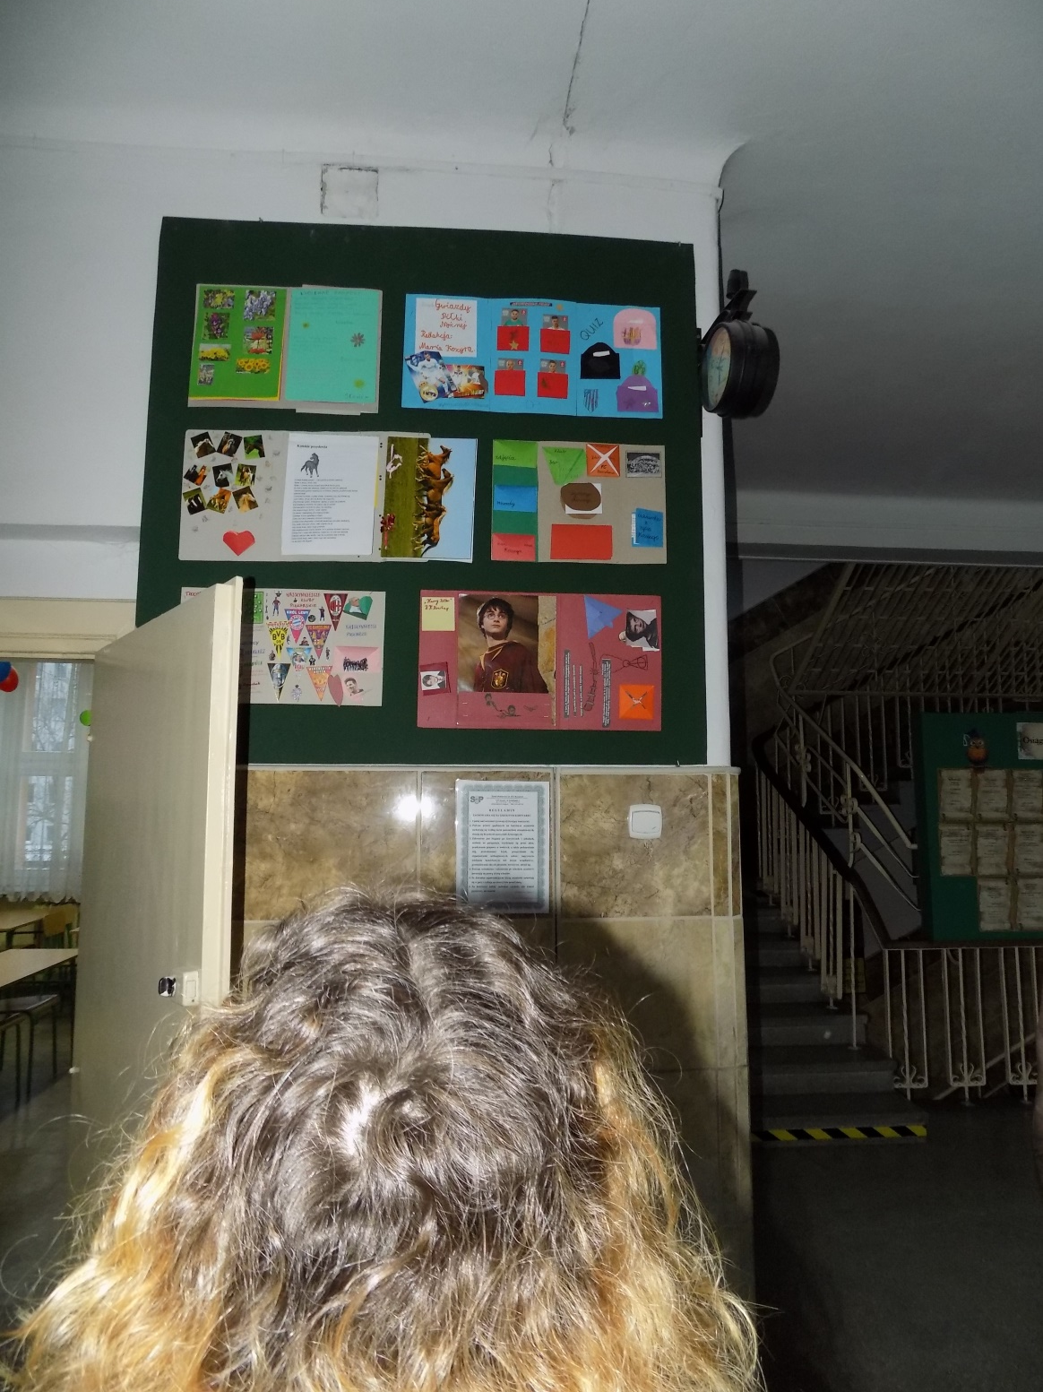

Slide 11
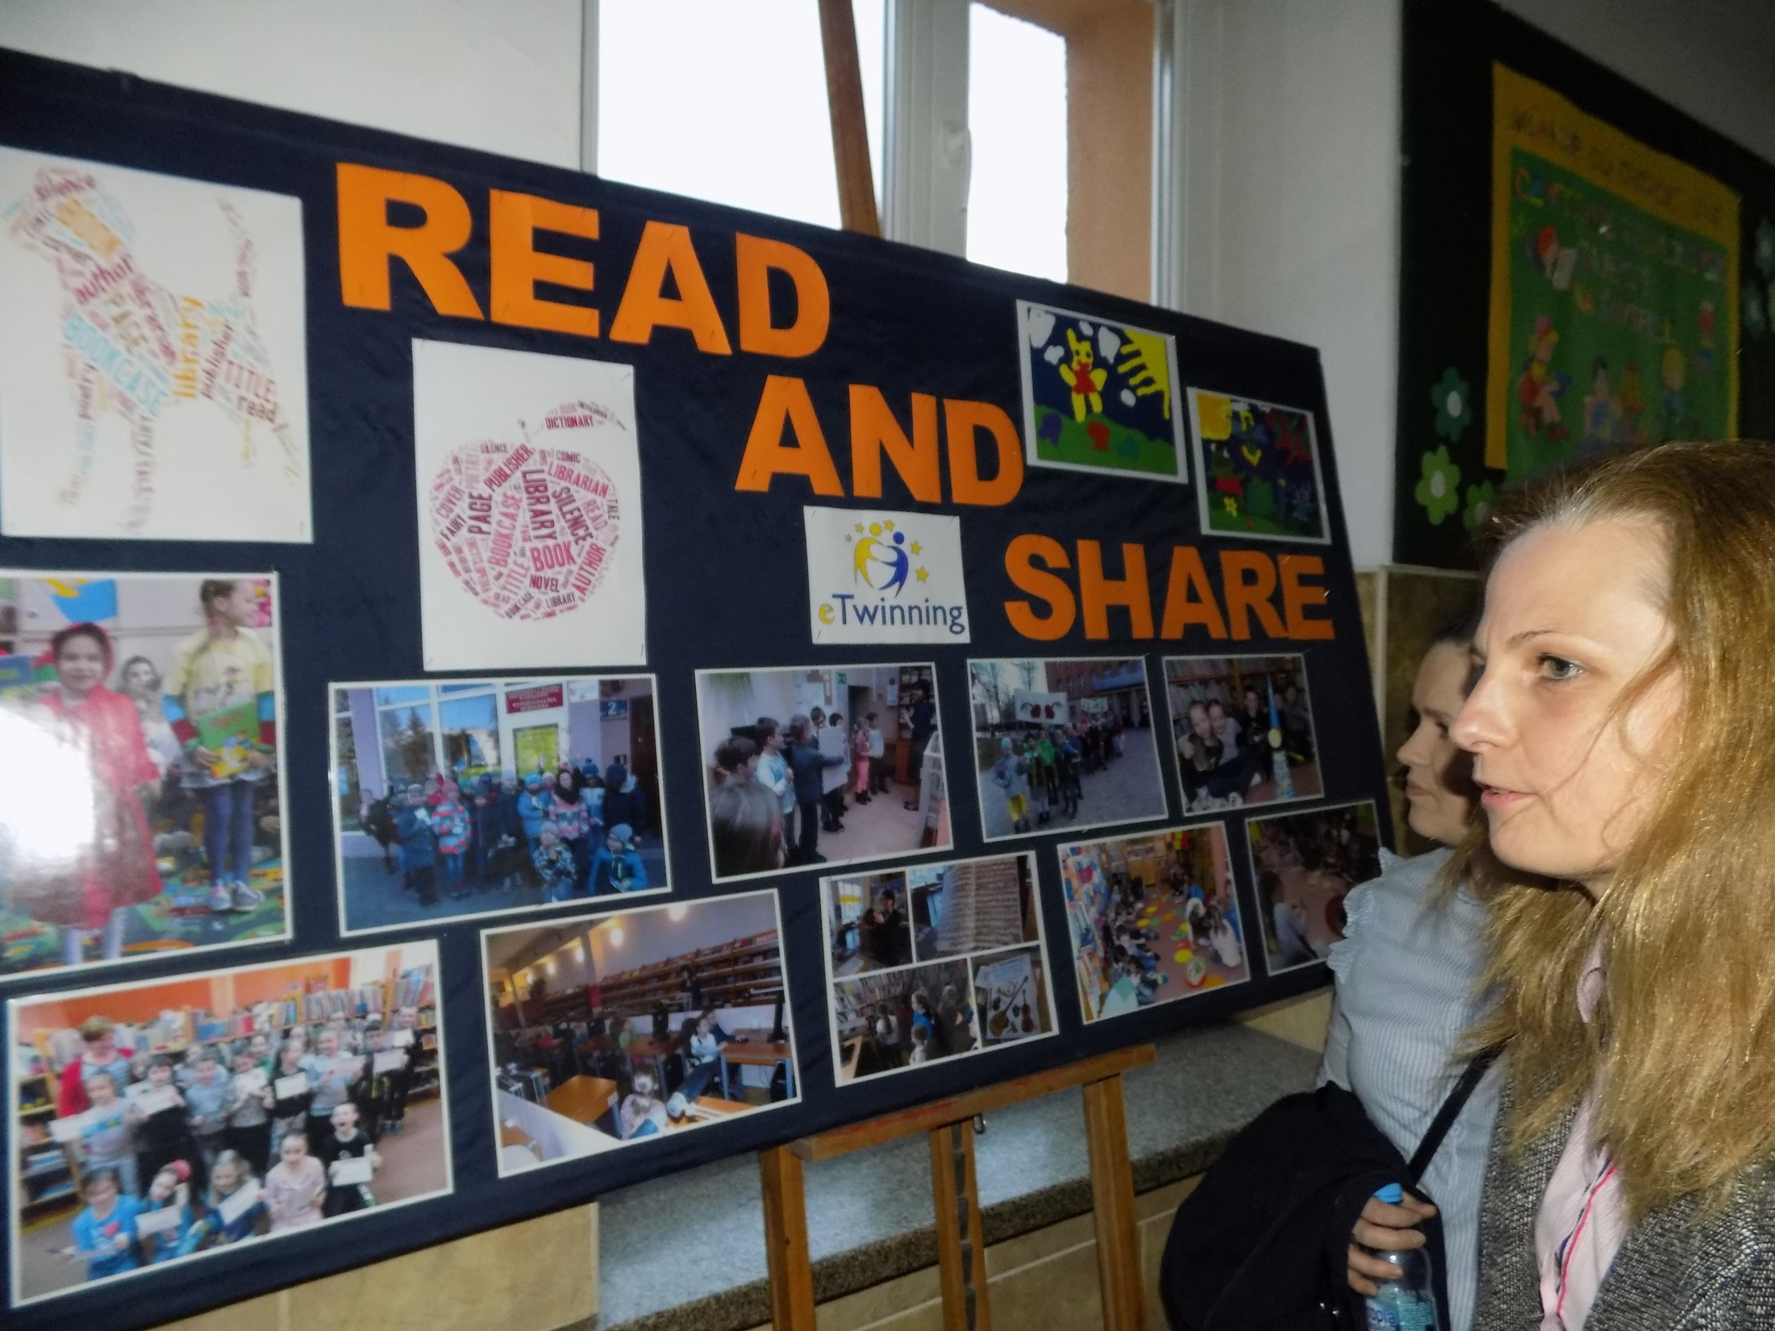

Slide 12
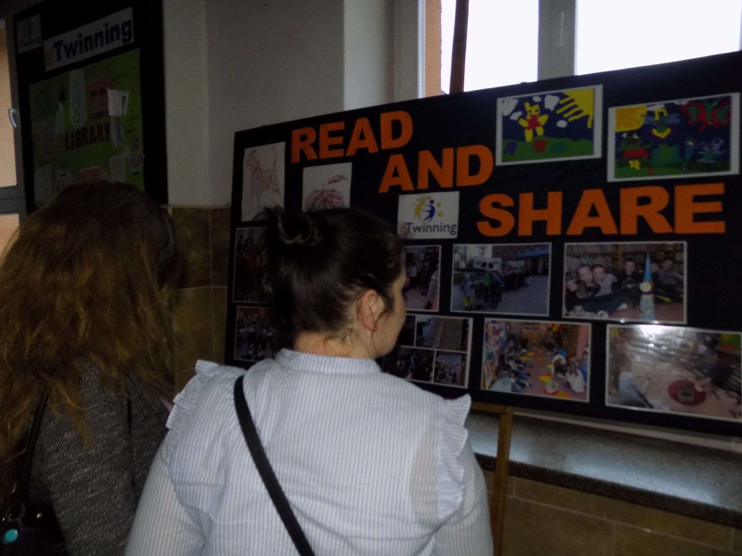

Slide 13
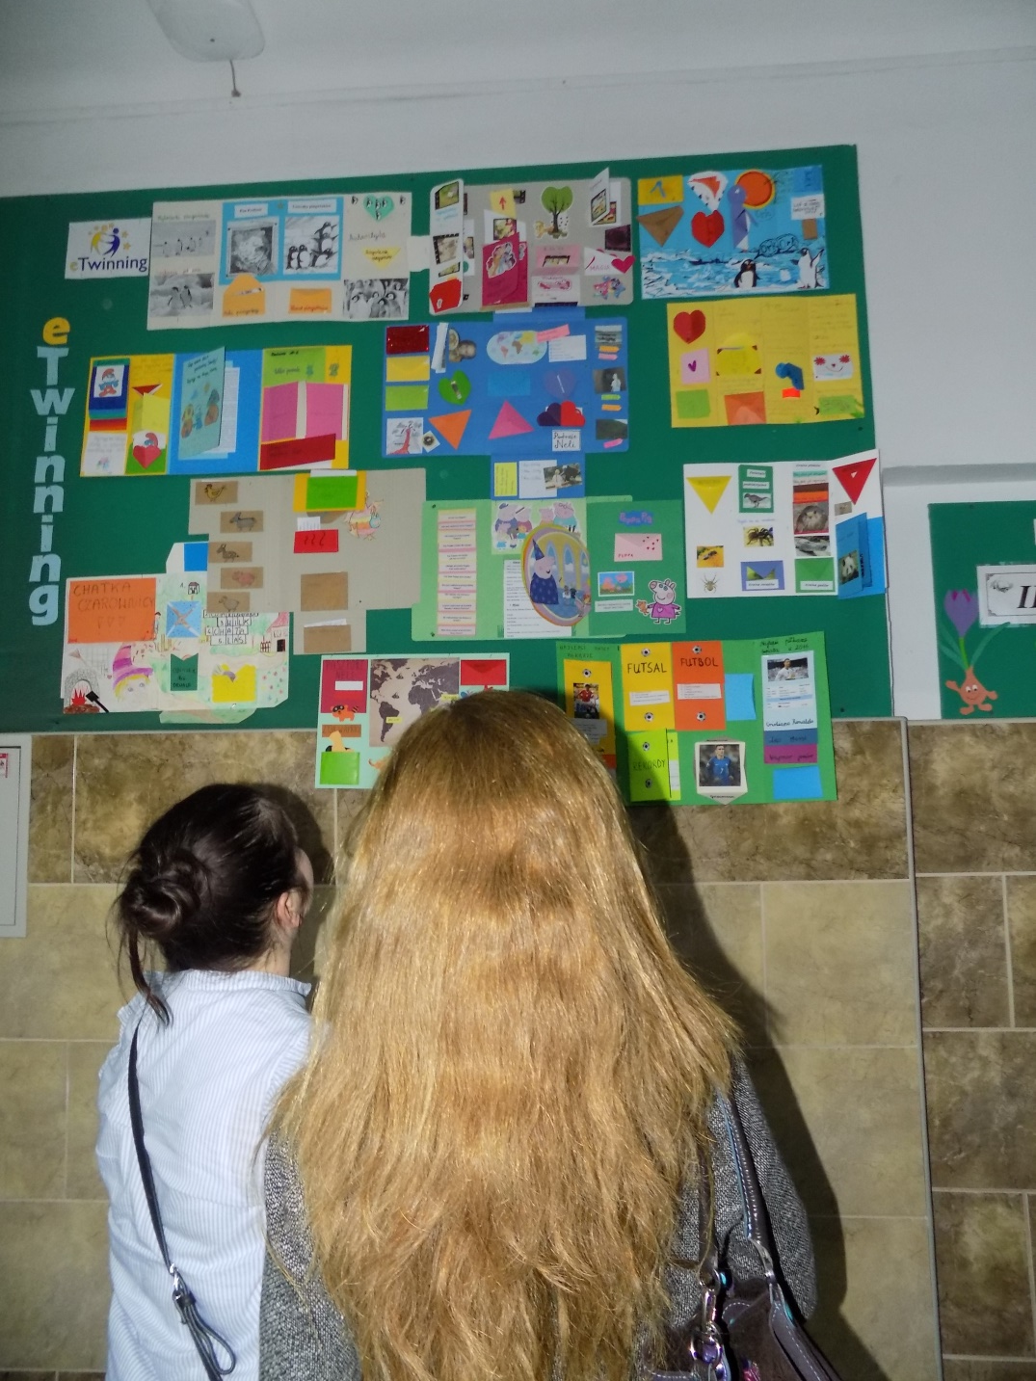

Slide 14
