Slide 1
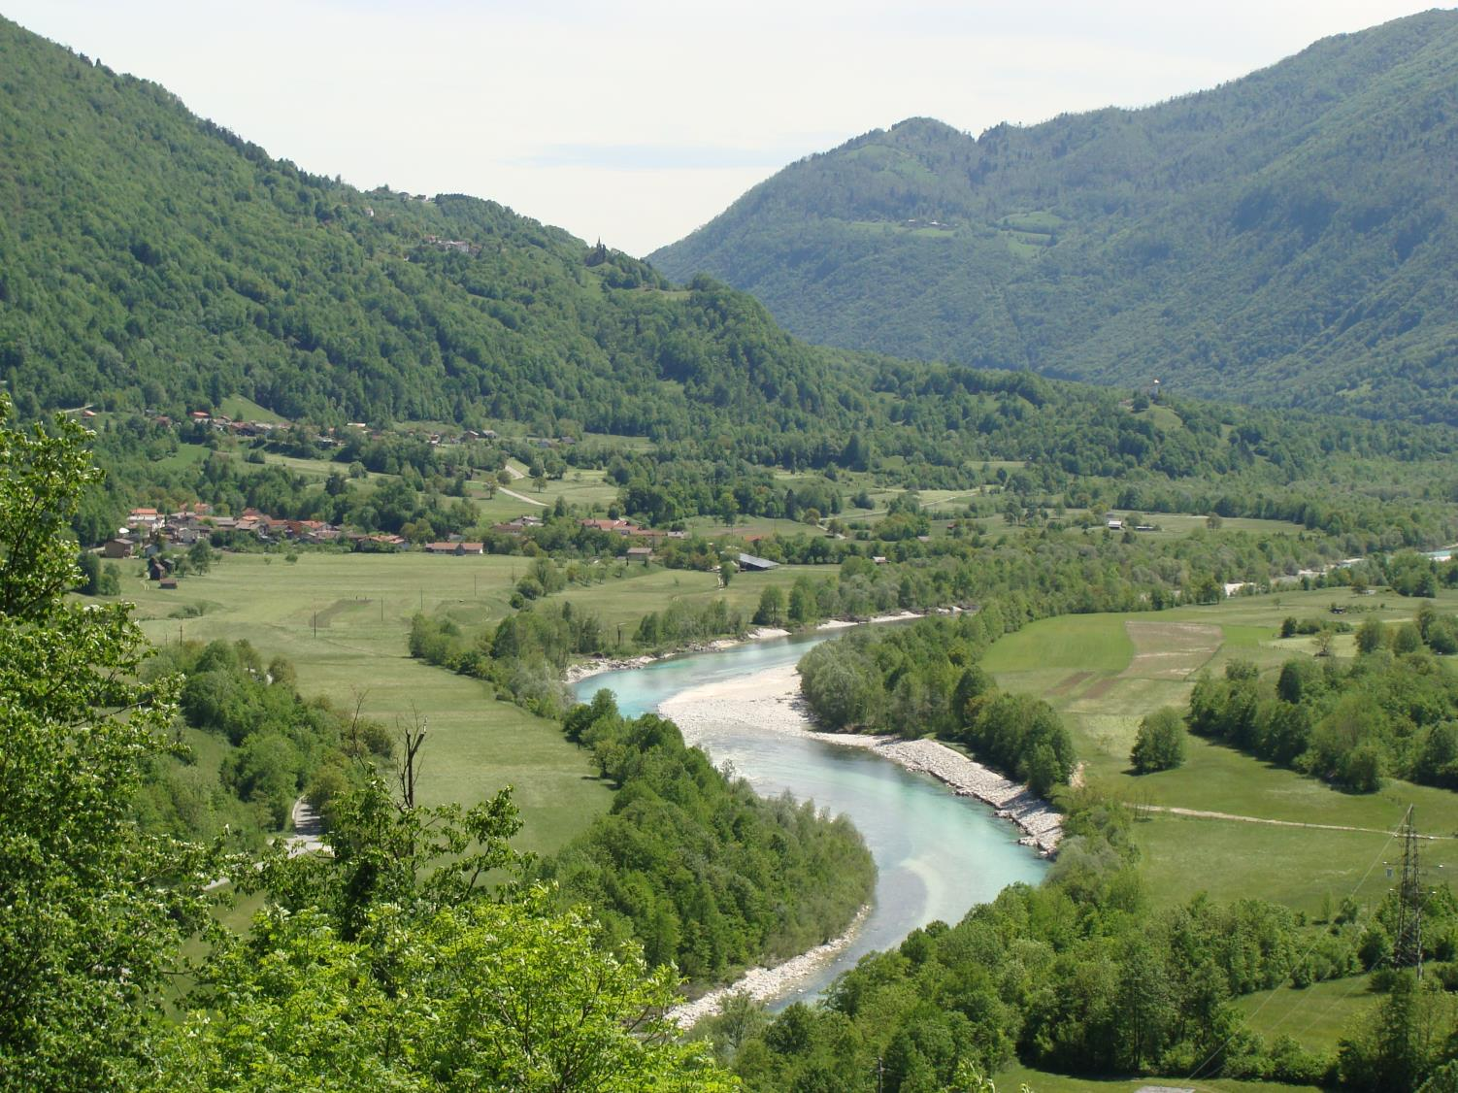
ISONZO FRONT
Cirila Kosmača Primary school
Piran, Slovenia

Slide 2
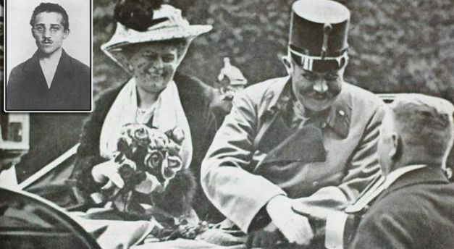
1914
Assassination of Archduke
Franz Ferdinand of Austria
Gavrilo
Princip

Slide 3
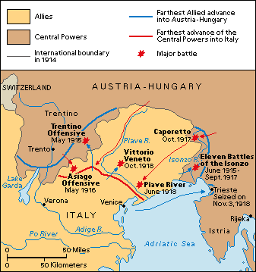
ISONZO FRONT
(1915-1917)

Slide 4
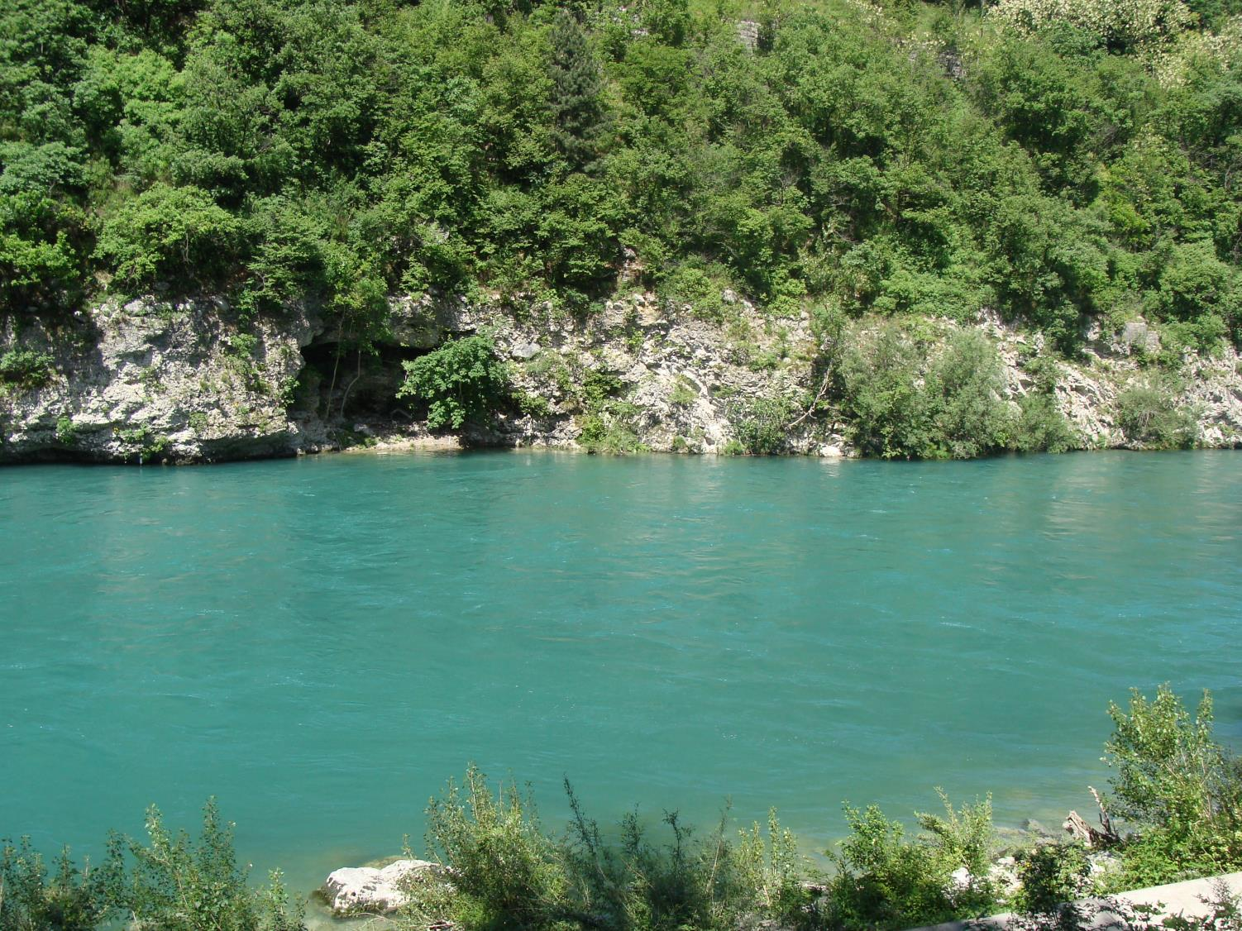
SOČA – ISONZO RIVER
The battles of the Isonzo were so-named because they
were fought along the Isonzo River (Soča).

Slide 5
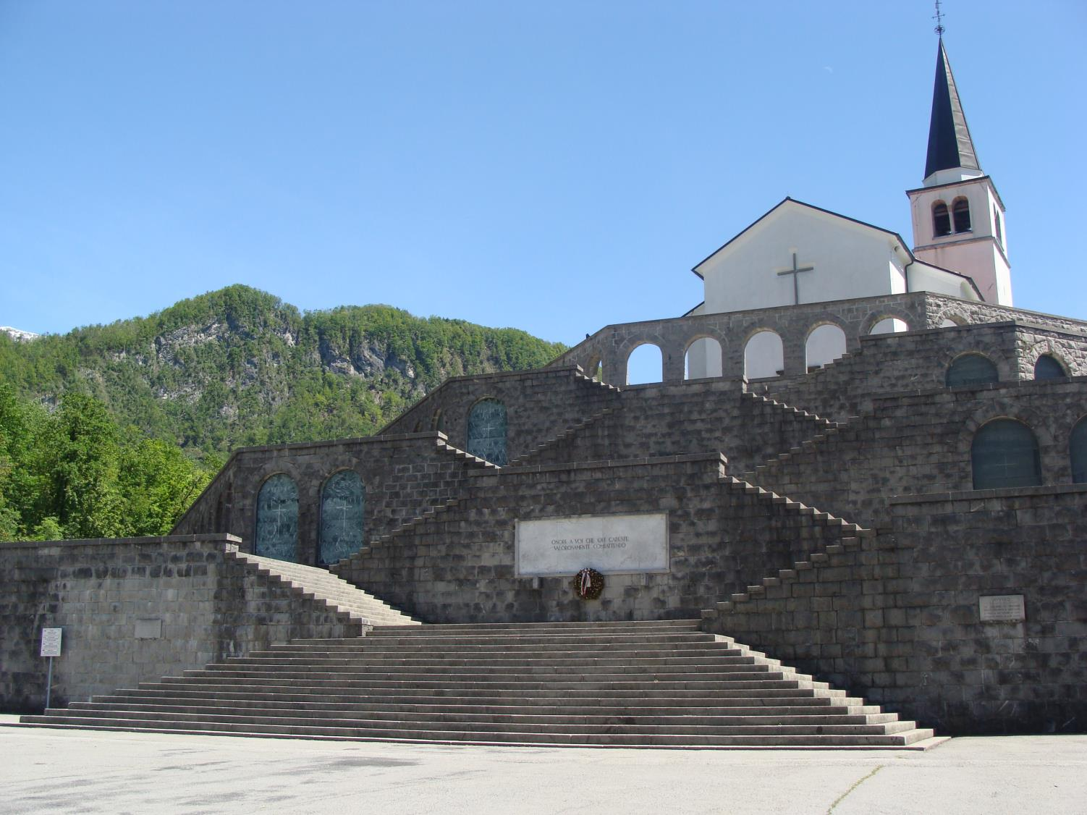
Italian Charnel House above Kobarid
(remains of 7014 soldiers)

Slide 6
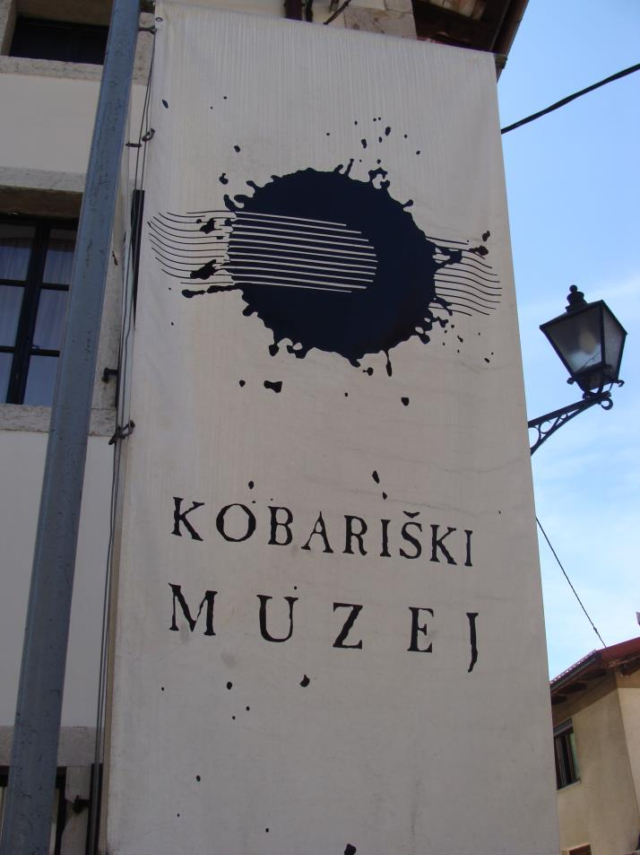
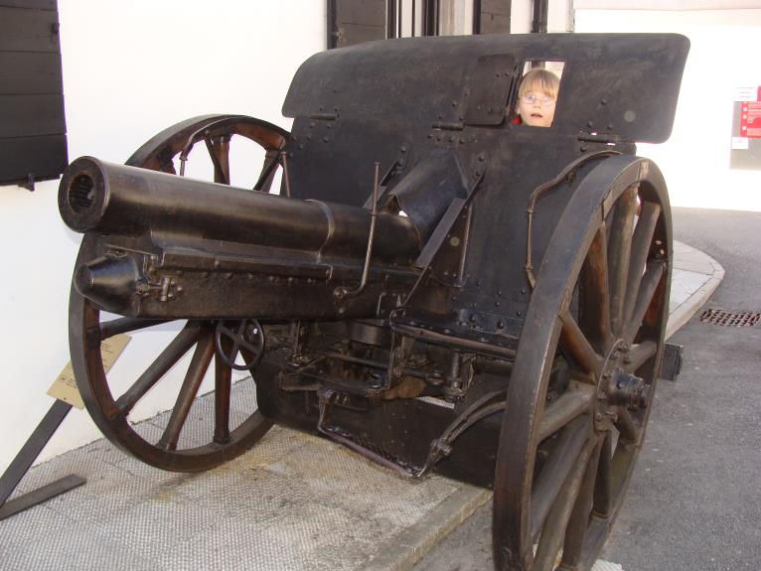
Kobarid
World War I museum

Slide 7
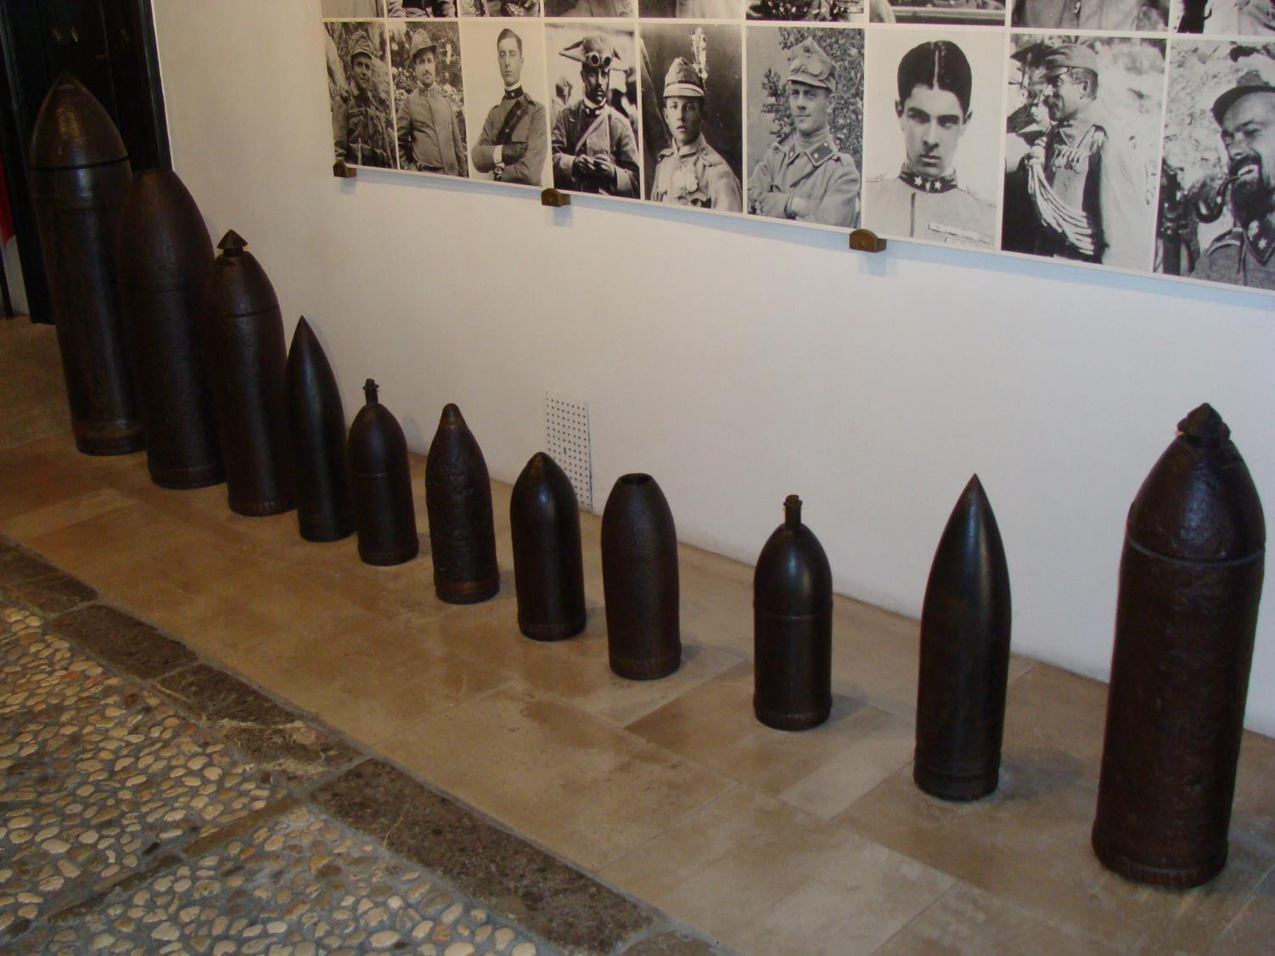
A collection of weapons from the Isonzo Front

Slide 8
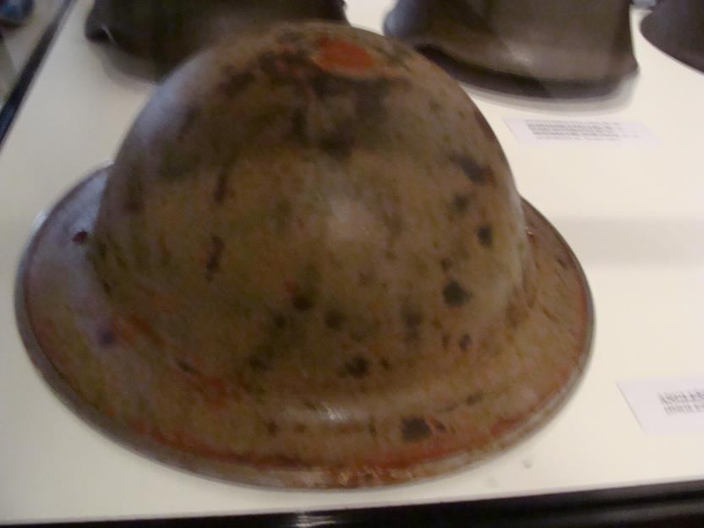
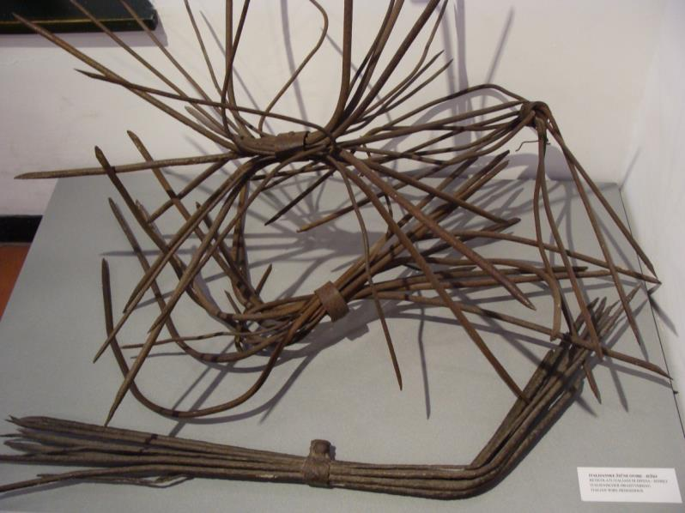
HELMETS and WIRE BARRIERS

Slide 9
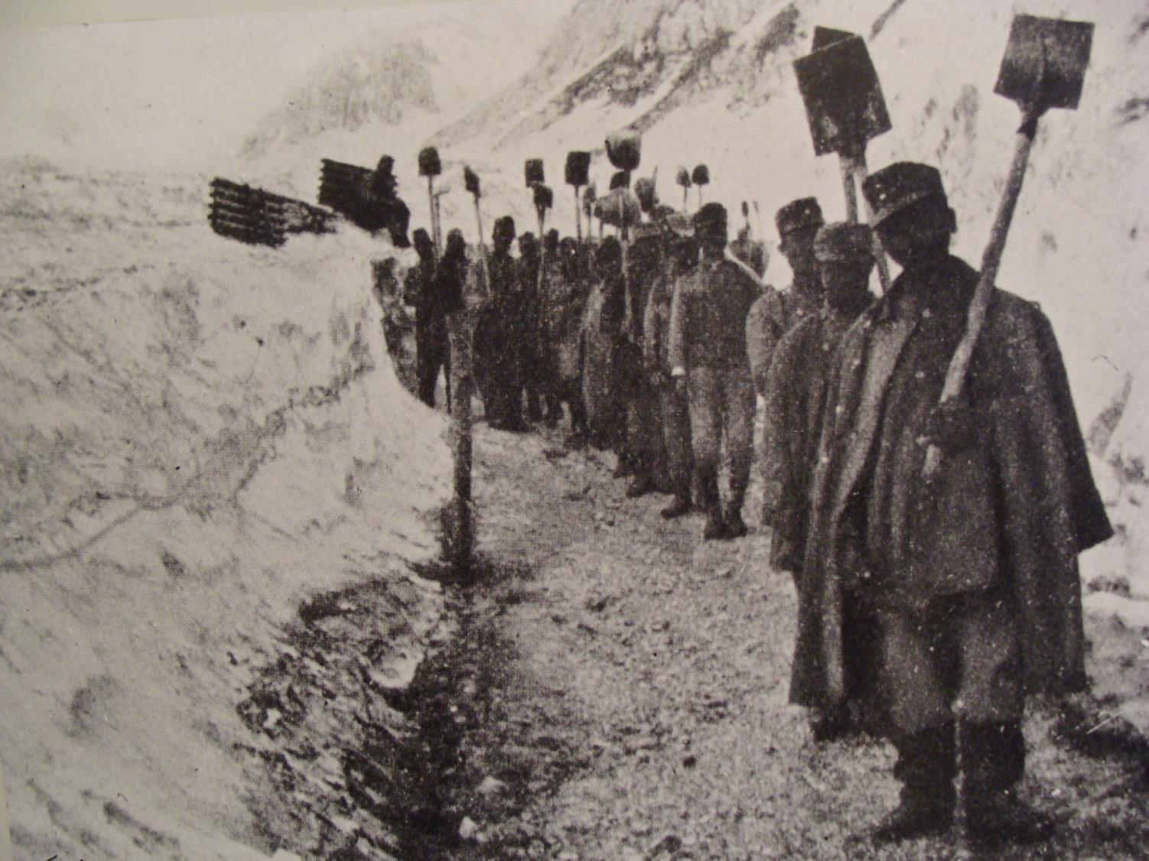
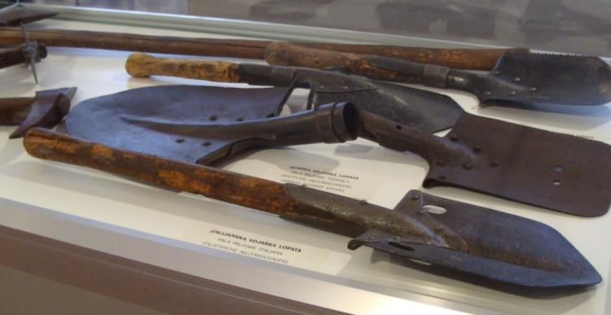
Shovels for
digging trenches

Slide 10
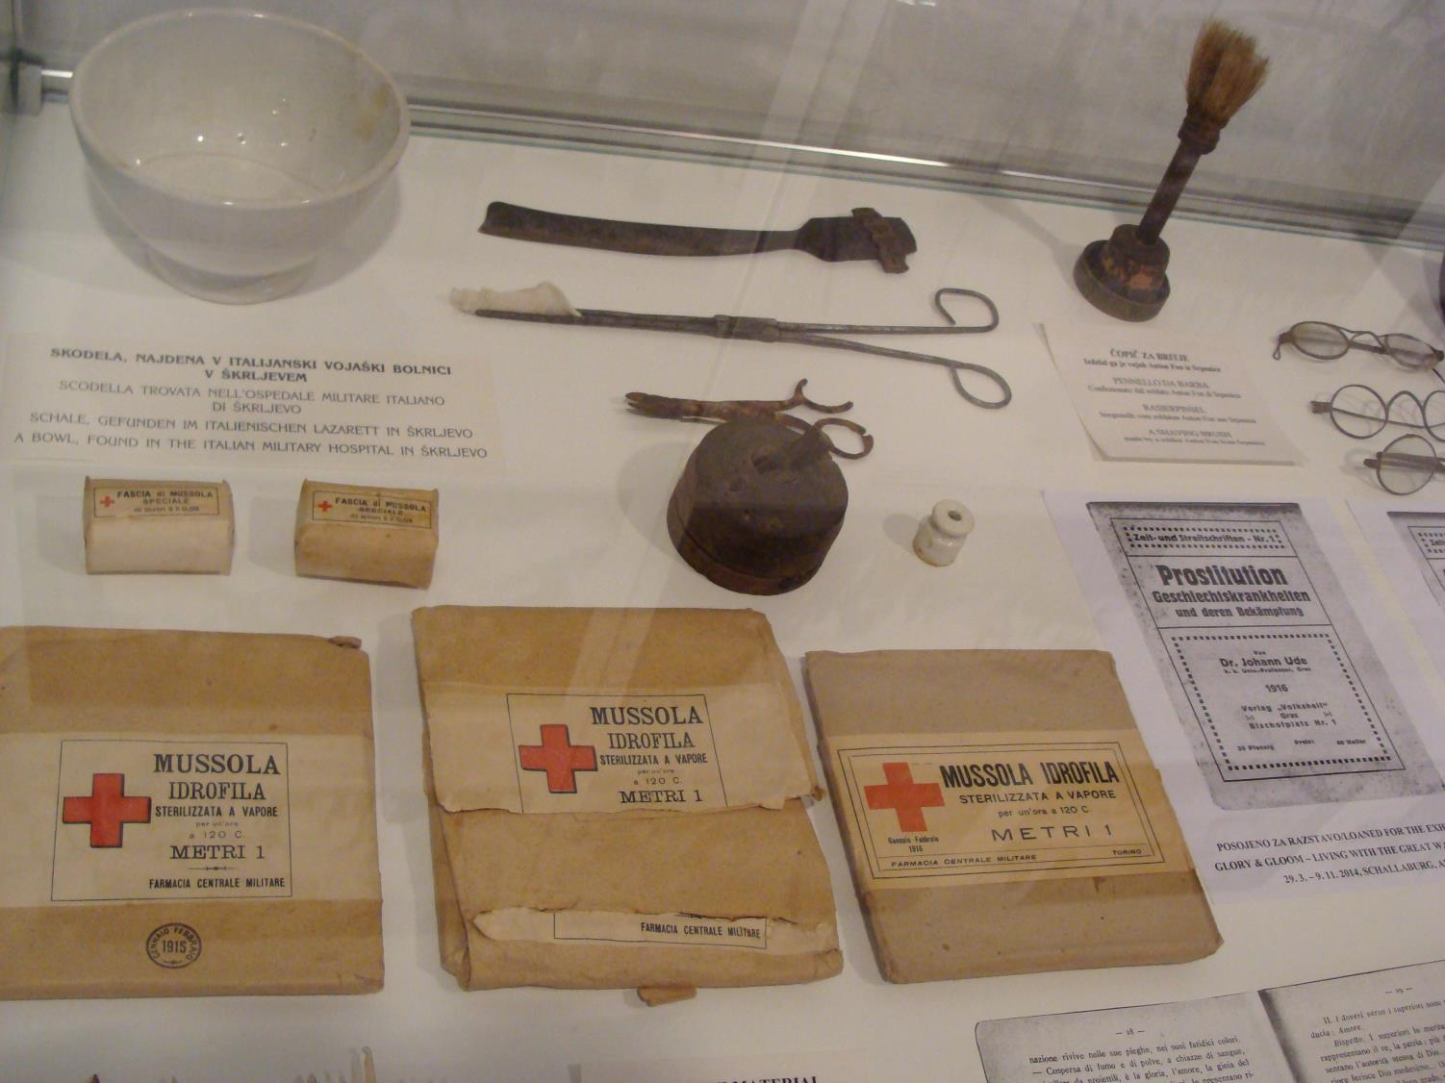
Medical supplies

Slide 11
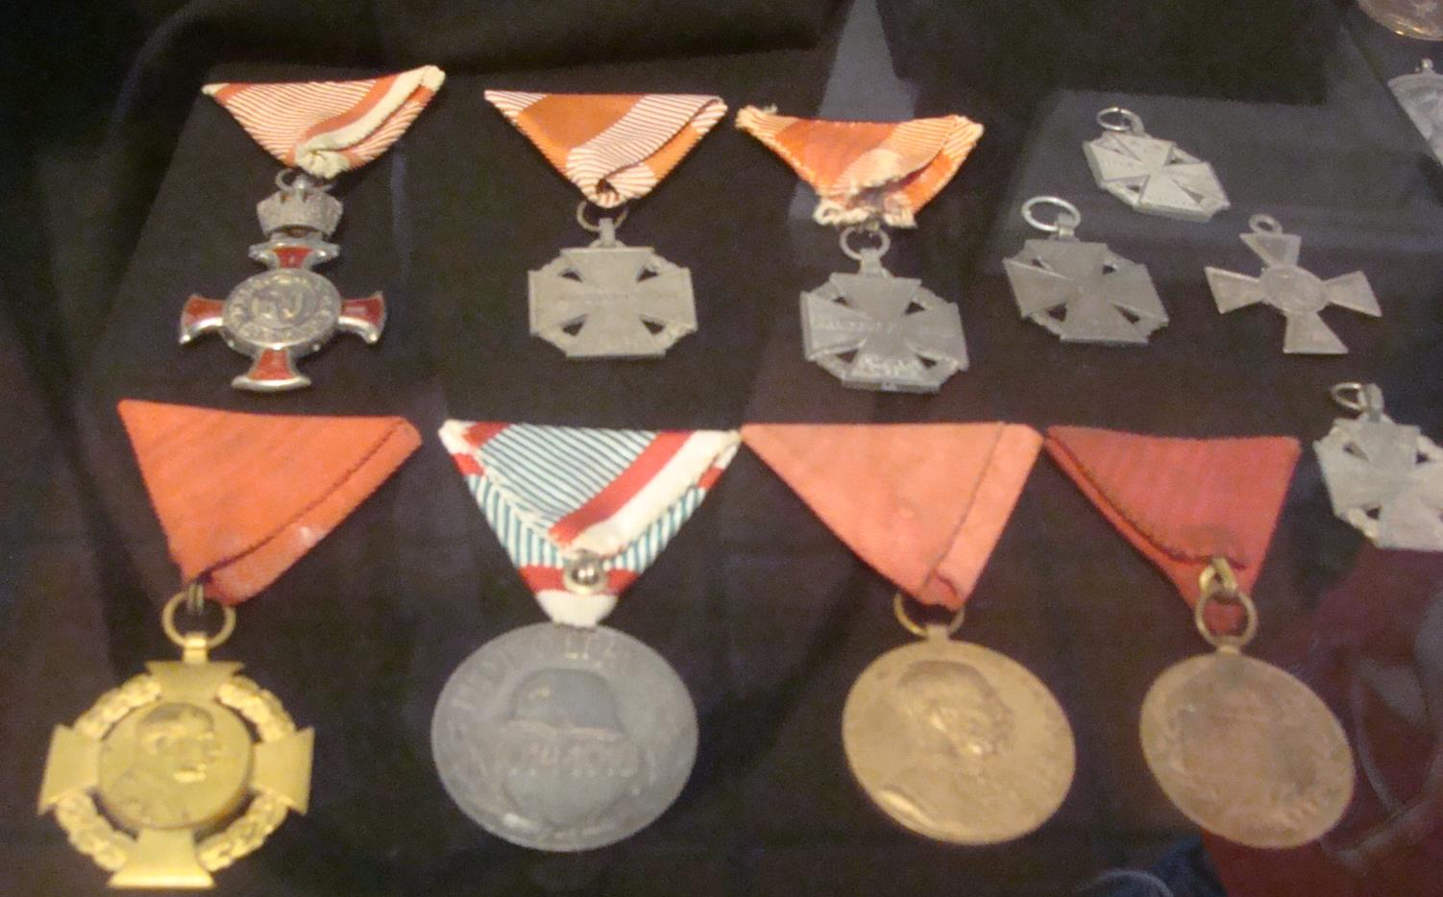
Medals from World War 1

Slide 12
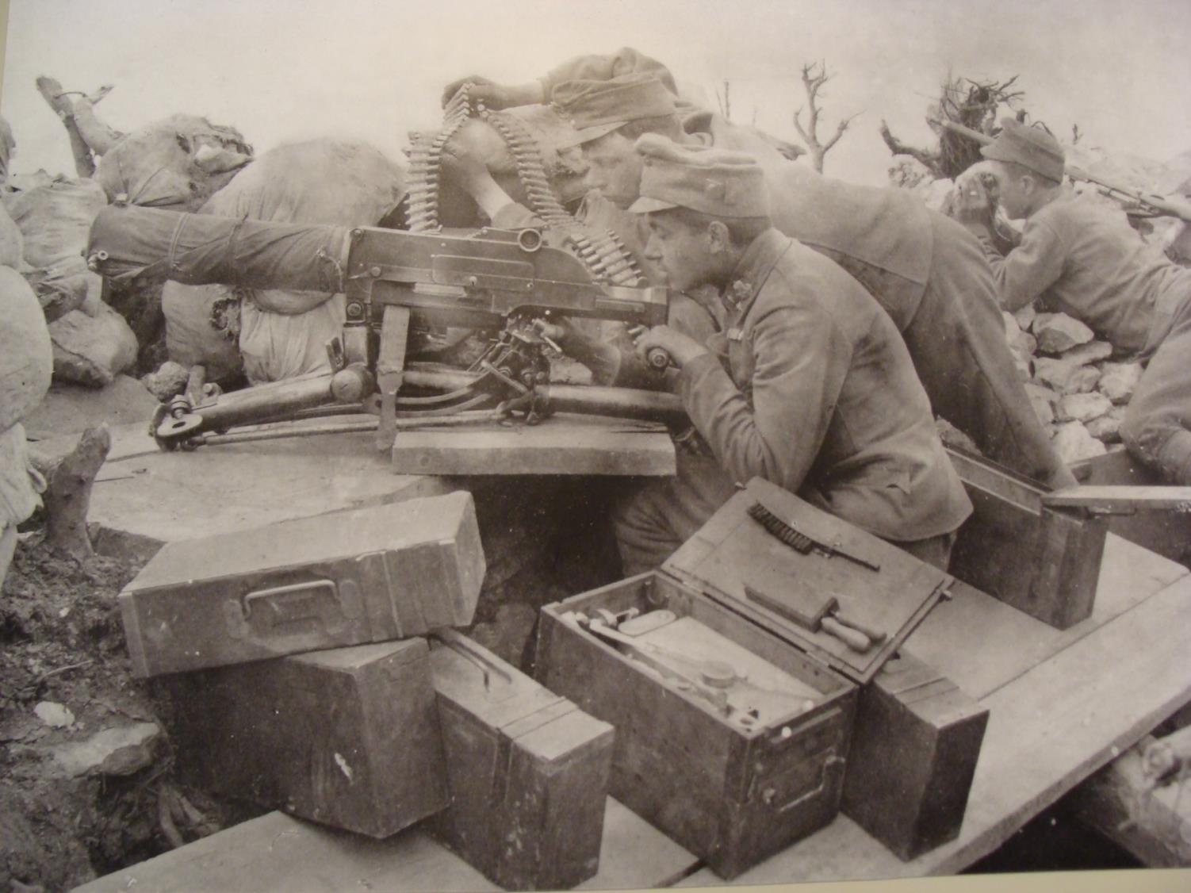
historical photos

Slide 13
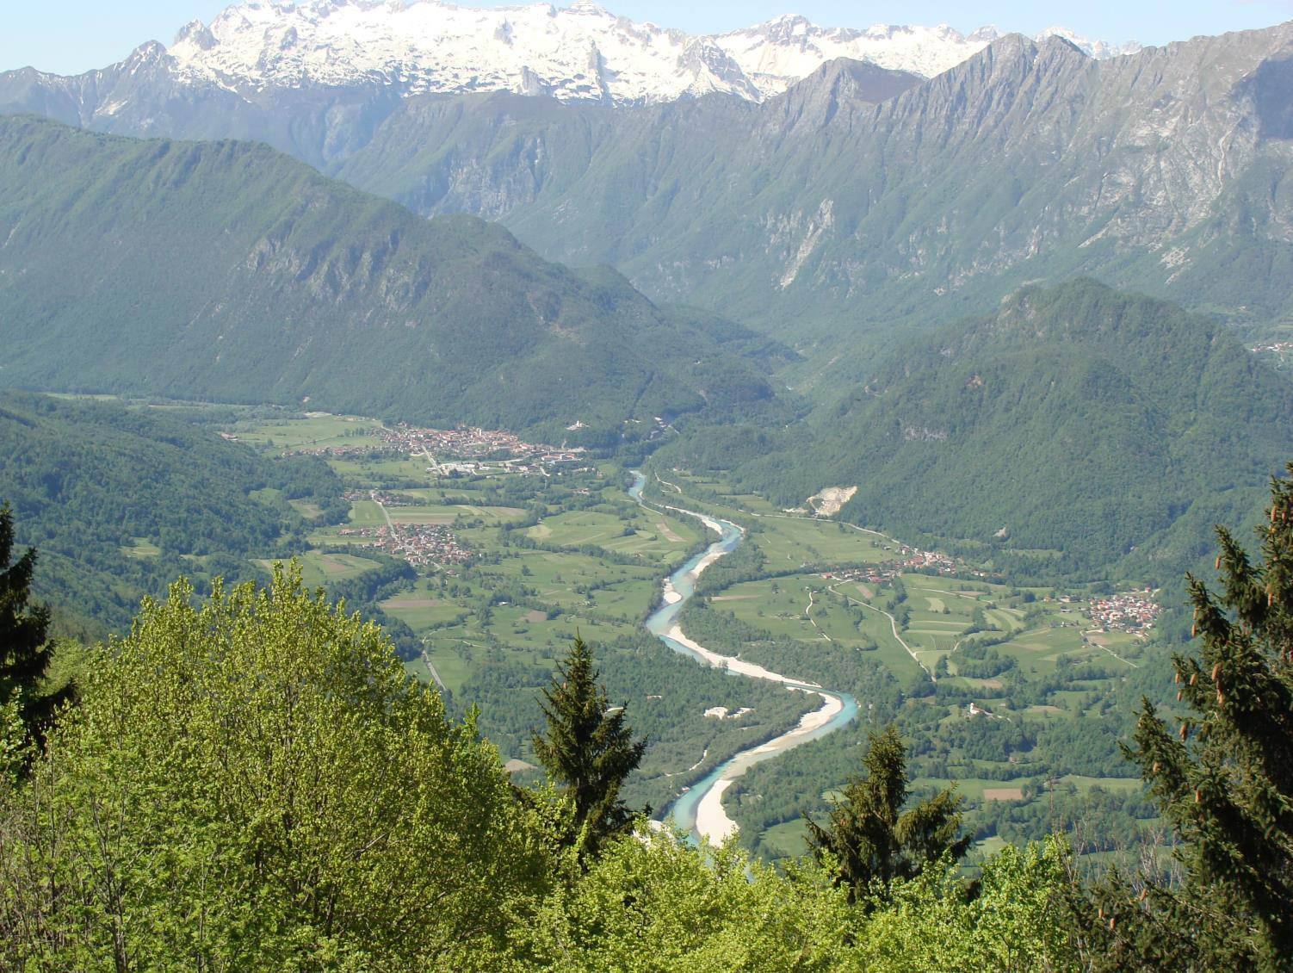
View from the Kolovrat hill
(The First World War Outdoor Museum)

Slide 14
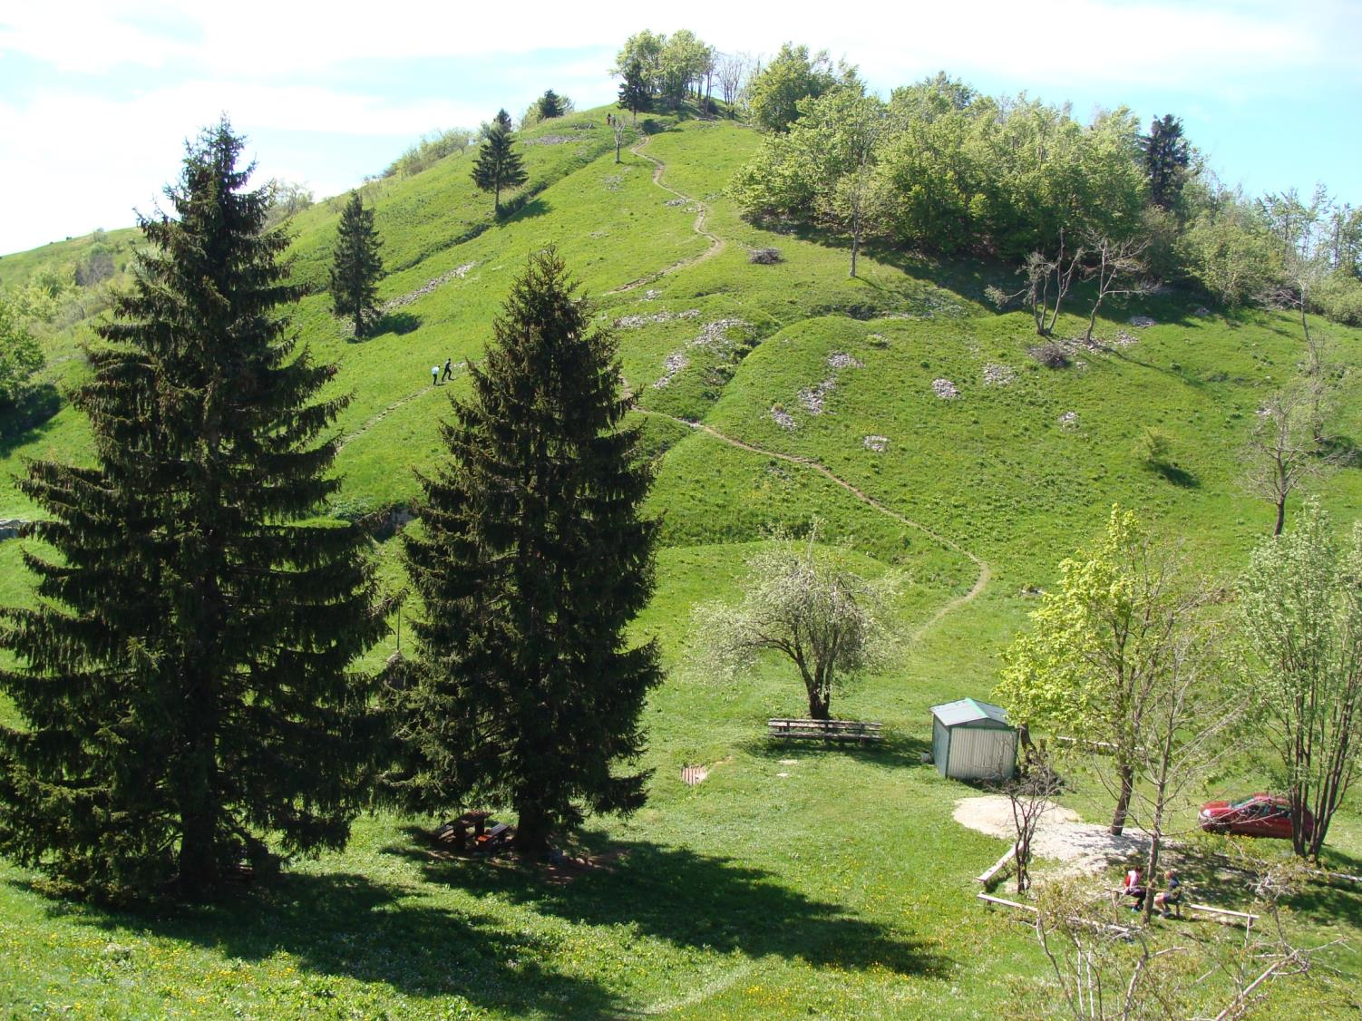
The trenches are still visible

Slide 15
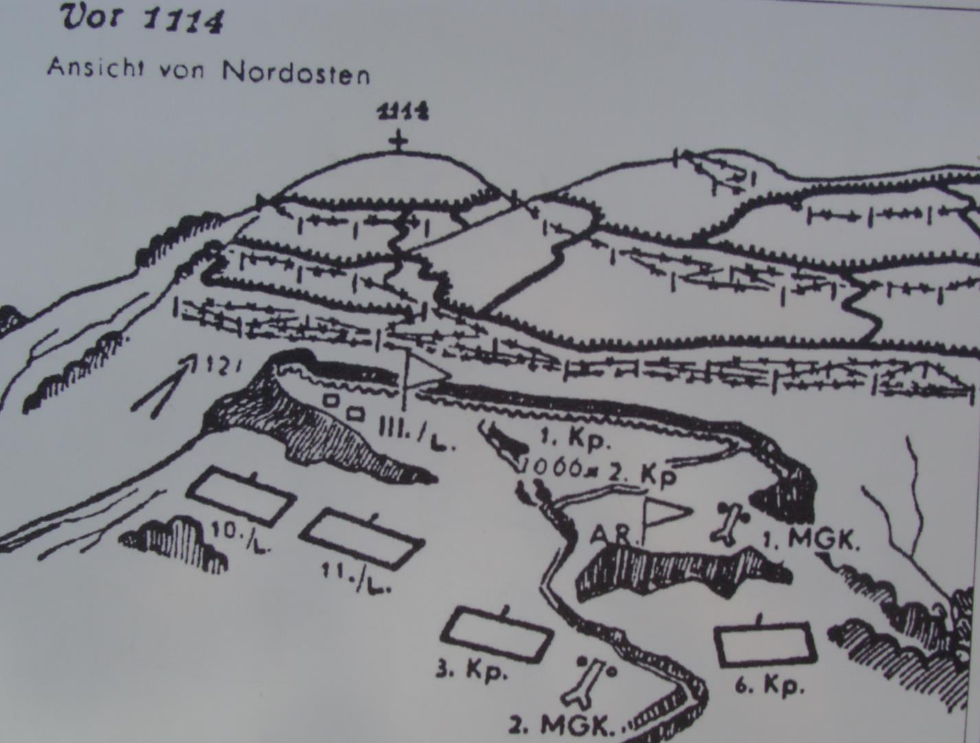
The Military map

Slide 16
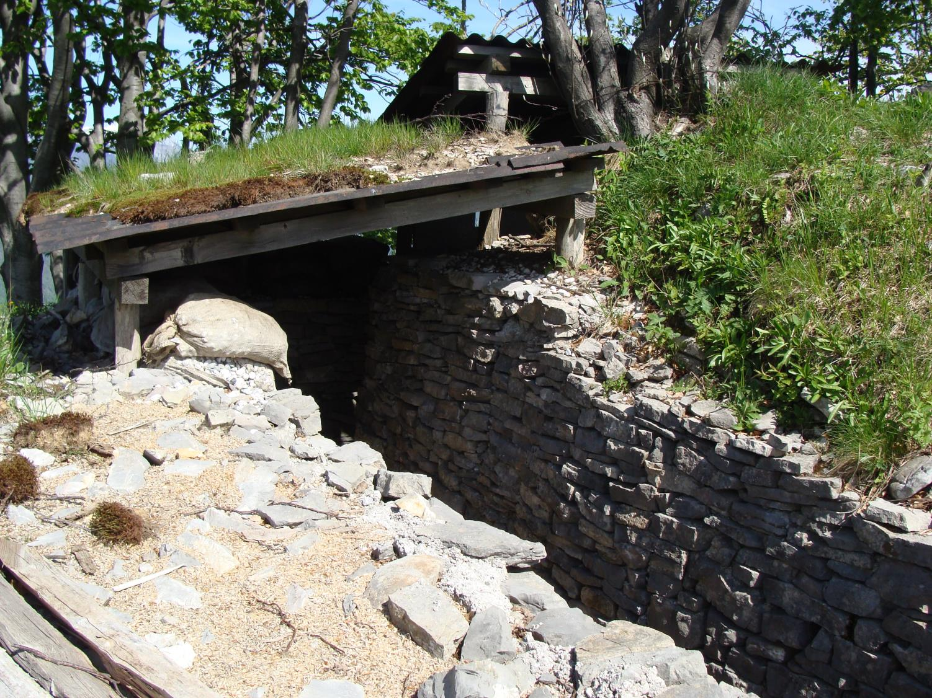
The Military trenches

Slide 17
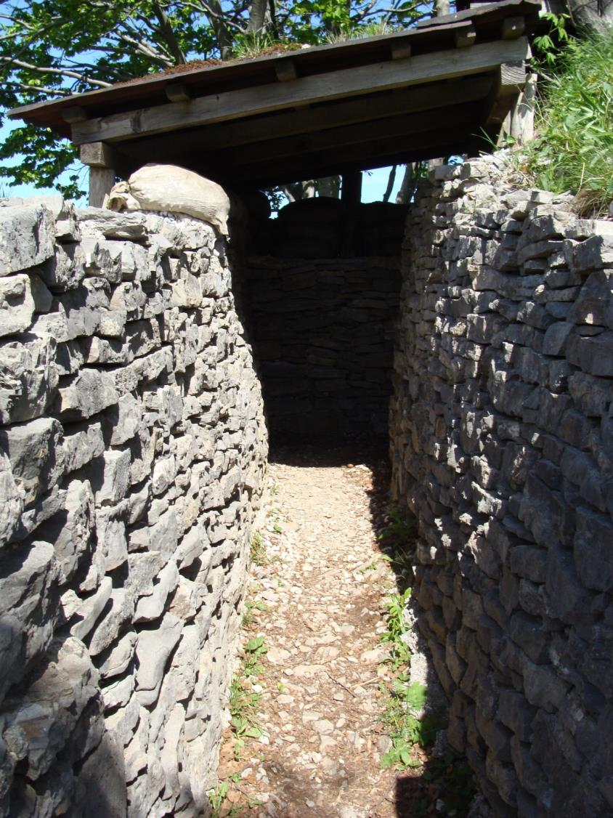
The military trenches were very narrow

Slide 18
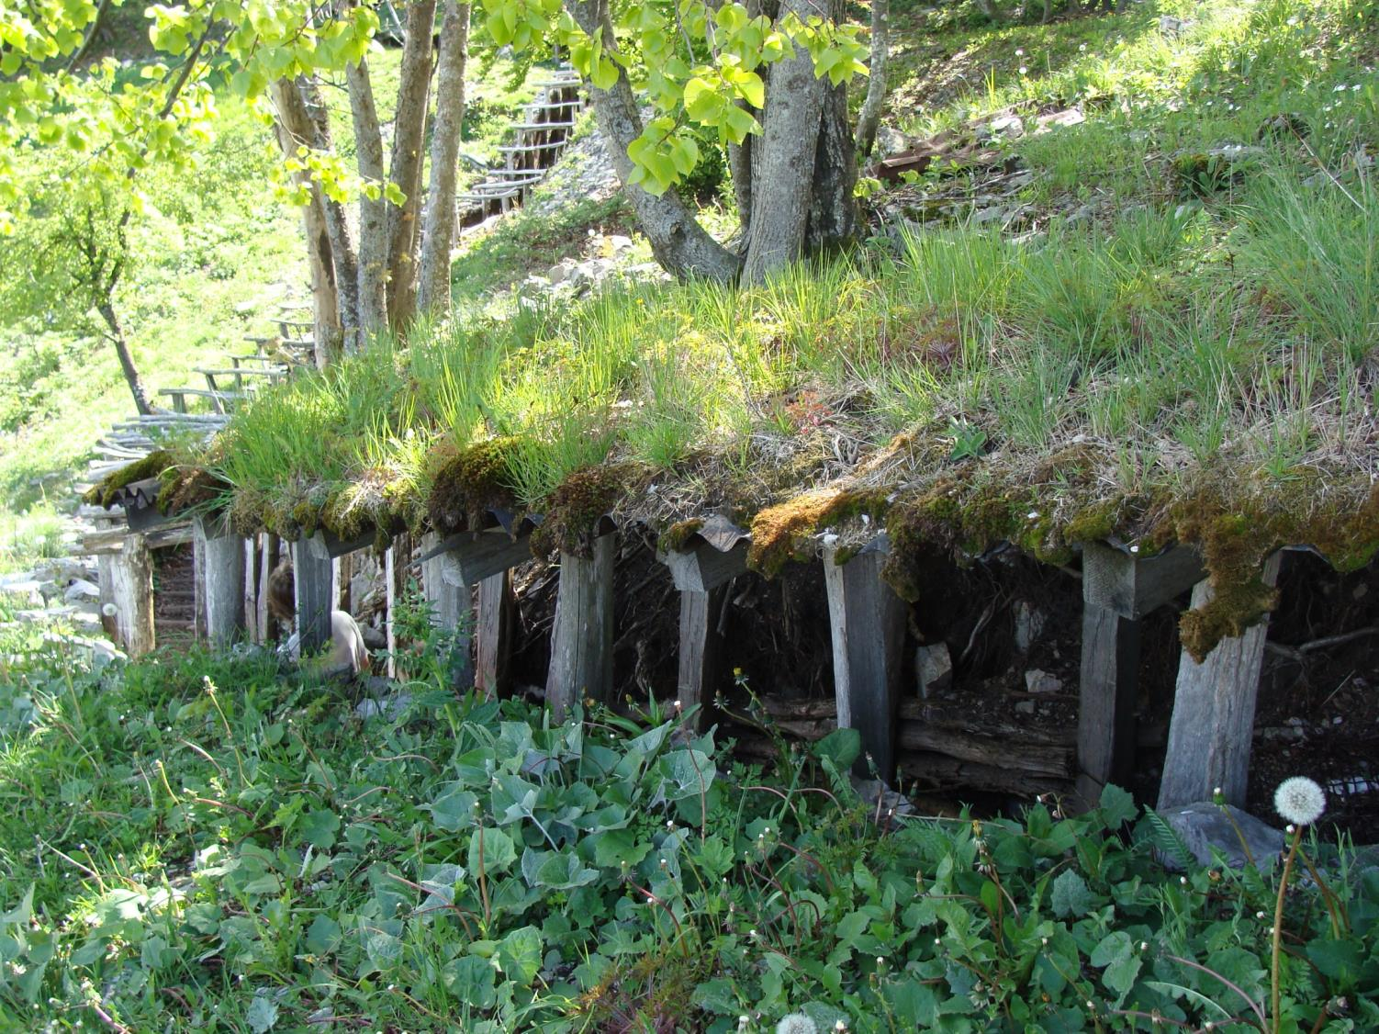
Some trenches
were covered

Slide 19
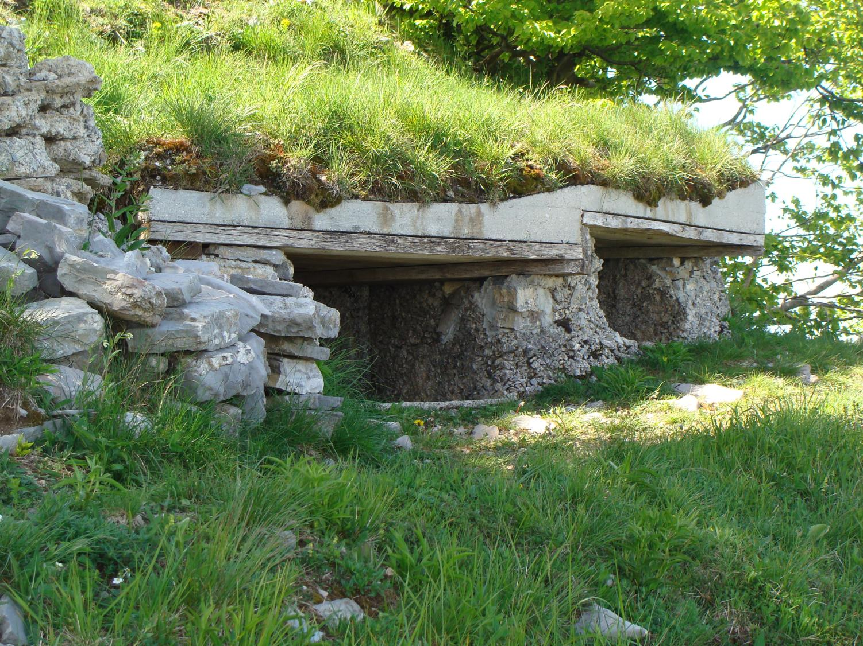

Slide 20
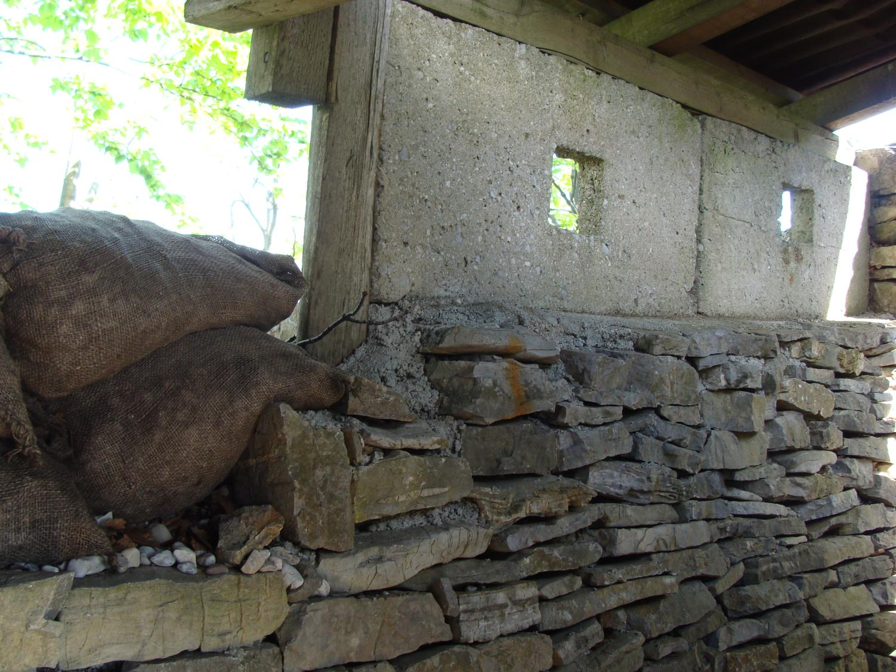

Slide 21
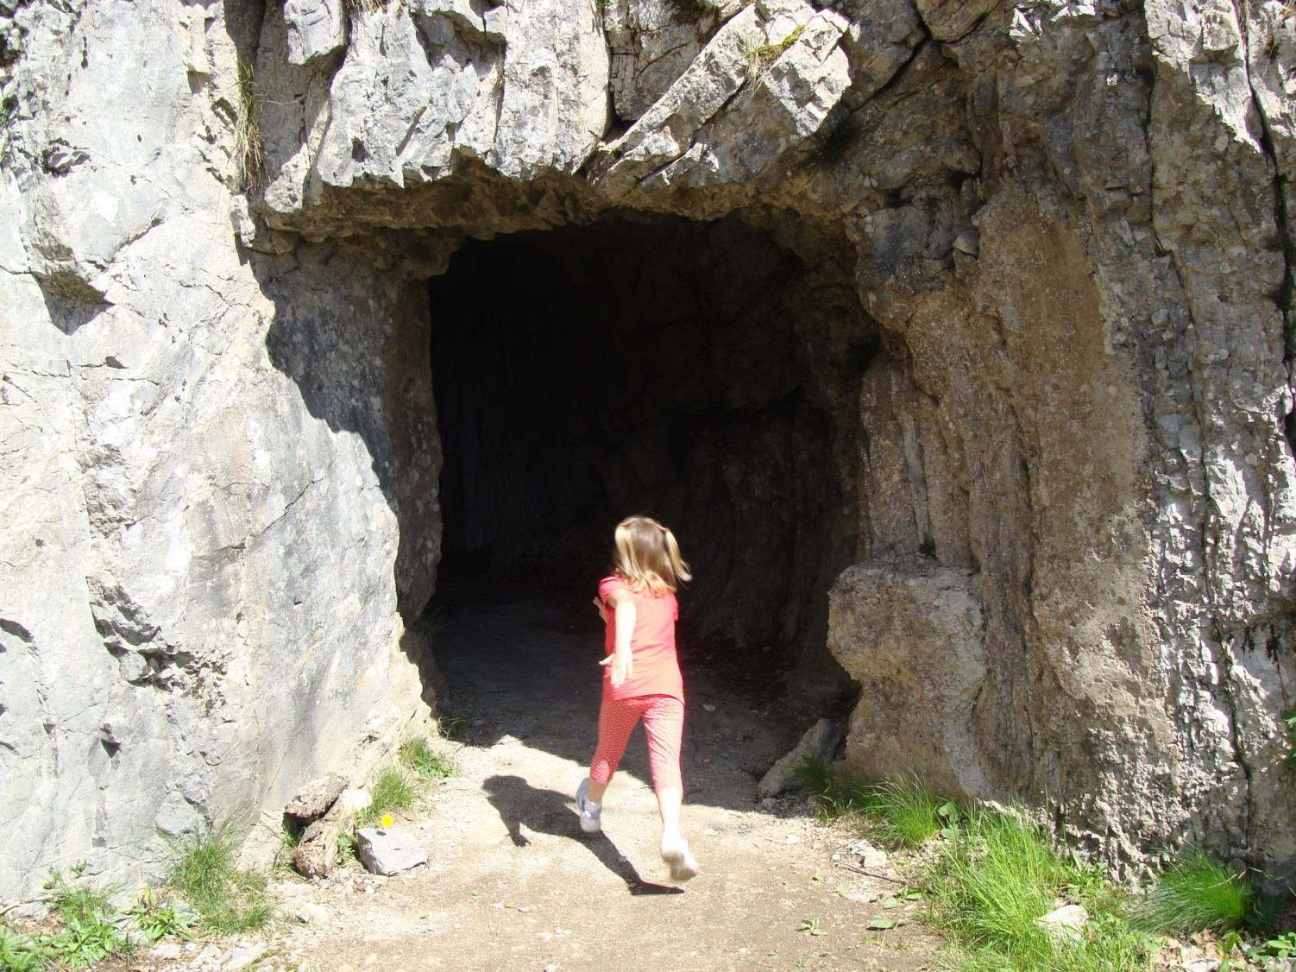
It was very dark but safe in the caverns.

Slide 22
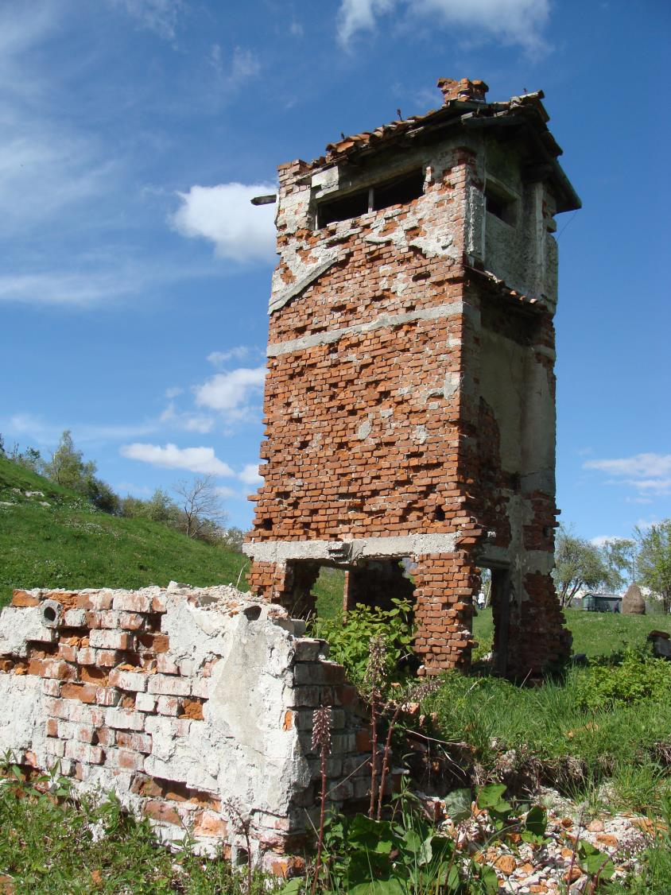
Scrap of military sites

Slide 23
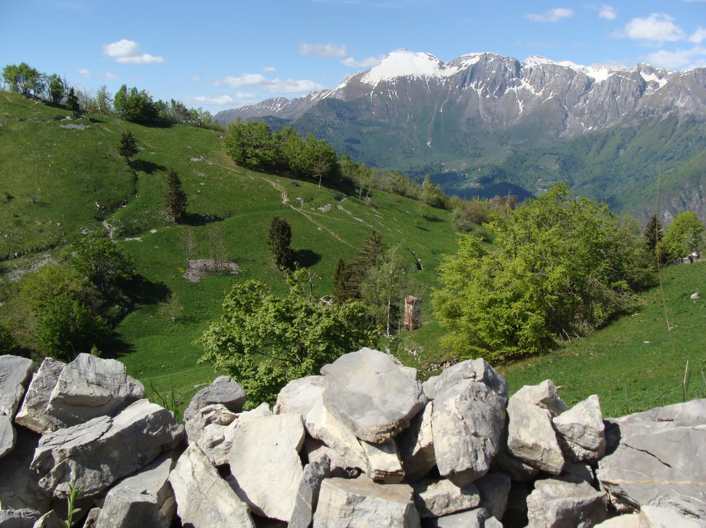
The outdoor museum
on the hill Kolovrat is now part of
„Walk of peace“.

Slide 24
Sources: - http://www.radiosarajevo.ba/novost/117154 - http://history.howstuffworks.com/world-war-i/world-war-i-in-19152.htm - Kobarid World War I museum - Outdoor museum on the hill Kolovrat

