Slide 1
YoungAction for YouropeVision
POLAND
2019-2020
GREECE
ITALY
LITHUANIA
FRANCE
GERMANY
TURKEY

Slide 2
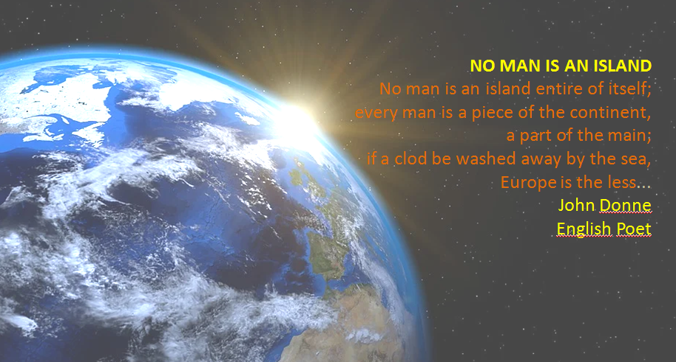
Starting with a poem…

Slide 3
You are the leaders of today and tomorrow.
For our common future,for a sustainable Europe,
ENGAGE
CONNECT
EMPOWER yourself

Slide 4
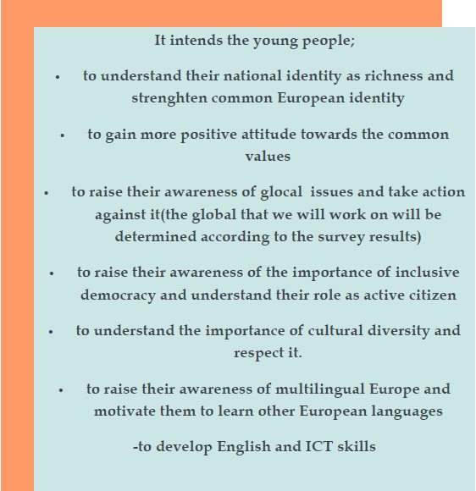
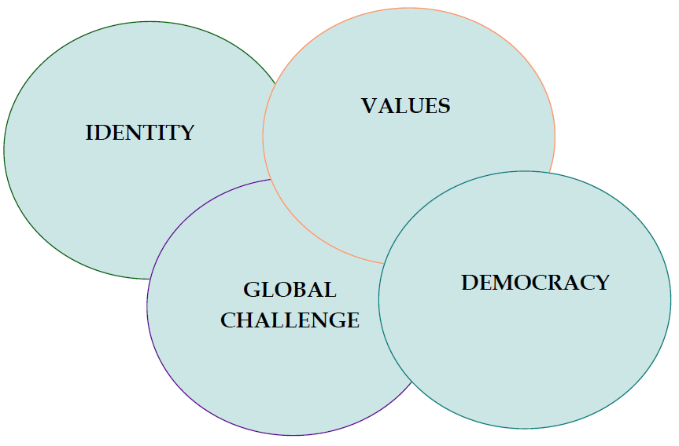
What is it about?
What are the project aims?

Slide 5
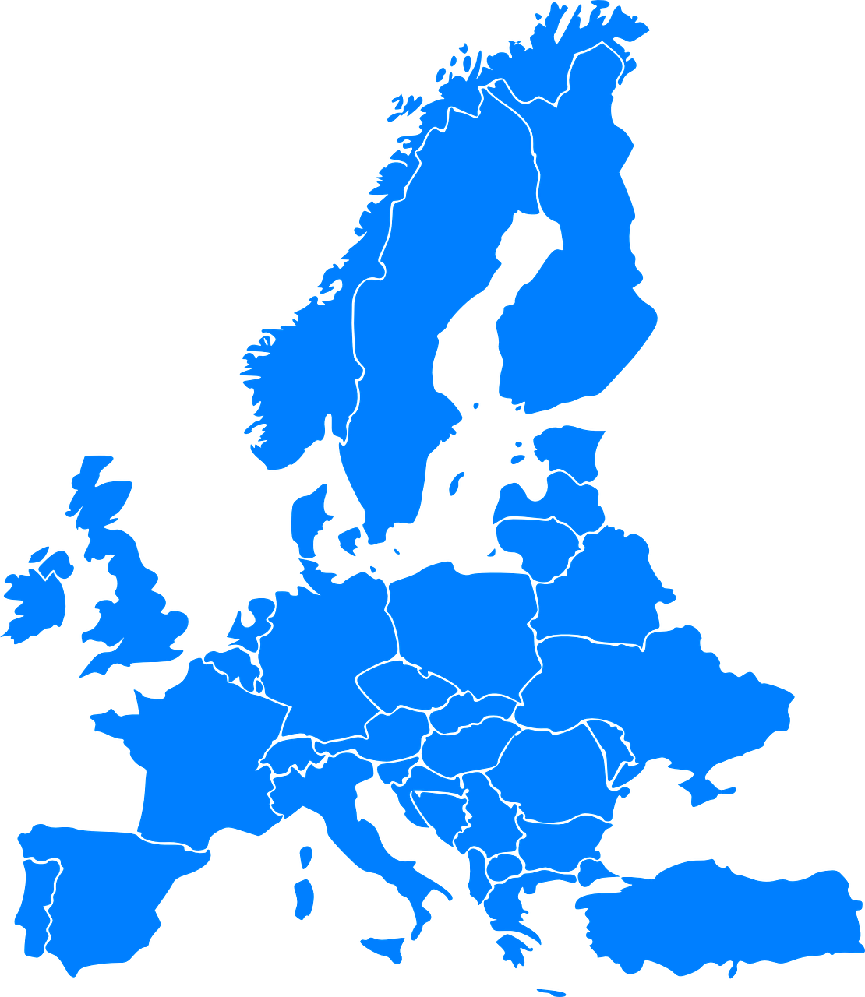
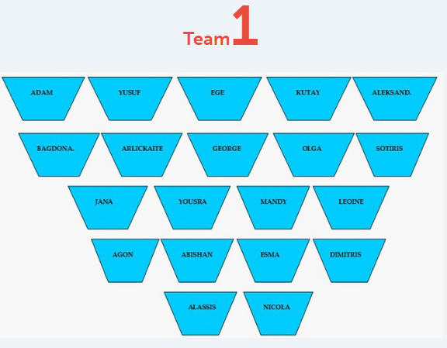
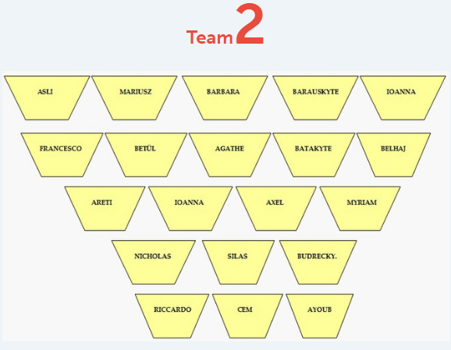
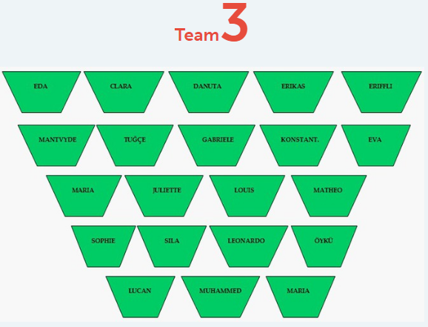
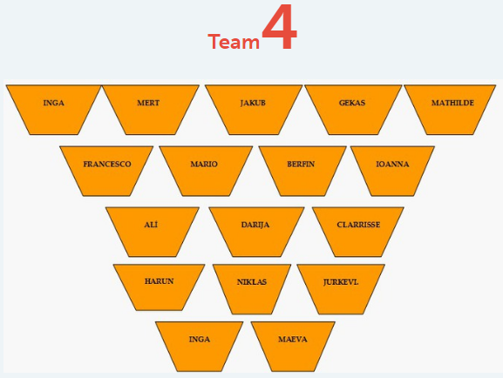
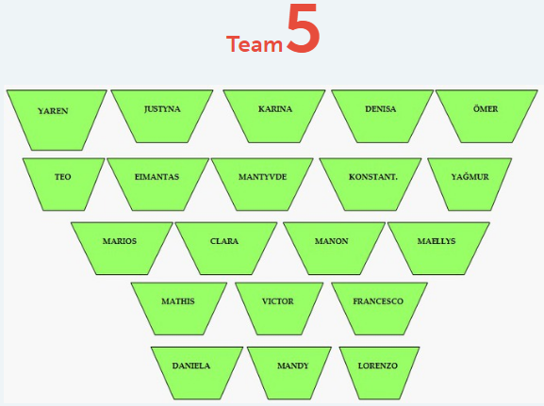
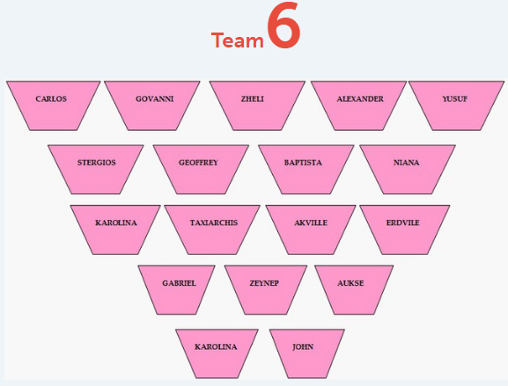
EUROPEAN TEAMS
10

Slide 6
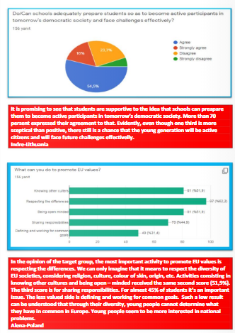
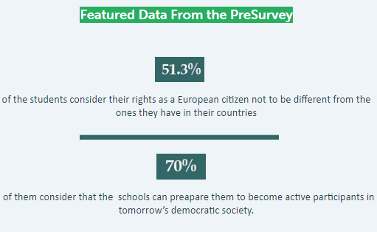
Presurvey
Identitiy
Active Citizenship
Values
Multilingualism
Democratic
Participation
Digitialization

Slide 7
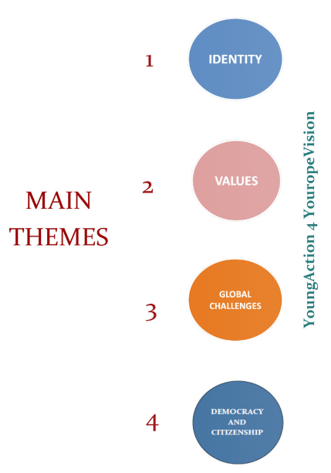

Slide 8
IDENTITY
2nd
Main Activity
On National Identity
On European Identity

Slide 9
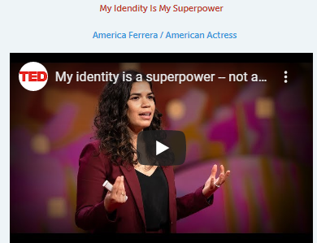
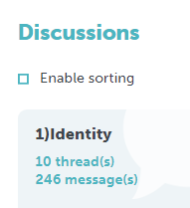
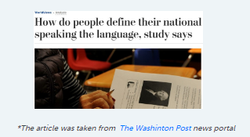
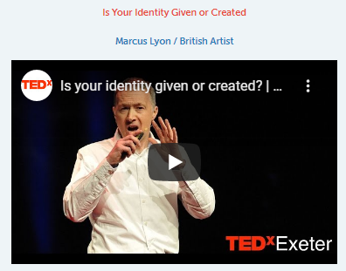
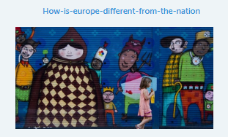
Warm Up
We suggest the students some related videos and articles about the theme

Slide 10
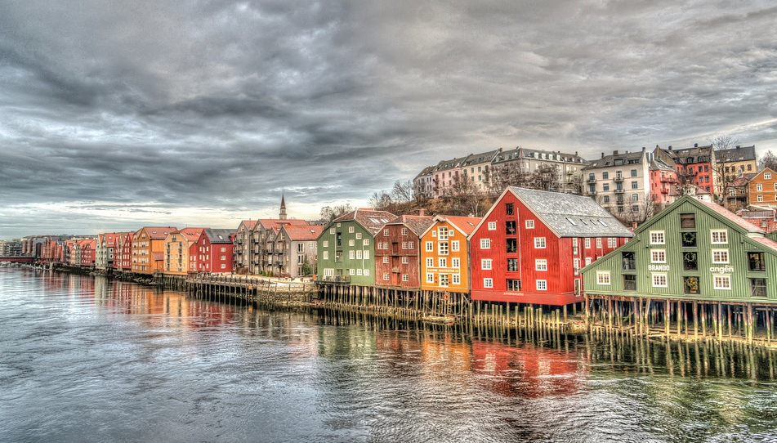
On
Different Aspects
of
National Identity
Historical Identity
Linguistic Identity
Geographical Identity
Traditional Identity
Cultural Identity
Social Identity
Clothing Identity
Consuming Identity
Musical Identity
Digital Identity

Slide 11
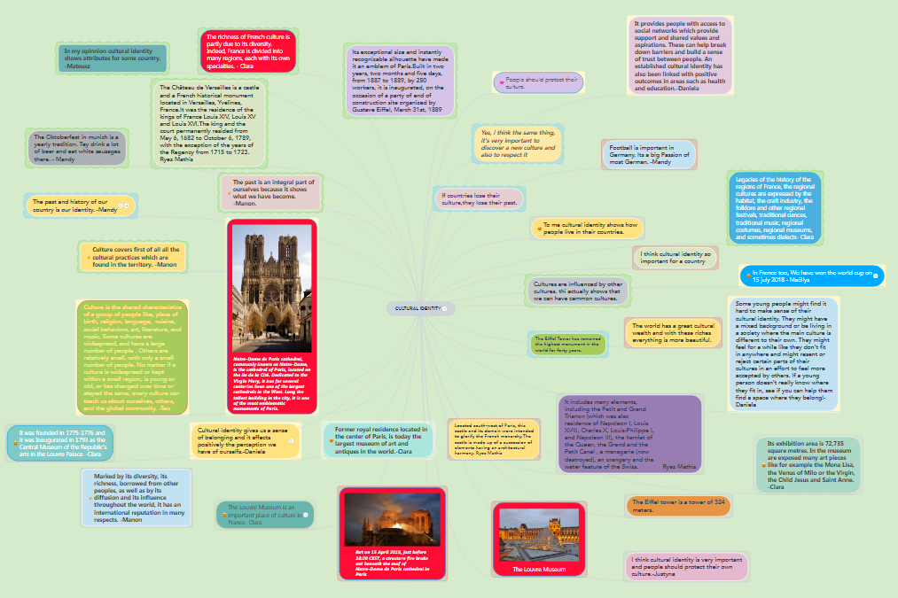
10 Different MindMaps
by the Mixed European Teams

Slide 12
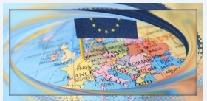
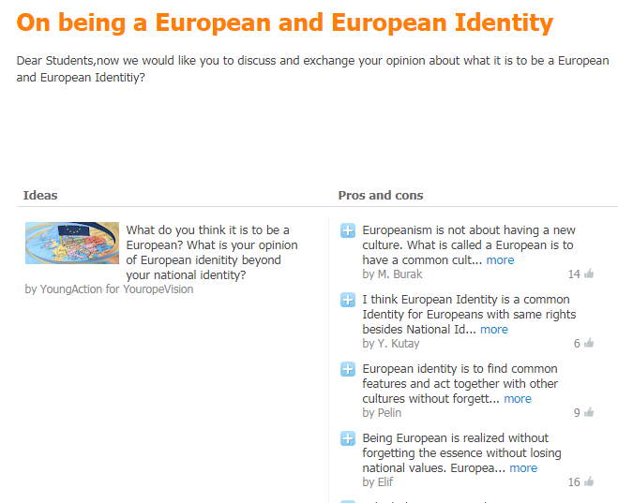
On the European Identity

Slide 13
VALUES
2nd
Main Activity
Land Description
Land Designs

Slide 14
Inclusive
Freedom
Human Dignity
Human Rights
Equality
Land Description
Rule of Law
Respect
Minority
Justice
Democracy

Slide 15
Inclusive
Freedom
Human Dignity
Human Rights
Equality
Land Designs
Rule of Law
Respect
Justice
Democracy
Minority

Slide 16
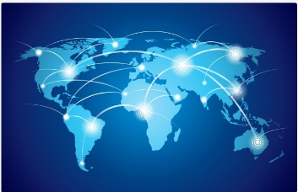
3rd
Main Activity
GLOBAL
CHALLENGES
Survey on Global Challenges
Sing for the Climate
European Teams’ Works
YoungMinds

Slide 17
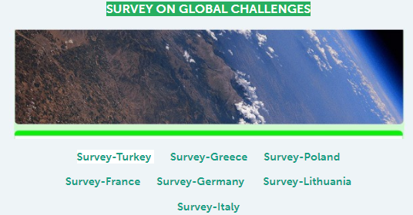
Survey
on
Global Challenges

Slide 18
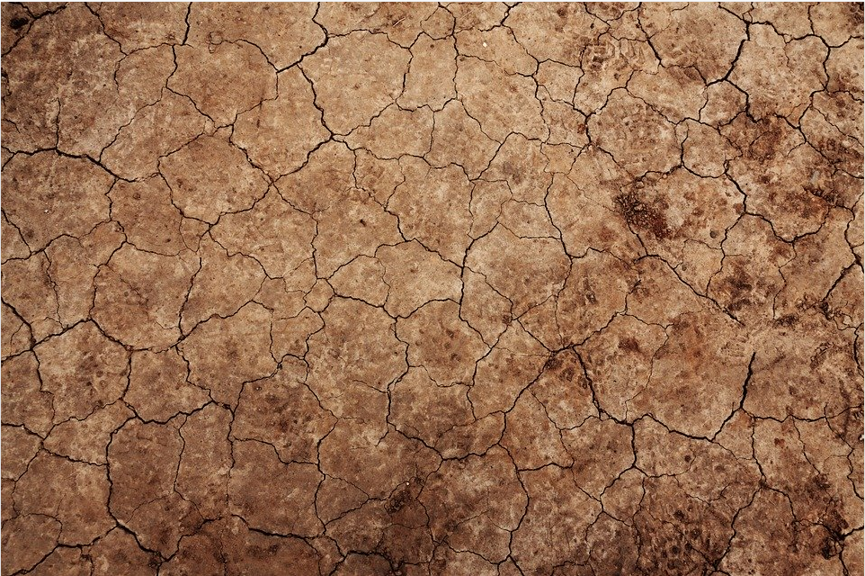
Warm-up Activity
We Sing for Climate

Slide 19
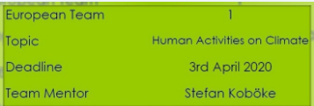
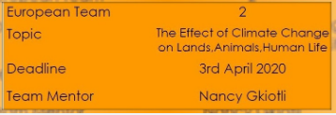
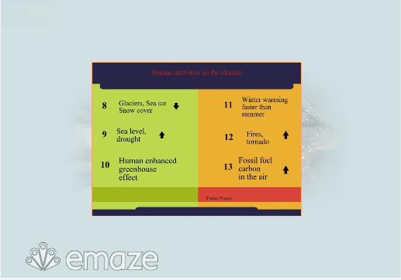
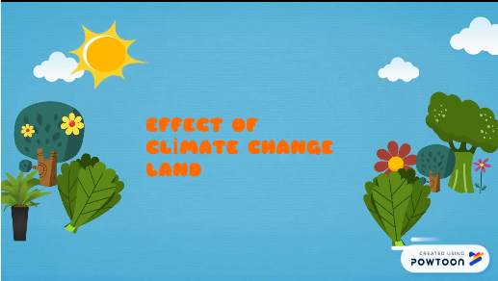

Slide 20
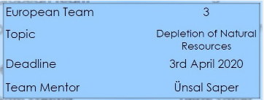
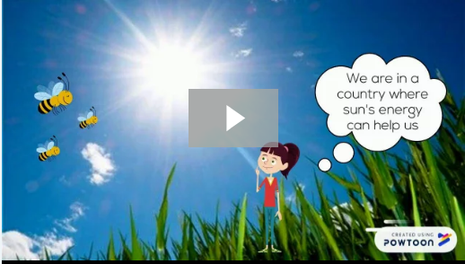
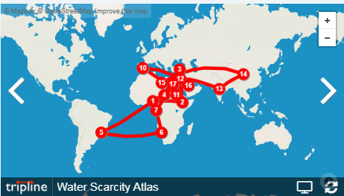

Slide 21
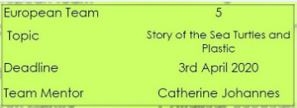
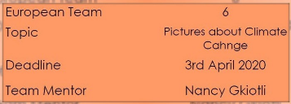

Slide 22
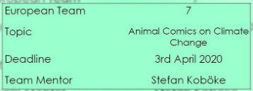
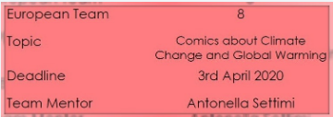
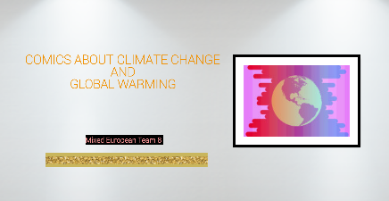

Slide 23
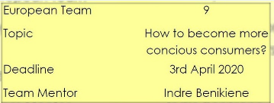
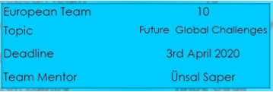
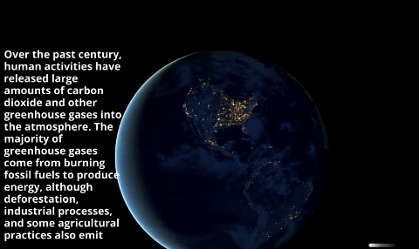

Slide 24
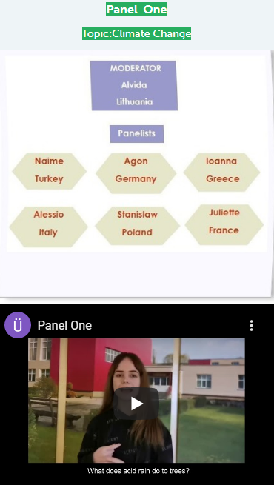
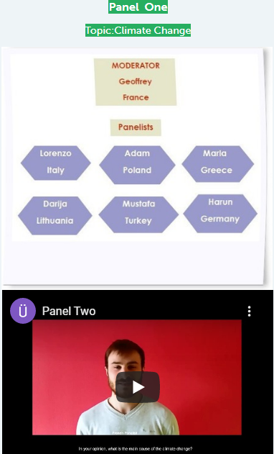

Slide 25
4th
Main Activity
Democracy
And
Active Citizenship

Slide 27
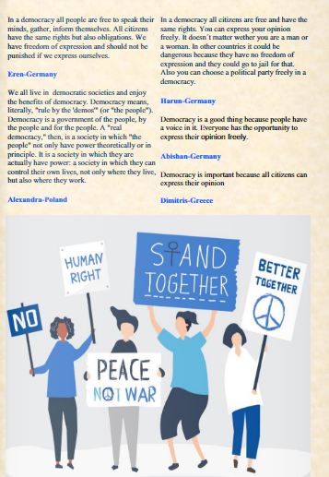
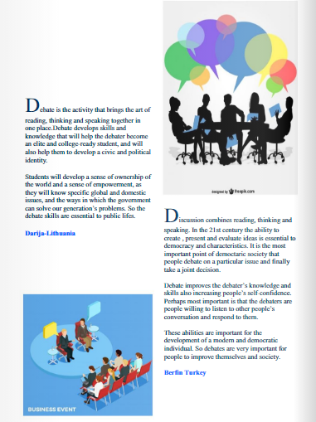
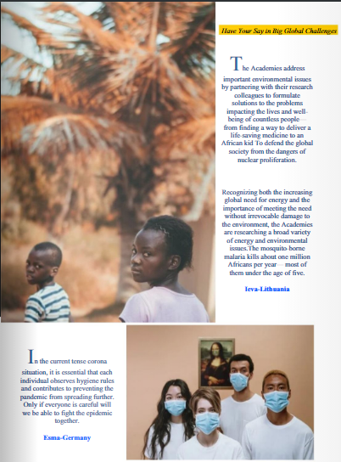

Slide 28
Common PSA Video

Slide 29
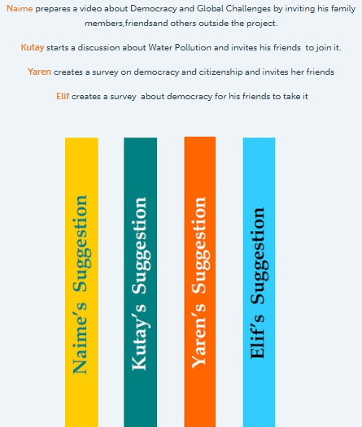
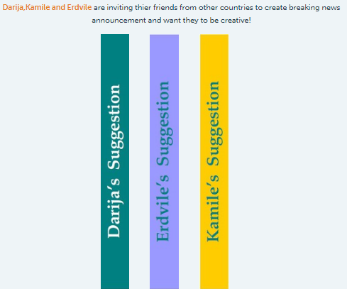
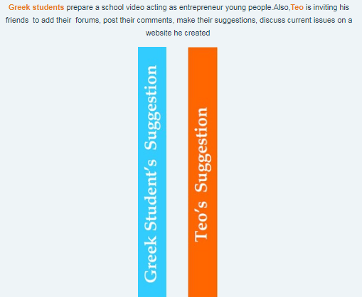

Slide 31
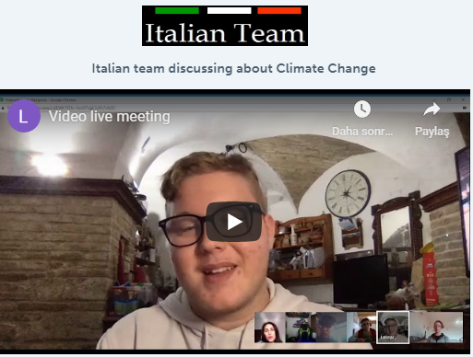
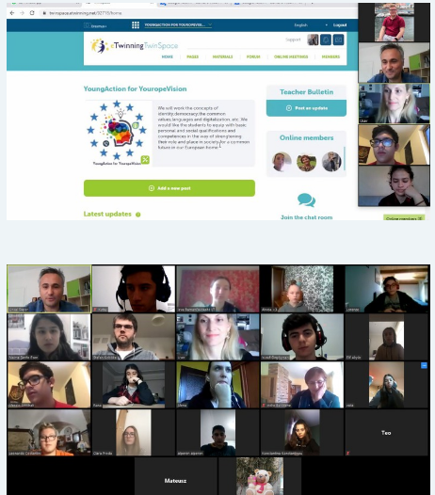
At Local Level
At European Level

Slide 34
Project Website

Slide 36
Final Evaluation

Slide 37
Nancy Gkiotli/Greece
Indre Benikiene/Lithuania
Alena Jackowska/Poland
Renata Laczak-Stachura/Poland
Catherine Johannes/France
Florence Rousselet/France
Antonella Settimi/Italy
Stefan Koböke-Germany
Ünsal Saper/Turkey

