Slide 1
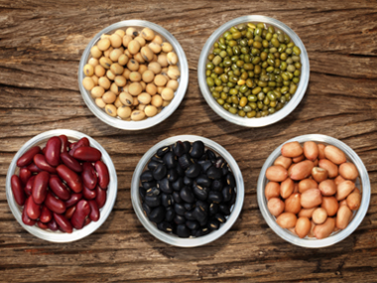
FOOD,FOOD,FOOD A CLASS PROJECT

Slide 2
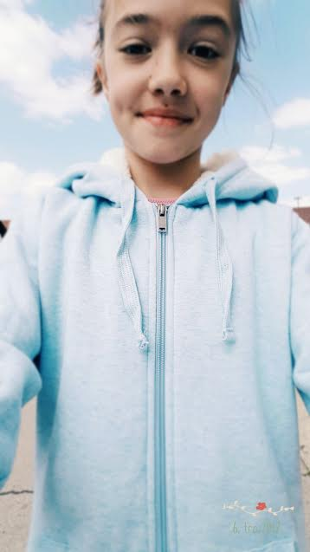
Meals and mealtimes-dora

Slide 3
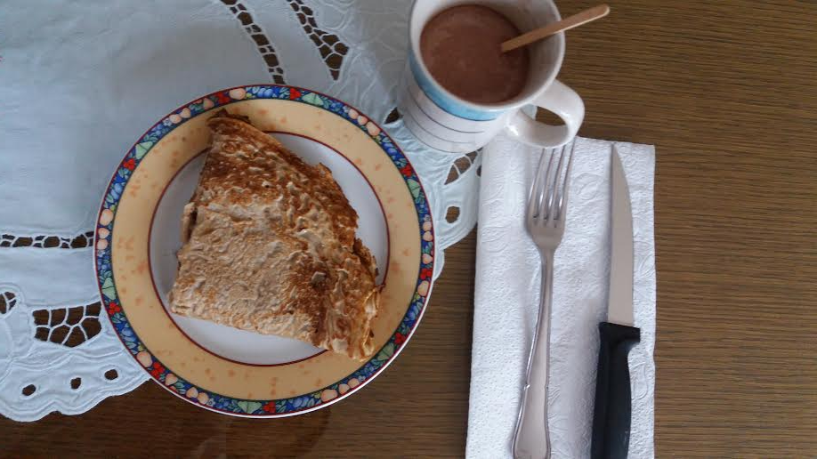
breakfast
PEOPLE USUALLY EAT BREAKFAST AT 8 O’CLOCK. SLAVONIA IS FAMOUSE FOR FOOD. FAMOUSE FOOD IS FRESH CHEESE, SAUSAGES, BACON, COW’S MILK AND KULEN.PEOPLE LIKE TO EAT EGGS WITH BACON AND DRINK FRESH MILK.

Slide 4
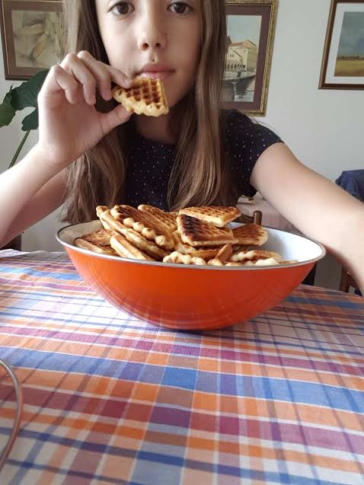
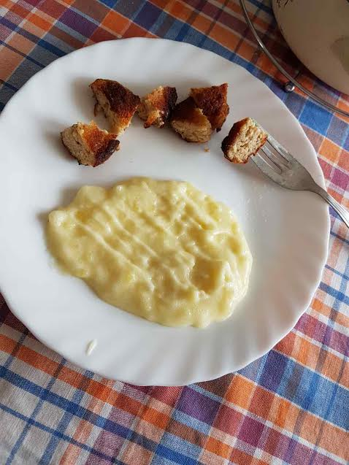
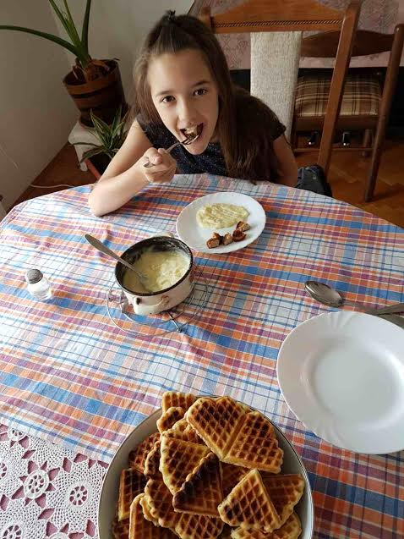
lunch
PEOPLE USUALLY EAT LUNCH AT 1 O’CLOCK.FOR LUNCH PEOPLE EAT VEGATABLES, BEANS, STEAK, VEGETABLE SOUP, GOULASH AND STEW. OLDER GRANDMA’S FOR DESSERT MAKE AN APPLE PIE OR POTATO PIE.

Slide 5
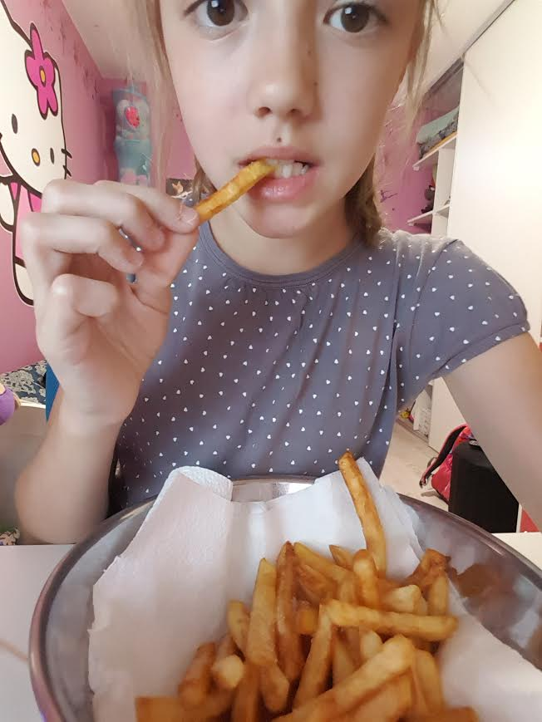
dinner
PEOPLE USUALLY EAT DINNER AT 7 O’CLOCK. FOR DINNER PEOPLE EAT FRUIT SALAD, BACON,BUTTER ON BREAD,ONION AND SAUSAGES.DRINK TEA OR COW’S MILK.

Slide 6
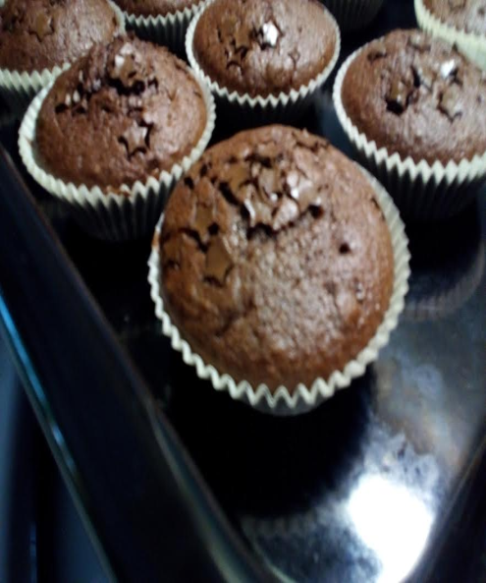
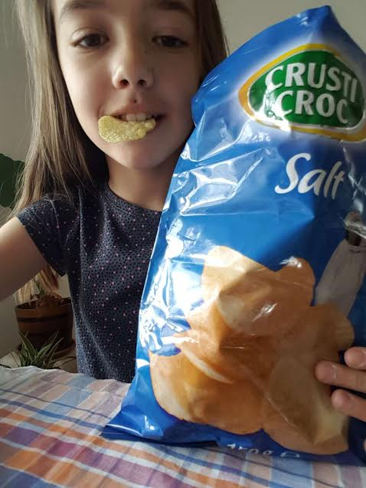
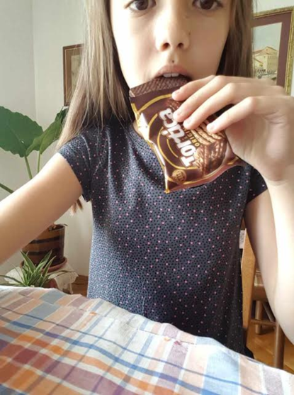
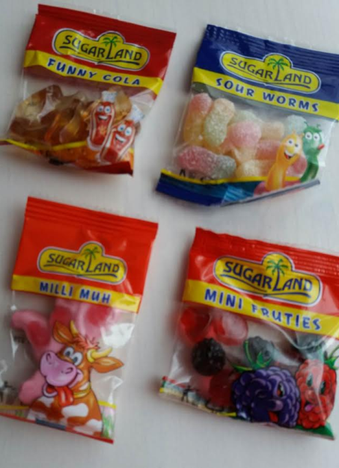
SnaCkS
PEOPLE USUALLY EAT FOR SNACK SMALL FOOD. THEY USUALLY EAT AN APPLES,COOKIES,BANANAS,CHIPS,MUFFINS AND DRINK HOT CHOCOLATE.

Slide 7
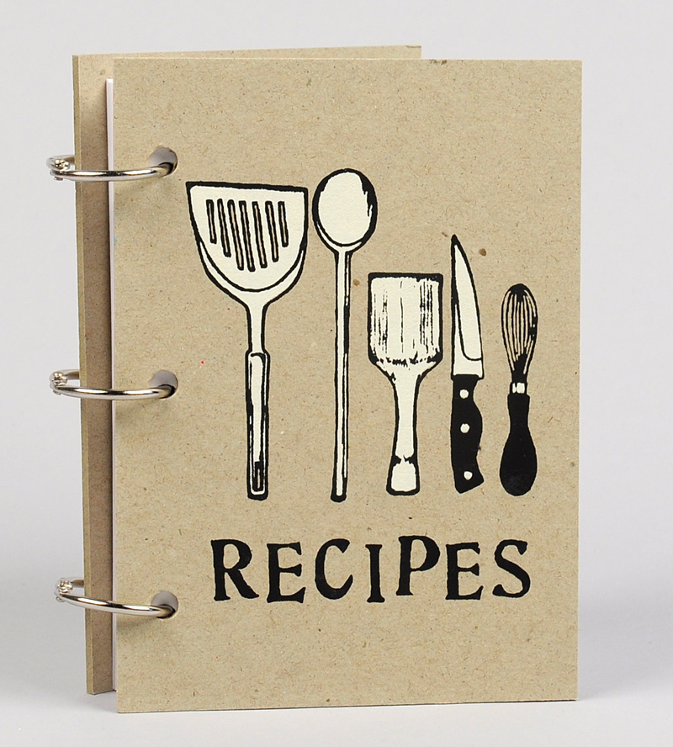
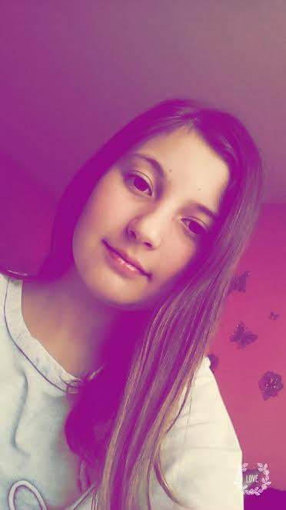
RECIPE-ANA

Slide 8
RECIPE
ANA’S recipe: BEAN
40 DAG beans
1 RED onion
3 SPOONS OF oil
SOME pepper
1 SPOON OF SALT
2 BAY LEAF
2 GARLIC
2 SPOONS OF FLOUR
2 SPOONS OF RED PEPPER
1 SPOON OF VEGETE
water

Slide 9
RECIPE
KLARA’S recipe: bean salad
30 DAG beans
1 onion
2 SPOONS OF Oil
1 SPOON OF SALT
VINEGAR

Slide 10
recipe
Dora’s recipe: rizi-bizi
20 DAG rice
10 DAG beans

Slide 11
recipe
Nika’s recipe: green bean
500 g green beans
2 garlic
700 g tomato paste
Spooun of pepper
Spooun vegete
salt
pepper
1 potatoe
1 l water

Slide 12
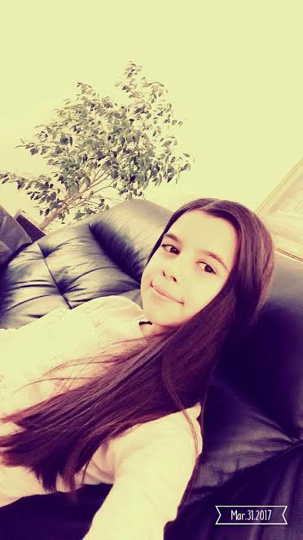
Shops and cafes-klara

Slide 13
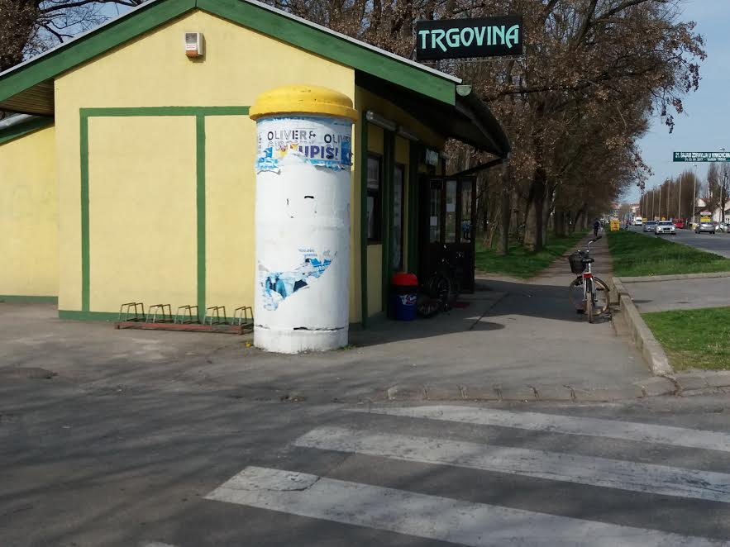
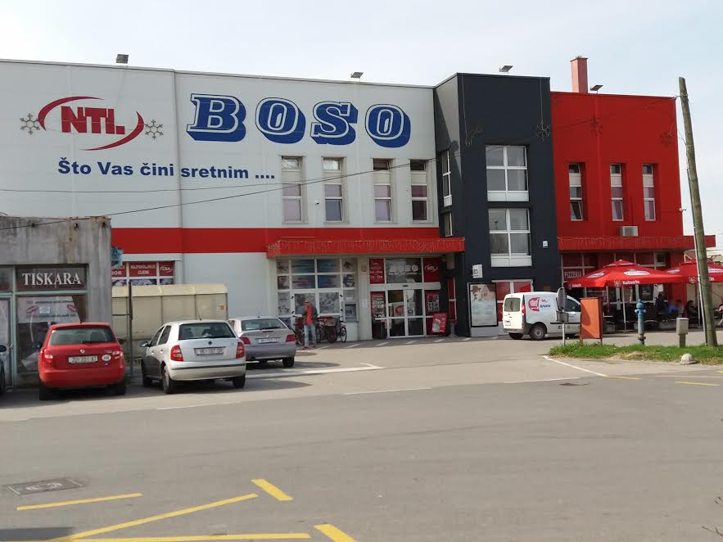
SHOPS

Slide 14
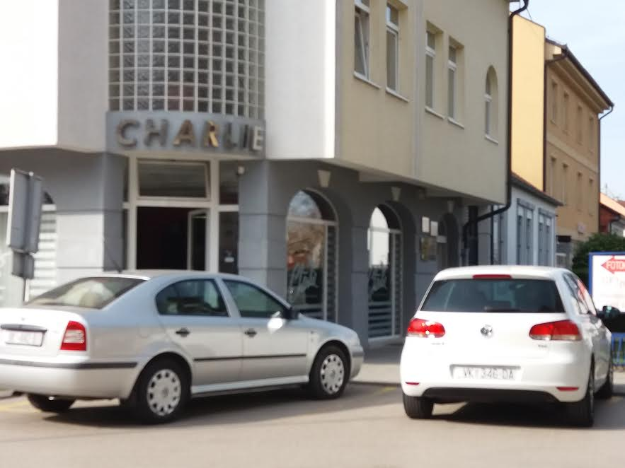
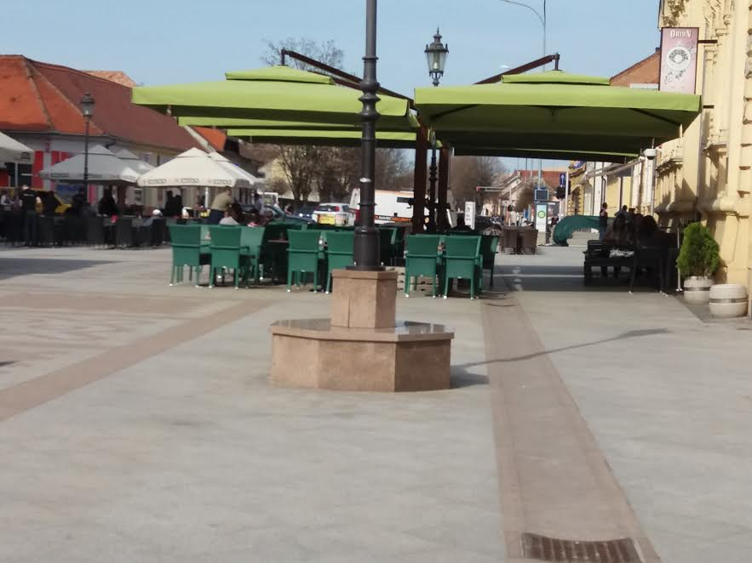
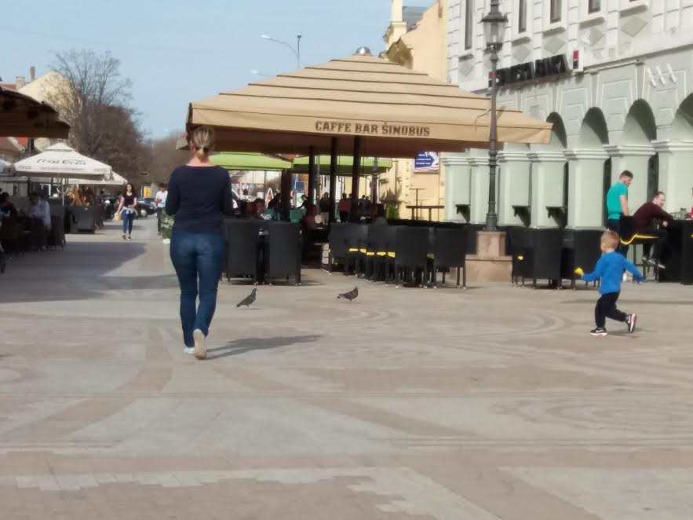
CAFES

Slide 15
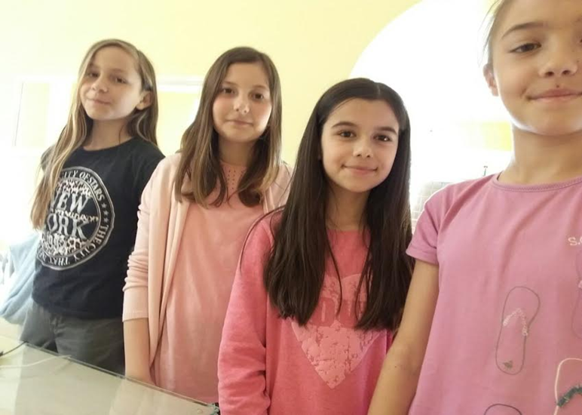
Video
LINK:https://www.youtube.com/watch?v=5Mq5xVlrG-g

Slide 16
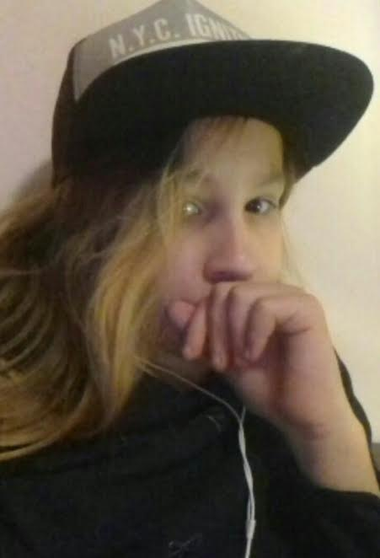
MOVIE

Slide 17
bean
LINK:https://www.youtube.com/watch?v=aI1ND-Lqd-0

Slide 18
roles
Klara-shops and cafes
Ana-recipe,lEader
Dora-meals and mealtimes
Nika-make beans,cameraman

Slide 19
Thanks for your attention

Slide 20
The End
By:Klara Kovačević,Ana Grgas,DoraDomaćinović and Nika Previšić

