Slide 1
Mr Bean, Mrs Lentil and their tiny peas celebrating the International Year of Pulses 2016
2nd Teachers meeting
of Vukovar – Srijem County
10th May 2017

Slide 2
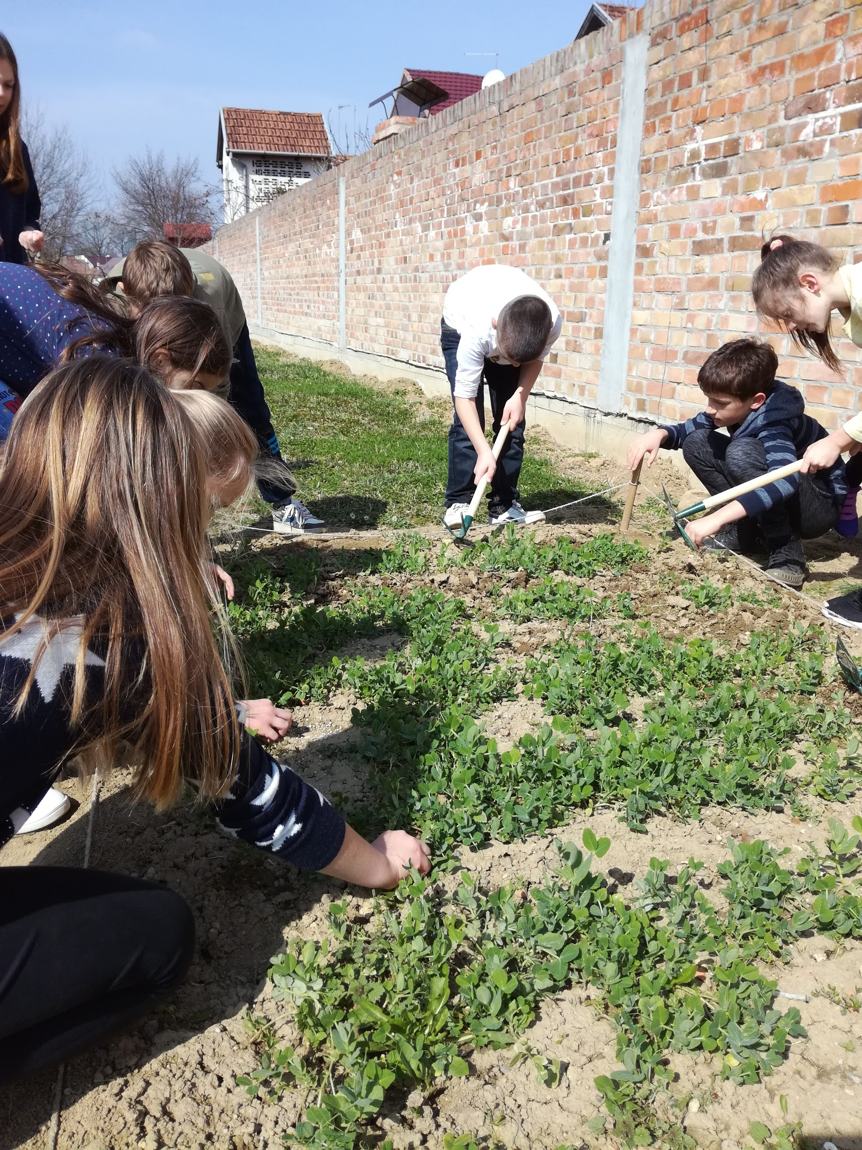
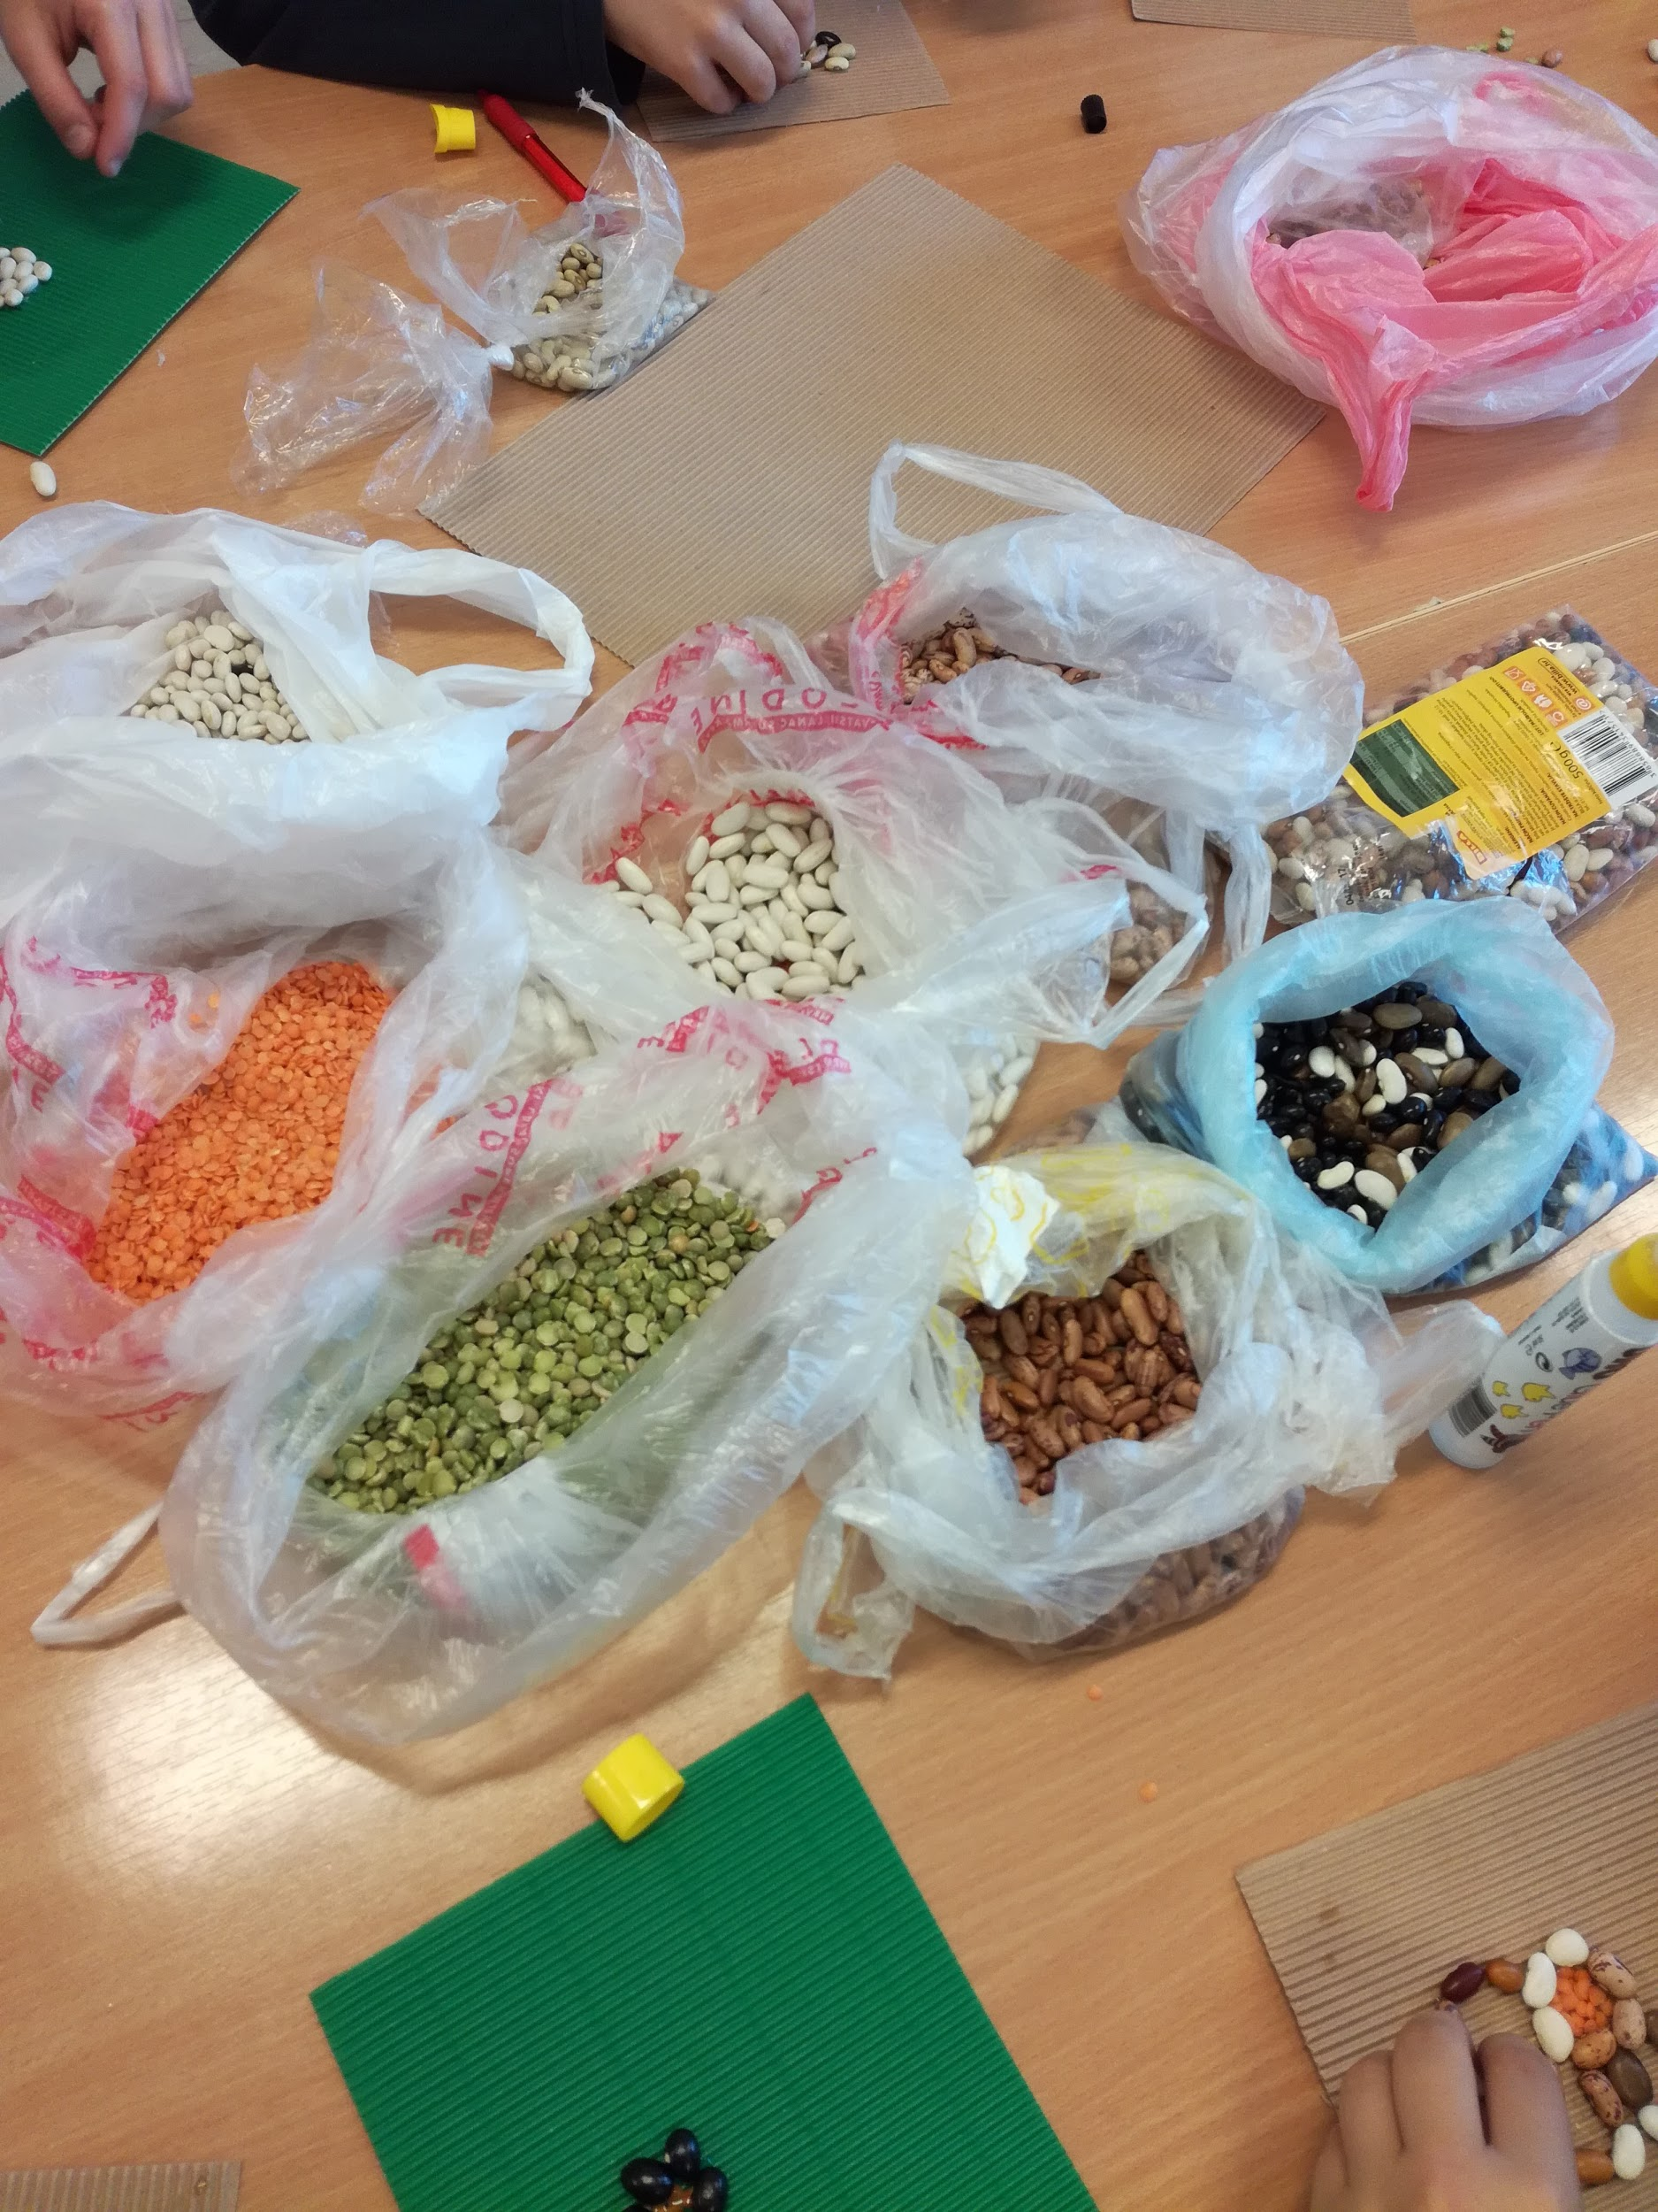
The goal:
The theme of the United Nations International Year of Pulses 2016 is to raise public awareness of the nutritional benefits of legumes.

Slide 3
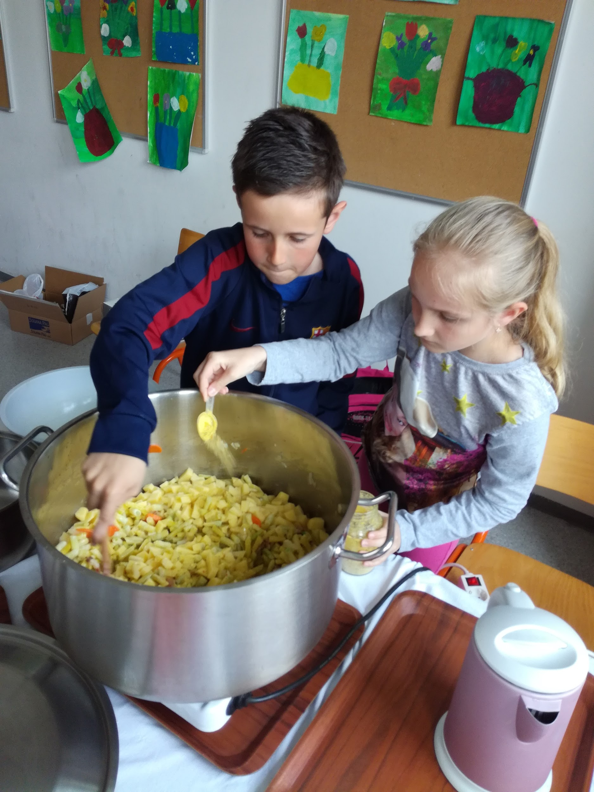
The aim:
In this eTwinning project we also address the experimental aspect of the cultivation of these legumes in the school environment, as well as the cultural dimension through collaboration between institutions on 4 continents

Slide 4
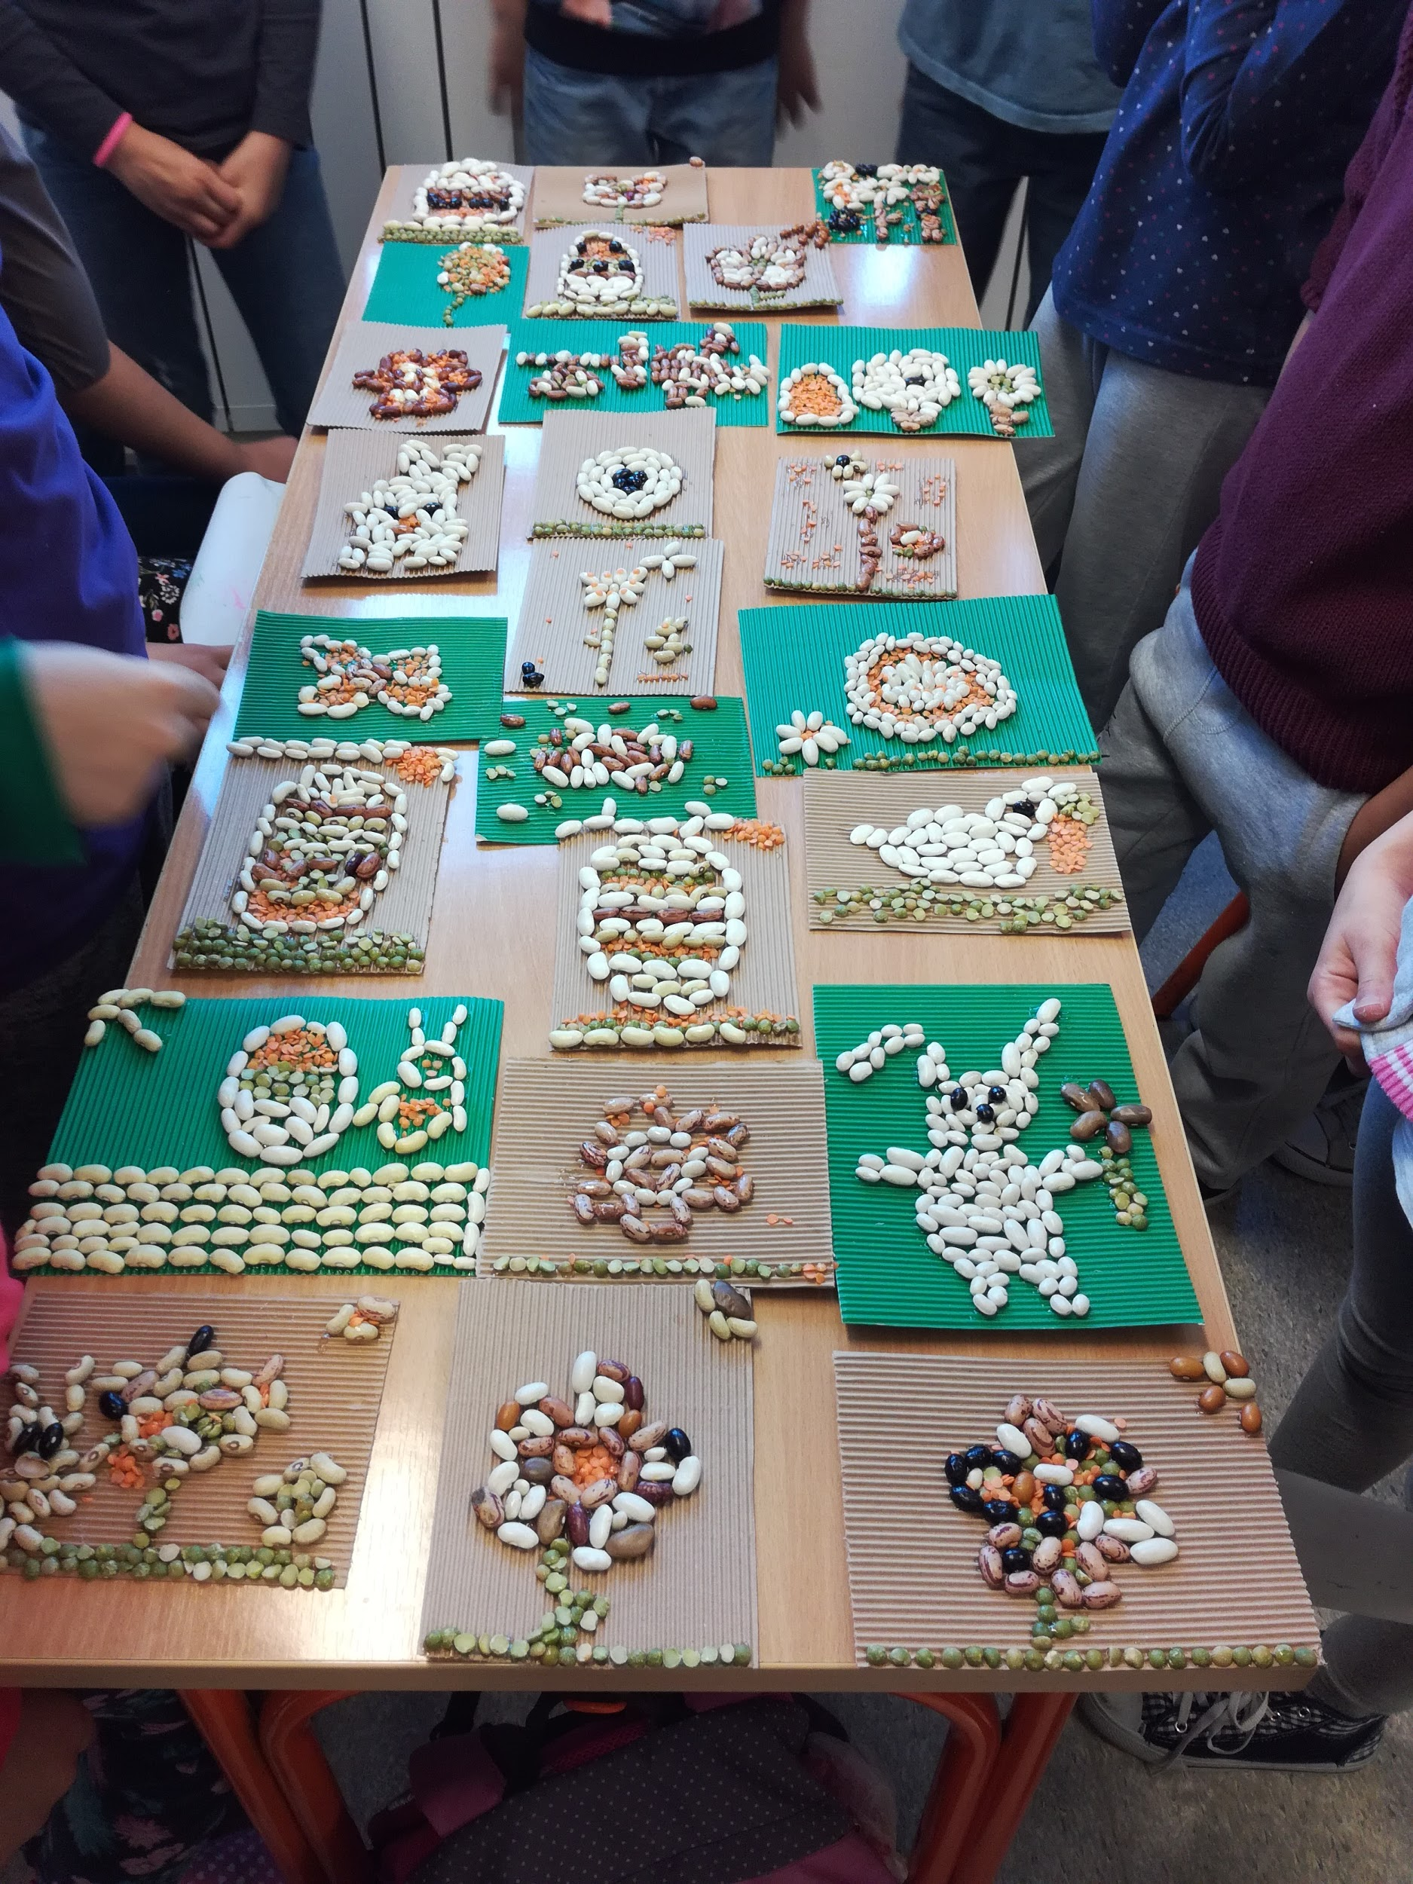
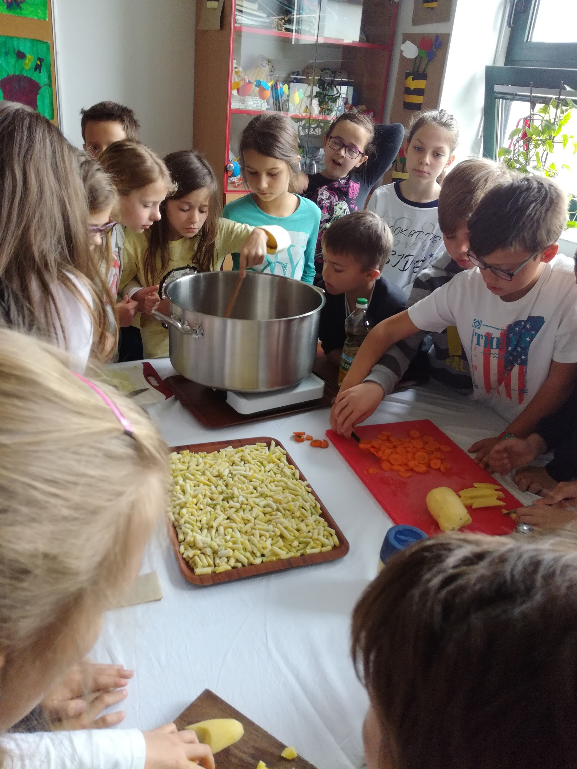
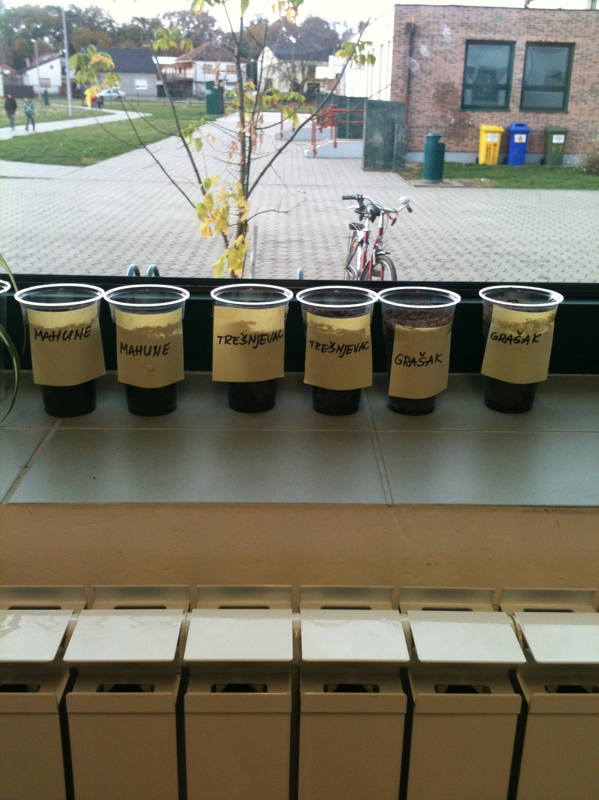
Activities:
Growing beans activity
At our school's canteen: Cooking
Nutrition
Art Bean
collaboration
exchanging
evaluation

Slide 5
PARTNER SCHOOLS:
Greece, Romania, Ukraine, Azerbaijan, France, Latvia, Spain, Chinana, Tunisia, India, Sovenia, Italy, Macedonia, Brazil,Croatia ....
Schools are allowed to join according to their Curriculum
The project started in August 2016. till June 2017.

Slide 6
Members of the project in our school are Kata Grgljanić, Manda Šteko and Slađana Raguž and classes 2.b, 3.b, 5.b, 7.a,b.
We were working in a project during extra curricular group – Domaćinstvo, Art, English lessons and Ethics

Slide 7
Evaluation:
We’ll fill forms (teachers and pupils) on Twinspace Evaluation page
(Students will do the evaluation in L1 – on the pieces of paper and then we’ll translate and complete online forms together.
At the end of the project we will apply for the quality label
- On the Twinspace: Students and teachers fill the forms
In the students’ Register: – teachers will evaluate students’ work

