Slide 2
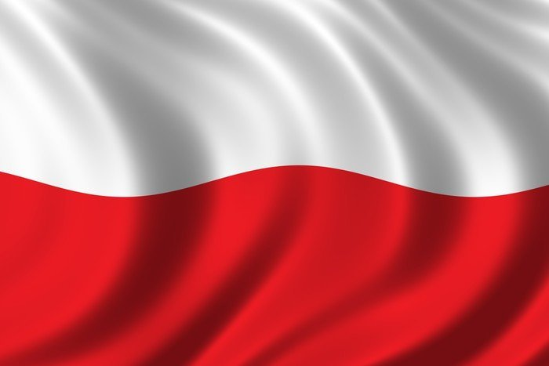
Polish migrations
Aleksandra Zmieniecka

Slide 3
Poland is a specific country. We have a lot of emigrants all over the world. Polish citizens, who are living outside of poland are called „polonia”. Our polonia is really big: it contains 18-20 mln polish people. It’s about 31% of polish population.

Slide 4
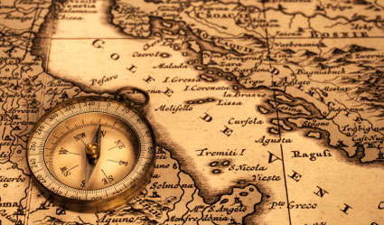
History of polish migrations

Slide 5
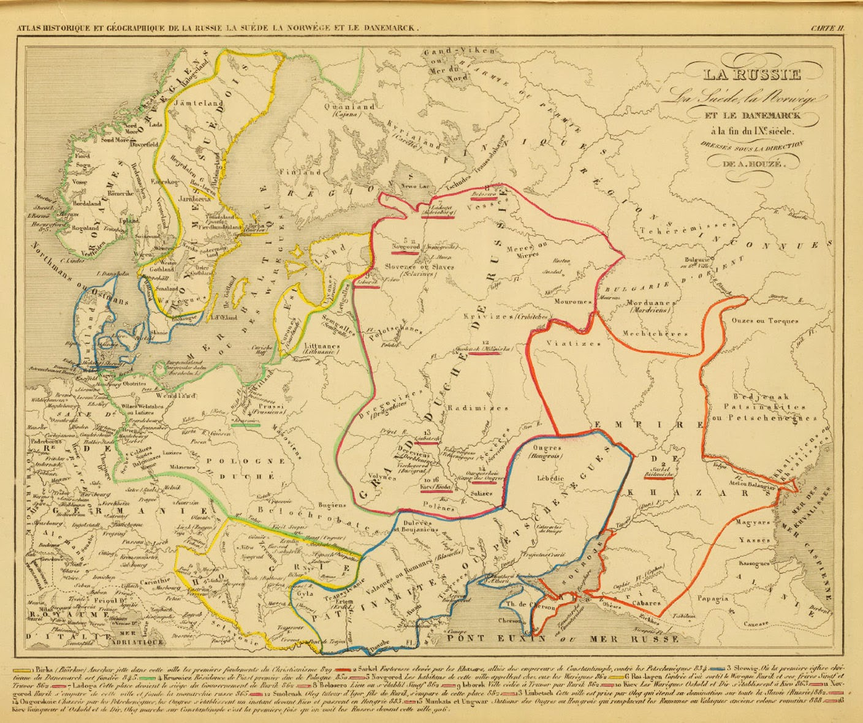
First polish migrations took place in the XIX-XX century. Polish people started to leaving their country to earn more money. The popular destinations were industrial districts in north America and europe.

Slide 6
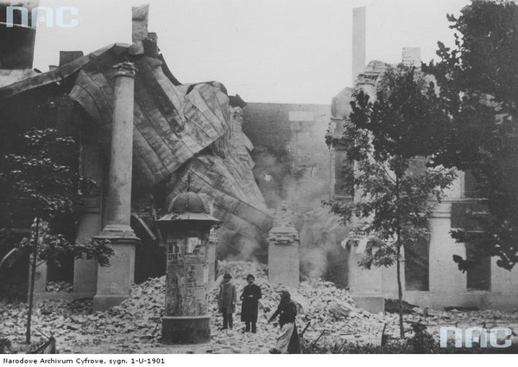
After first world war polish people started emigrating to france and belgium because of war losses and financial problems. Our country was really destroyed.

Slide 7
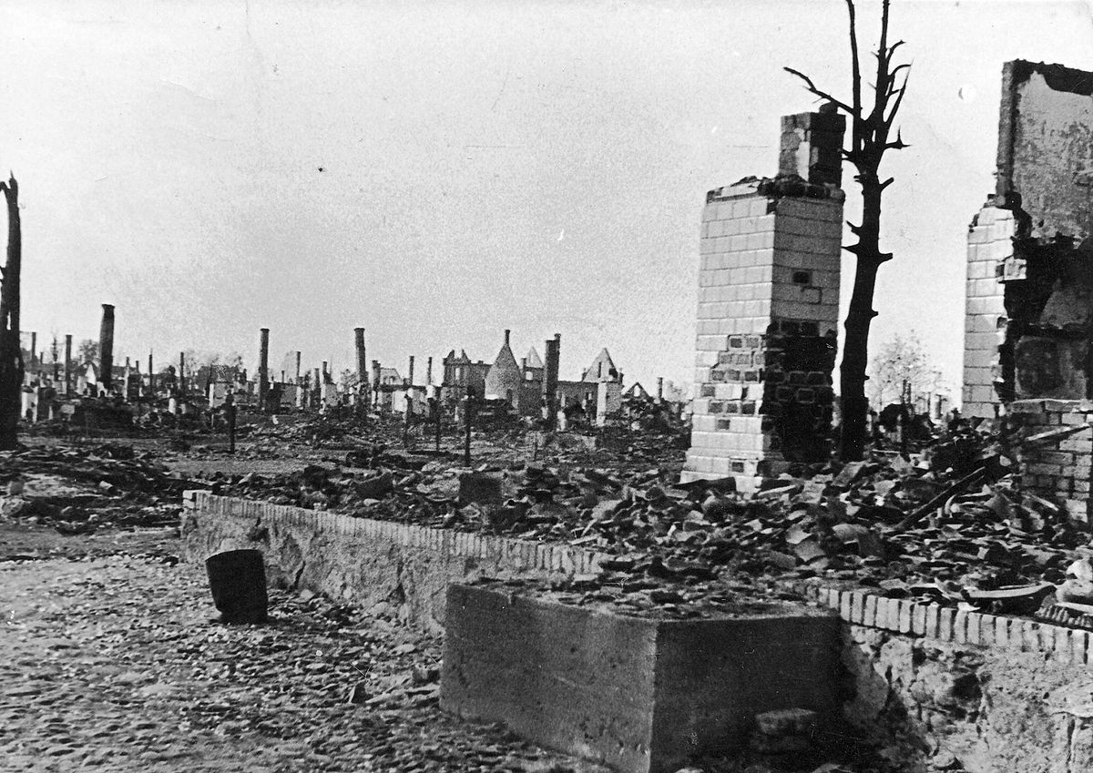
Next stage of migrations was in 1939-1945. russians displaced a lot of polish people to USSR and Germans to germany. A lot of poles were trying to escape from war to france or uk.

Slide 8
After second world war some of polish people came back to poland, but a lot of them decidied to stay in their new place of residence. We deported a lot of germans from our country.

Slide 9
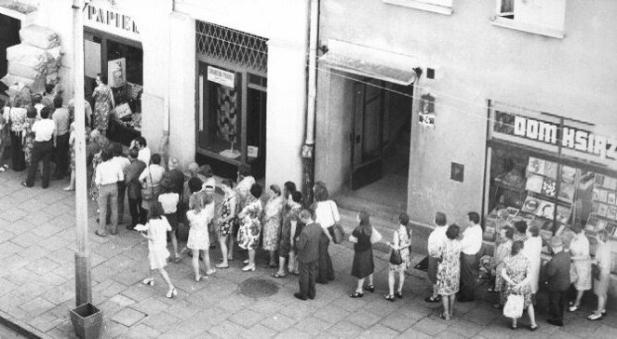
In 1970-80s emigrations for better living to big and rich countries were very popular. Most popular destination was the usa, australia and the uk.

Slide 10
After 1989 western europe was more popular than the usa. After 2004, when we joined european union emigrations increased instantly. Right now polish people are still choosing germany or the uk as a Destination of emigration.

Slide 11
Current migrations

Slide 12
In these Times about 50% of polish migrants lives in germany or the uk. Most of polish emigrants are under 30. popular destinations are also norway, denmark, the usa, canada or australia. About 23% of polonia have higher education. Our big emigrant society is a little bit controversial for other countries.

Slide 13
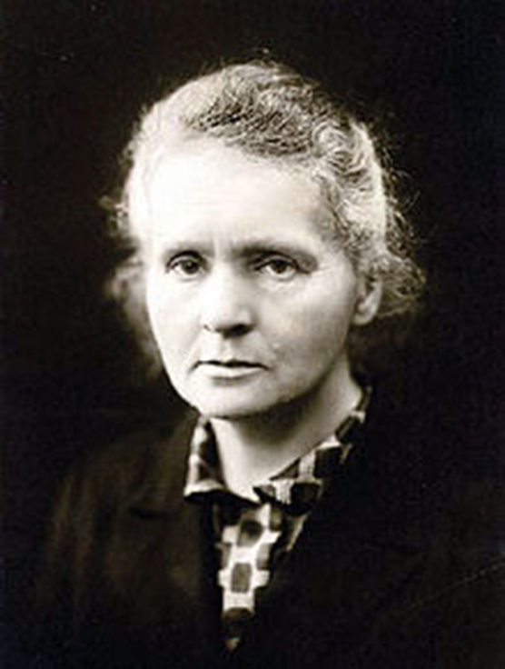
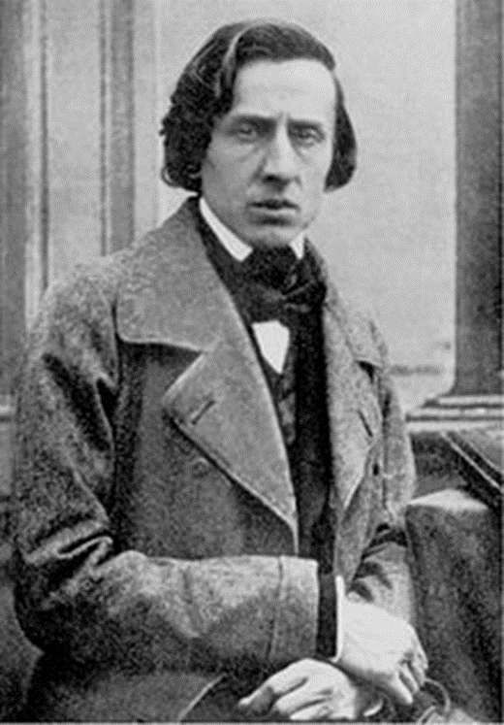
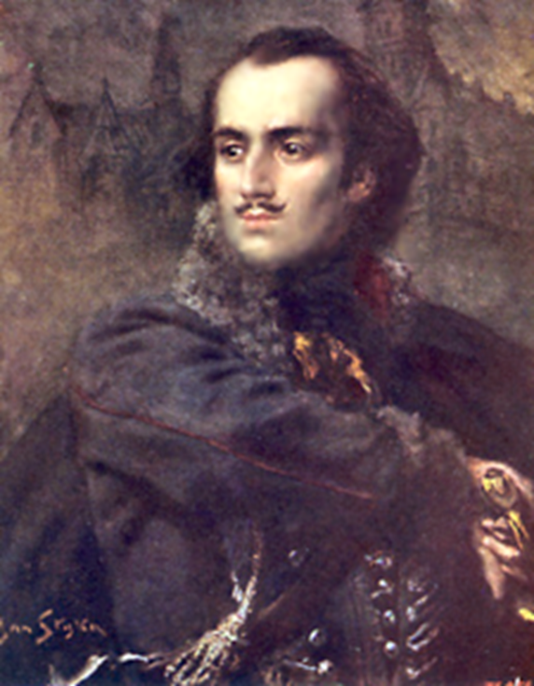
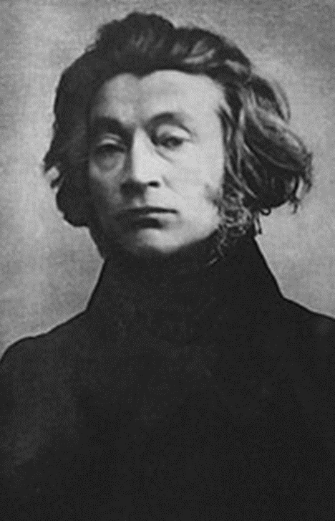
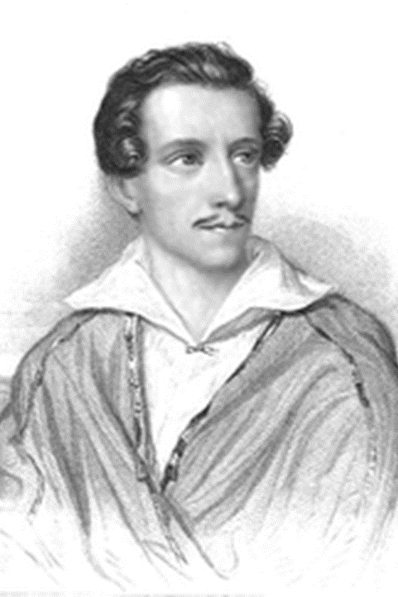
Famous polish emigrants

Slide 14
Marie Skłodowska-Curie (7 November 1867 – 4 July 1934) was a Polish and naturalized-French physicist and chemist who conducted pioneering research on radioactivity. She was the first woman to win a Nobel Prize, the first person and only woman to win twice, the only person to win a Nobel Prize in two different sciences. She was also the first woman to become a professor at the University of Paris, and in 1995 became the first woman to be entombed on her own merits in the Panthéon in Paris.

Slide 15
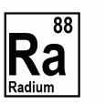
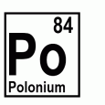
Maria skłodowska-curie discovered radium and polonium.

Slide 16
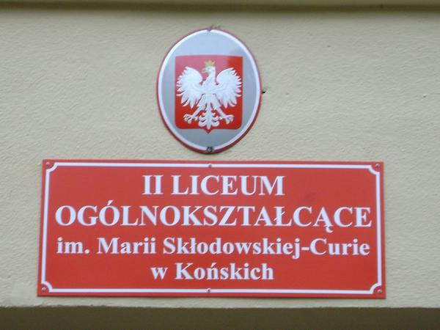
We are really proud that Maria skłodowska-curie is also our school patron

Slide 17
Fryderyk Franciszek Chopin (March 1810 – 17 October 1849) was a Polish composer and virtuoso pianist of the Romantic era who wrote primarily for the solo piano. He gained and has maintained renown worldwide as a leading musician of his era, whose "poetic genius was based on a professional technique that was without equal in his generation.Chopin was born in what was then the Duchy of Warsaw and grew up in Warsaw, which in 1815 became part of Congress Poland. A child prodigy, he completed his musical education and composed his earlier works in Warsaw before leaving Poland at the age of 20, less than a month before the outbreak of the November 1830 Uprising.

Slide 18
Kazimierz Michał Władysław Wiktor Pułaski of Ślepowron (March 4 or March 6, 1745 – October 11, 1779) was a Polish nobleman, soldier and military commander who has been called, together with his Hungarian friend Michael Kovats de Fabriczy, "the father of the American cavalry". Born in Warsaw and following in his father's footsteps, he became interested in politics at an early age and soon became involved in the military and the revolutionary affairs in Poland (the Polish–Lithuanian Commonwealth). Pulaski was one of the leading military commanders for the Bar Confederation and fought against Russian domination of the Commonwealth.

Slide 19
Adam Bernard Mickiewicz (24 December 1798 – 26 November 1855) was a Polish poet, dramatist, essayist, publicist, translator, professor of Slavic literature, and political activist. He is regarded as national poet in Poland, Lithuania and Belarus. He is known chiefly for the poetic drama Dziady (Forefathers' Eve) and the national epic poem Pan Tadeusz. His other influential works include Konrad Wallenrod and Grażyna. All these served as inspiration for uprisings against the three imperial powers that had partitioned the Polish-Lithuanian Commonwealth out of existence.

Slide 20
Juliusz Słowacki (23 August 1809 – 3 April 1849) was a Polish Romantic poet. He is considered one of the "Three Bards" of Polish literature — a major figure in the Polish Romantic period, and the father of modern Polish drama. His works often feature elements of Slavic pagan traditions, Polish history, mysticism and orientalism. His style includes the employment of neologisms and irony. His primary genre was the drama, but he also wrote lyric poetry. His most popular works include the dramas Kordian and Balladyna and the poems Beniowski and Testament mój.

