Slide 1
Emigration
French team presentation for the meeting in Sicily by
Lucie, Gwendoline and Maxime.

Slide 2
What is EMIGRATION ???
It is the action of leaving one’s
country or region for economic,
political and religious reasons.

Slide 3
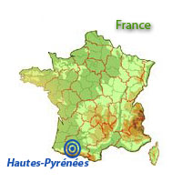
Our French region
Located down the Pyrenees, our region is called HAUTES-PYRÉNÉES.
The Pyrenees :
a mountain chain from the Atlantic Ocean to the Mediterranean Sea.
a natural border with Spain ?
Our economy :
Rural mostly in the 19th century
Industrial in the 20th
Notes:
We are very close to the Spanish border, yet the border has never been considered as a physical or natural border. There have always been commercial exchanges between the French farmers who used to cross the mountain chain to sell their products during the Winter season to Spain. Actually, people “crossed the Pyrenees” not a border, as it was part of a same region.

Slide 4
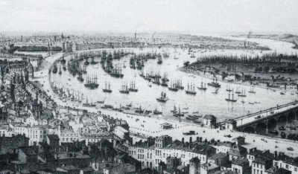
French Emigration:
For hundreds of years, French people have been found on
the roads of emigration. The HAUTES-PYRÉNÉES reflect
the French emigration history on several levels :
16th and 17th centuries : temporary
migrations to Spain
19th : rural exodus
1832-1913 : 25000 leaving for America (Argentina, Louisiana in Canada)
Notes:
The rural exodus : to farther destinations abroad (Canada, South America and especially… ) and to main cities (Tarbes, Toulouse or Bordeaux)
The industrial period with

Slide 5
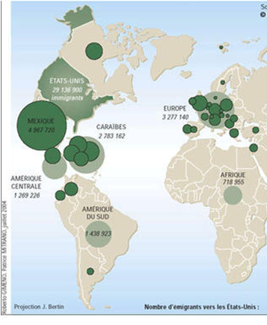
Where were they going and why ?
Their main destinations were North America, South America
and Canada.
The economic emigration was
essentially the youngest sons of
the families who left to find land
and to enlarge the market of their
family.

Slide 6
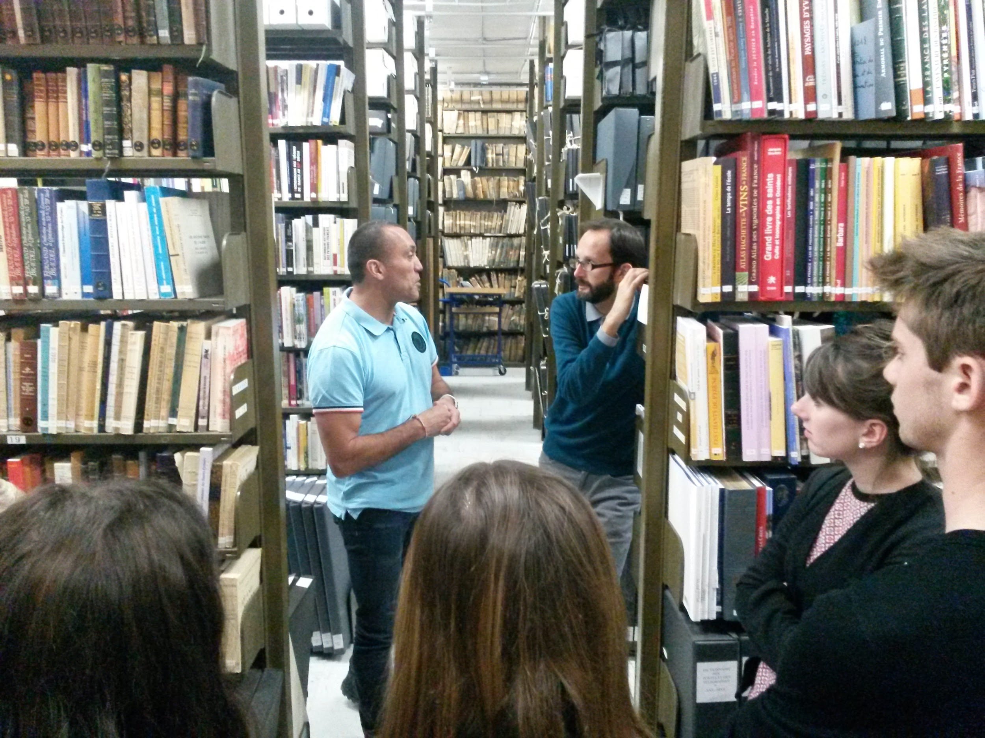
A visit to the Archives of our County
The French team visited
the Archives of the department.
Notes:
prononciation : a:kaivz

Slide 7
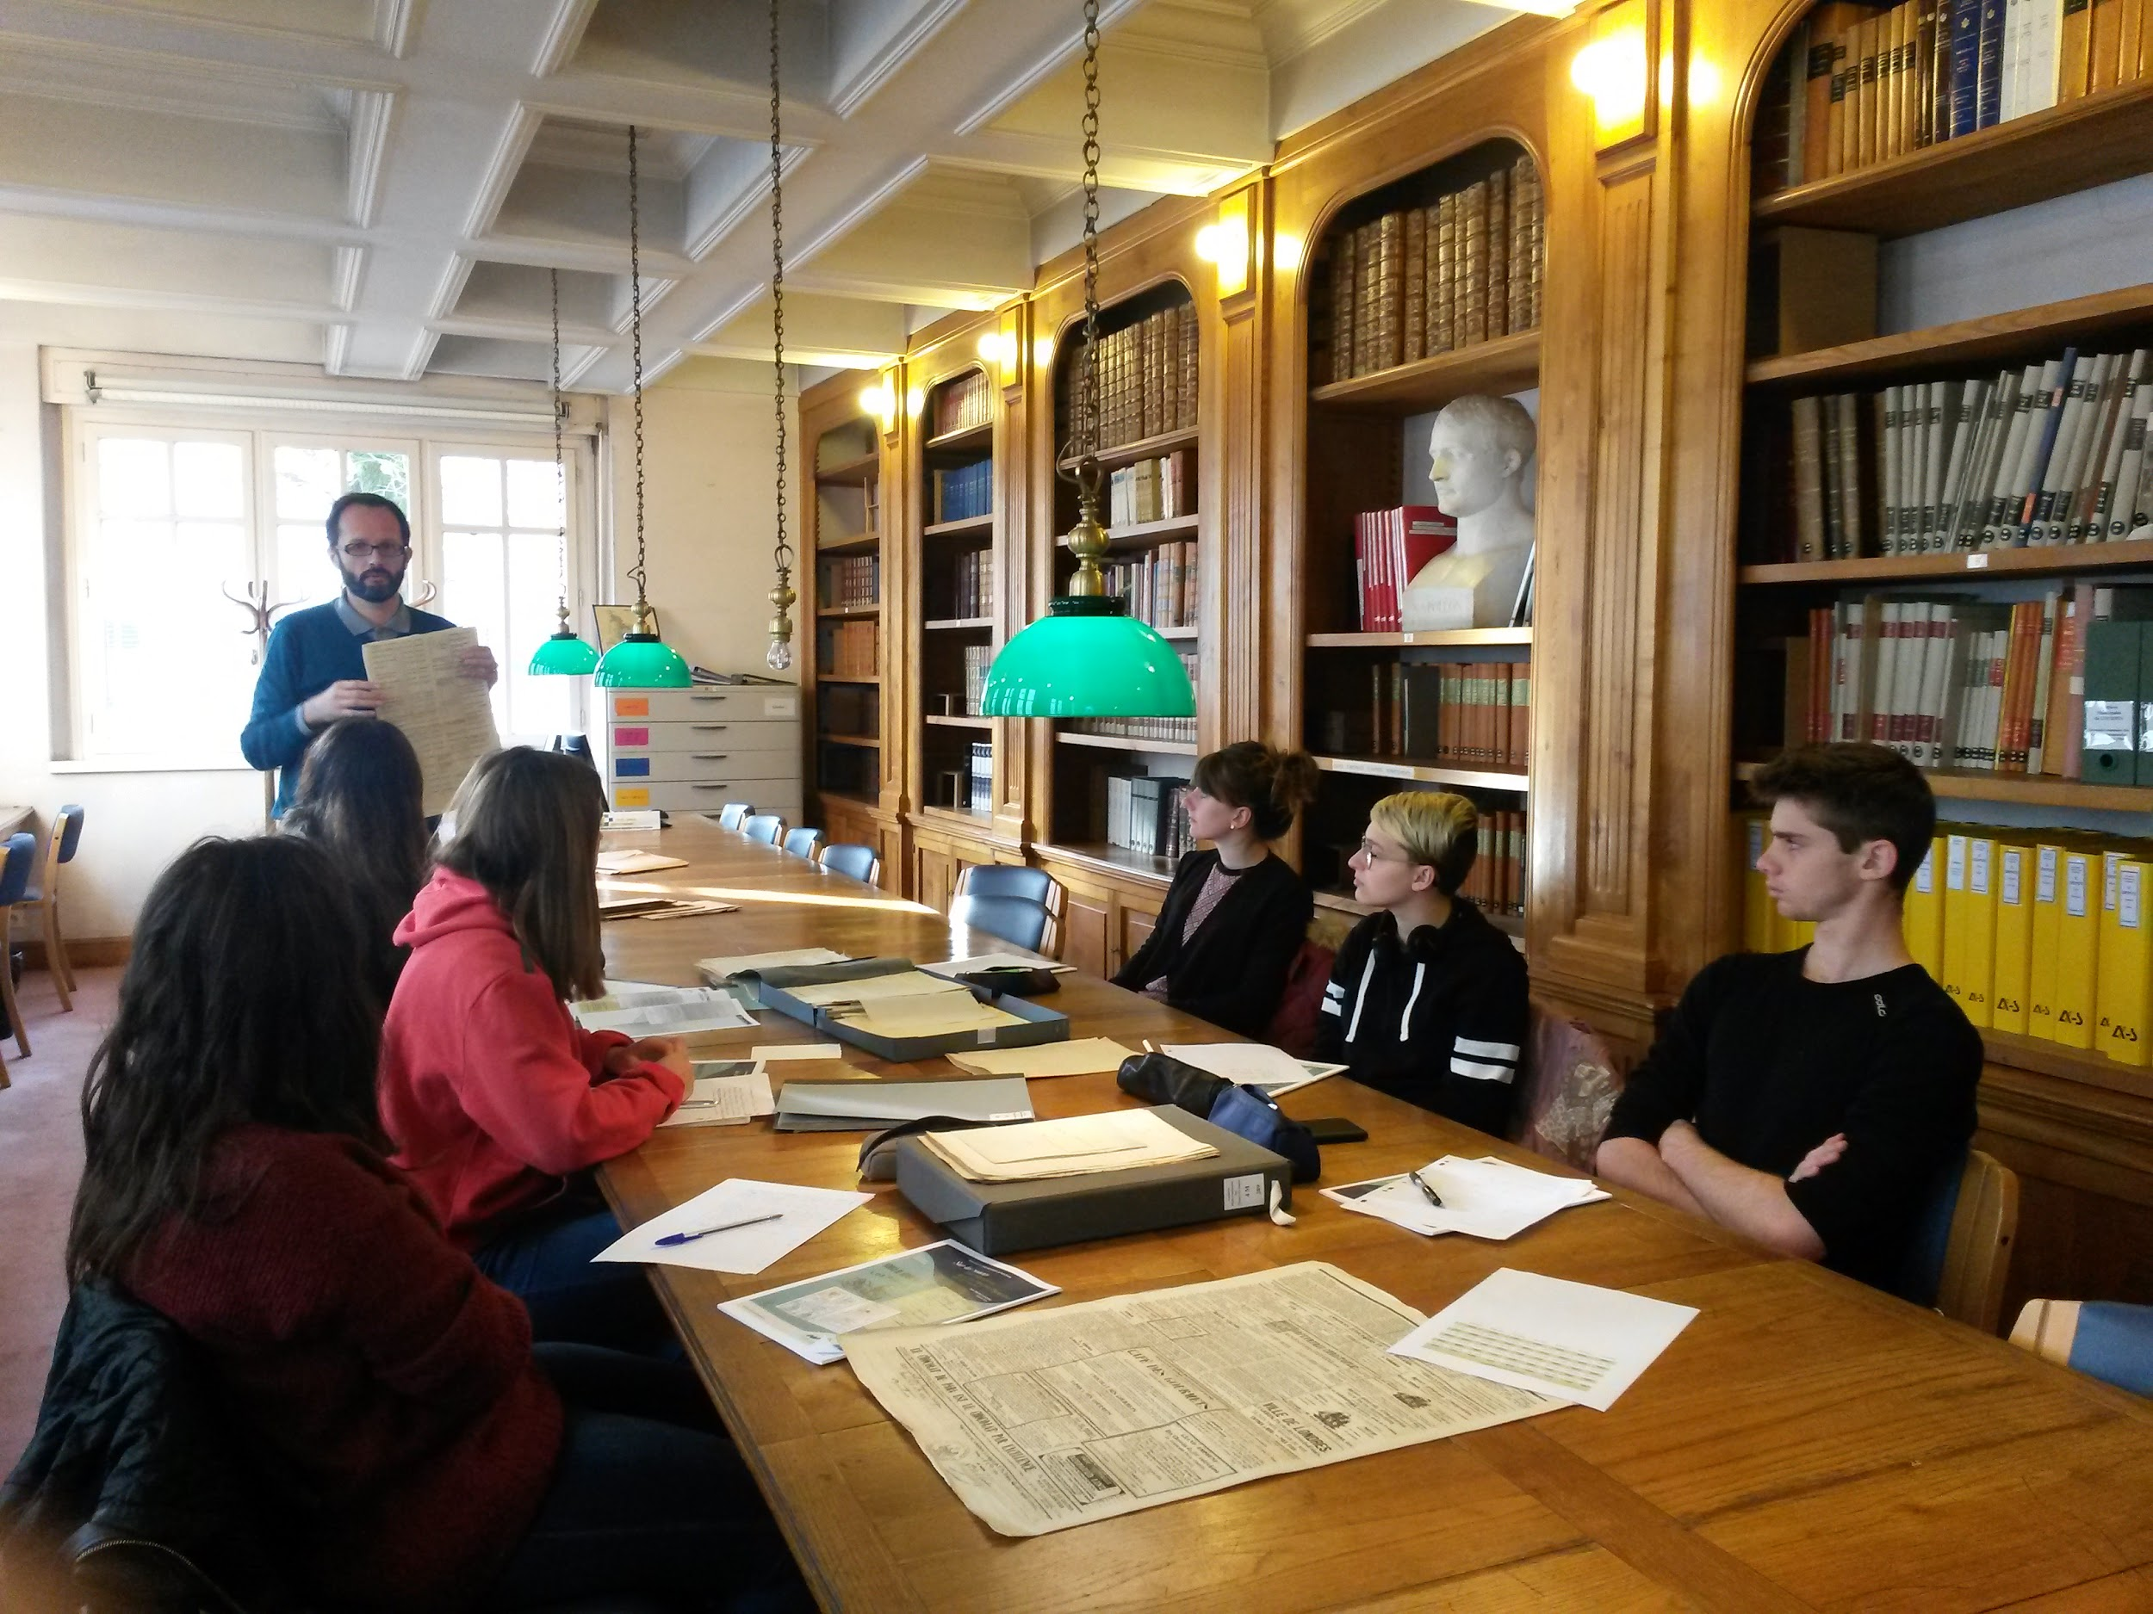
They explained how our region was related to the issue of Emigration from the 17th century to nowadays.

Slide 8
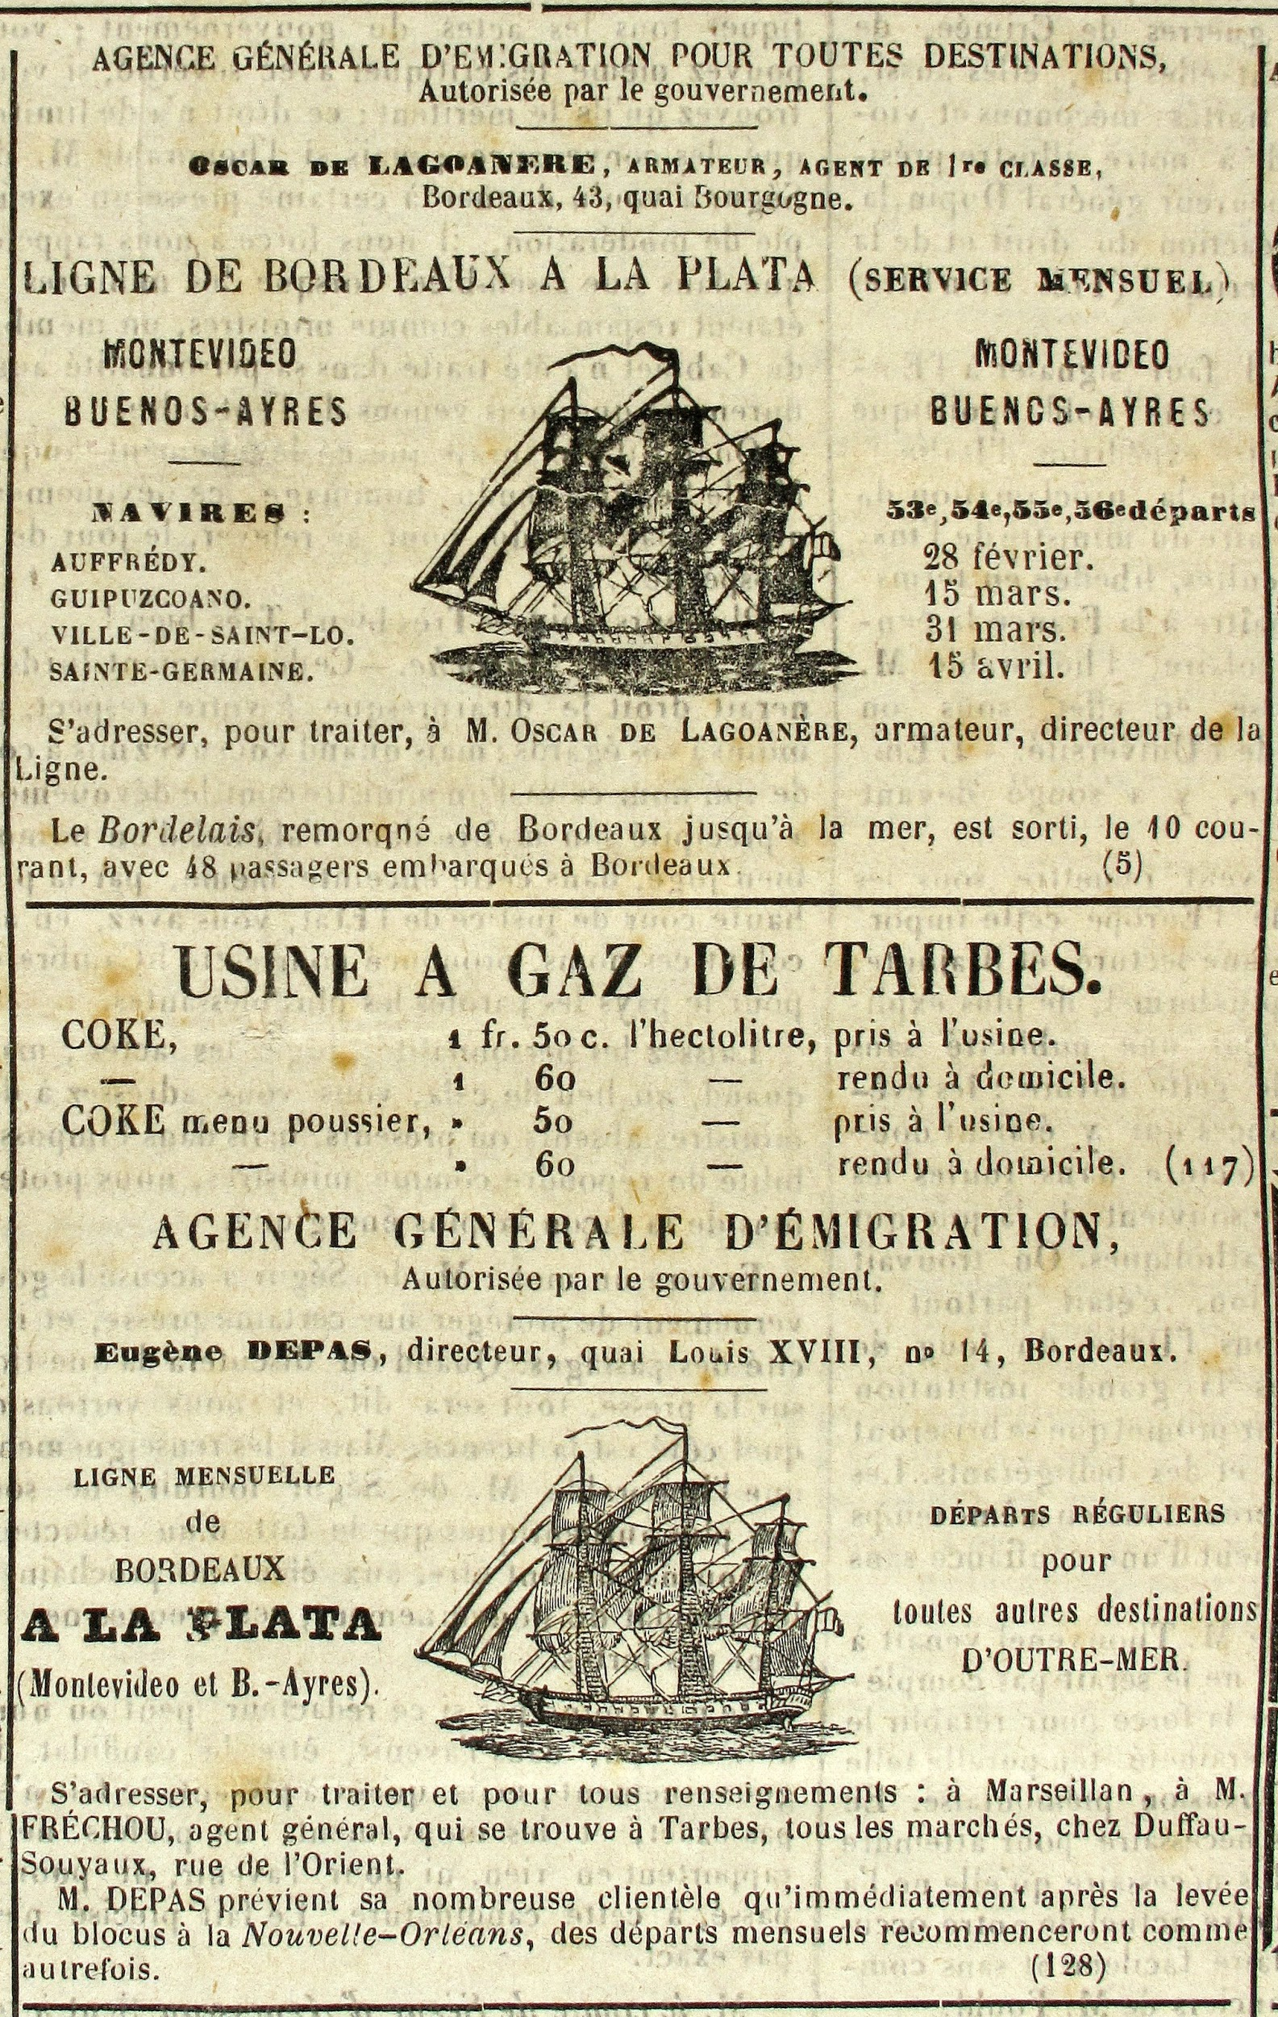
Archival material
An advert for human exportation

Slide 9
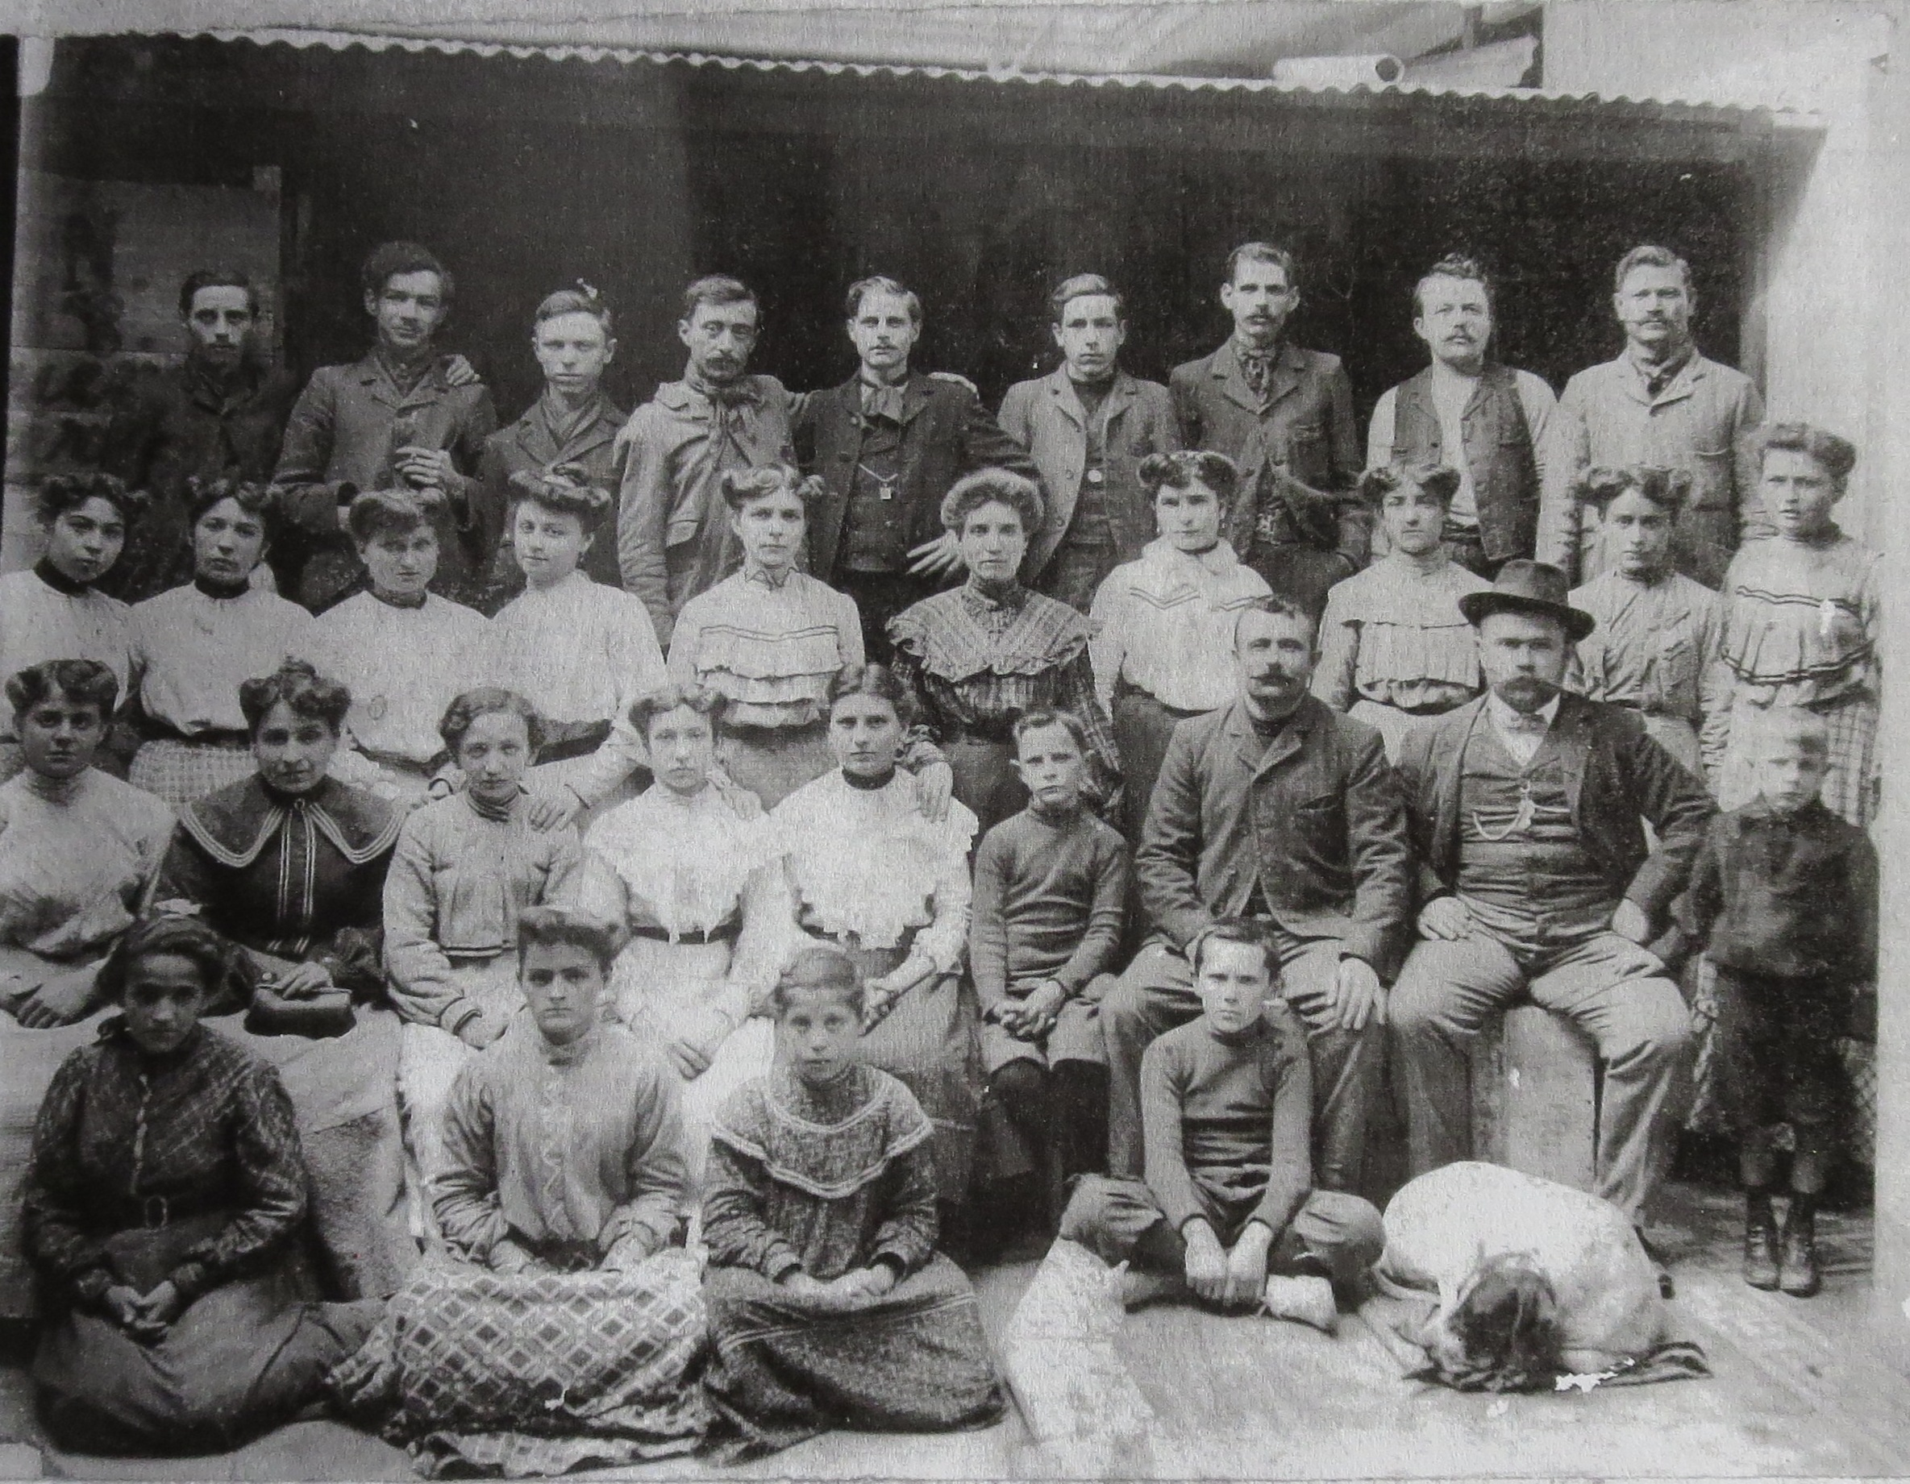
Archive materials
Proof of emigration: letters and photos
Notes:
They either come from the official papers, records from the State Offices when people left, as they had to fill in questionnaires or provide identity papers before leaving, or from familial backgrounds.

Slide 10
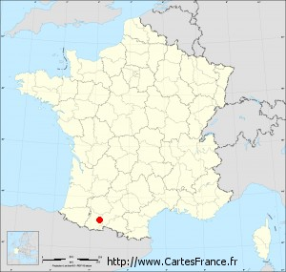
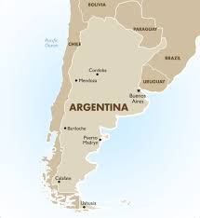
The Example of Louis Azum
The owner of spinning factories in the Pyrénées
in the 1900s.
He migrated to Argentina to implant his spinning
industry.
Note : Spinning factories are establishments where big textile materials are spun.

Slide 11
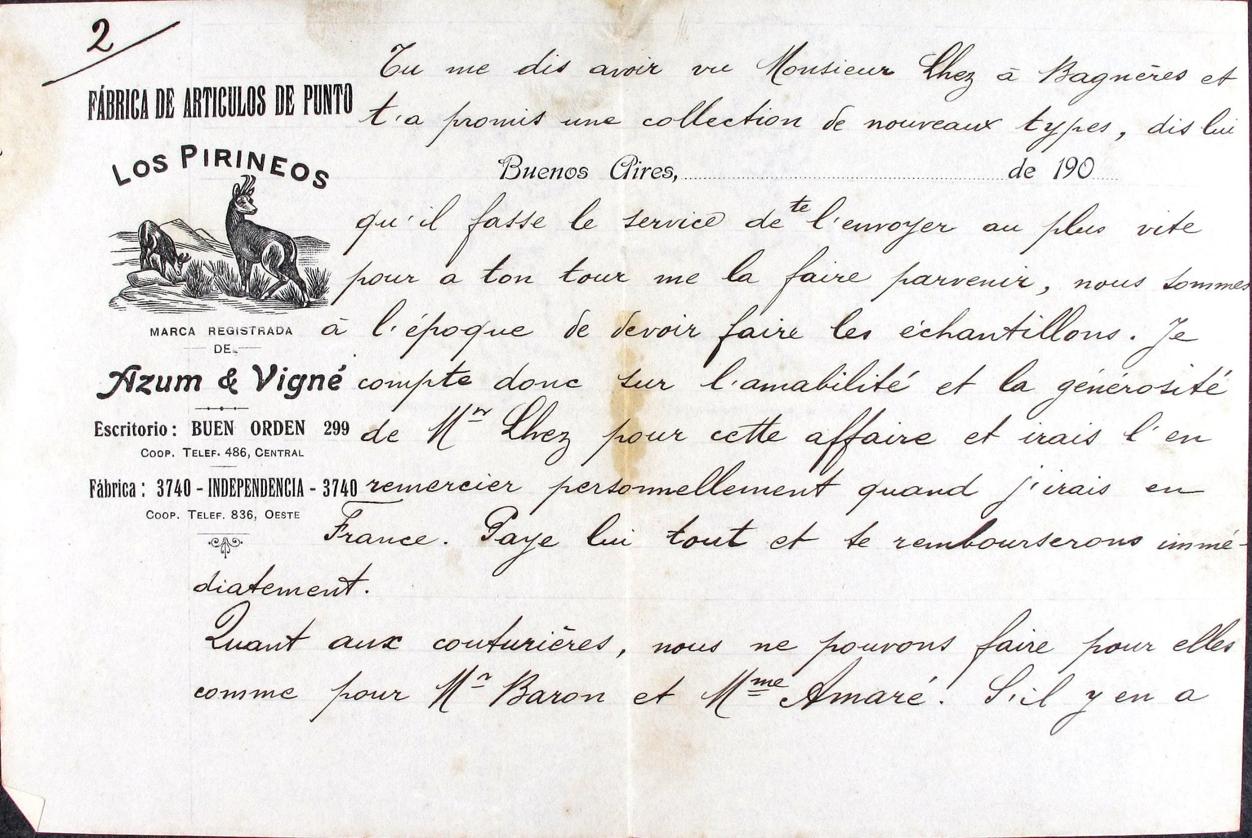
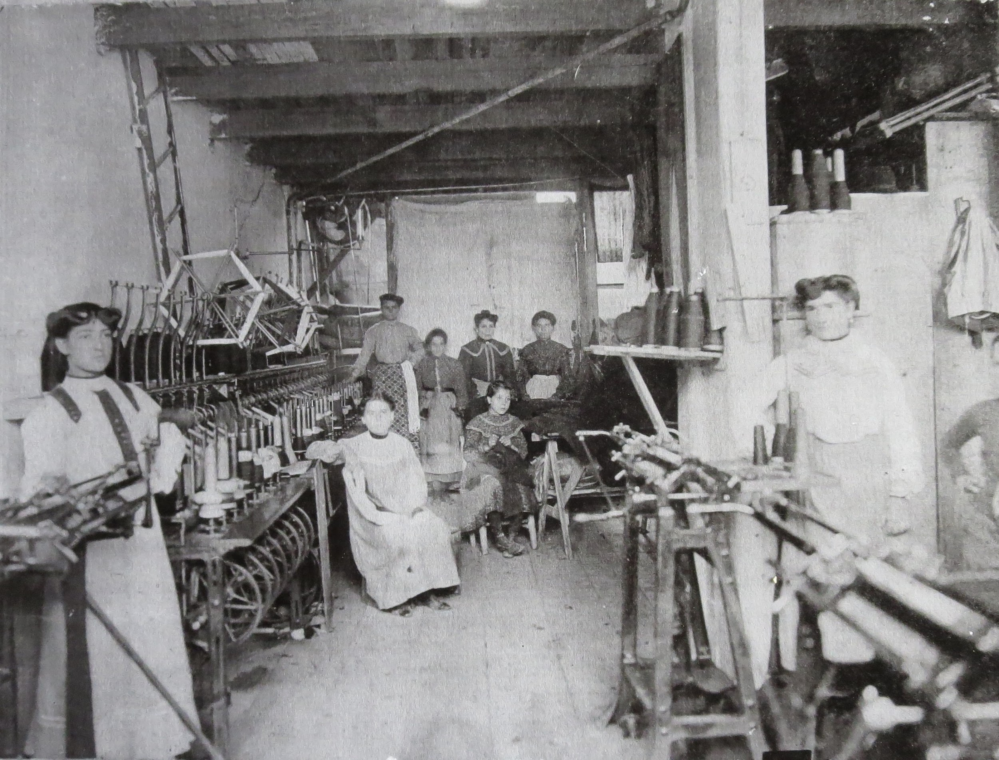
His Firm
Links between the region and the firm :
Commercial links
Professional links

Slide 12
The Family
Many family members emigrated to Argentina to work.
These members were usually nephews or little brothers.

Slide 13
The emigration in Hautes-Pyrénées

