Slide 1
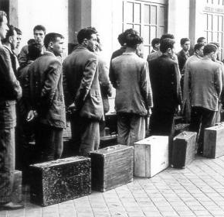
Portugal – 60^{s}
Migrations

Slide 2
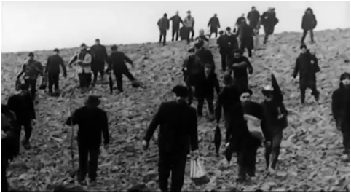
Portugal – 60^{s}
People lived in dictatorship;
The country was facing a huge economical crisis;
Colonial war in Africa.

Slide 3
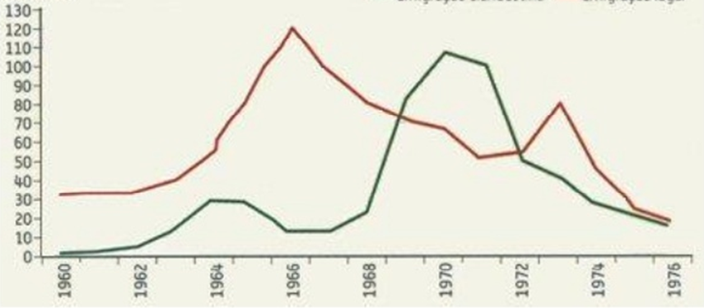
Here the ones that leave
Evolution of portuguese migrations (1960-1976)
Legal Migrations
Ilegal Migrations

Slide 4
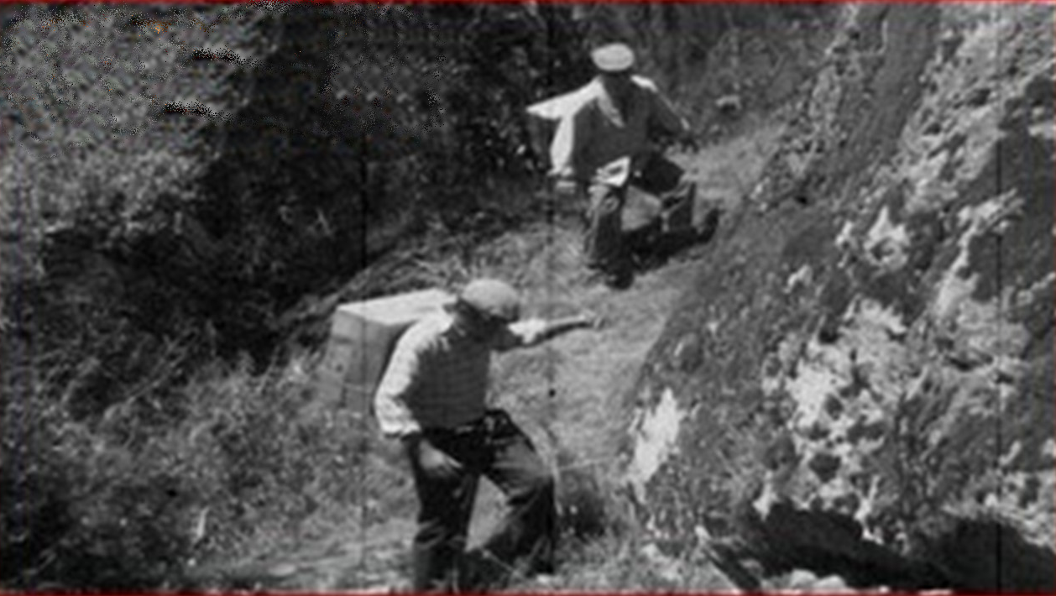
Why migrate…
Economic backwardness of our country and the low salary levels;
Dictatorship
Colonial war ,that makes a lot of young people ran away from military services
Failure of resources in portugal and a really low level of the population;

Slide 5
How you migrate…
Some portugueses go out of the country with fake documents;
Others like “tourists” waiting to find some job while it lasted your stay visa;
Some with one “job contract ” achieved for someone that already migrate before.
A lot “to jump”.
Emigration to jump – Clandestin Emigrations
(Emigração a Salto – Emigração Clandestina)

Slide 6
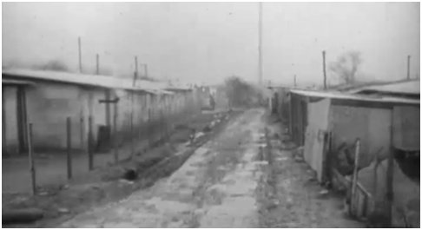
Live on the host country
Neighborhood of Portuguese emigrants in Champigny, France, where he came to reside about 20,000 immigrants in the late 60s.

Slide 7
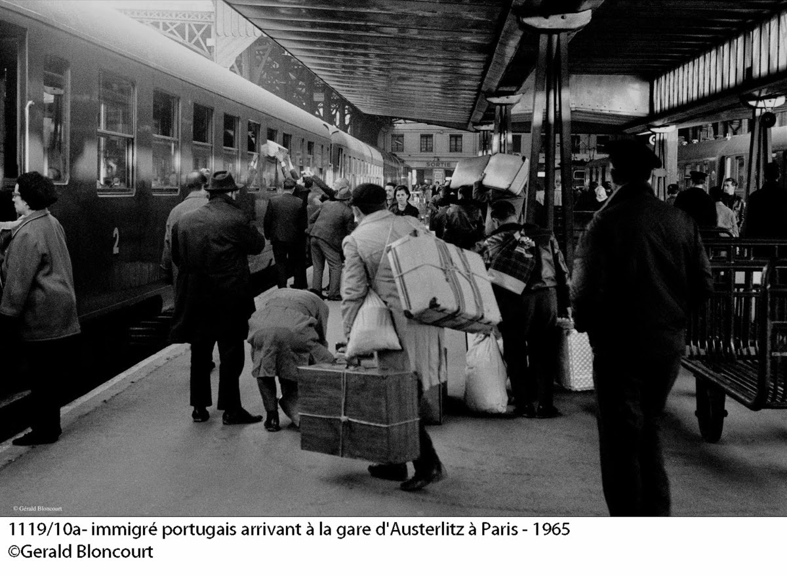
What we get and what we lose?
Contact with another cultures and countries open the mentality of portuguese people.
In the beggining of the 70s the money that portuguese take to portugal was represent by more than 6 from GDP.
With migration we lose a lot of people that was working on portugal
We get one ageing of population because the young people were migrating a lot
Afect the families separate fathers from the sons or couples when only the man migrate.

Slide 8
Webgraphy
http://ensina.rtp.pt/artigo/sessenta-anos-de-emigracao-portuguesa/
http://www.prof2000.pt/users/elisabethm/geo10/index9_ficheiros/evoluimi.jpg
http://www.prof2000.pt/users/elisabethm/geo10/index9_ficheiros/desti.jpg
https://www.google.pt/search?q=emigra%C3%A7%C3%A3o+na+decada+de+60+portugal&source=lnms&tbm=isch&sa=X&ved=0ahUKEwjG8f7cpvrXAhXDXhQKHaK9CTcQ_AUICigB&biw=1422&bih=761#imgrc=_

Slide 9
Work by: André Pereira, Filipa Geraldo & Matilde Santana
Teachers: Ana Luz, Antónia Salgueiro, Cristina Ferreira & Helena Roquete
Thanks for Watching!
(Please don’t ask too much )

