Slide 1
Personalities with a migration background
Daniel Chodowiecki, Franz Winterhalter, Christoph Waltz
(Team Germany)

Slide 2
Overview
1. Daniel Chodowiecki
General Information
Life
Examples
2. Franz Xaver Winterhalter
General Information
Life
Examples
3. Christoph Waltz
General Information
Early Life & Career
Personal Life

Slide 3
Daniel Chodowiecki – General Information
Born 16th October 1726 in Danzig
Died 7th February 1801 in Berlin
Was a Polish – and later German – painter and printmaker
He had 6 daughters and 3 sons
Was one of the closest friends to Johann Wolfgang von Goethe

Slide 4
Daniel Chodowiecki – Life
Was able to make a living as an etcher (what he was most famous for)
Became the most famous German graphic artist of his time
In 1797 he was appointed as director of the Academy of Arts in Berlin
Buried at the Französischer Friedhof cemetery in Berlin

Slide 5
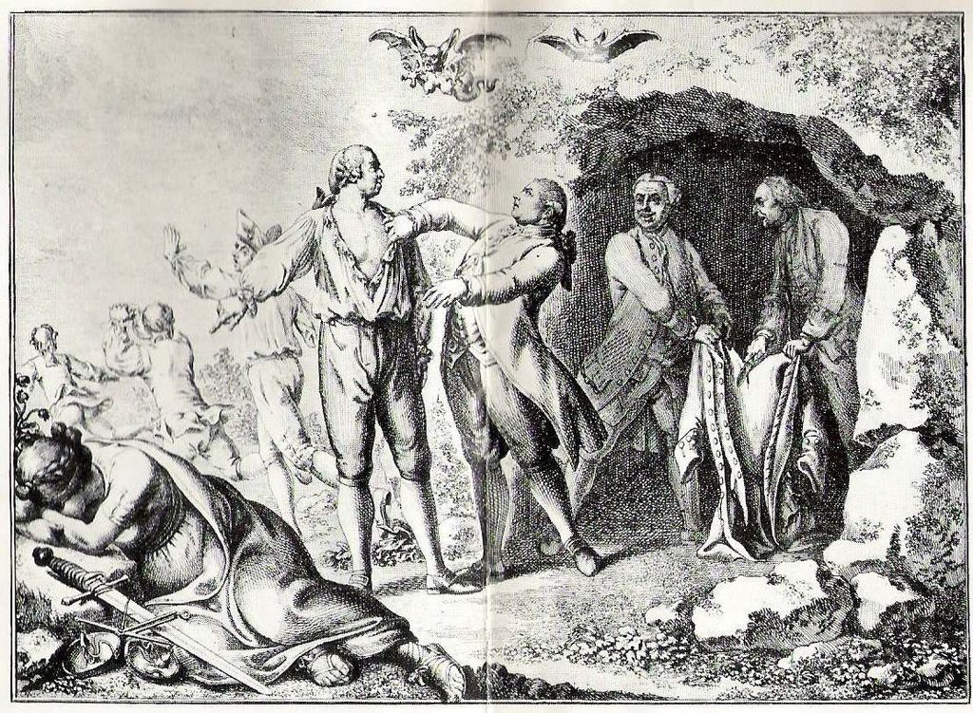
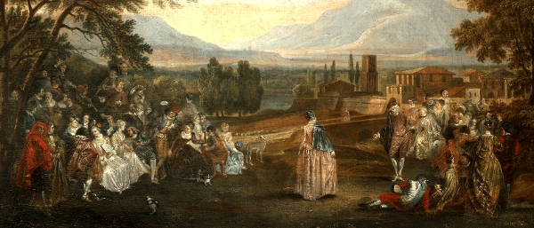
Daniel Chodowiecki - Examples
Cartoon etching 1781 on the partition of Poland
Minuet in the Park, 1760‘s (National Museum of Warsaw)

Slide 6
Franz Xaver Winterhalter – General Information
Born 20th April 1805 in Menzenschwand
Died 8th July 1873 in Frankfurt
Was a German painter and lithographer known for his portraits of royality in mid-19th century
One of his best know works are “Empress Eugénie surrounded by her Ladies in Waiting” (1855) and the portraits of Empress Elisabeth of Austria (1865)

Slide 7
Franz Xaver Winterhalter – Life
Left his hometown and went to Freiburg at the age of 13 to study drawing and engraving
At the age of 18 he went to Munich and began a course of study at the Academy of Arts in Munich
Worked in Paris, Austria, England, Switzerland, Belgium, Italy and Poland
Some of his works are shown in the Buckingham Palace and the National Museum of Warsaw
Notes:
Like a modern european today

Slide 8
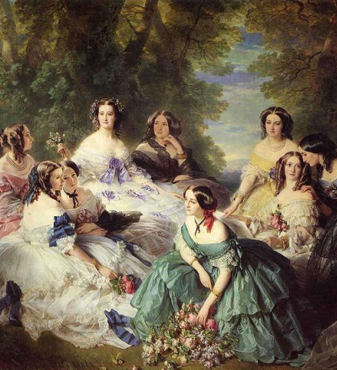
Franz Xaver Winterhalter – Examples
“Empress Eugénie surrounded by her Ladies in Waiting” (1855)

Slide 9
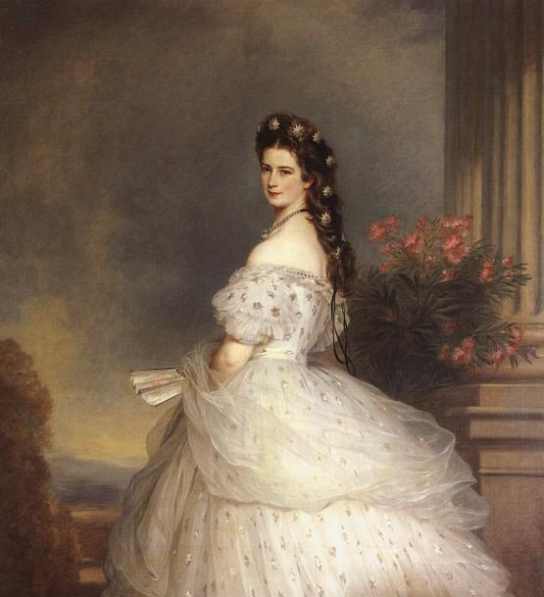
Franz Xaver Winterhalter – Examples
„Elisabeth of Bavaria, Empress of Austria“ (1865)

Slide 10
Christoph Waltz – General Information
Born 4th October 1956 in Vienna
German-Austrian actor, director and voice actor
Widely known for his work with American filmmaker Quentin Tarantino
Inglorious Basterds (2009), Django Unchained (2012)
Won an Academy Award (Oscar), British Academy Film Award, Golden Globe Award and a Screen Actors Guild Award

Slide 11
Christoph Waltz – Early Life & Career
Parents are Johannes Waltz and Elisabeth Urbancic
Studied acting in Vienna
Spent some time in New York City studying method acting in the late 1970‘s
Started his career as a stage actor in Zurich and Vienna
Became a television actor from 1980 – 2000

Slide 12
Christoph Waltz – Early Life & Career
After playing the role of the SS-Standartenführer Hans Landa in Quentin Tarantino‘s movie „Inglorious Basterds“ he received a lot of Awards for Best Actor and Best Supporting Actor
He is the only actor to have won an Oscar for playing a character in a Quentin Tarantino film

Slide 13
Christoph Waltz – Personal Life
He has 3 children with his former wife and a daughter with his second wife
They‘re dividing their time living in Berlin, London and Los Angeles
His native language is German and he is fluent in English and French
He was born in Vienna to a German father who applied for him to become a citizen of Germany after his birth
He received the Austrian citizenship in 2010, thus holding citizenship both of Austria and Germany

Slide 14
Christoph Waltz – Personal Life
He considers himself more Austrian than German despite having the German citizenship since birth
"I was born in Vienna, grew up in Vienna, went to school in Vienna, graduated in Vienna, studied in Vienna, started acting in Vienna – and there would be a few further Viennese links. How much more Austrian do you want it?"

Slide 15
Thank you for your attention

