Slide 1
MIGRATIONS OF POLISH POPULATION
Then and now

Slide 2
Migrations in history
The turn of the XIX and XX centuries: Trips to industrial districts of Europe and North America to earn money.
After the First World War: Trips to France and Belgium, where was a lack of employess.
Years 1939 – 1945: Mass, forced displacement of the Polish population that had been living in areas occupied by Russian troops. Many Polish deported from areas occupied by Germany to labour camps.
After the Second World War: Territorial changes - displacement from the Eastern Borderlands to the former German territories and repatriation of the population from the USSR (1945 – 1949).
70’s and 80’s: Trips to highly developed countries in order to earn money and political emigrations.
After 1989: Trips to countries of Western Europe in order to earn money.

Slide 3
Migrations now
Now, people from Poland mainly emigrate because they need a job. These are especially young people. They leave to Great Britain, Germany or Austria. They sometimes leave to the USA. These people usually go there forever and they only sometimes visit their family.
We usually emigrate on holiday to different states. We go there with our family or friends. We leave Poland because we have buissness activities or we must have got operation in other country. These migrations are temporary. We go there for few weeks or months.
Sometimes people have family abroad or their spouse is a foreigner. This type of migration is often permanent.

Slide 4
Migrations of famous Polish people

Slide 5
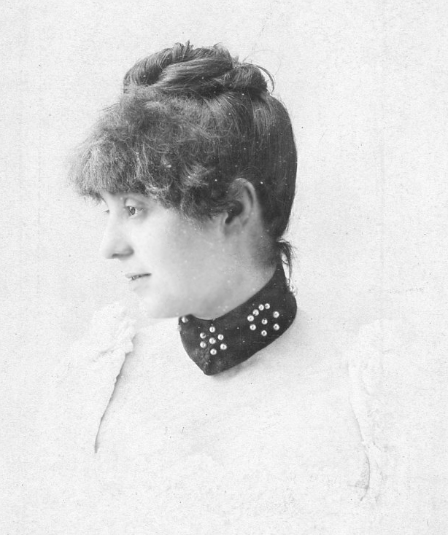
Gabriela
Zapolska

Slide 6
Gabriela Zapolska
Maria Gabriela Stefania Korwin-Piotrowska known as Gabriela Zapolska, was a Polish novelist, playwright, naturalist writer, columnist, theatre critic and stage actress.
She is the author of „The Morality of Mrs. Dulska” or „One Day in the Life of a Rose”
In 1904 she moved to Lwów and married a painter, Stanisław Janowski. She became a patron of the travelling theatre named after her (Gabriela Zapolska Theatre) which during the years of 1907–1908 toured Galicia. She divorced her second husband in 1910.
In 1915, after Lwów was captured by the Russian Army, she ran a small confectionery. Zapolska died on 17 December 1921 in Lwów (now Lviv, Ukraine) and buried at the Lychakivskiy Cemetery there.

Slide 7
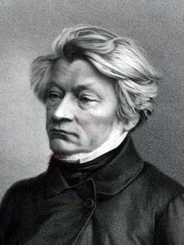
Adam Mickiewicz

Slide 8
Adam Mickiewicz
He was born in 1798 in Poland. He is a principal figure in Polish Romanticism, he is counted as one of Poland's "Three Bards" and is widely regarded as Poland's greatest poet. He is known mainly for the poetic drama „Dziady” and the national epic poem „Pan Tadeusz”.
Mickiewicz was banished to central Russia in 1824. He crossed the border into Russia about 11 November 1824, arriving in Saint Petersburg later that month. He spent the next five years in Saint Petersburg and Moscow, except for a notable 1824 to 1825 excursion to Odessa, then on to Crimea. That visit, from February to November 1825, inspired a notable collection of sonnets.

Slide 9
Adam Mickiewicz
Adam Mickiewicz met a lot of influential inviduals in Moscow. They helped him obtain passport and permission to leave Russia for Western Europe.
He visited Prague and then he returned to Weimar. Next he was in Germany and Italy. When in Poland the November Uprising broke out he was in Rome. Mickiewicz stayed several months in Dresden, in Saxony, where he wrote the third part of his poem "Dziady".
On 31 July 1832 he arrived in Paris. In 1834 he published another masterpiece, his epic poem "Pan Tadeusz".
He visited Constantinople in 1855 where he died on 26 November 1855. Now he is buried in Wawel in Poland.

Slide 10
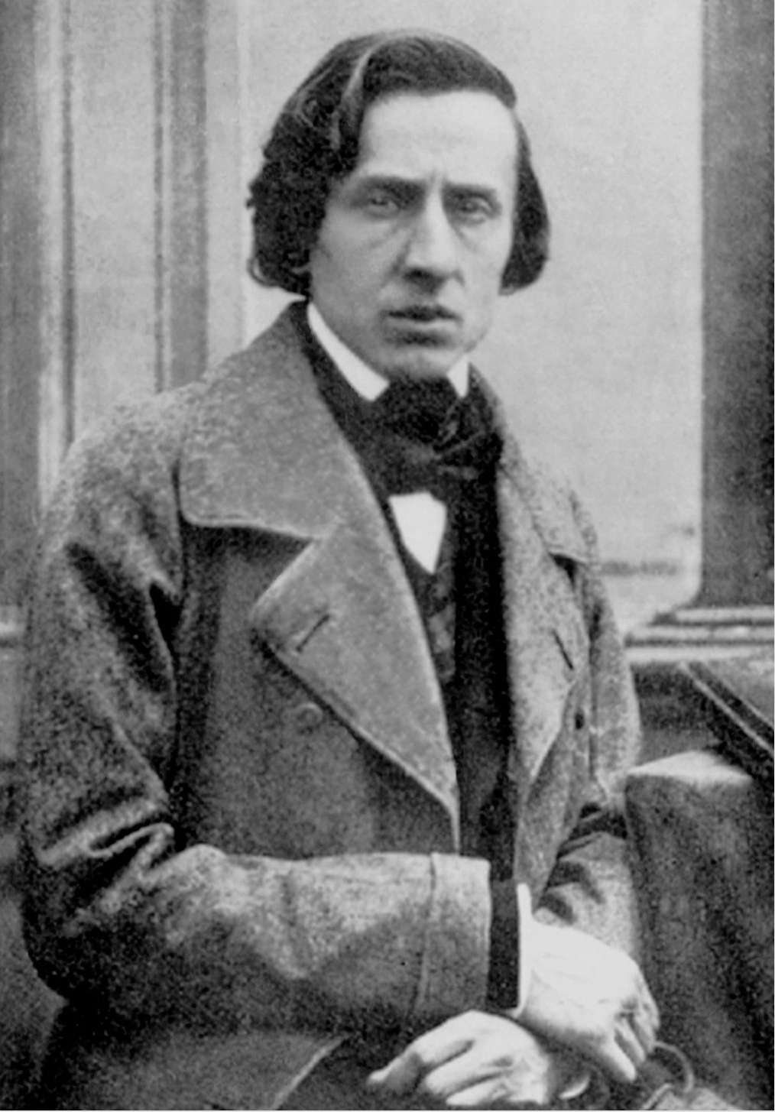
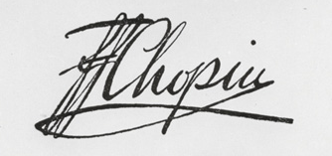
Fryderyk
Chopin

Slide 11
Fryderyk Franciszek Chopin
Fryderyk Franciszek Chopin was a Polish composer and virtuoso pianist of the Romantic era. Chopin was born on 1 March 1810 in the Duchy of Warsaw and grew up in Warsaw. He completed his musical education and composed his earlier works in Warsaw before leaving Poland at the age of 20, less than a month before the outbreak of the November Uprising.
He took up residence in Paris when he was 21. During the last 18 years of his life, he gave only some 30 public performances. He obtained French citizenship in 1835.

Slide 12
Fryderyk Franciszek Chopin
In April, during the Revolution of 1848 in Paris, he left for London, where he performed at several concerts and at numerous receptions in great houses.
Chopin made his last public appearance on a concert platform at London's Guildhall on 16 November 1848, when, in a final patriotic gesture, he played for the benefit of Polish refugees.
At the end of November, Chopin returned to Paris. He died there in 1849, at the age of 39, probably of tuberculosis.

Slide 13
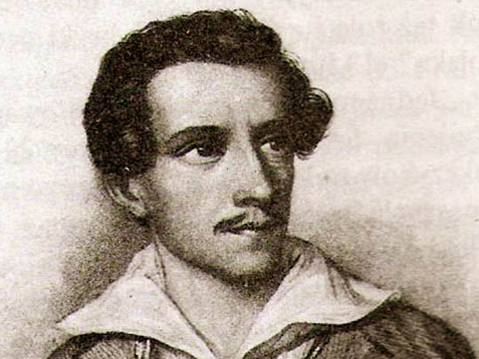
Juliusz
Słowacki

Slide 14
Juliusz Słowacki
He was a Polish Romantic poet. He is considered one of the "Three Bards" of Polish literature — a major figure in the Polish Romantic period, and the father of modern Polish drama.
When the uprising ended in defeat, he found himself abroad and thereafter, like many compatriots, lived the life of an émigré. He settled briefly in Paris, France, and later in Geneva, Switzerland. He also traveled through Italy, Greece and the Middle East. Eventually he returned to Paris, where he spent the last decade of his life. He briefly returned to Poland when another uprising broke out during the Spring of Nations

Slide 15
Juliusz Słowacki
Arrested by the Prussian police, Słowacki was sent back to Paris. On his way there, he passed through Wrocław, where in mid-June he was reunited with his mother, whom he had not seen for almost twenty years. He returned to Paris in July 1848.
Słowacki died in Paris on 3 April 1849 of tuberculosis, and on 5 April he was buried in the Montmartre Cemetery in Paris.

Slide 16
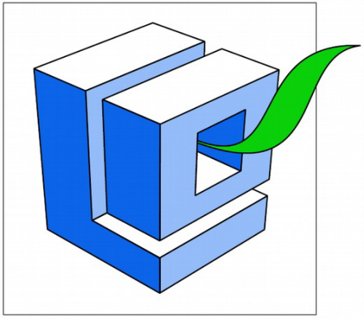
Made by Agata Wróbel, Natalia Miedzińska
For Erasmus Migrations Matters
Projekt „Migration Matters”- współfinansowany w ramach programu Unii Europejskiej Erasmus+
„Publikacja odzwierciedla jedynie stanowisko jej autorów i Komisja Europejska oraz Narodowa Agencja Programu Erasmus+ nie ponoszą odpowiedzialności za jej zawartość merytoryczną”.

Slide 17
The End
Thanks for watching

