Slide 1
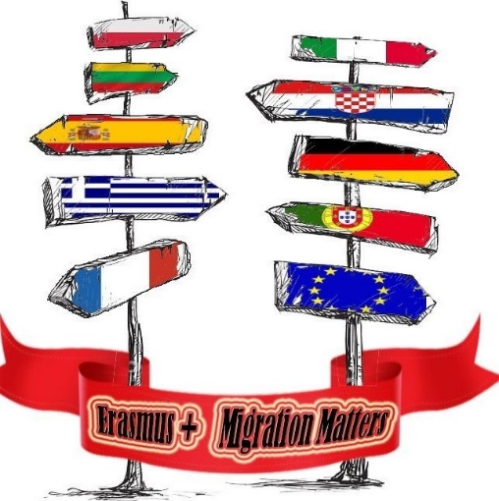
The legend of the cravat

Slide 2
The meaning of the word cravat
Cravat – a scarf or piece of cloth worn around the neck as a tie
The word “cravat” stems from the French term “cravate” – “Croat” because Croatians were the ones who popularised the fashion of wearing a scarf tied around the neck.
Encyclopedia Britannica states under the noun cravat that it derives from Crabate, Cravate, Croatian, and that the appearance of the cravat dates from 1656. Diderot-D’Alambert Encyclopedia from 1754 links the cravat with Croats

Slide 3
The legend of the cravat
As with many other great things which marked humanity, behind the story of the cravat lies love as its source and inspiration
Croatian girls have always tied a scarf around the necks of their fiancés as a sign of their mutual love and devotion

Slide 4
This was the sign of their mutual commitment, and also a way to show their love to the world
The importance of this act dramatically increased in times of war
Through it, the women promised their fiancés that they were ready to wait for them for years, while the men - the soldiers - found solace and encouragement in this in the most difficult moments in the battlefield

Slide 5
MIGRAtion : croatian soldiers in Paris
The key moment in the history of the cravat took place during the Thirty Year War, in the 17th century
The Croatian light cavalry was famous for its exceptional bravery Part of the cavalry entered the service of the French king
In addition to military prowess and bravery, Croatian soldiers were also famous for one original detail - a red scarf around their necks
The fashion conscious Parisians immediately noticed this

Slide 6
In contrast with the high stiff collars of the time, Croatian scarves were simple, picturesque, airy and on top of it, elegantly tied into a knot
That fashion novelty was enthusiastically accepted at the court of King Louis XIV. The cravat, as a sign of dignity and civility, courtesy and ceremony, soon conquered the current civil fashion and first won over Europe, then America, and now the entire world

Slide 7
Cravat – a universal symbol
Cravat is a universal symbol of elegance and male dress culture, but its powerful symbolic potential implicates many other values
The vertical of the cravat symbolizes the human vertical – human dignity and self confidence, moments of ceremony and celebration, successfulness and business spirit…
With its airiness at one end, and a knot at the other, the cravat “ties” freedom and responsibility
It encourages us to be more aware of our own and other people’s dignity, of our freedom but also of our responsibilities

Slide 8
Cravat is not “just” an accessory
Cravat has a much deeper significance – Croatian cultural and historical heritage
Its very shape and appearance represent a balance between responsibility and freedom, which is the basis of democracy

Slide 9
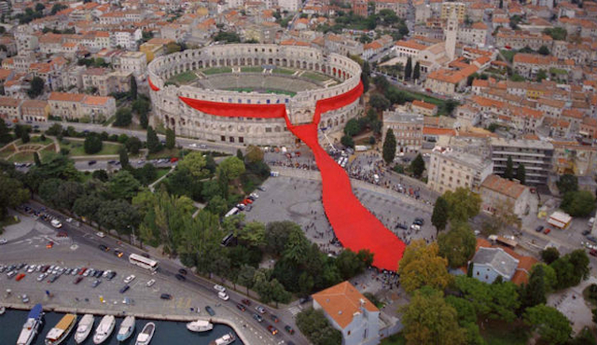
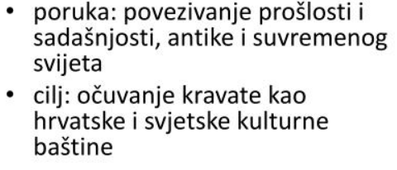
Some Interesting facts about the cravat
In 2003 the photo of the longest cravat in the world, tied around the Pula Arena, Croatia, spread around the world
This is how a cravat which was 808 m long and which weighed 800 kg got into the Guinness Book of World Records
The message: bringing together the past and the present, classical antiquity and modern world
The aim: preserving the cravat as Croatian and world heritage

Slide 10
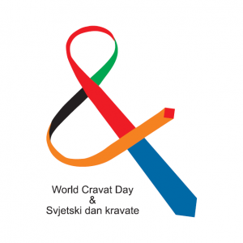
The cravat has been honoured by the Croatian Parliament.
Since 2008, 18 October has been celebrated as Cravat Day

Slide 11
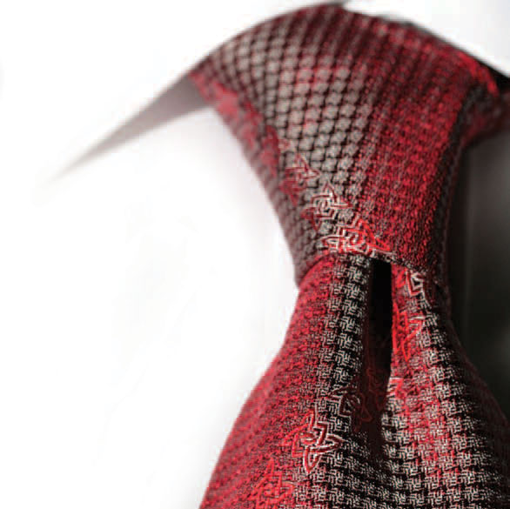
Cravat quotes
Oscar Wilde
” A well-knotted cravat is the first serious step in a man’s life.”
Norman Davies, a British historian, Europe: A History
”In all situations, people who underrate the influence of smaller nations should remember that Croats hold us all by our necks.”
Luca Goldoni, a writer
” If Freud had watched his patients’ cravats, he would not have had the need to listen to their dreams.”

Slide 12
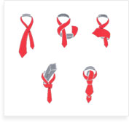
A workshop on how to tie a tie

Slide 13
Throughout history, the cravat was a symbol of accepting Croatians as a nation and accepting their culture
Nowadays, it is a symbol of human bonding and strengthening of friendships

Slide 14
Thank you for your attEnTion
Croatian team
Viktor, Juraj i Dorijan

