Slide 1
Workmigration
New Home
Erasmus Project 2017
Alexandra P. , Dilara M.

Slide 2
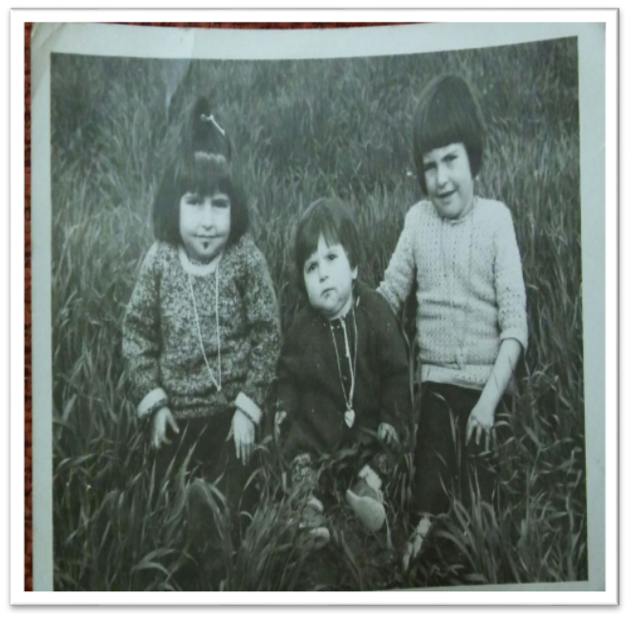
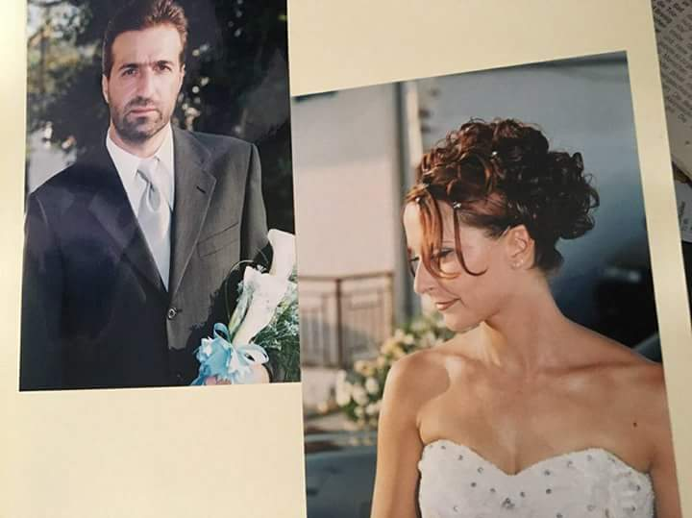
When did our parents arrive in Germany?

Slide 3
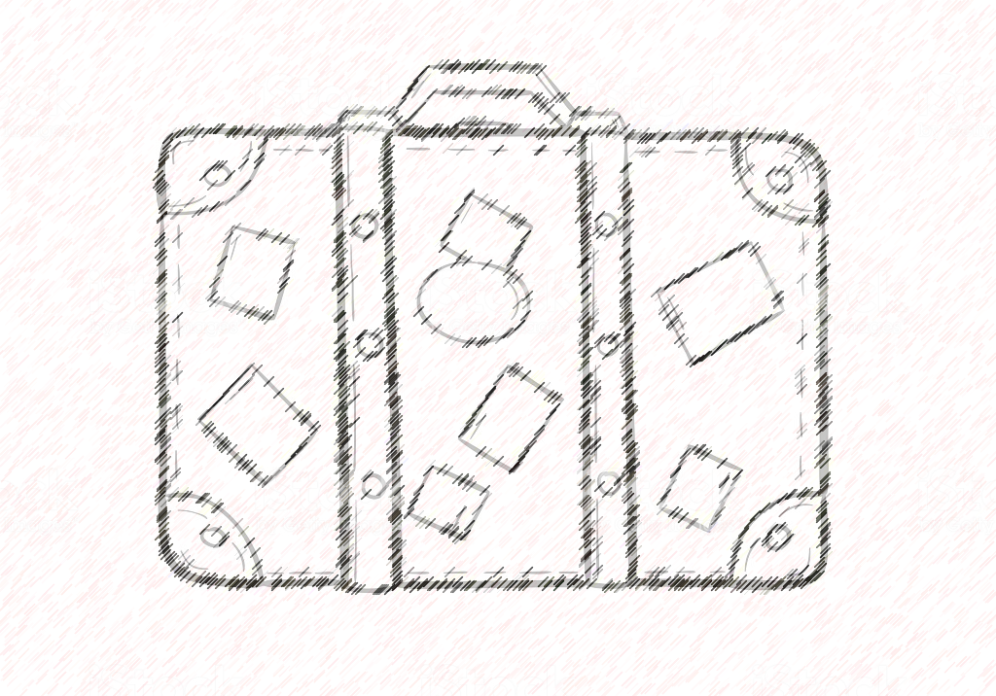
Why our parents had to move?
Main action: Work
Better possibilities for education
Political situations
Bad life-conditions in their homecountry
Bad or none Social support from their homeland

Slide 4
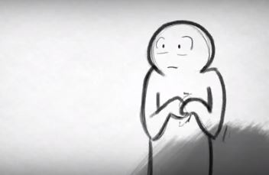
What kind of feelings/fears did they have before their trip ?
Couldn‘t realize it Happiness , Luck, Excitement New adventures New friends, new school Completely different environment | Had to leave their family, friends in their homecountry How can I reorient myself in this country? Anger towards everybody even the parents → in childhood

Slide 5
What kind of difficulties did they face?
Cultural difficulties
New way of life→ Customs
New language
Hide their sense of shame → not being able to be themselves
Food

Slide 6
Before and after , what‘s changed ?
Before | After
-Poorness -strict household-rules -strict nuture -stressfull days -children had to work on fields -children had to raise their sibblings -youth didn‘t use to be so free -youth depended on their parents | -no strict household-rules -more jobs → access to money -neglect their own culture -new generations aren‘t as comfortable with their culture -forgotten origins -new way of life (eingedeutsch) -

Slide 7
What are our parents craving?
Warm-hearted humans ( from their homecountry)
The typical scent of home
The climate
Feeling free showing their beliefs
Ease of mind
The food and the beach
Family time

Slide 8
What are they missing?
Warm-hearted humans ( from their homecountry)
The typical scent of home
The climate
Feeling free showing their beliefs
Ease of mind
The food and the beach
Family time

Slide 9
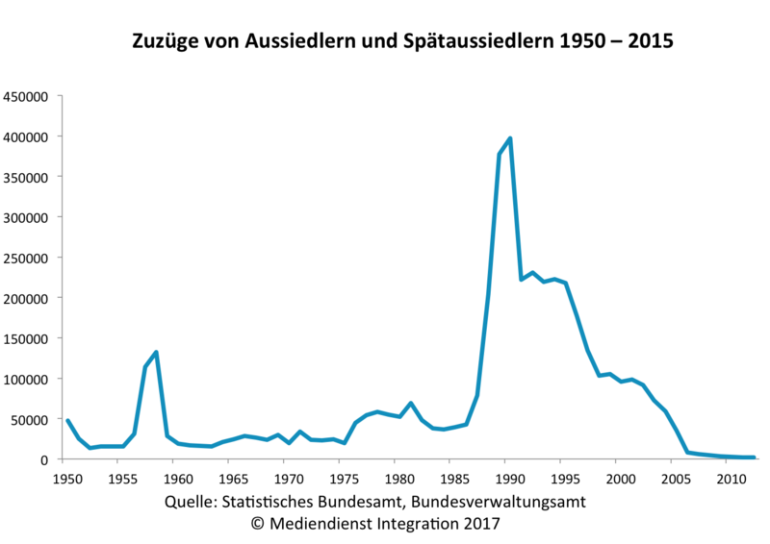
Immigration to Germany 1950 - 2015

