Slide 1
Migrations
and
globalization processes

Slide 2
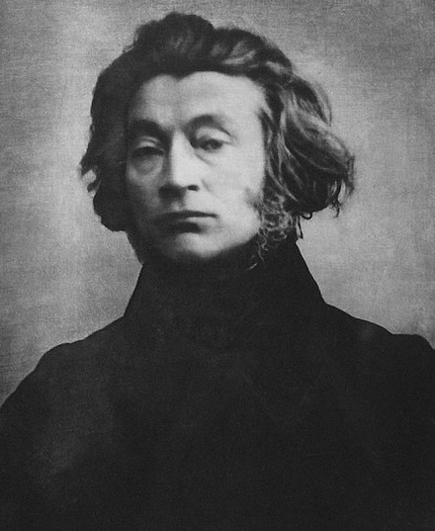
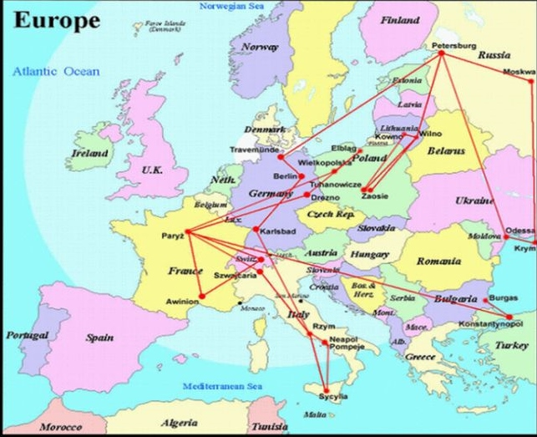
The great example of influence of migrations on art is Polish national bard Adam Mickiewicz. He held a huge travel through Europe which brought him a lot of inspiration for his works.
One of the examples can be his journey among the Crimea which fructified arising of „The Crimea Sonnets”.

Slide 3
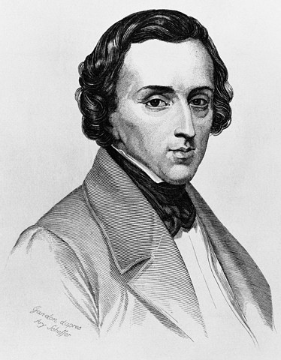
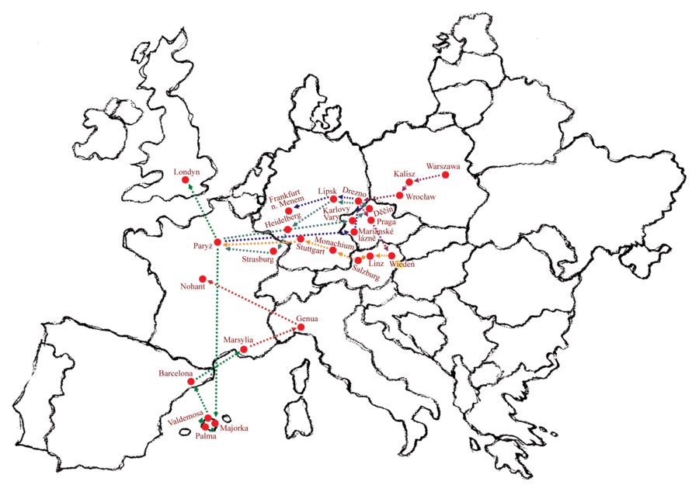
Next of great examples of this influence is Fryderyk Chopin. He was travelling through Europe, took part in The Great Migration and arrived to Paris. Many cultures in France influenced on his works.

Slide 4
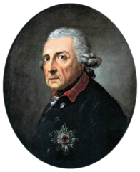
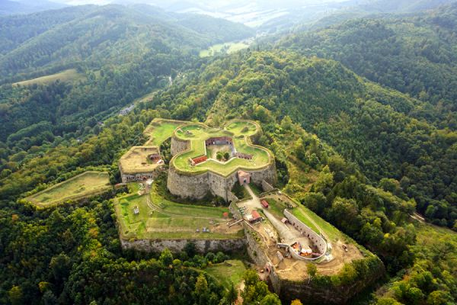
Influence of migrations and globalization on architecture is seen in Srebrna Góra Fortress. It was built for Prussian king’s, Frederick the Great, initiative. It is an example of Prusian influence on architecture in Poland.

Slide 5
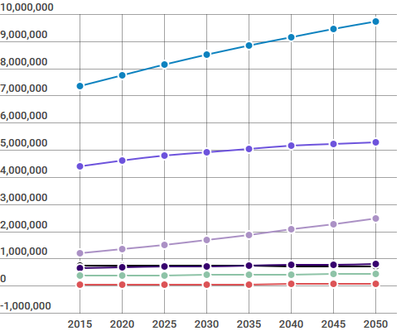
Population projection
World
Asia
Africa
Europe
Latin America and the Caribbean
North America
Oceania

Slide 6
Migrations projections
Based on contemporary situation in the world we can predict that people from the East will be moving to the western countries.
The reasons why people want to leave their countries are willingness to improve level of their education and lifestyle, what is more they want to feel safe.
Among European citiziens
will appear Asian and African people because of increasing number of population in their motherland.

Slide 7
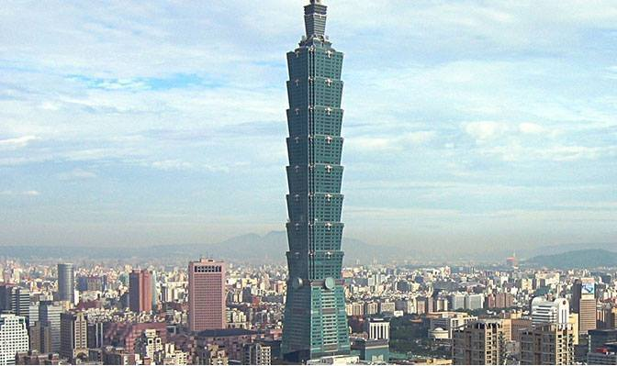
How do we see future?
Migrations and globalization processes will have great influence on architecture and arts. The influx of people from different parts of the world will cause bringing elements of other cultures into art in country where they will have come. The same situation will be with architecture, for example the influx of Asian people will cause that Asian ways of building will be used in Europe.

Slide 8
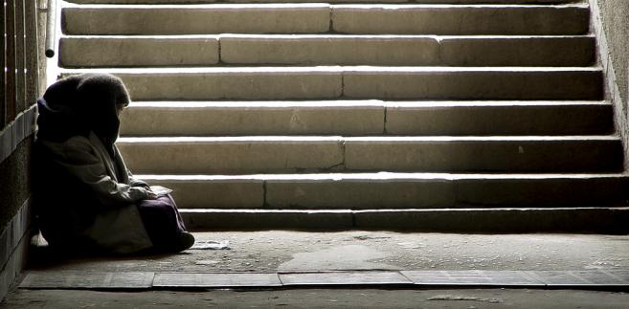
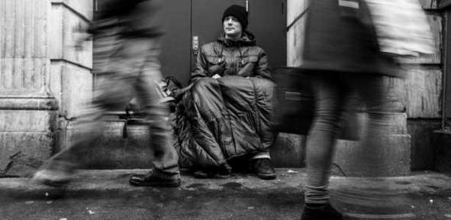
Future problems
Migrations will also cause problems like homelessness. Overpopulation will affect lack of places to live. The solution to this problem will be building more refuges for homelesses. Local leadership could give those poeple a job, help them to start a new life.

Slide 9
Thank you for your attention!
Weronika Muskała
Anna Głąbała
Piotr Pawlik

