Slide 1
Erasmus + Migration matters
Famous croatian migrants
Poland, 10 – 15 December 2018

Slide 2
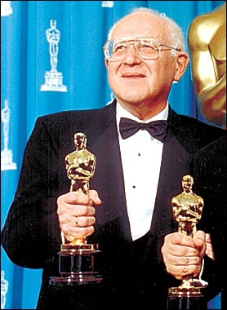
BRANKO LUSTIG
croatian producer AND ACTOR
of jewish origin,
the first Croatian two-time Oscar winner

Slide 3
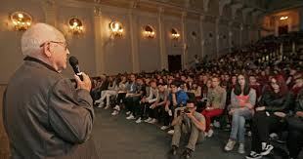
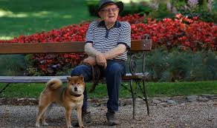
born in Osijek in 1932
he lived in Čakovec before and after World War II; his father was killed there in 1945
World War II concentration camps - Auschwitz and Bergen-Belsen – he survived Holocaust (so did his mother)
he spent 25 years in Hollywood as a producer and actor
now he lives with his family in Zagreb

Slide 4
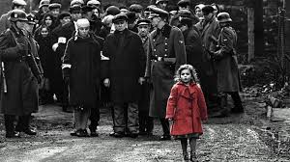
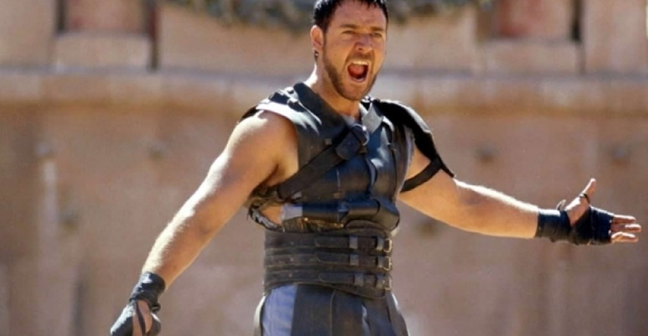
A scene from Schindler’s list (Oscar for production in 1993)
A scene from Gladiator
(Oscar for production in 2000)

Slide 6
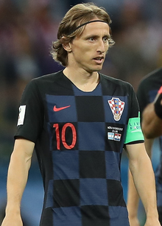
LUKA MODRIĆ
Named the best player in the world by FIFA in 2018
Named the best player in Europe by UEFA in 2018

Slide 7
born in Zadar
a refugee during the Croatian War of Independence
moved to Zagreb to play professional football
invited to play for Tottenham Hotspur
now he plays for Real Madrid and lives in Spain
the captain of the Croatia national football team

Slide 8
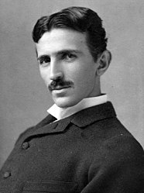
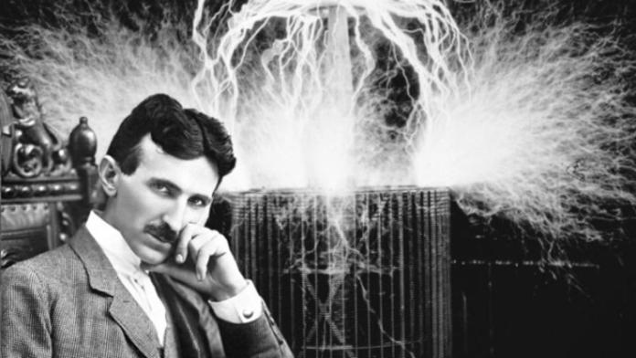
NIKOLA TESLA
One of the greatest world-famous Croatian scientists and the inventor of AC current

Slide 9
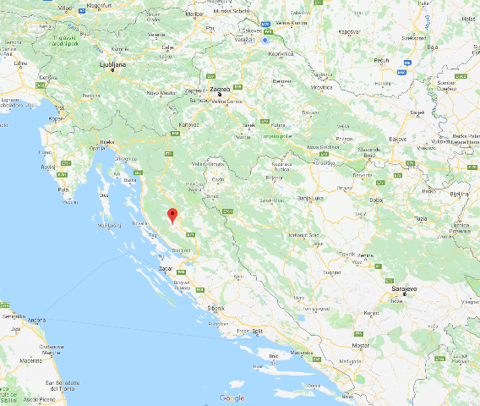
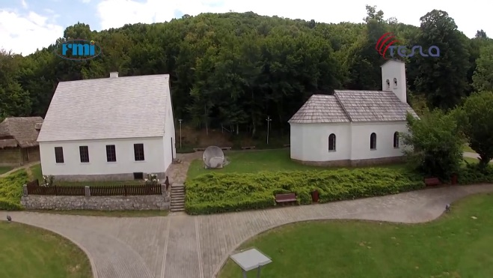
Early years
born and raised in Smiljan in 1856
of Serbian origin
in Karlovac he finished a 4-year gymnasium which took him only 3 years beacause he had eidetic memory

Slide 10
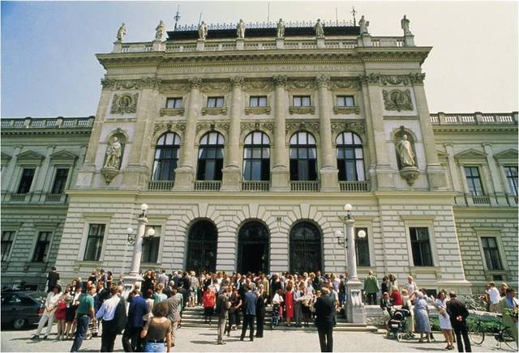
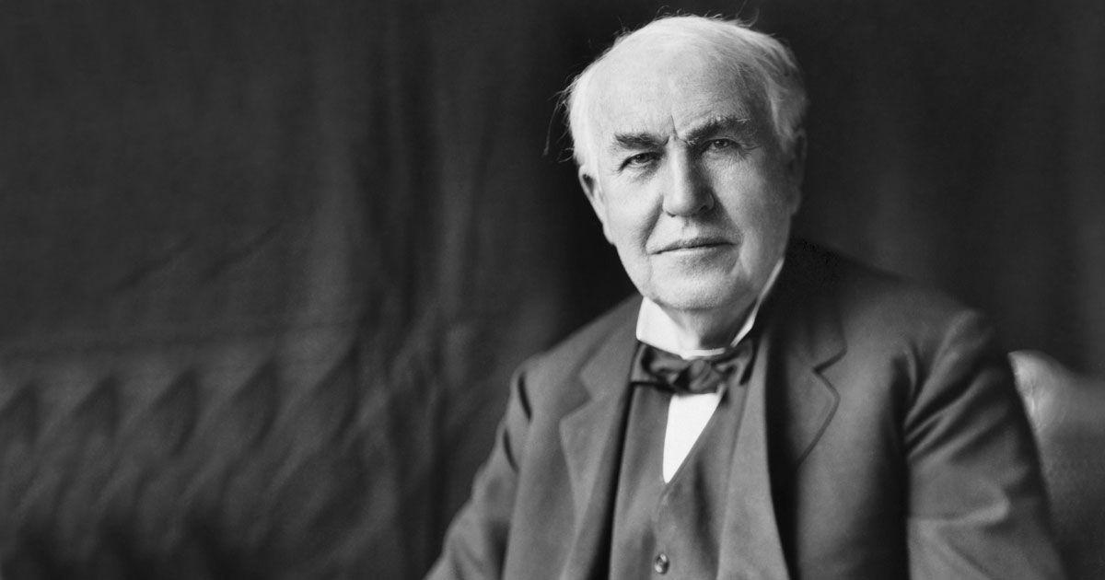
Migrations
he enrolled at Austrian Polytechnic in Graz but dropped out, then he worked in Budapest and Paris
he was invited to work for Thomas Edison in New York
a lot of his inventions were patented by Edison because he was the source of his materials and tools

Slide 11
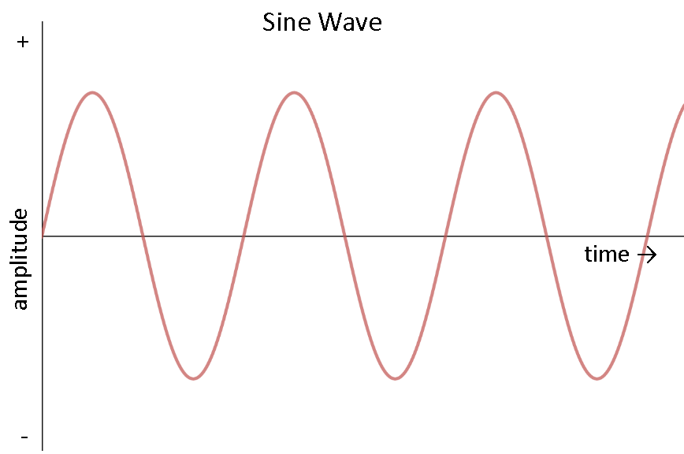
Famous experiments
AC Current

Slide 12
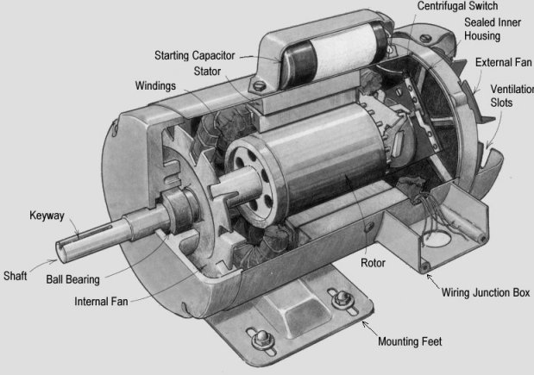
The Induction Motor

Slide 13
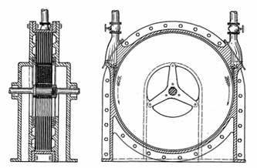
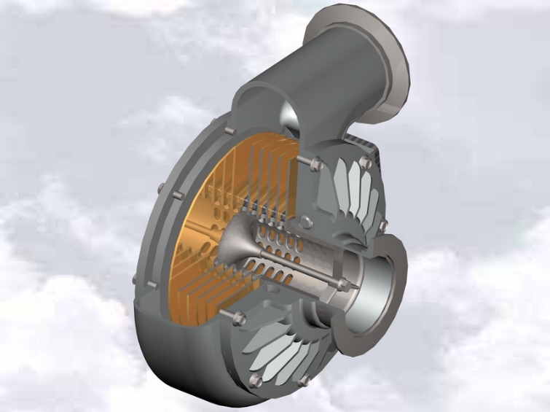
The Tesla Turbine

Slide 14
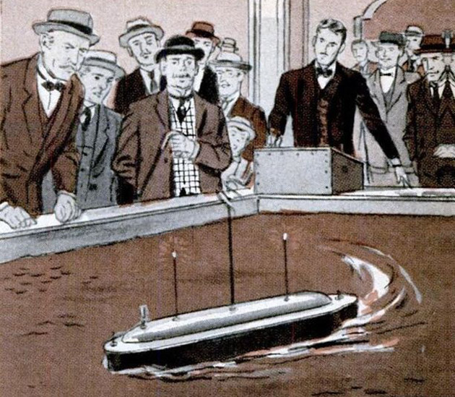
Radio remote control

Slide 15
Thank you for your attention!
Blagus Luka i Srpak Juraj
Čakovec , November 2018.

