Slide 1

ERASMUS+
MIGRATION MATTERS
Authors : Chojnacka Wiktoria, Najmanowicz Gabriela

Slide 2
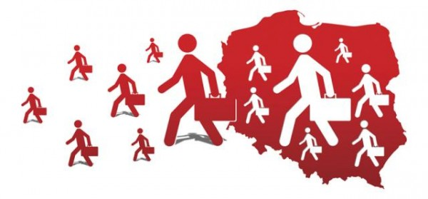
MIGRATIONS
IN POLAND

Slide 3

What is migration?
Migration of people is the movement of people from one place to another with the intentions of settling, permanently or temporarily, in a new place.

Slide 4
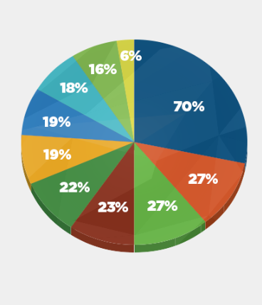
Reasons of migration
Higher earnings
People want to travel the world
People are looking for a perfect job
Higher standard of life
Excellent prospects of work
Family is living abroad
Better social issues
Better system of tax
Friendly public atmosphere
Safer place in case of geography

Slide 5
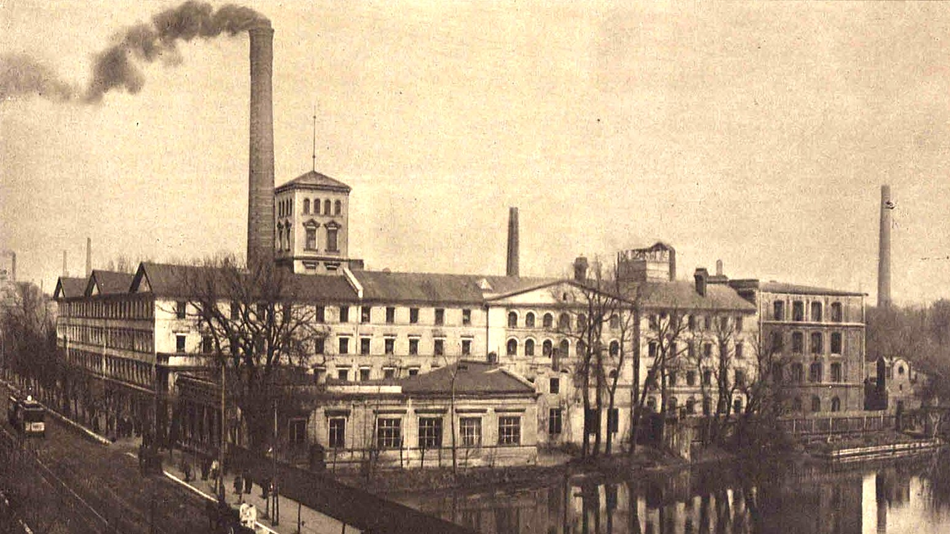
effects of
INTERNAL MIGRATION
Cotton factory in Łódź

Slide 6

effects
of emigrations

Slide 7
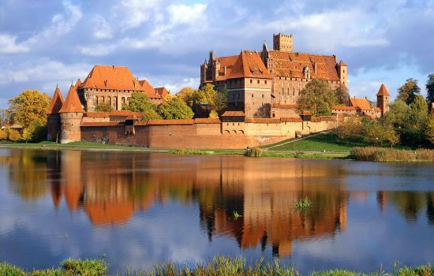
The influence on architecture of Teutonic Knights settling on Polish lands

Slide 8
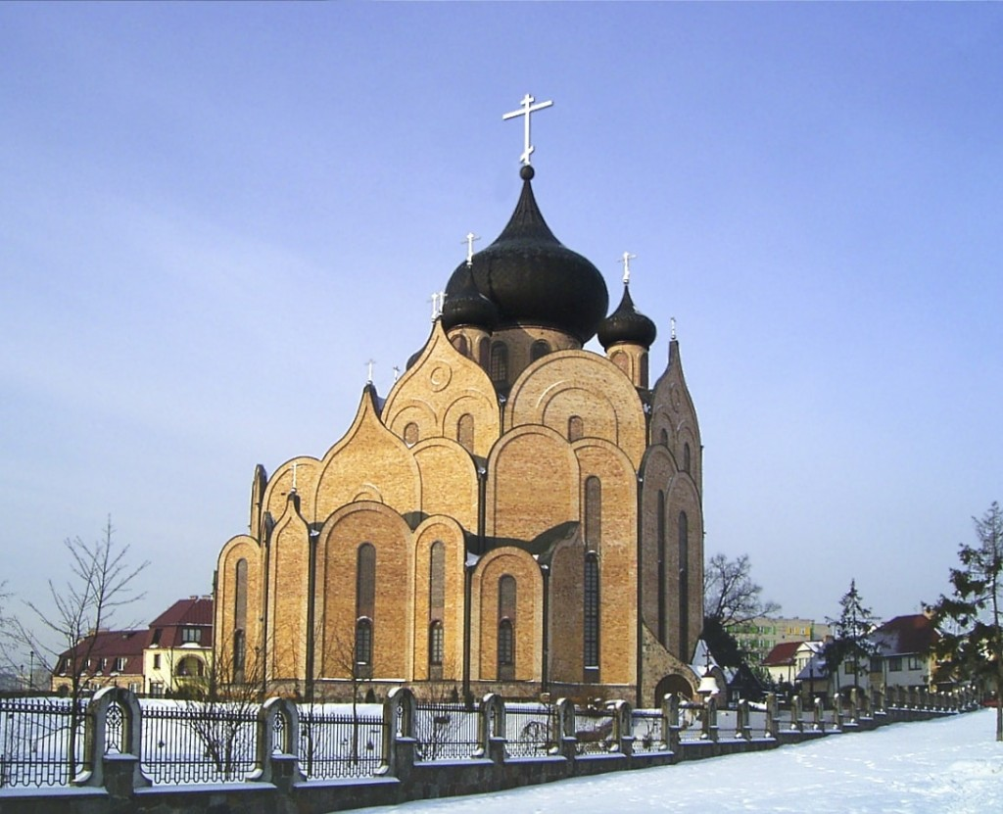
Traces of Orthodox emigrants
church in Białystok

Slide 9
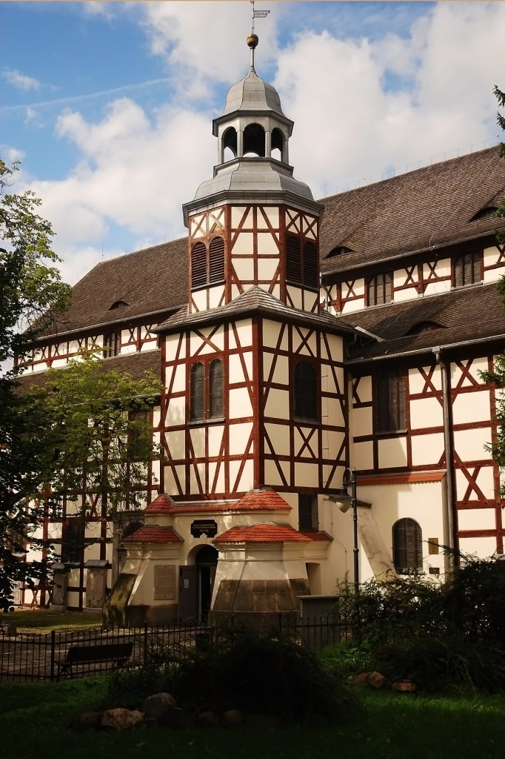
German building in Jawor

Slide 10
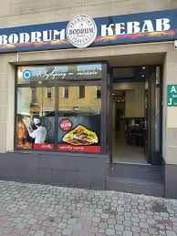

Traces of migration in Końskie

Slide 11

GLOBALIZATION
Globalization is the increasing interaction of people, states, or countries through the growth of the international flow of money, ideas, and culture.

Slide 12
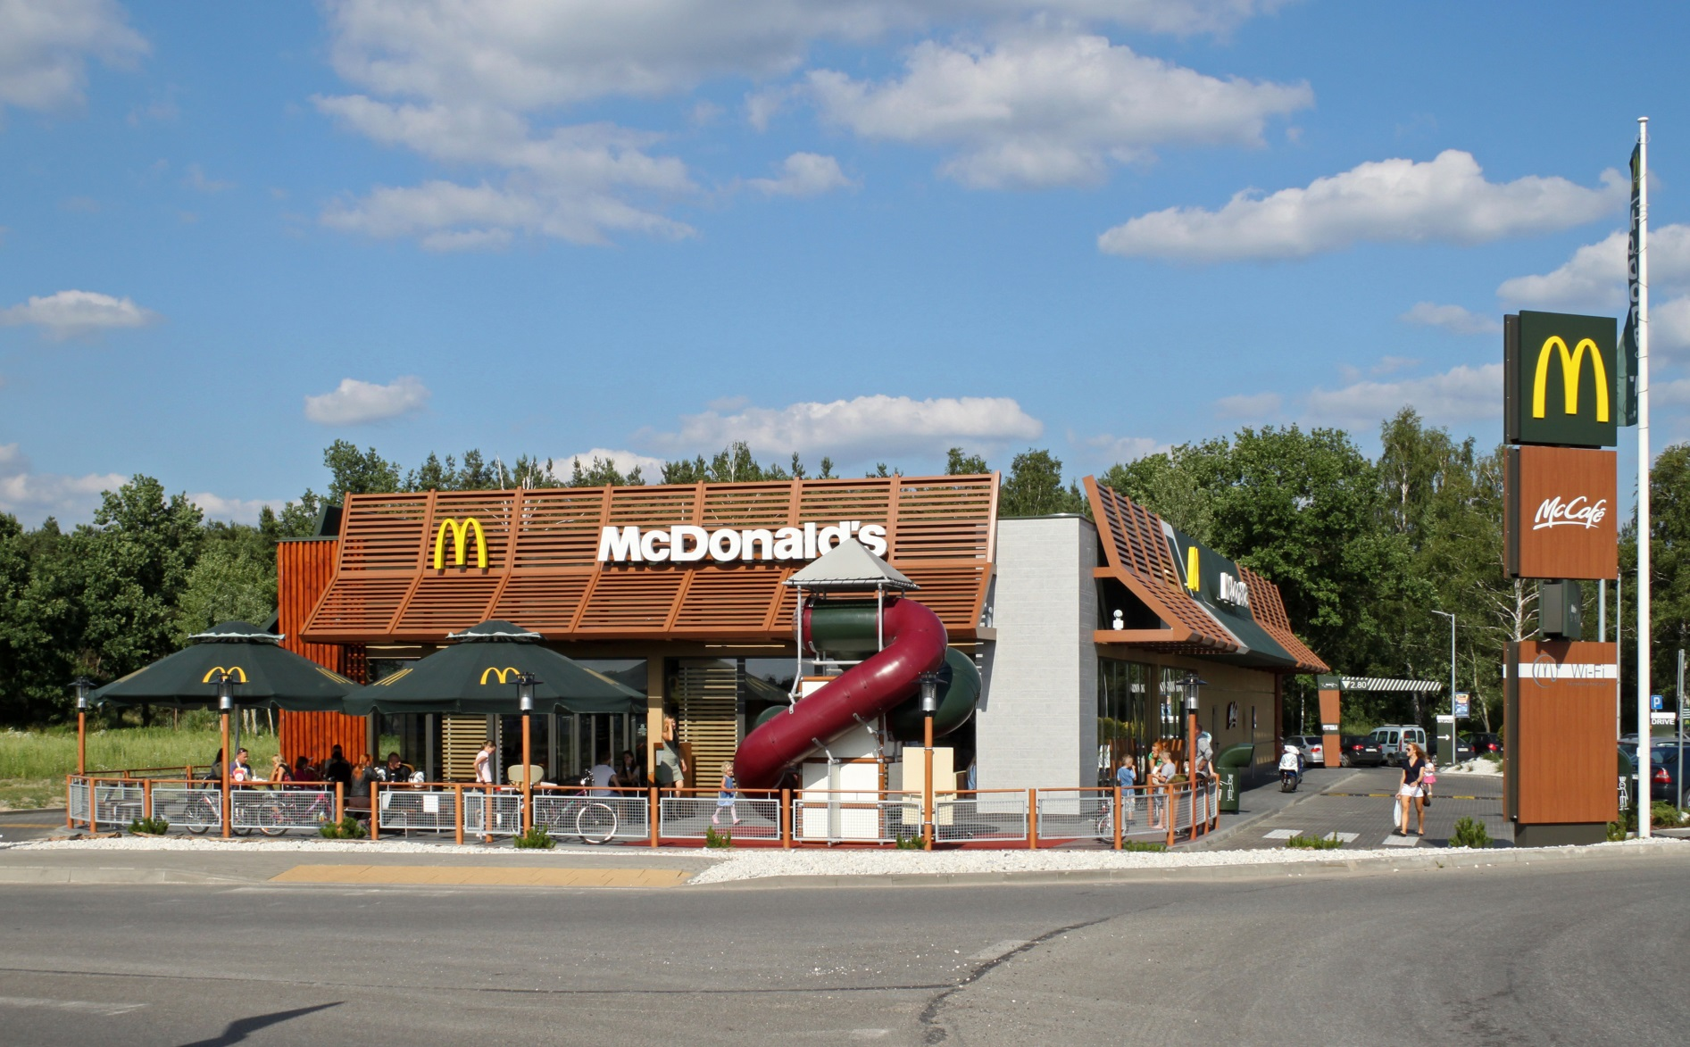
Traces of globalization
in Poland

Slide 13
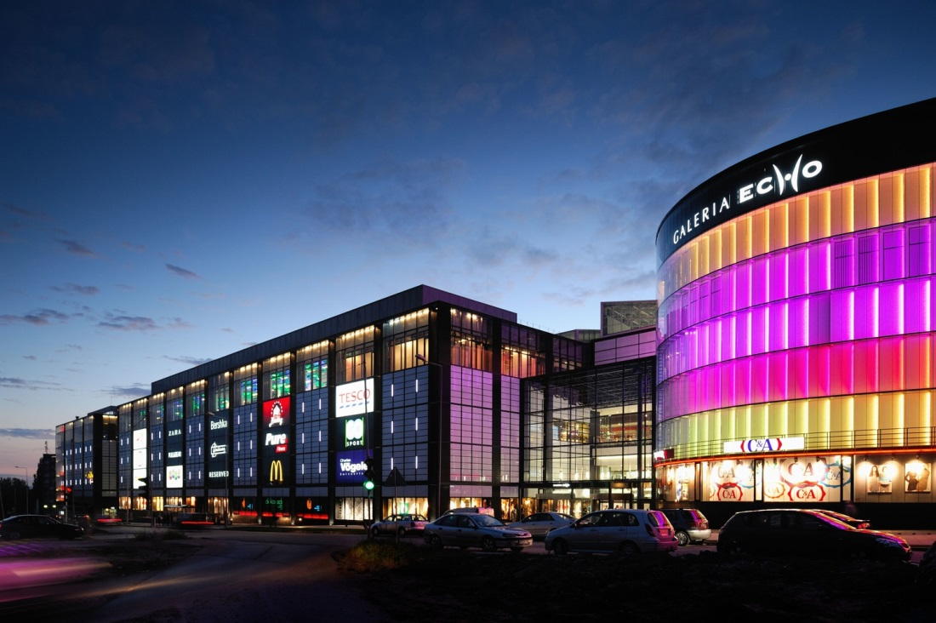
In Kielce, in the shopping center there are over 200 foreign stores

Slide 14
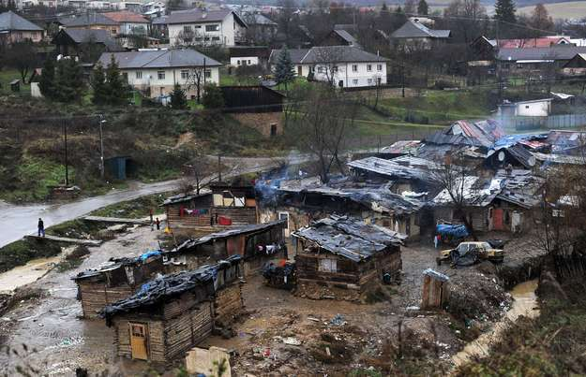
The problem of poor Gypsies in Poland

Slide 15
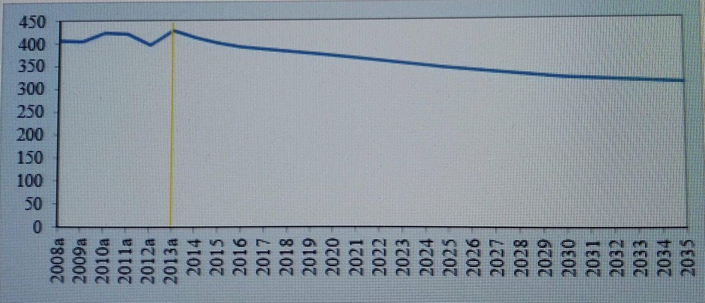
Forecast of migration movements until 2040
Internal migration (inflow/outflow) in 2014-2040 (in thous.)

Slide 16

Population growth forecast
by 2040
Changes in population size.
According to the forecast - in the whole forecasted period, the population of Poland will systematically decrease. The loss - compared to 2013 - will reach, at the end of the forecast horizon, PLN 4,545 thousand people, including as much as 98% of the anticipated decline in population size will affect cities. Already in the first two years it is expected to fall by almost 77 thousand people. However, significant changes will begin after 2015. Over the next five years - by 2020 - the population will decrease by 281 thousand, while in subsequent periods we will observe a significant acceleration of the pace of change. After 2035, every fifth of the forecasted period will be marked by a drop in the population by more than 800,000. By the end of 2050, the Polish population will reach 33,951,000, which is 88.2% of the state from 2013. Considering the division into urban areas and rural areas clearly show significant differences in the course of demographic processes.

Slide 17
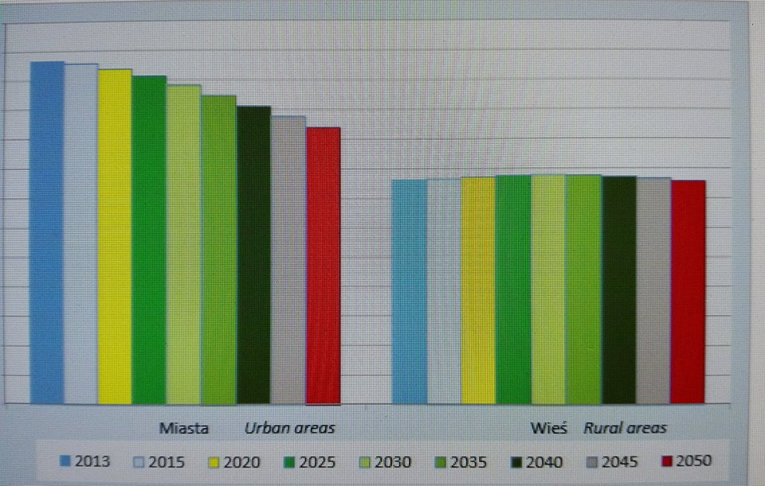
Projection of urban and rural areas population until 2050 (in mln)

Slide 18

THANK YOU FOR
YOUR ATTENTION

