Slide 1
Emigration in Lithuania

Slide 2
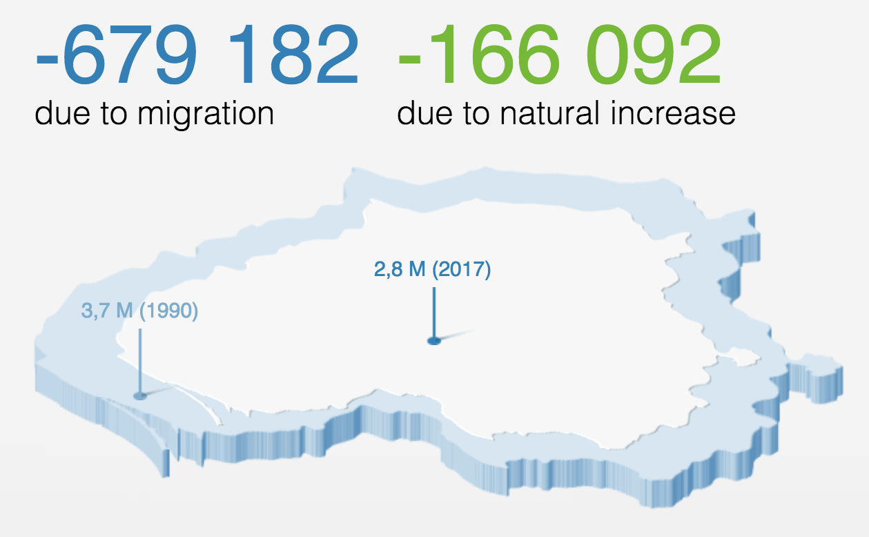
Emigration in general

Slide 3
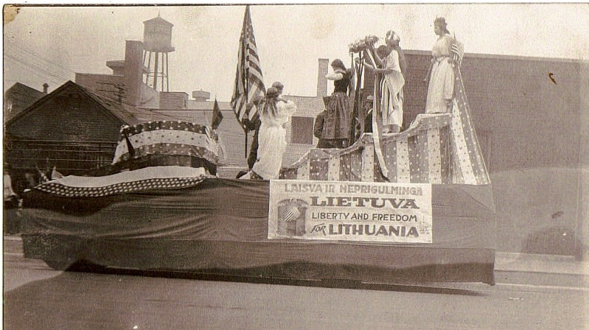
The first wave of emigration from Lithuania
So the first wave brings us back to the 1860s when lots of Lithuanians moved and ran from Europe. The first really significant wave of Lithuanian emigration to the United States began in the late 1860s, after the Civil War.

Slide 4
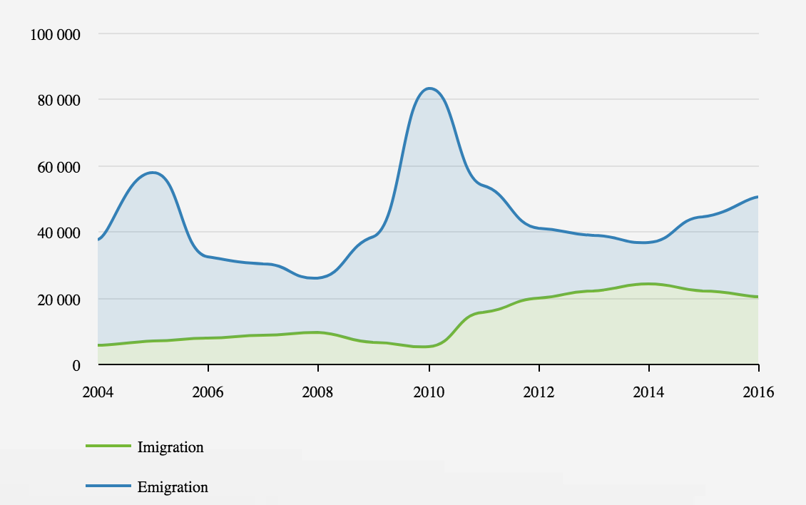
The second wave of emigration from Lithuania
And now lets talk about the second huge wave of emigration from Lithuania which began ~10years ago and is still happening now.

Slide 5
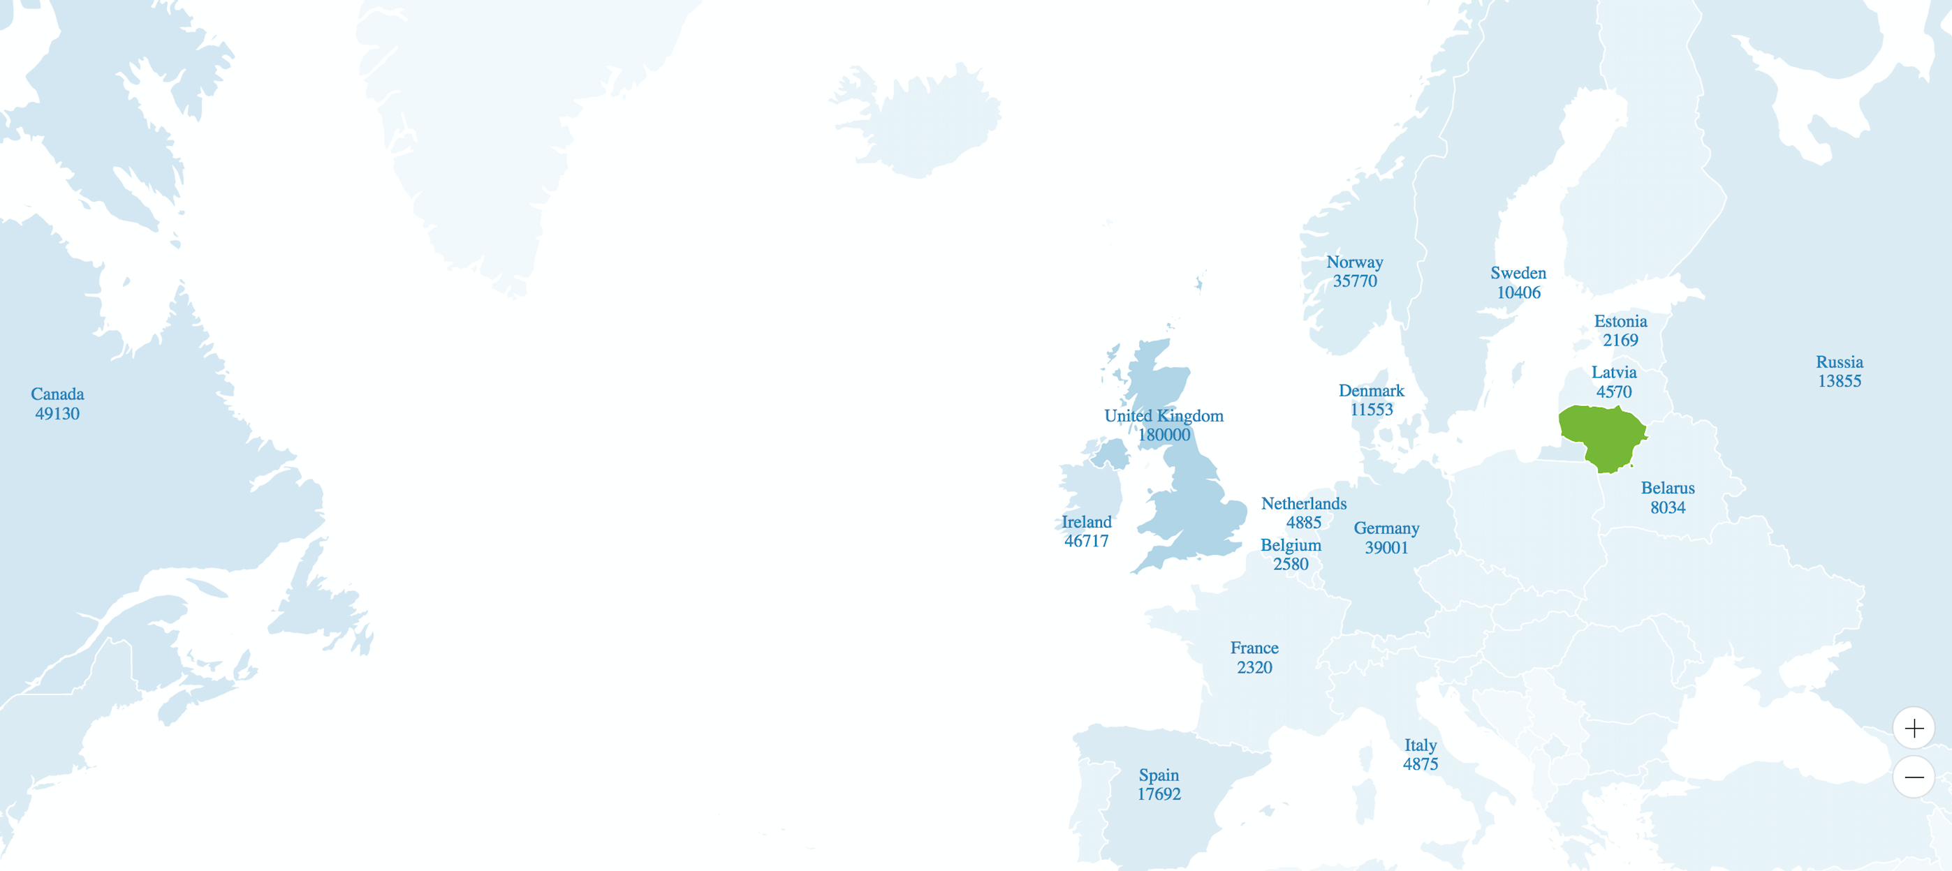
Most popular locations where Lithuanians choose to go

Slide 6
Thank you for your attention ٩(๑❛ᴗ❛๑)۶
Ugne Bucaite. LITHUANIA

