Slide 1


Migrations
Karolina Stolarczyk
Aleksandra Gil
Projekt „Migration Matters”- współfinansowany w ramach programu Unii Europejskiej Erasmus+
„Publikacja odzwierciedla jedynie stanowisko jej autorów i Komisja Europejska oraz Narodowa Agencja Programu Erasmus+ nie ponoszą odpowiedzialności za jej zawartość merytoryczną”.

Slide 2
Influence in the past
In the past, a substantial amount of Polish people emigrated to the West. They saw various arts there, which was fascinating for them. At that time in Poland buildings were made in social realism architecture.
It made Polish people think: „We can create something better”. That’s how the idea of new styles and buildings was born.

Slide 3


Inspirations
Now our country looks like the highly developed countries. Nowadays, we follow the American style.
Everyone watches American films – the biggest influence now.
Even our clothes are like the one people wear everywhere else and we look really good. (:

Slide 4
Predictions
In next years, population of the world is predicted to keep growing. As we can see, in 2030 it will reach 8,5 million and in 2040 about 9,1 million
The number of people on continents with majority of developing countries will increase. For example:
Asia: in 2030 4,9 million
in 2040 5,1 million
Africa: in 2030 1,6 mililon
in 2040 2,1 million
but population of Europe will be slightly smaller: from 0,733 million to 0,706million

Slide 5

Predictions
As for migrations, the immigrant and emigrant countries are not expected to change.
Europeans --- the USA
South Americans ----- the USA
South East Asians ------ the USA
North & South Africans ----- Europe
Europeans from the east parts ------ Western Europe
the most skilled workers ----- countries like Taiwan, Japan, Dubai
so basically, people from poorer parts of the world are still expected to emigrate to more developed countries.

Slide 6
What will demographic changes really change?
The number of immigrants is constantly increasing and it will surely make some changes in the way societies live and look.
I think that religion and culture of immigrants can cause much good and help us show the diversity of the world.

Slide 7

Arts
Artists having different origins could also express other feelings and thought than us.

Slide 8
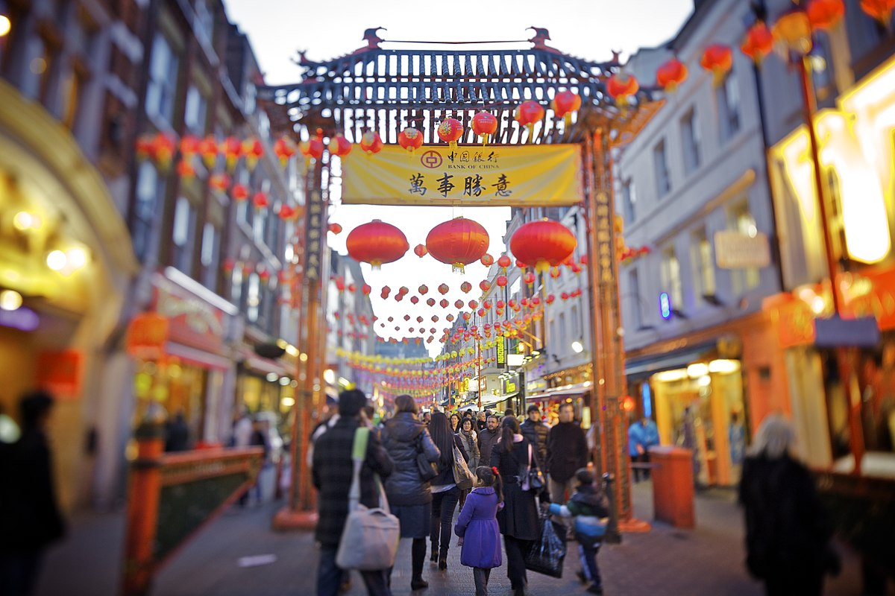
Influences
Other nations can also build places reflecting their roots and origins – China Town in London.

Slide 9
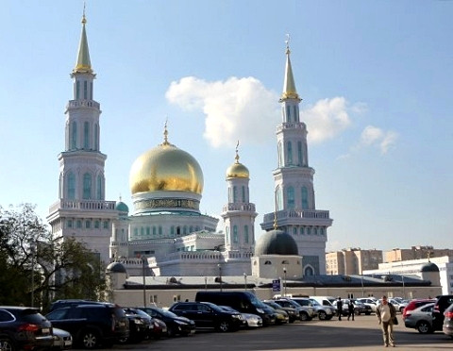
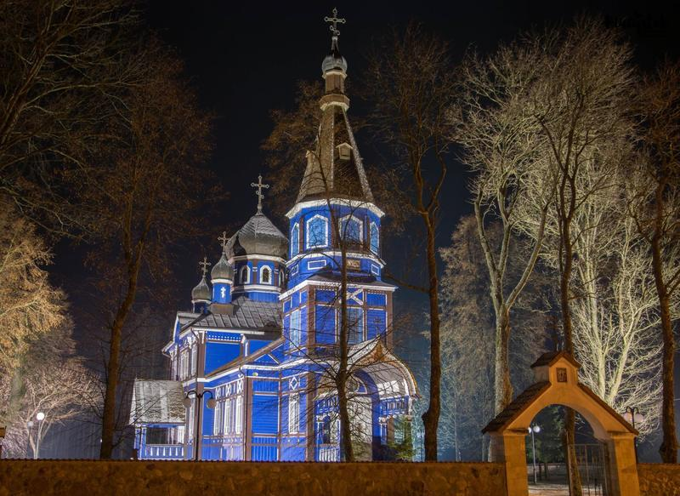
Religion
As the number of Muslims and Ortodox Christianity people increases we can easily see places where they attend in the whole Europe.

Slide 10
There are also negative sides
There are lots of homless people. They've emigrated and they cant find a job due to lack of knowlegde or skills.
So, what can government do?
A good solution is educating these people. They can be great workers, they might just need some education.
Good solution could be a special buildings for this people too.

Slide 11

And children…
Lots of parents go to different countries, because they want to find a good job. They leave the children in motherland for example with grandparents.
This children are growing up without their parents.

