Slide 1
The influence of migrations and globalization
POLAND
„Publikacja odzwierciedla jedynie stanowisko jej autorów i Komisja Europejska oraz Narodowa Agencja Programu Erasmus+ nie ponoszą odpowiedzialności za jej zawartość merytoryczną”

Slide 2
Migration to 2040
In the past, migration movement was impacting really subtly a total population growth. However, in recent years, it has changed. Nowadays, in Poland there is a large group of migrants mainly from Ukraine and Russia.
There are groups of both legal and illigal immigrants. Among them there are 20 000 legal migrants. The exact amount of illigal ones is unnkown.

Slide 3
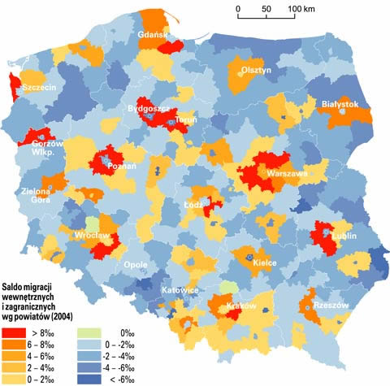
Internal and external migrations in Poland

Slide 4
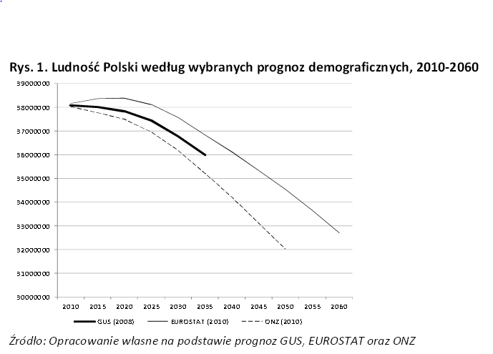
Growth forecast of Poland over the period of 2010-2060

Slide 5
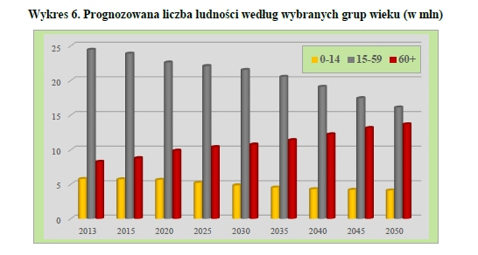
Prognosticated polish population by age grougs

Slide 6
Amount of foreigners in population in other countries
Country | Year | Population (in millions) | Amount of foreigners (%)
Germany | 2000 | 82,2 | 9,9
 | 2050 | 68,3 | 23,56
Englang and Wales | 2001 | 52 | 11,3
 | 2051 | 63,1 | 36,1
Sweden | 2004 | 9,01 | 15,9
 | 2050 | 10,63 | 32,3
Norway | 2005 | 4,55 | 7,5
 | 2060 | 5,58 | 23,5
Netherlands | 2004 | 15,9 | 17,5
 | 2060 | 16,9 | 29,7

Slide 7
HOW CAN it LOOK like IN THE FUTURE?

Slide 8
ARCHITECTURE
In our opinion Polish architecture will change because of migrants impact. Migrants will want to have places in Poland which will be similar to their native places. They will probably create their own space where a lot of sanctuaries and shops with products from native countries will be found. It will remind an asylium.

Slide 9
ART
We think that migrants will want to bring something from their own culture to our. Maybe Polish artists will be inspired by foreigners and their belief or perception. They will create some artistic movement together. It will be something new.

Slide 10
HOMELESS
We are afraid of homeless people, because Polish government will have to assure flats or houses for migrants. In lots of European countries government implemented programme called „housing first”. I insist on reducing interims centres and giving to homeless people constant places to live. We also have to think about this issue and find a good solution.

Slide 11
Our proposals of solutions for demographic problems

Slide 12
HOW WE CAN HELP HOMELESS PEOPLE
We can organize some places for buildings where homeless people will live. It can be something like hotels but people won’t pay for living in these „flats”. These flats should have basic equipment, so it won’t be expensive to maintain. We think that one small room should be enough for one pearson. Families should get bigger rooms/flats.

Slide 13
Thanks for attention ☺
Pracę wykonały: Michalina Duda, Karolina Antos, Wiktoria Gołos
„Migration Matters”- współfinansowany w ramach programu Unii Europejskiej Erasmus+

