Slide 1
Erasmus-France
Made by: Saša Martinjaš and Mario Moharić

Slide 2
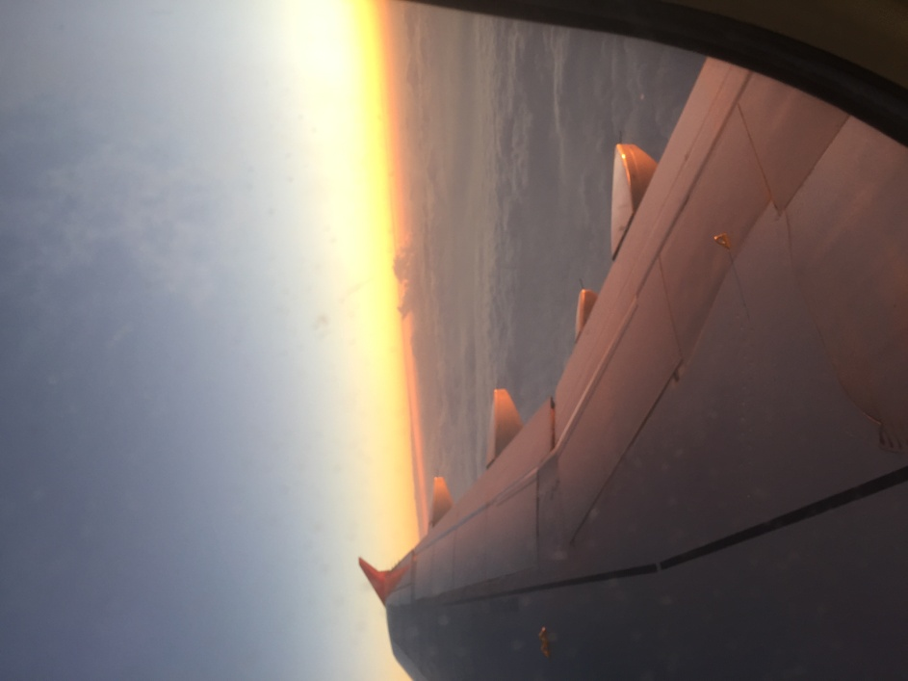
Migration matters
Our trip to France was 7 days long
The topic of the meeting was “Migratory Professions”
We travelled by car, by bus, by plane and by train

Slide 3
Migration matters
Our journey started in Čakovec from where we drove to Venice and our final destination was French city Tarbes.
Our hosts were students of Lycée Général Théophile Gautier, Tarbes

Slide 4
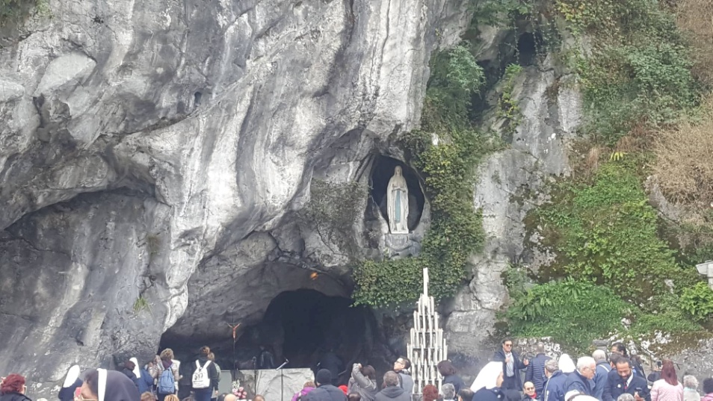
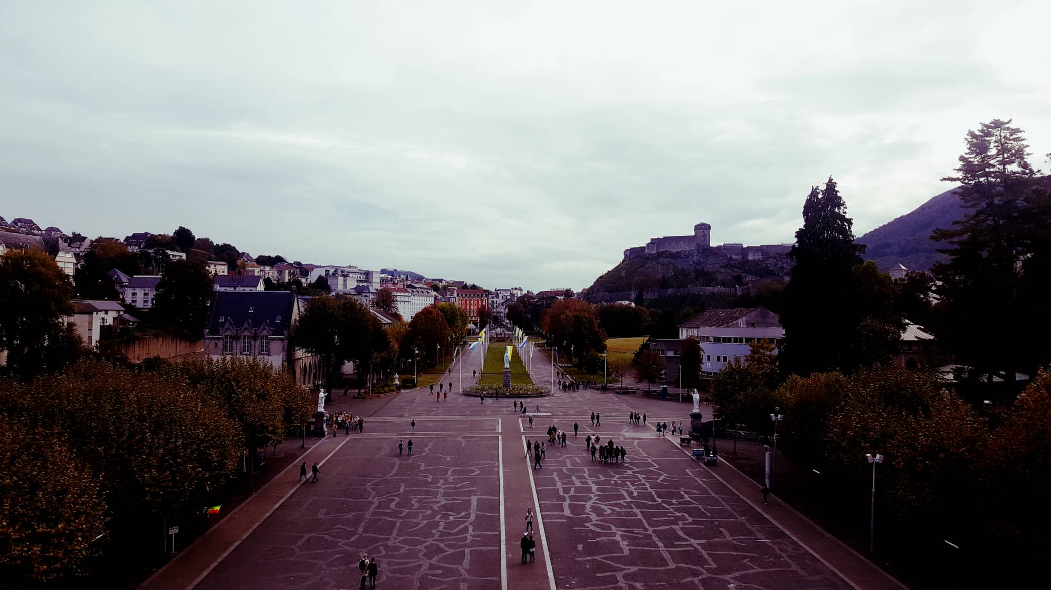
Trip to Lourdes

Slide 5
Midi pyrenees
Trip to Pic du Midi – 2877m

Slide 6
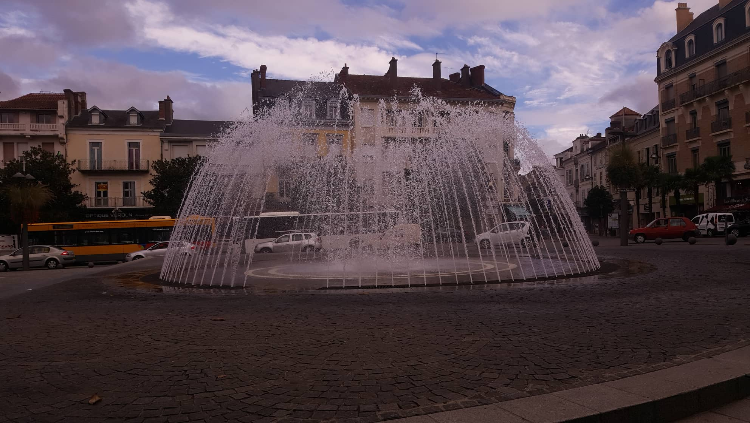
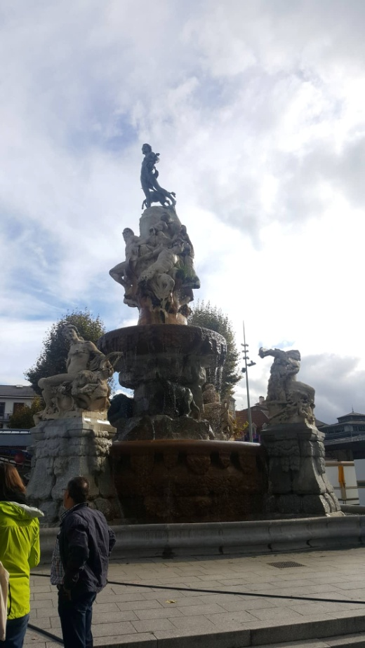
Tarbes

Slide 7
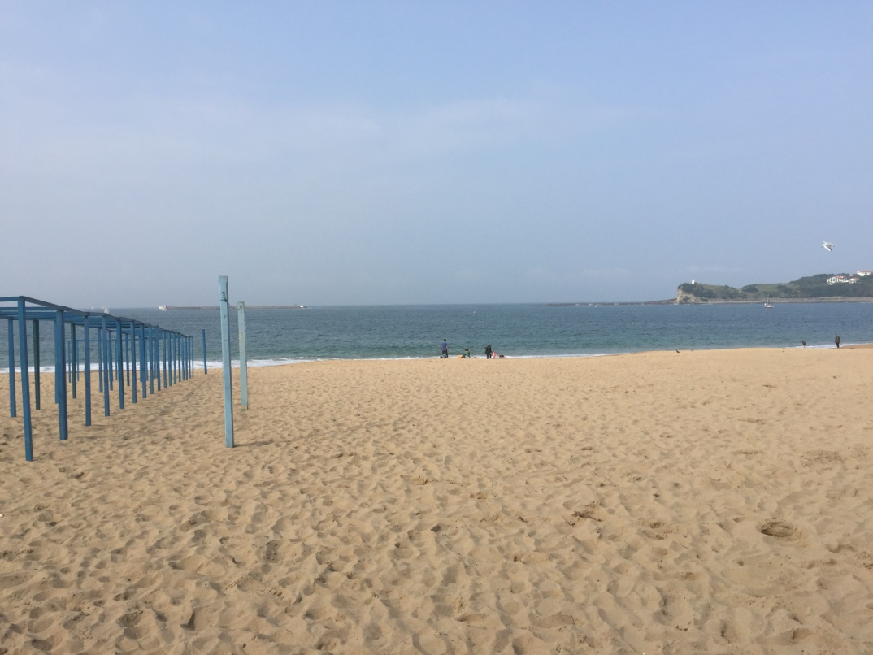
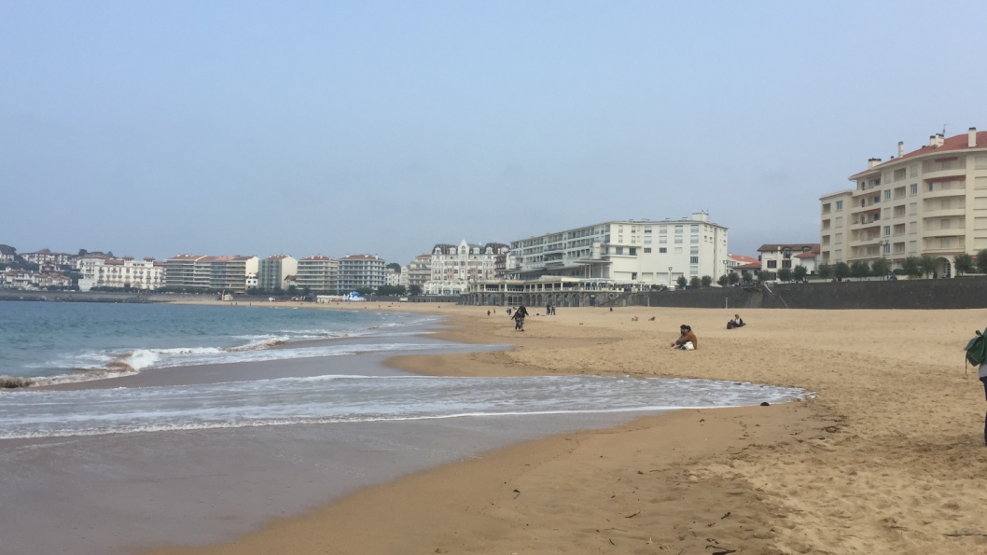
Saint Jean de Luz
On the last day of our stay we went to the Atlantic coast

Slide 8
Conclusion of the project
Mario: The meeting was a fun experience, I met a lot of different people and made some new Friends. The only downside for me is that French people eat a lot of cheese.
Saša: Project was really fun and great, I met a lot of amazing people and I’m glad I still talk to some of them, I hope I’ll see them again. Everything was pretty good for me, I had a lot of fun and I would to do something like that again

