Slide 1
Next 20 years of architecture
The impact of migration on architecture
Jan Czarnecki & Wiktoria Czabator

Slide 2
Warning!
Project financed by Europe Union within framework Europe Union Erasmus+​
The publication reflects only the positon of its authors andEuropean Commission and Erasmus + National Agency do not take responsibility for the content​

Slide 3
Architecture in Renaissance
Poland was very tolerant in terms of beliefs. Poles accepted faiths which were different than Christianity.
Foreigners used this and emigrated to Poland. That's why Renaissance
architecture was changing over the XV century.

Slide 4
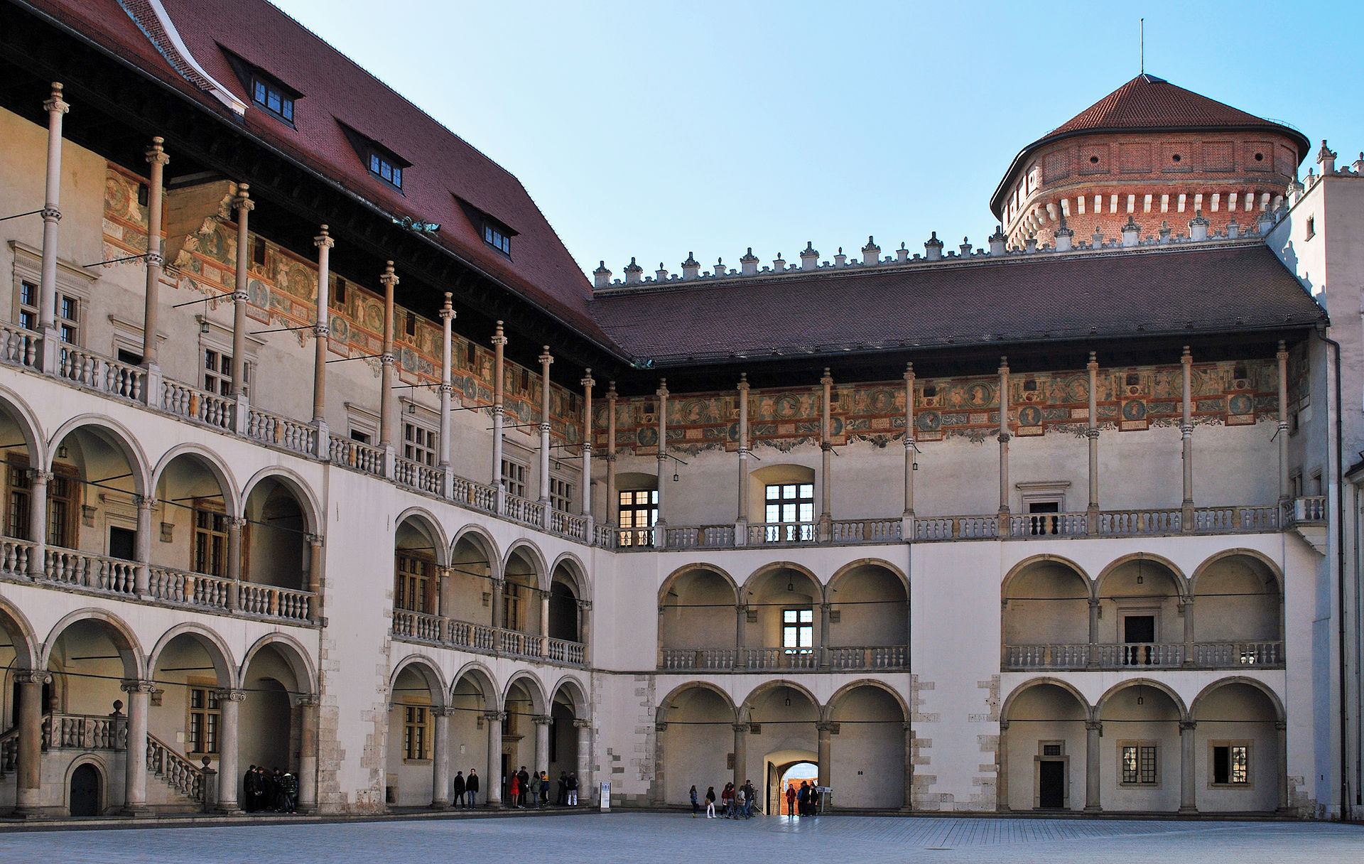
Period I (Italian)
Wawel Royal Castle, courtyard

Slide 5
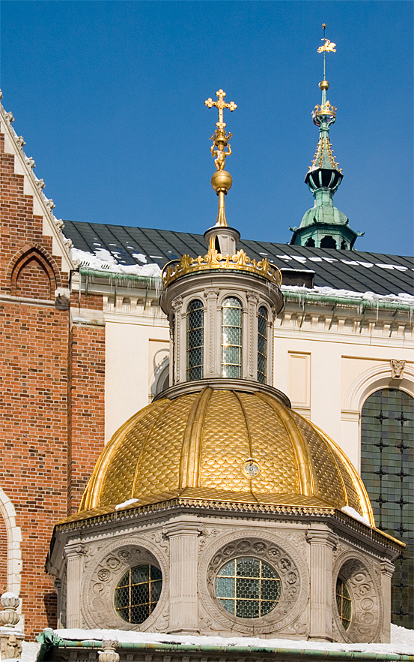
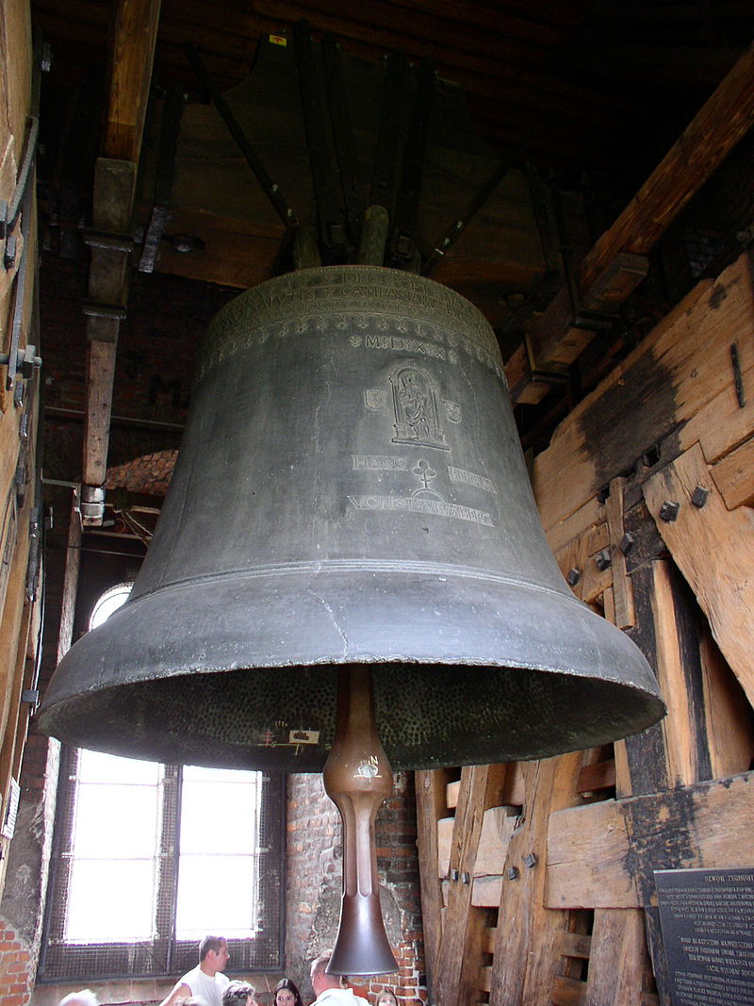
Cupola of chapel (Kraków)
Zygmunt's bell (Kraków)

Slide 6
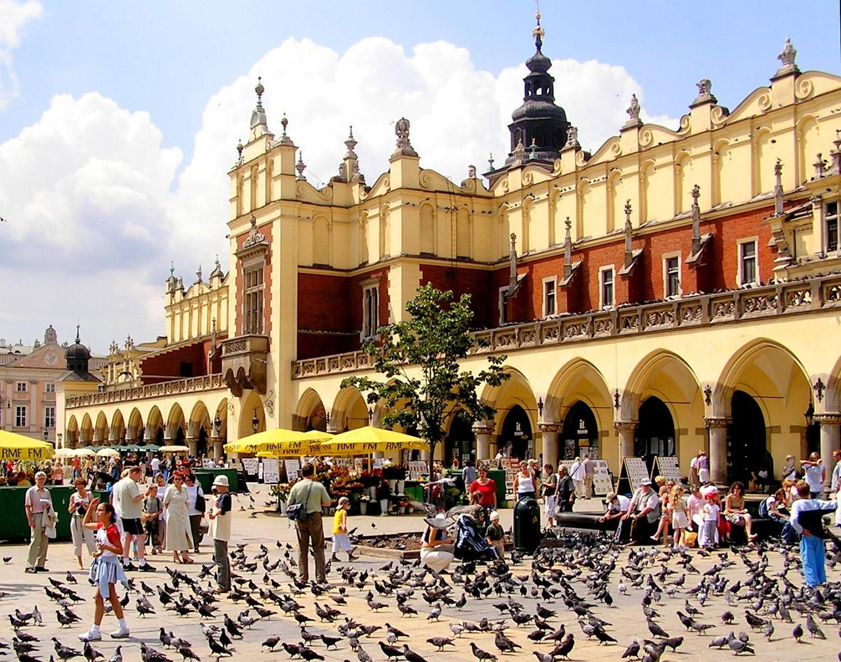
Cloth Hall in Kraków

Slide 7
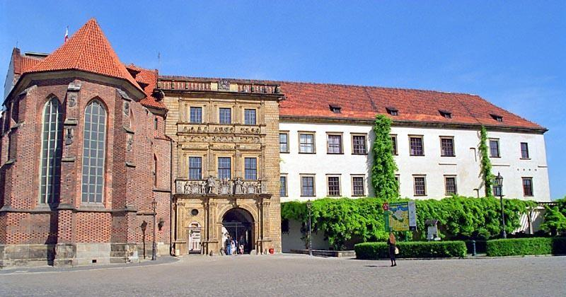
Period II (Mannerism and Dutch impacts)
Castle in Brzeg

Slide 8
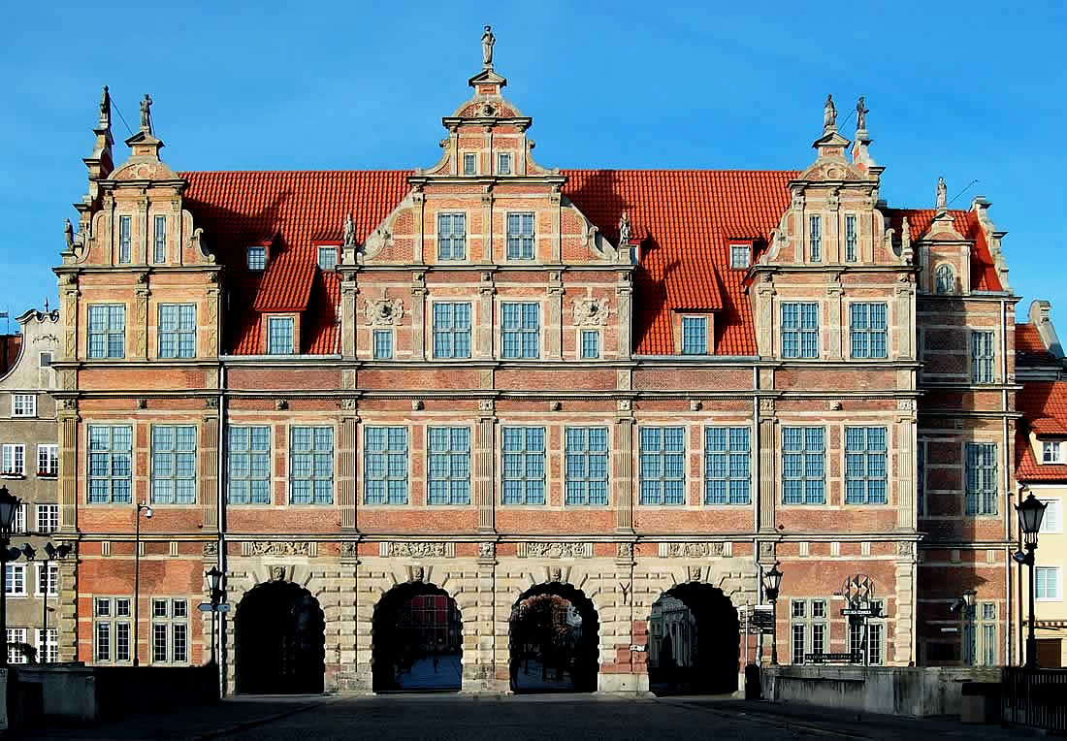
Green Gate in Gdańsk

Slide 9
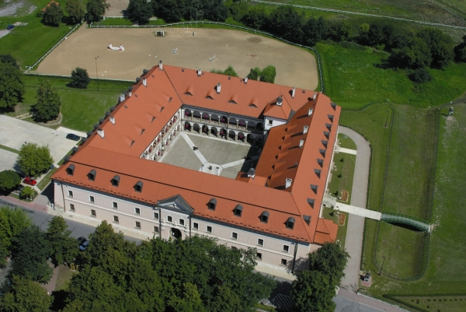
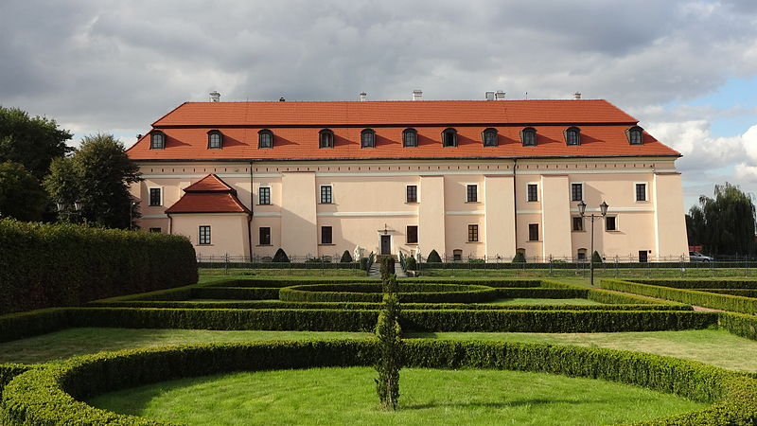
Royal Castle in Niepołomice

Slide 10
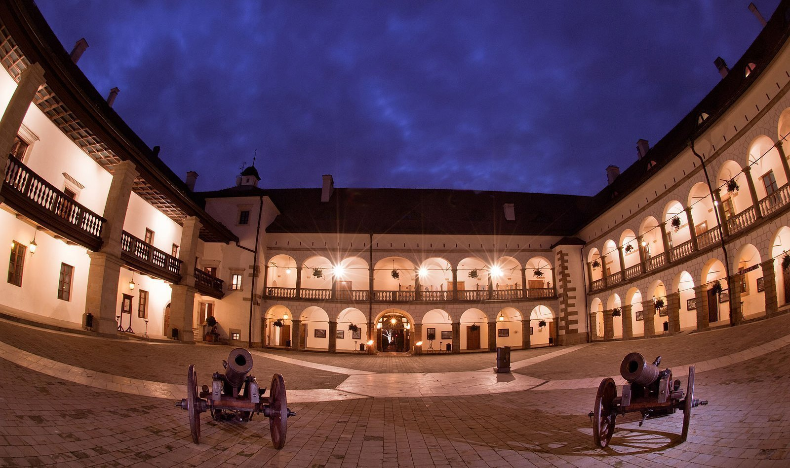
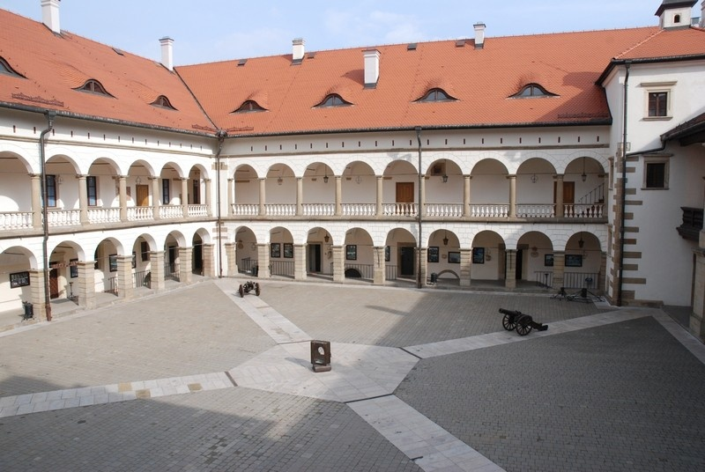
Courtyard

Slide 11
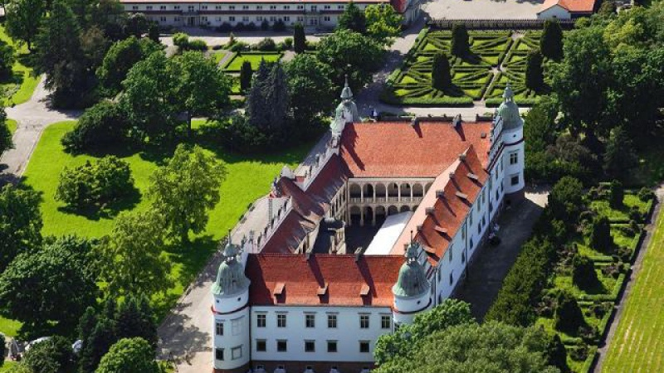
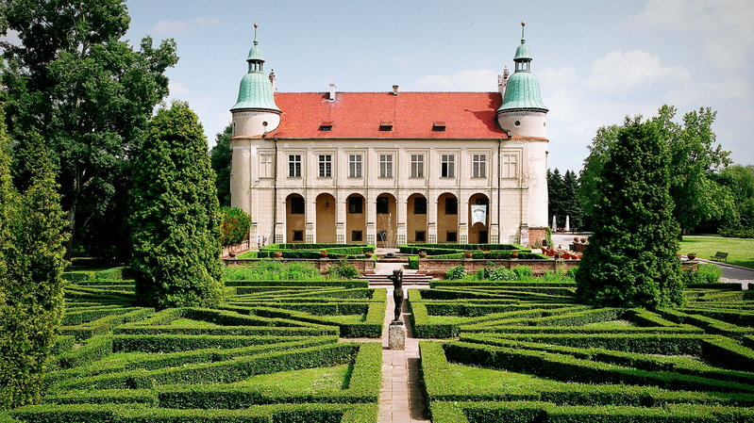
Castle in Baranów Sandomierski
Designed by Santi Gucci

Slide 12
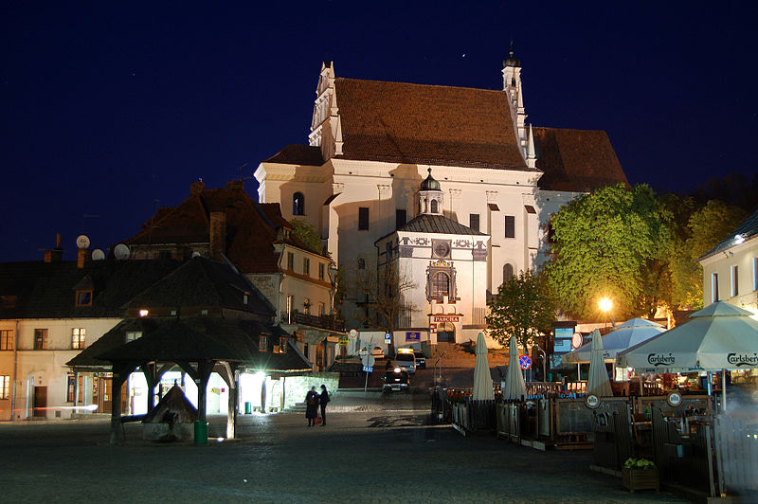
Period III (Mannerism and elements of early Baroque)
Church of Saint John the Baptist and Saint Bartholomew in Kazimierz Dolny

Slide 13
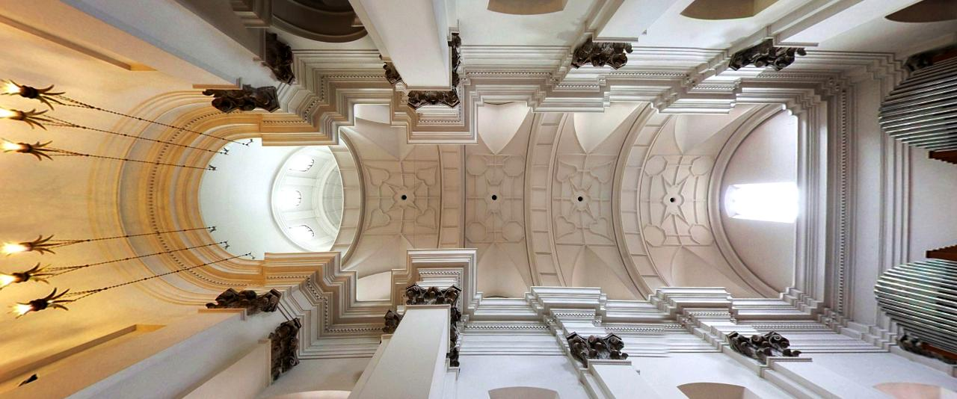
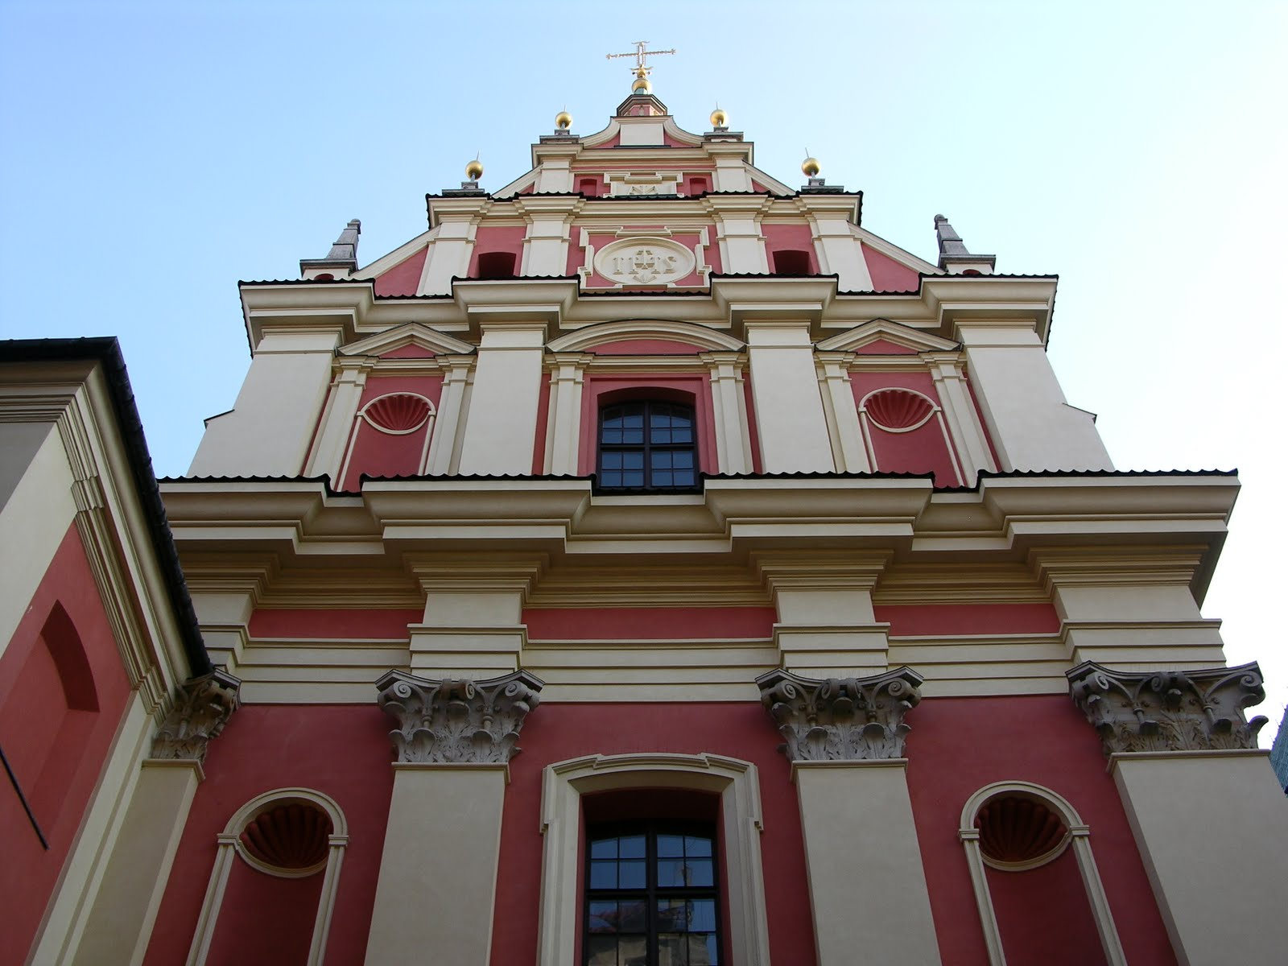
Church of Mother of God in Warsaw

Slide 14
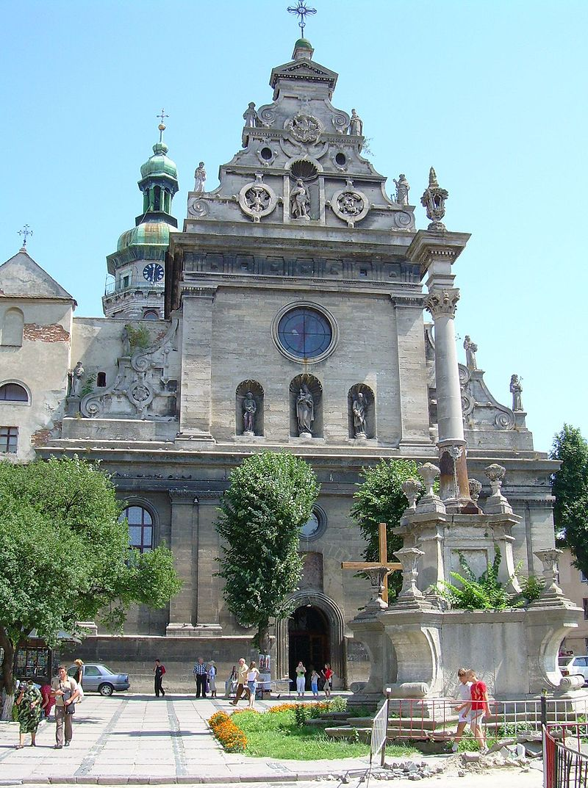
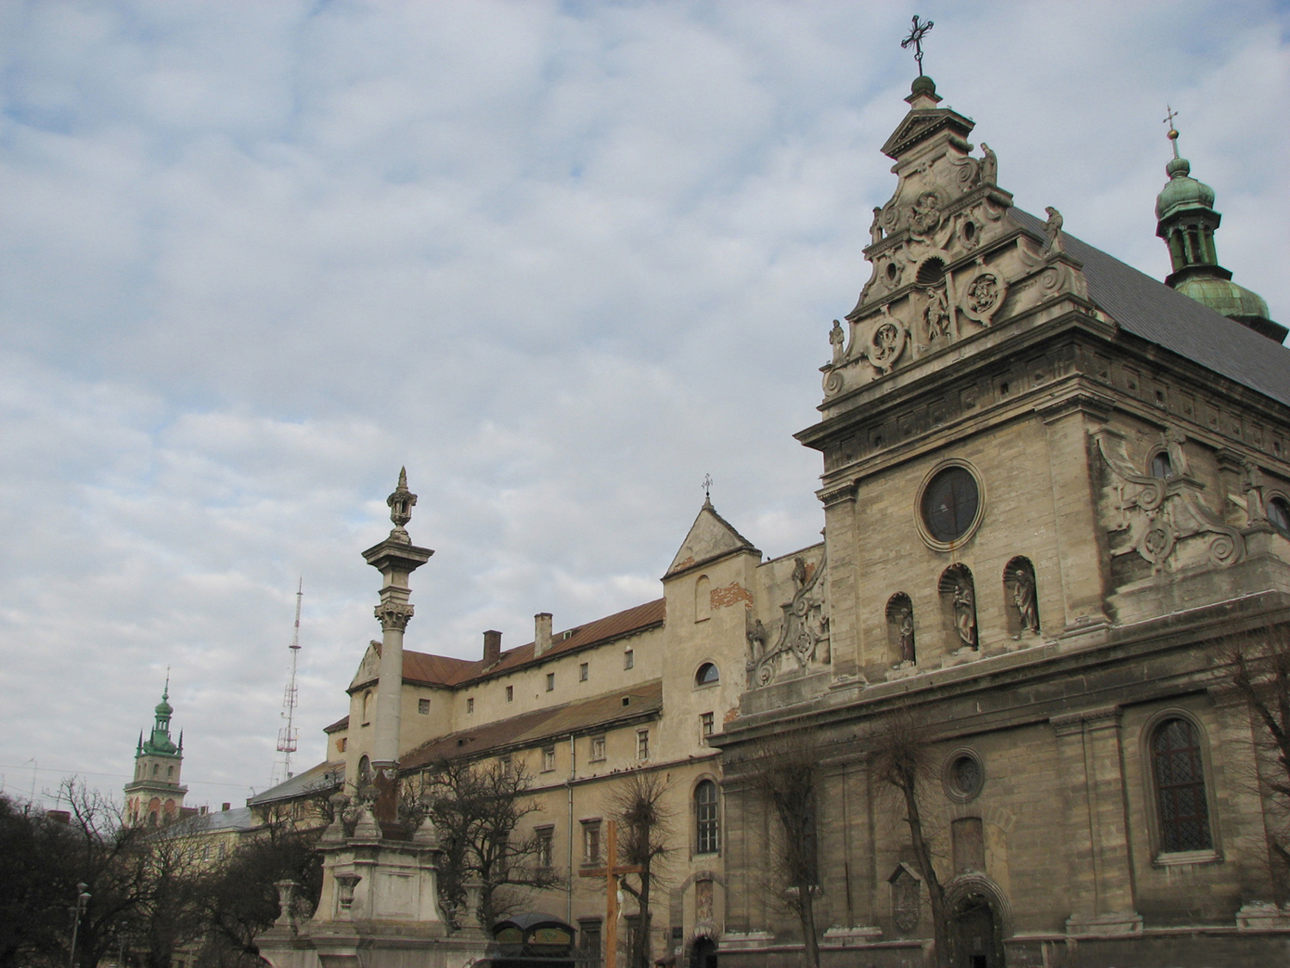
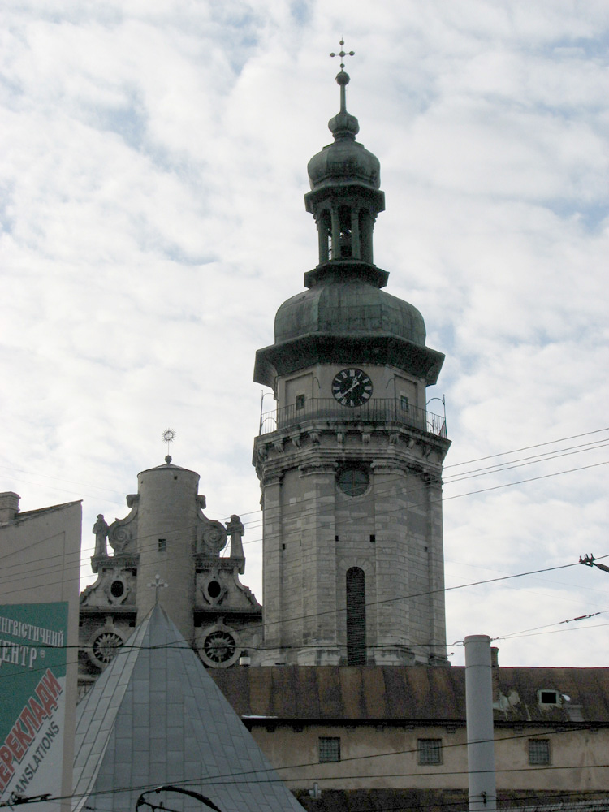
Church of Saint Andrew and The Bernardine’ monastery in Lwów

Slide 15
Since the 70s of the XX century four main regions of global migration are distinguishable:
The USA and Canada – where most of the current foreign population is mainly from Asia, Latin America and the Caribbean
West Europe – which most of the population from former colonies (mainly in the case of the United Kingdom, France and the Netherlands) and from Turkey and the countries of Central and Eastern Europe (mainly in the case of Germany).

Slide 16
Arabic countries and Persian Gulf - along with the development of oil extraction and processing in this region, the demand for labor, which was initially coming in from the neighboring Arab states (Egypt, Jordan, Palestine, Syria), in recent years the tendency shifted and the majority of immigrants keep coming from outside this region (mainly: India, Pakistan, Indonesia, Bangladesh);
The countries of Southeastern Asia and Australia - with the economic development of the countries of this region, mainly the so-called The Asian Tigers and Australia have seen a sharp increase in the inflow of immigrants coming mainly from neighboring countries (mainly India, China, Indonesia, and Vietnam).

Slide 17
In 2040 there is a huge possibility that people will migrate especially into Asian countries and Western Europe countries. This may be caused by quick technology development of Japan and China which are pioneers of this branch of economy. Around that time employment rate may be much higher in these countries. In 2040s oil fields in Persian Gulf countries can start depleting, endangering people employed in that sector to lose their jobs.
As of now, about 7,2 billion of people live on Earth. That number will most certainly rise. It is estimated that the world population might reach even 11,3 billion by 2040. The highest population increase will be most likely observed in West Europe and Asia, especially India, which is slowly becoming the world’s most populated country.​

Slide 18
Certain political implications might also shift current tendencies of world migration. Policies forced by the United States’ government are largely against stable development of new, clean sources of energy and scientific as well as educational sectors are largely underpaid.
Provided this attitude is kept within the next 10-20 years, China will overtake the USA in imperial race, especially that 2017 was the first year since ages, when more scientific papers have been published in China than in the USA.
On the other hand, China’s political system may be still unattractive for entrepreneurs and simple workers as well, due to poor human-rights standards and subpar quality of life on the lower social levels.​​

Slide 19
Then again, political decisions made by those who rule in Europe may also cause large, unpredictable fluctuations in migrations from, to and within Europe. For instance, Germany’s decision to allow Syrian immigrants on a large scale has proven to have disastrous effects on the stability of economy, as many of these immigrants stay on welfare and do not seek jobs.
Lack of substantial control as to who actually is allowed to stay in the country is probably the main reason behind the current situation. Whether the situation in Syria will be ultimately handled or not, immigration problems may be to stay due to economical reasons. ​

Slide 20
Finally, it is not entirely foreseeable what the future of world migrations will look like, especially when it comes to a very dynamic situation of Europe in this matter.
Until 2040 many different problems may start tormenting Europe and the world and we may indeed see some radical shifts in world migrations, maybe such that we would have never been able to imagine.​

Slide 21
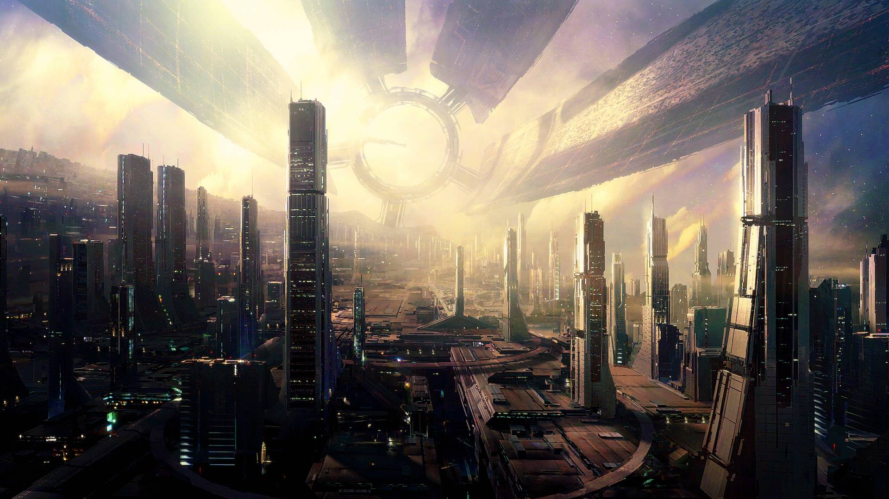
Futurist vision of architecture, art and problem of homelessness

Slide 22
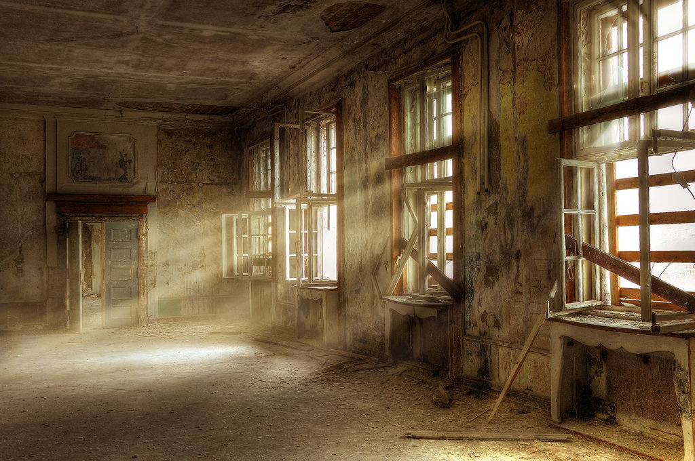
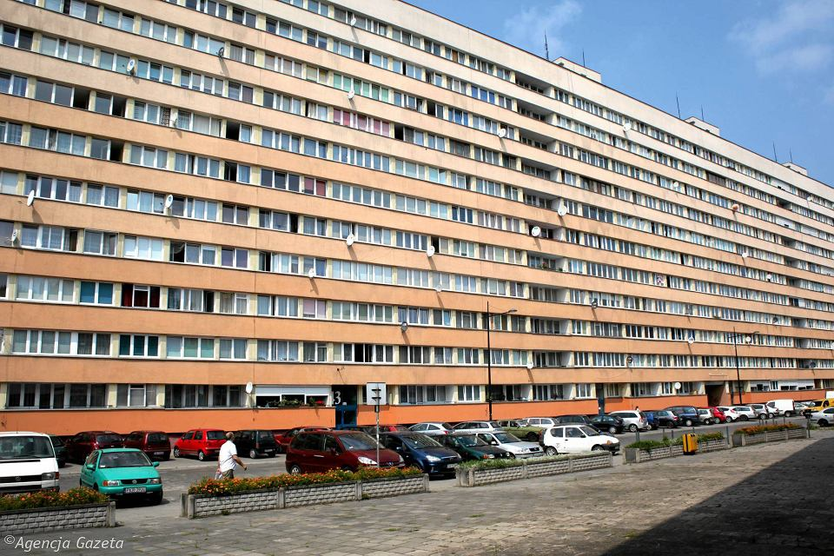
This is really old building. These kind of buildings should be renovated and arranged for the homeless who could get a place to live and work to start normal live.
Countries may build new blocks to make new places for living.

Slide 23
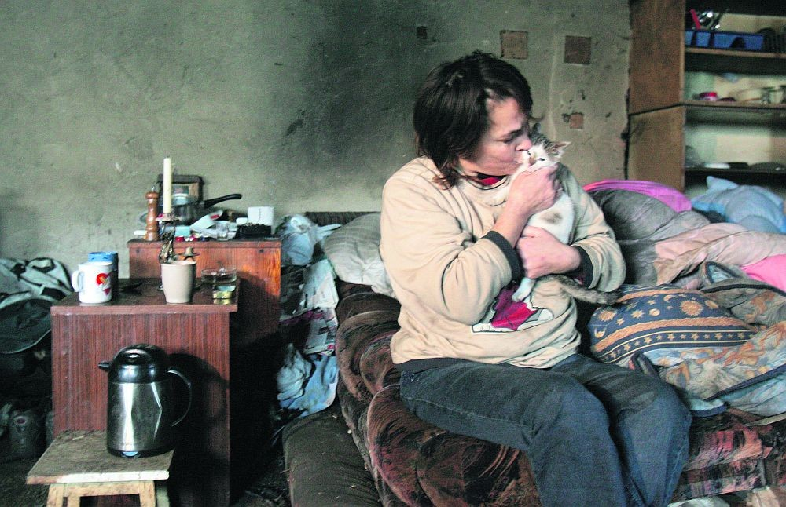
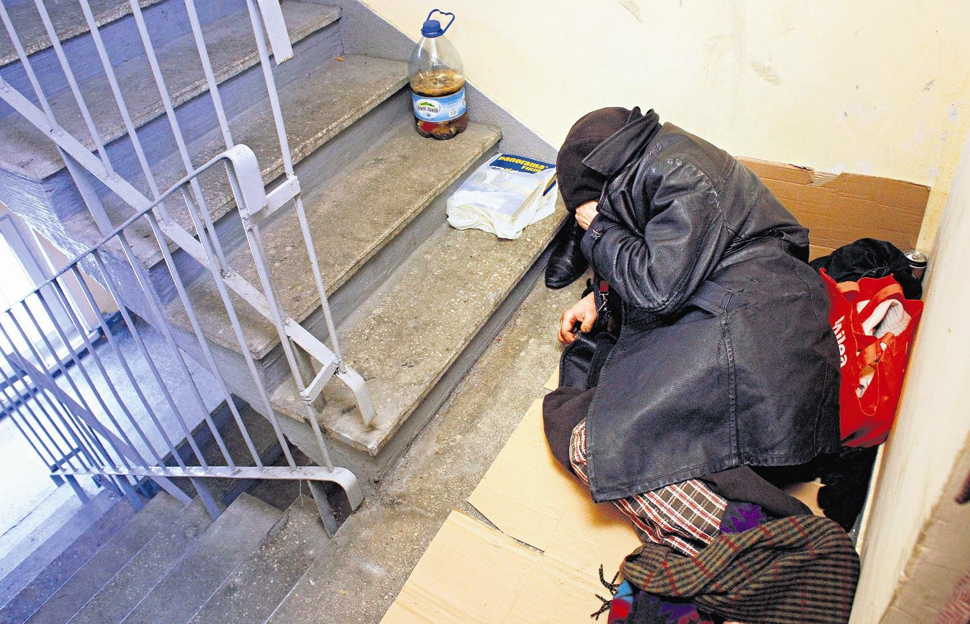
In this way world could be better, because...
The homeless live in terrible conditions...

Slide 24
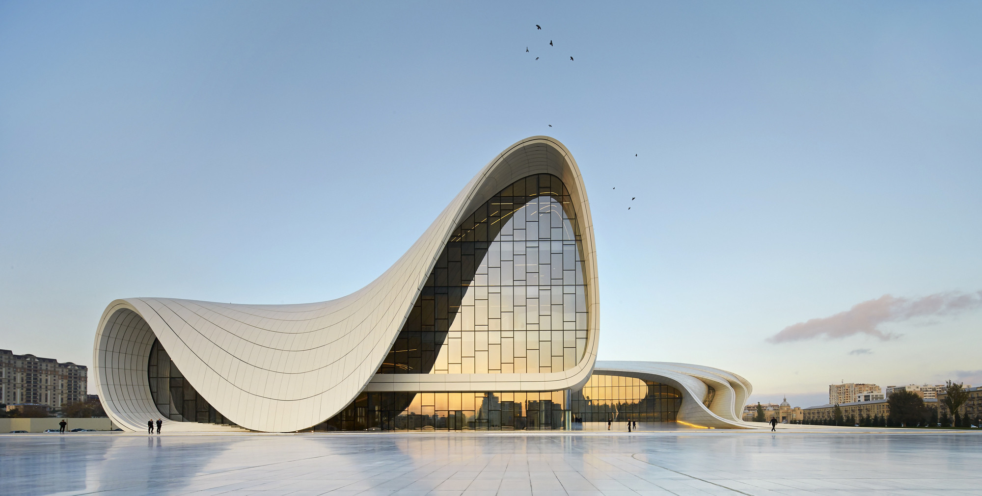
Futuristic architecture is something new, something unprecendent, but more and more often it becomes our daily reality.

Slide 25
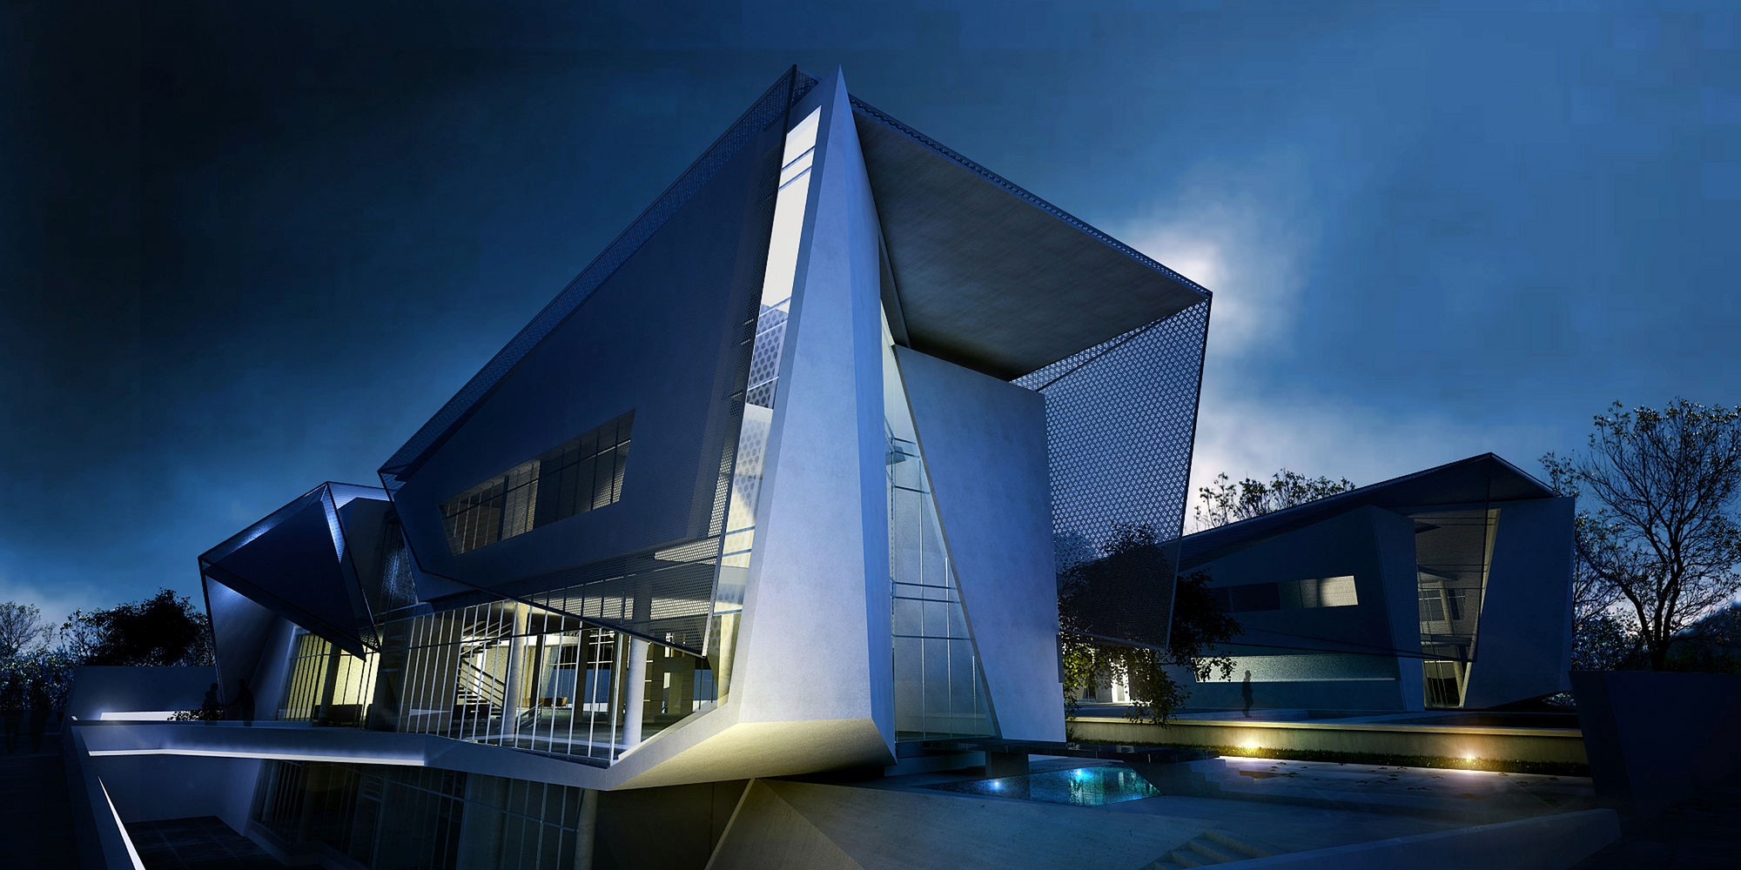
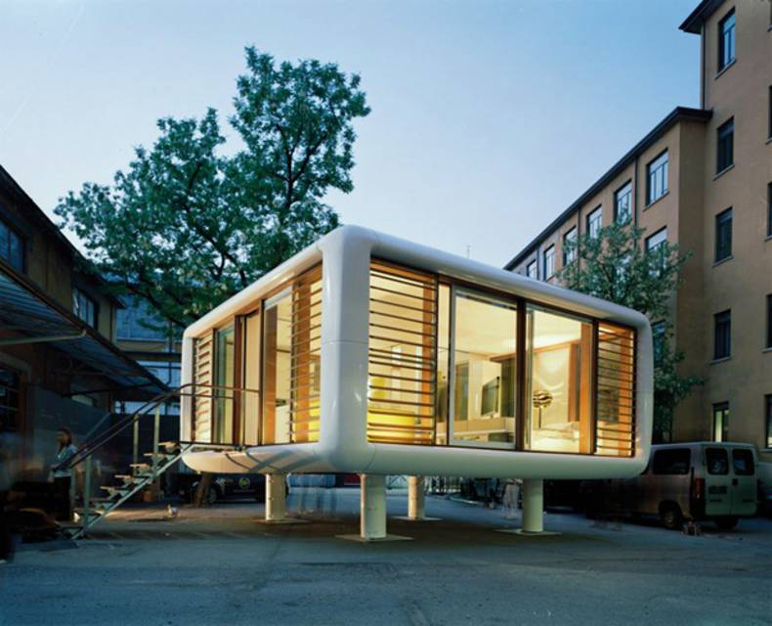
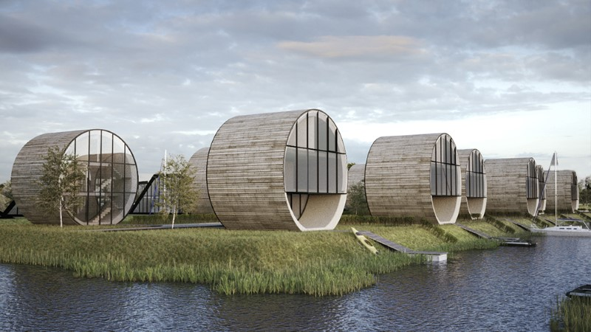
Houses may look like... anything

Slide 26
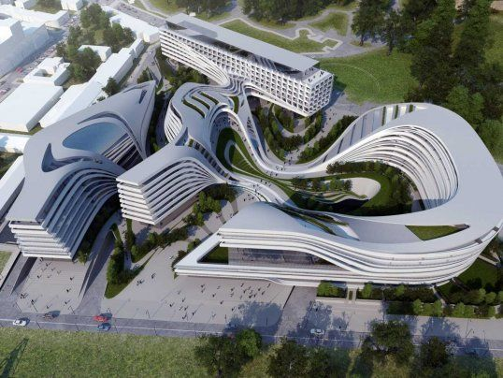
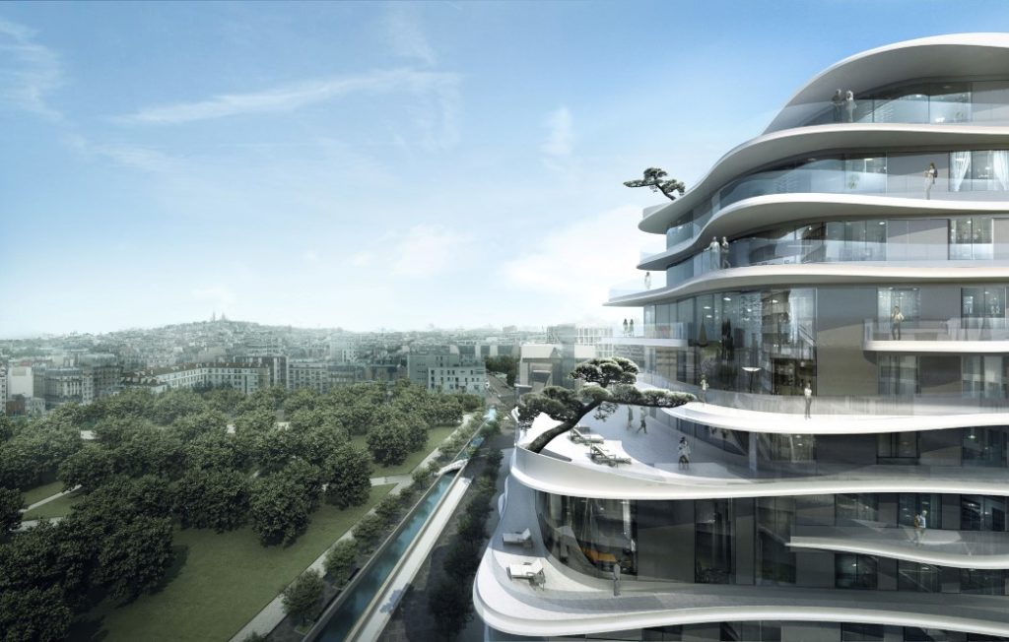
Residental areas may look more complicated and blocks of flats may be bigger and have more open space.
It's really modern so it could be our future.

Slide 27
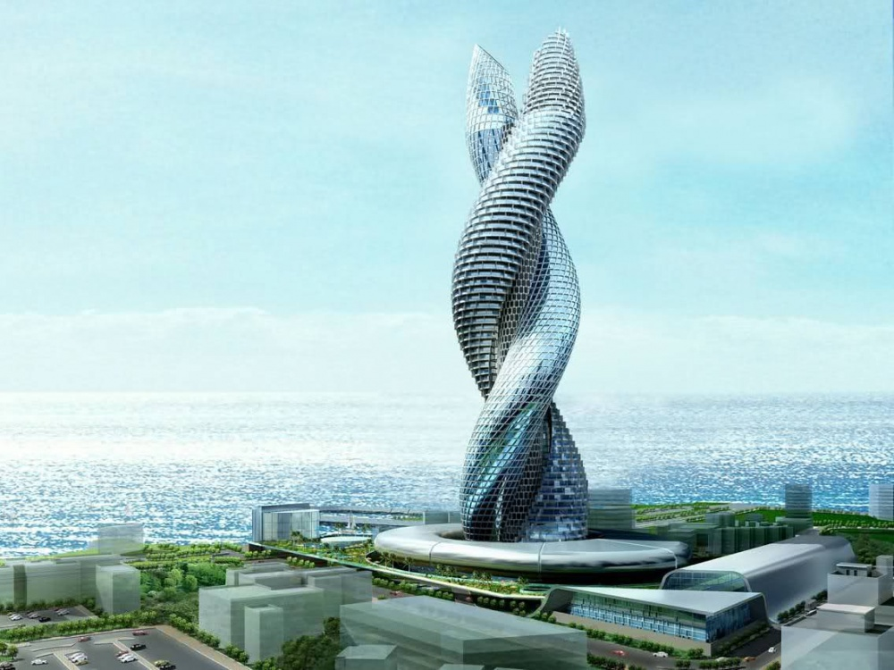
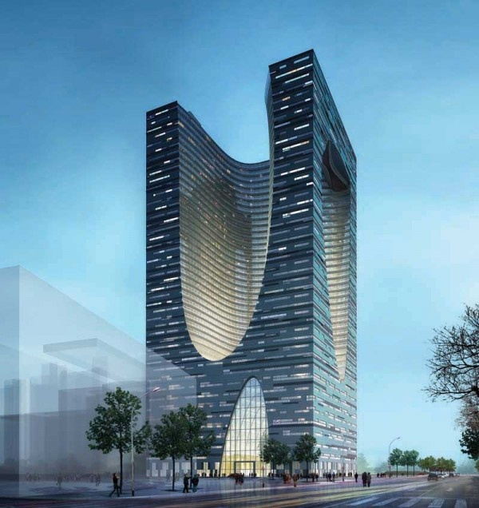
Boring office blocks may be so suprising and breathtaking!!

Slide 28
The Future art may be abstruse

Slide 29
Sources:
https://gracedivineart.deviantart.com
https://www.widewalls.ch
http://poznan.naszemiasto.pl
http://slaskie.naszemiasto.pl
https://pl.wikipedia.org/
https://www.google.pl/(...)
Jan Czarnecki & Wiktoria Czabator

