Slide 1
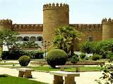
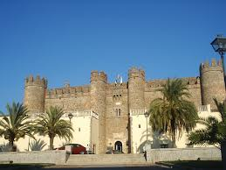
The castle of Zafra, a town in the southwest of Spain
By Piluca, student of 6th Primary

