Slide 1
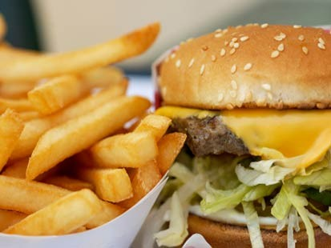
Healthy and unhealthy habits

Slide 2
Healthy and unhealthy habits
BAD HABITS
Internet addiction,smoking,
TV addiction,eat unhealthy
food,alcohol,drugs,computer
addiction.
GOOD HABITS
Every day go outside,eat
healthy food,don’t watch
TV too long,don’t use com-
puter every day.

Slide 3
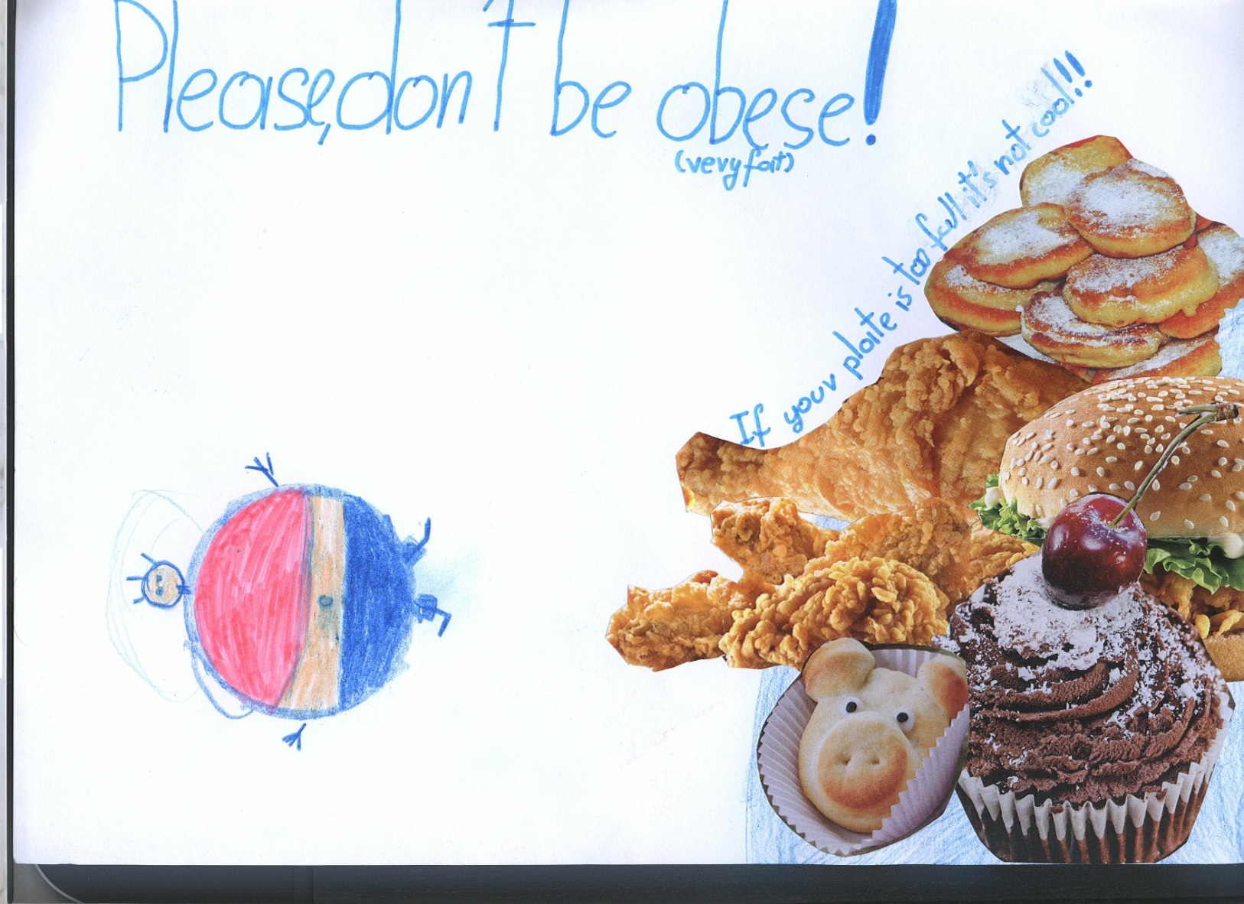
Please, don’t be obese!

Slide 4
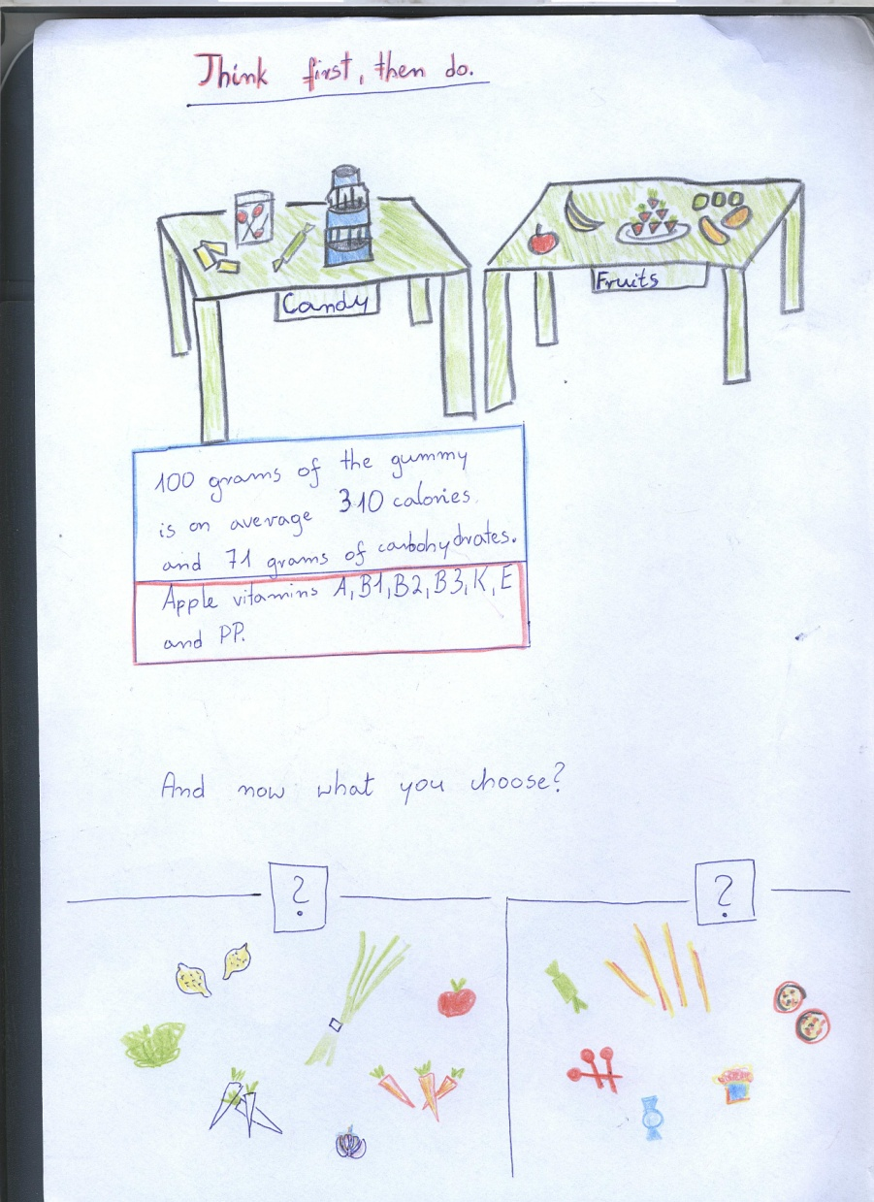
Healthy and unhelthy food

Slide 5
Stop smoking!

Slide 6
Bad habits

Slide 7
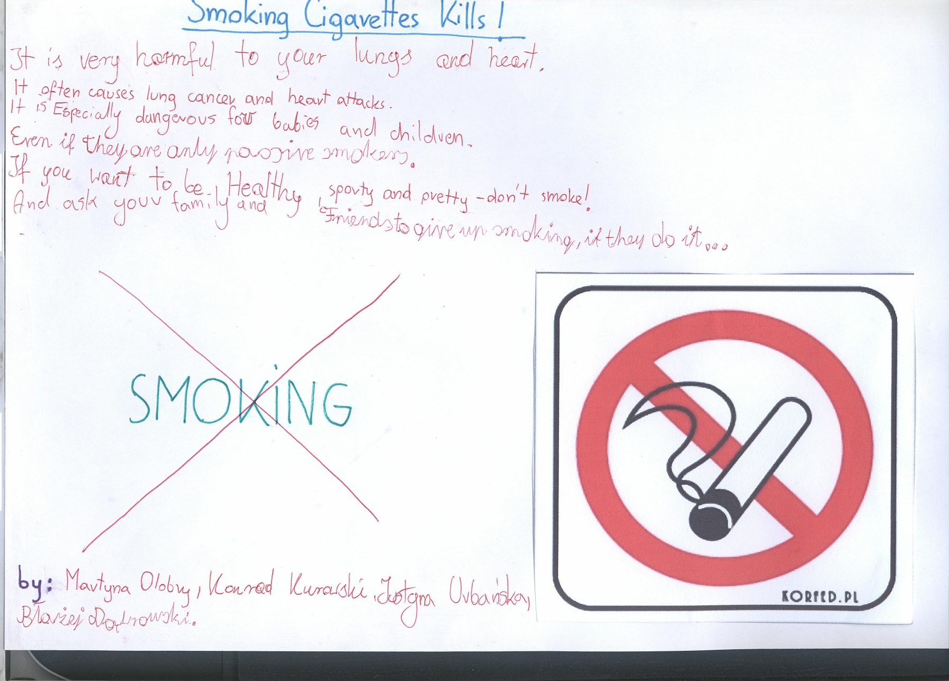
Smoking cigarettes kills!

Slide 8
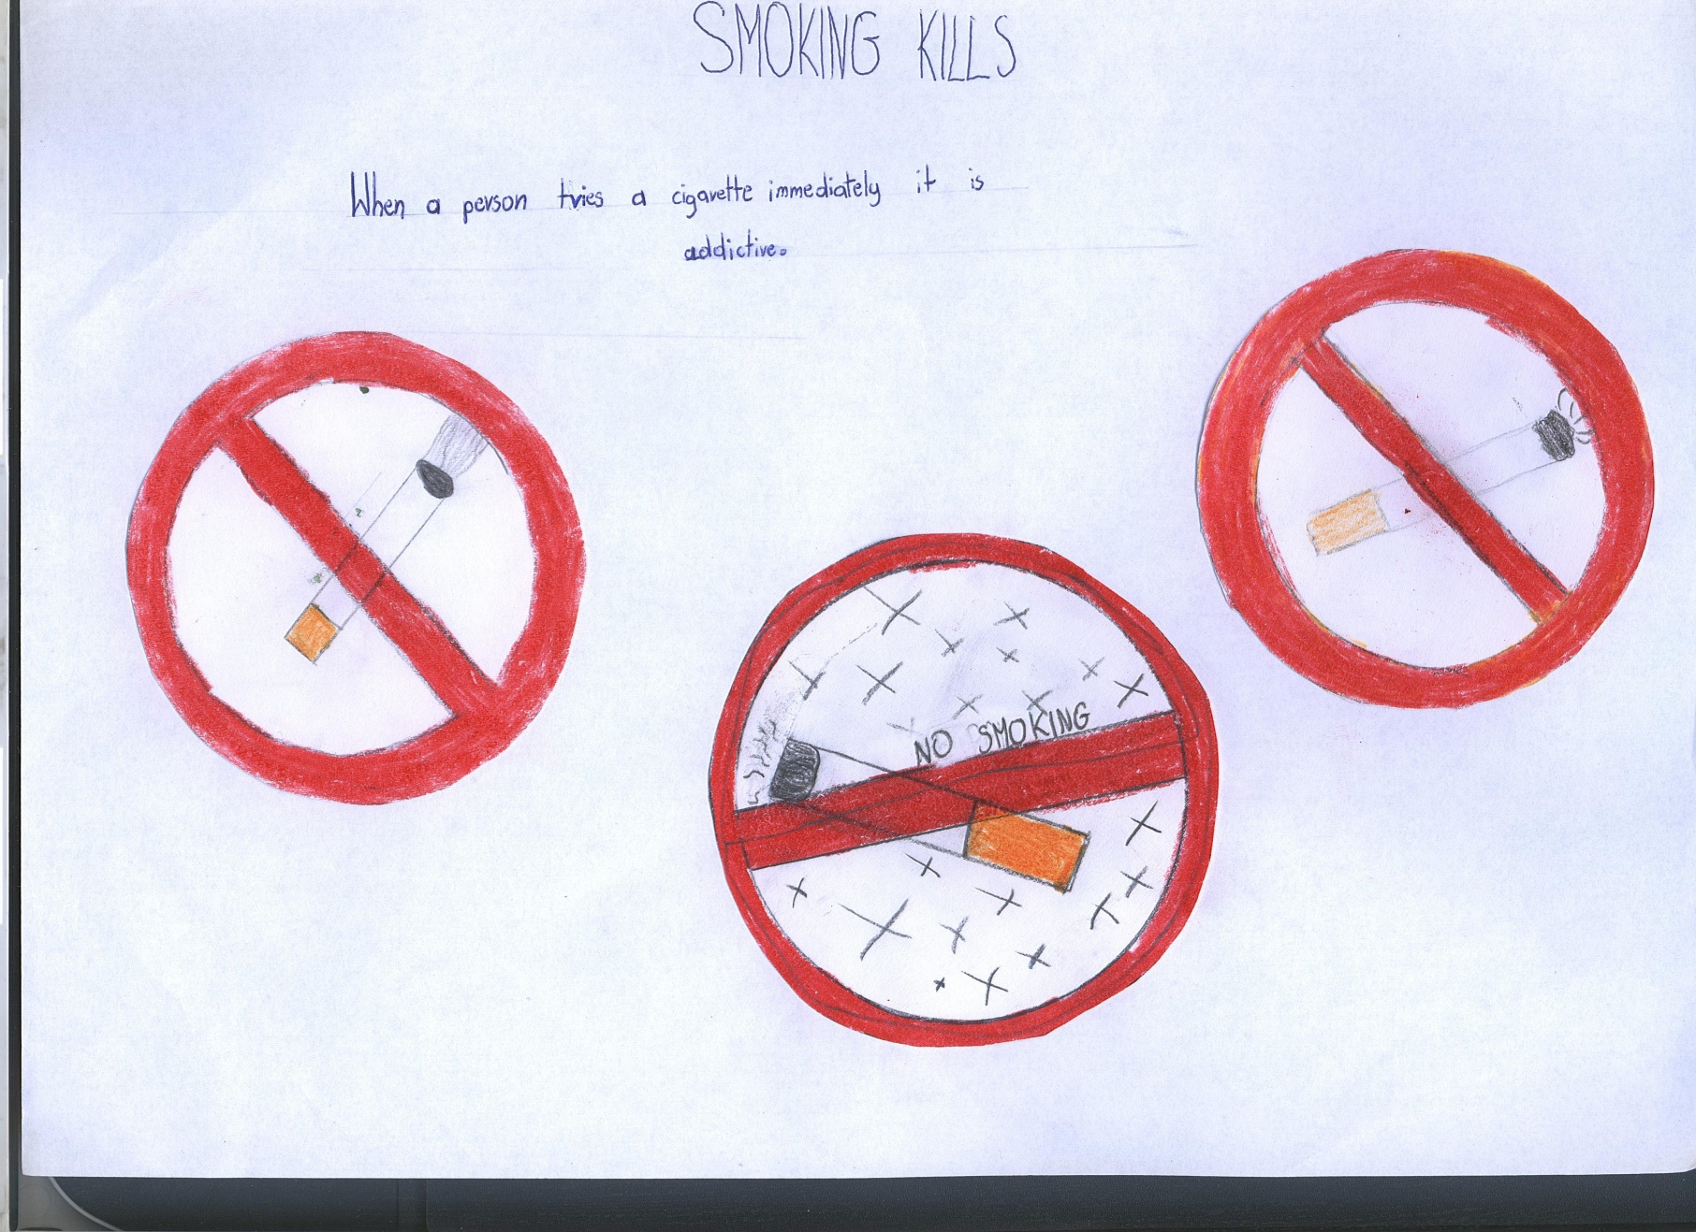
No smiking! Smoking kills!

Slide 9
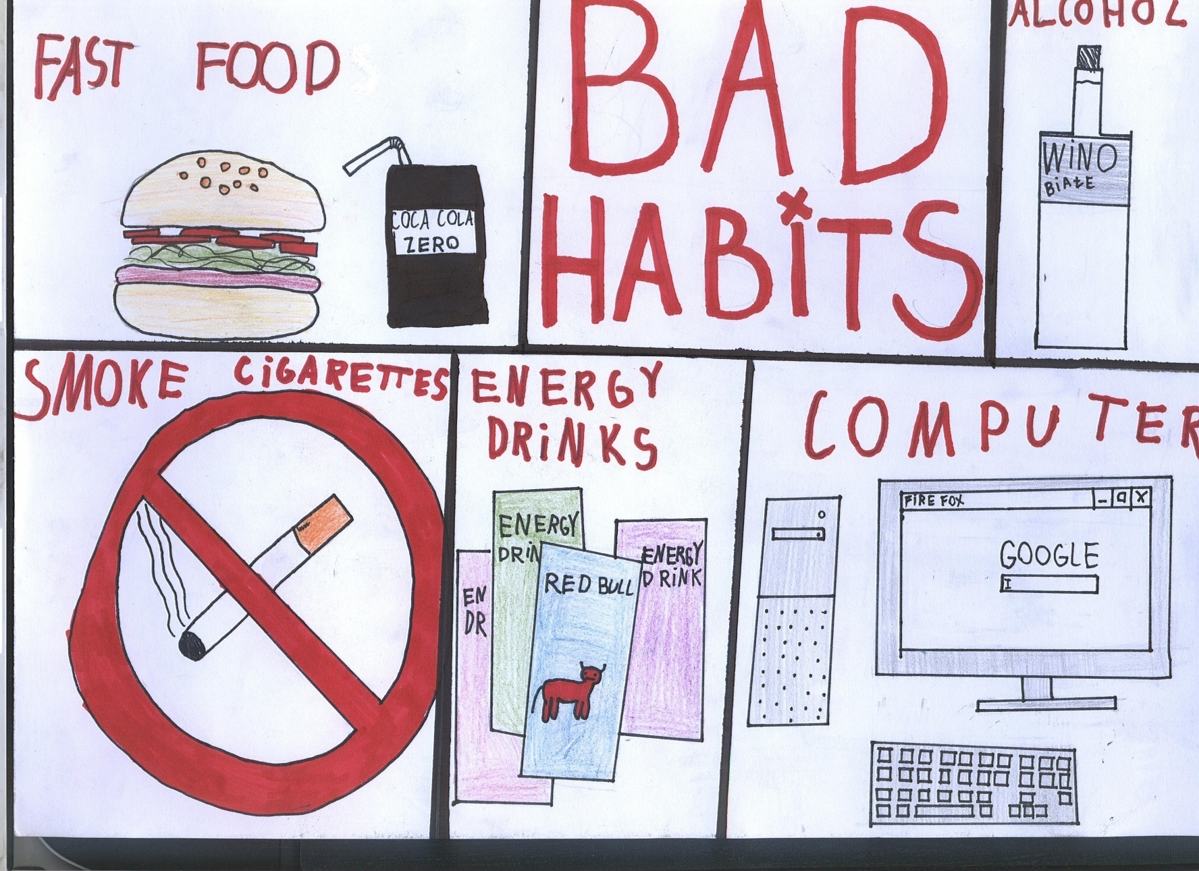
Bad habits X: fast food, alcohol, computer, energy drinks and smoking.

Slide 10
Do not eat too much of fast foods…

Slide 11
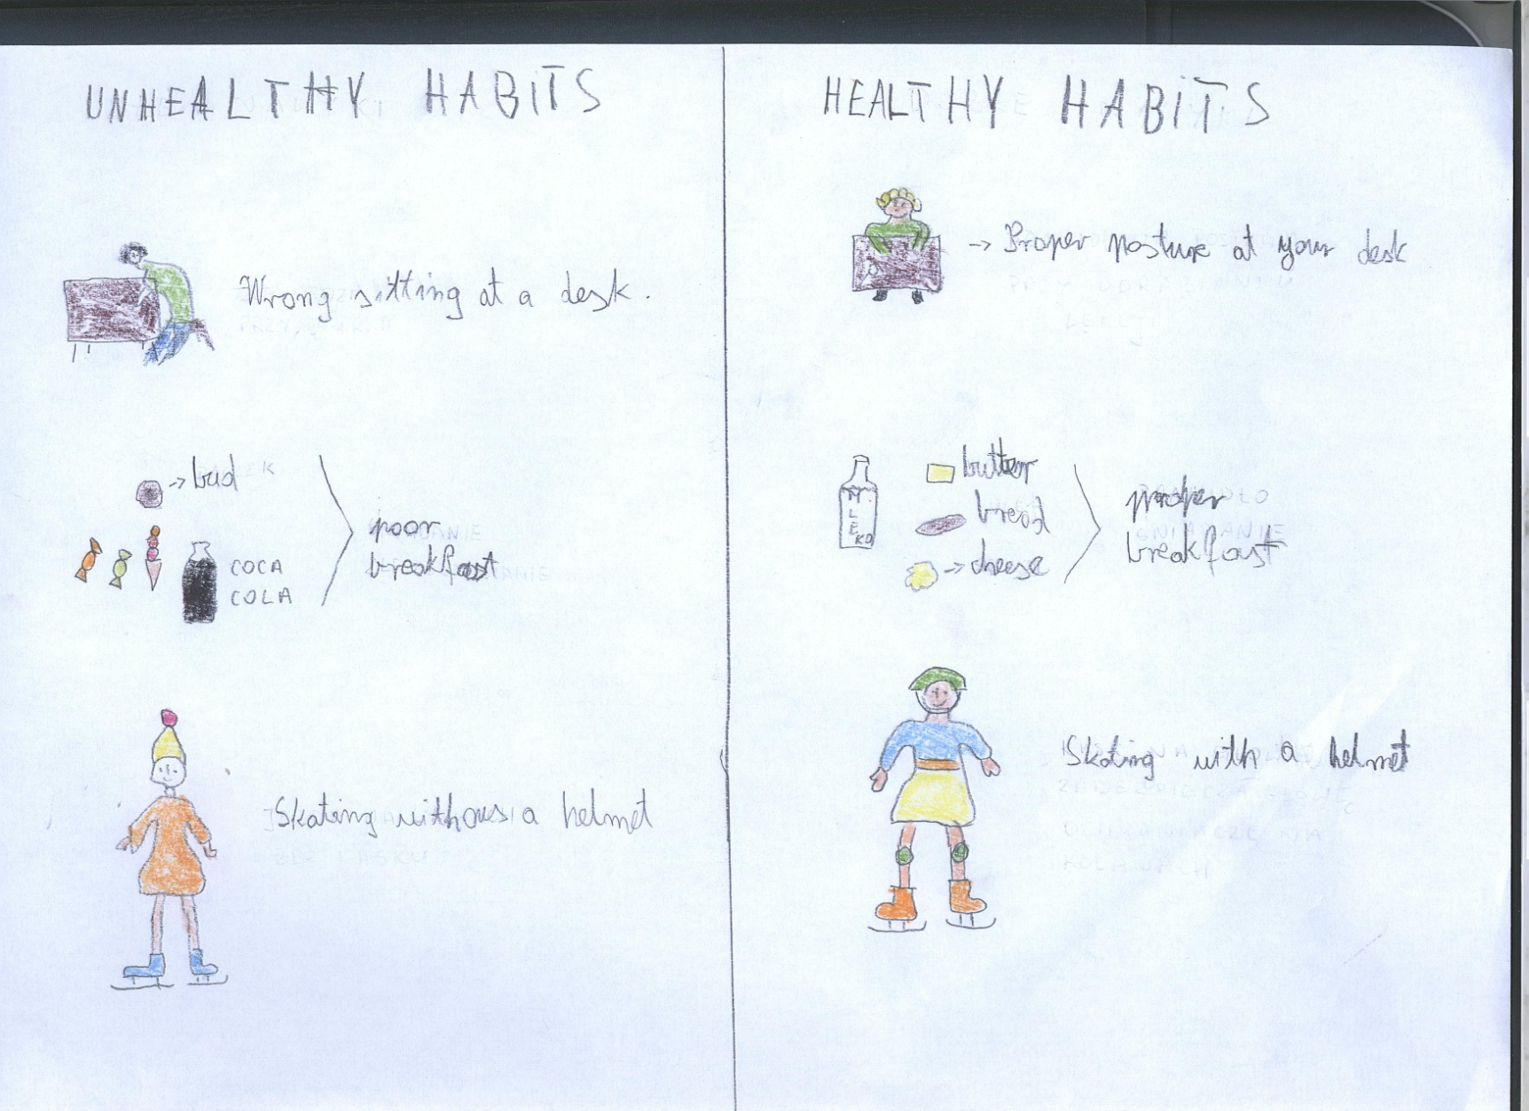
Healthy and unhealthy habits-opposites

Slide 12
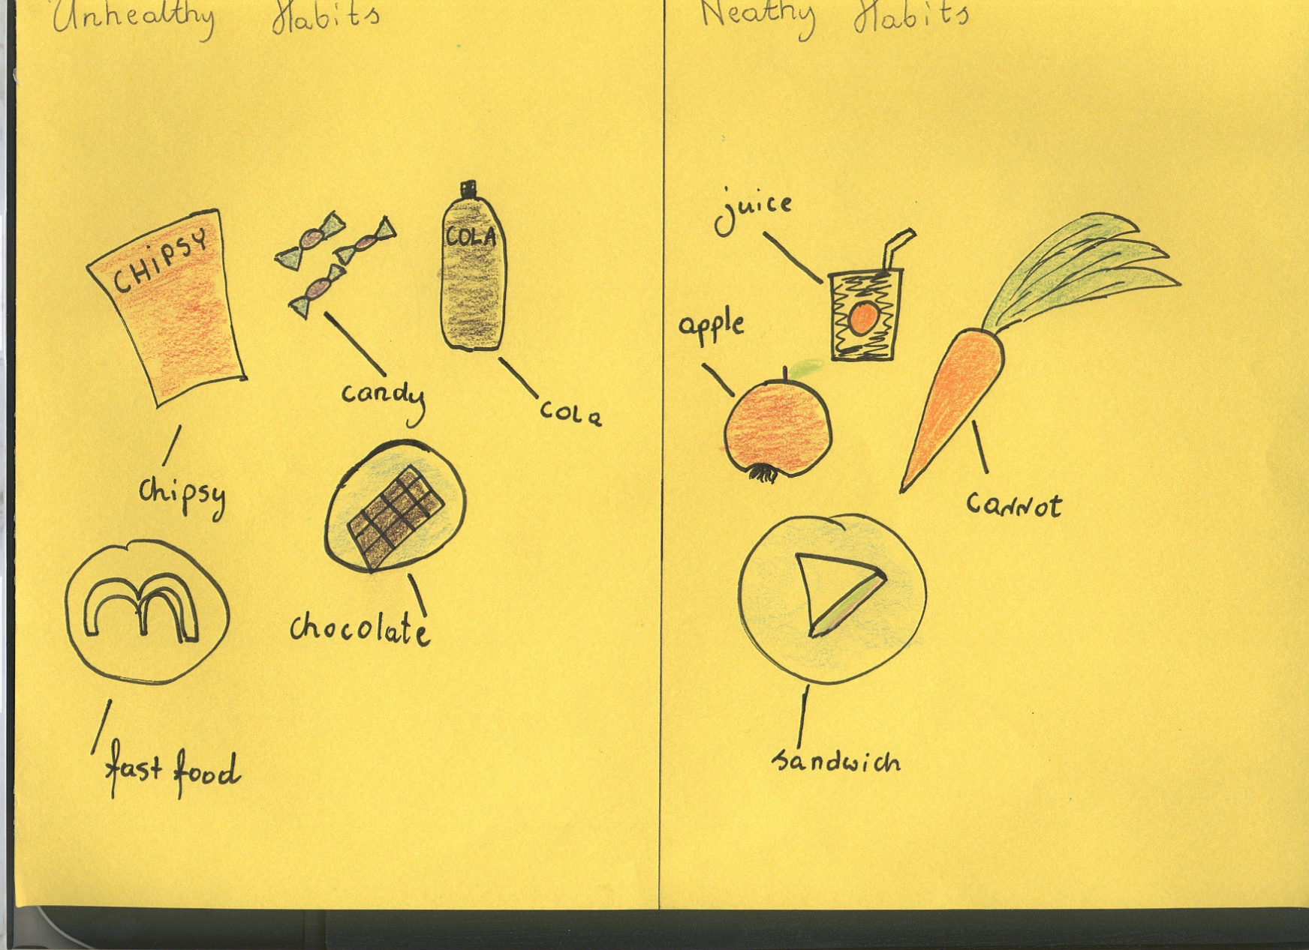
Healthy and unhealthy food

Slide 13
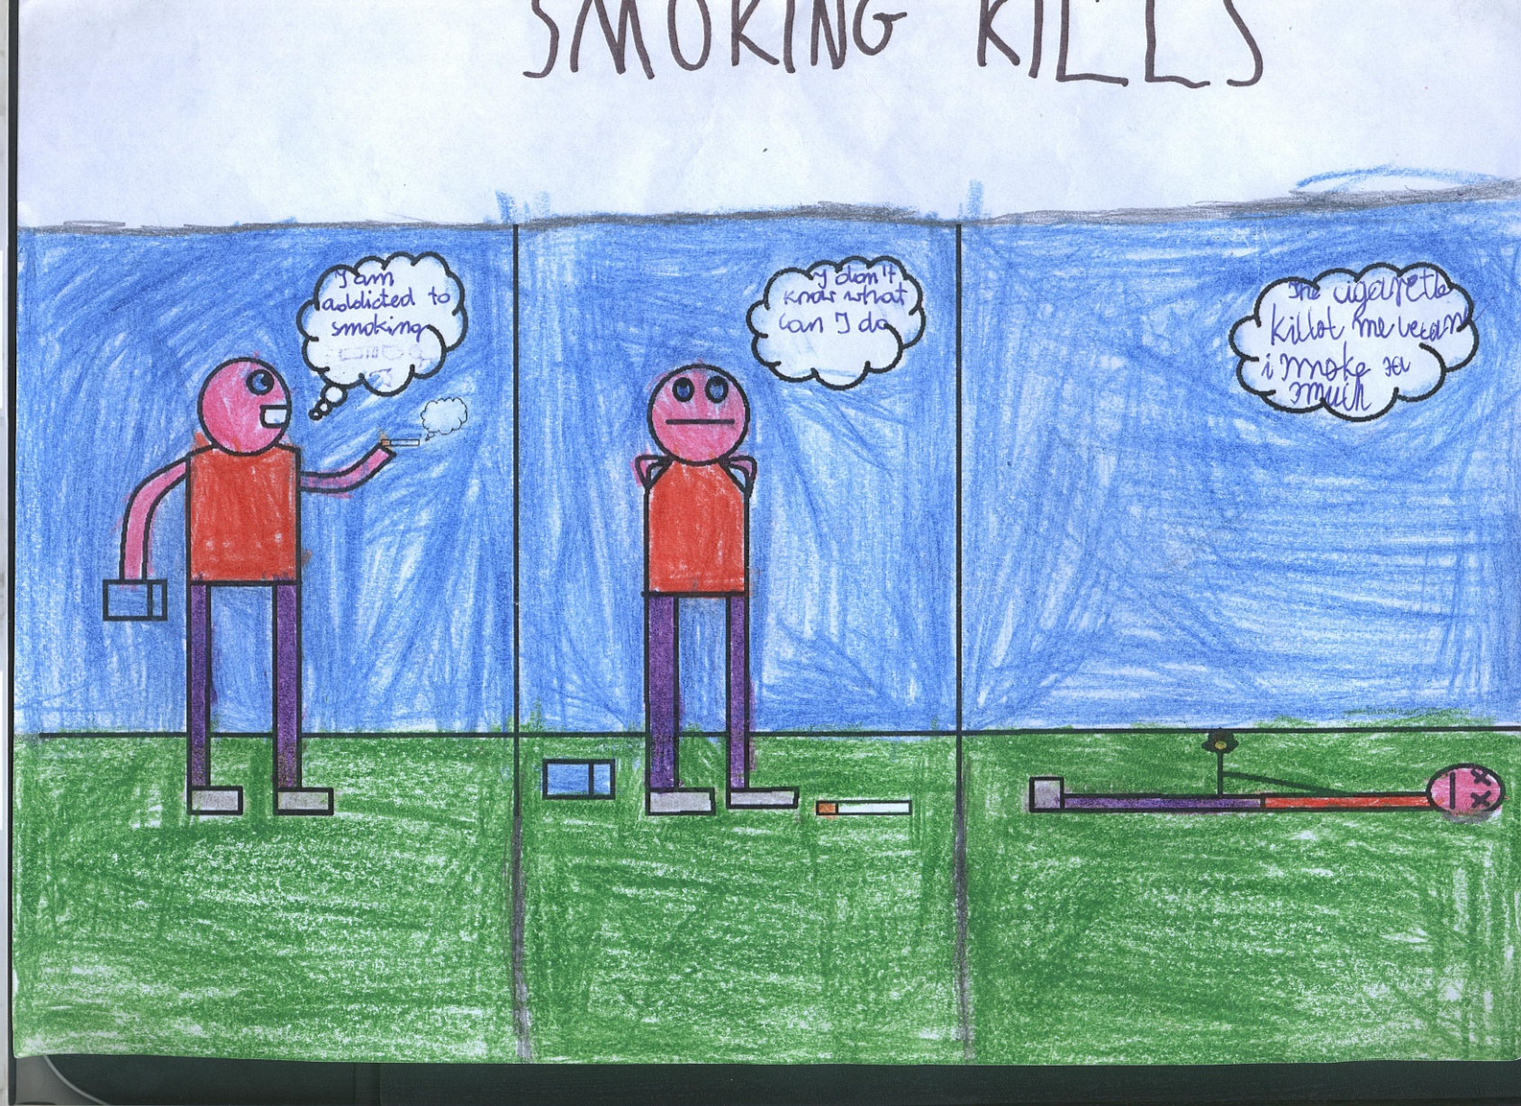
Smoking kills!!!!!!!!!!!!!

Slide 14
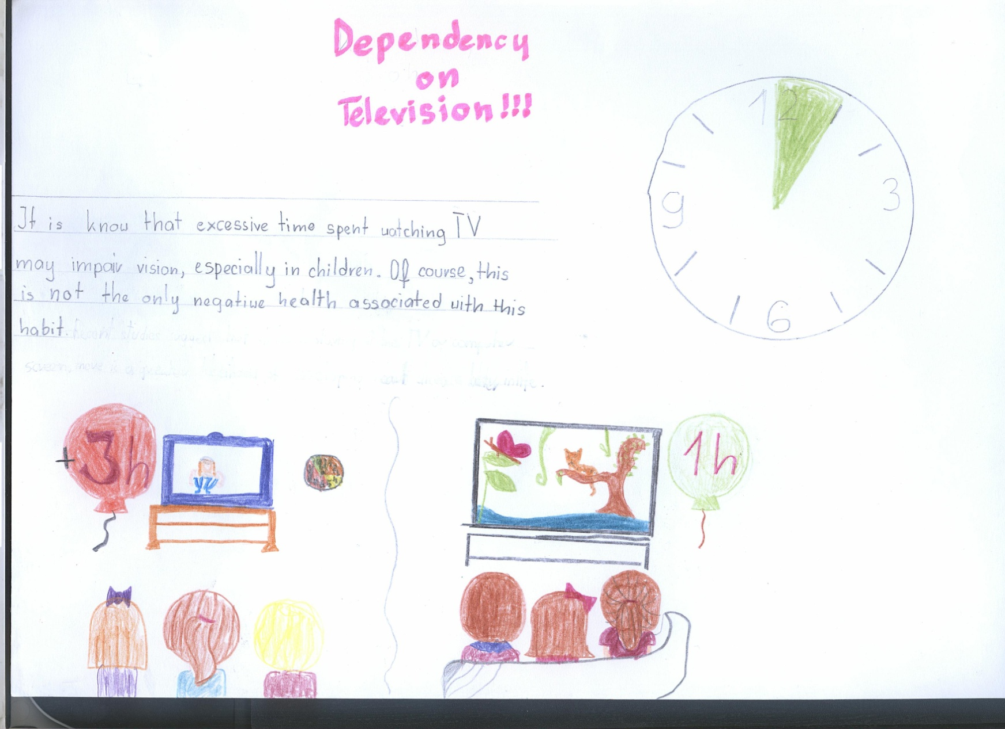
Dpendency on television

Slide 15
Remember! Unhealthy
habits kills!!!!!!!!!

