Slide 1
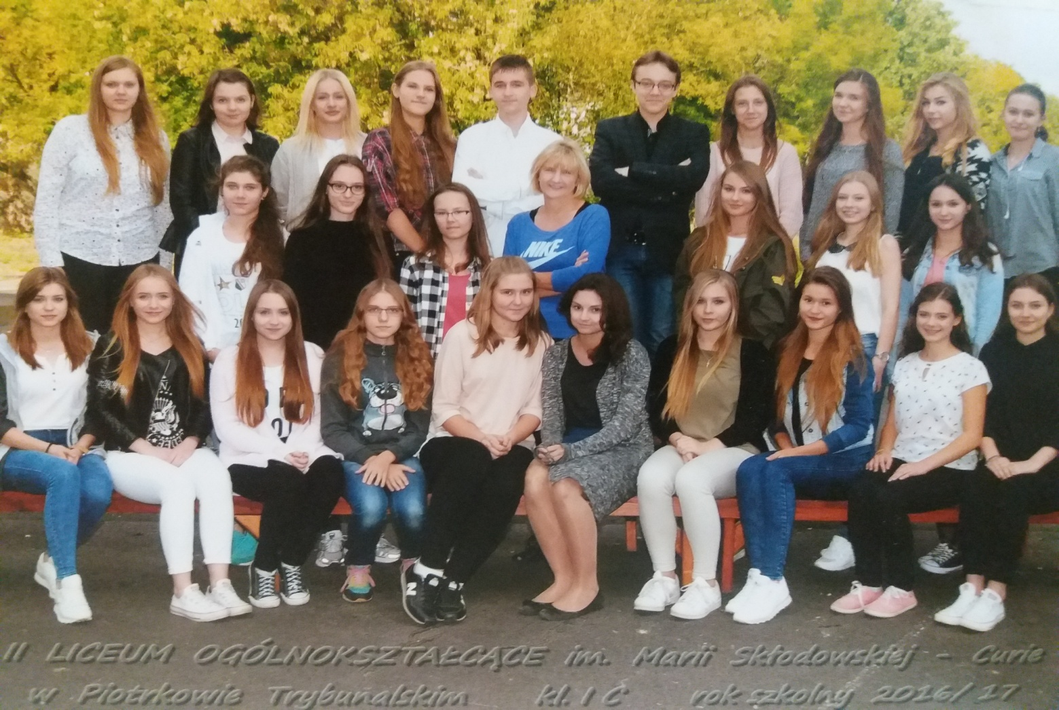
Class 2c

Slide 2
We go to 2 c class in the II highschool of Maria Skłodowska – Curie in Piotrków Trybunalski. We belong to the students of the humanities classes. In our class there are twenty eight people – two boys and twenty six girls. Our favourite subjects are Polish and history. Why ? We are typical humanists. We enjoy reading books. We also like history and we are interested in old events. We are funny teens and we like to smile. Generally, we like all our teachers, but only two teachers are our favourite – it is our history and Polish teacher. They are very ambitious and well – educated people. We admire them for broad knowledge and fascinating way of giving lectures. We never get bored during their lessons.

Slide 3
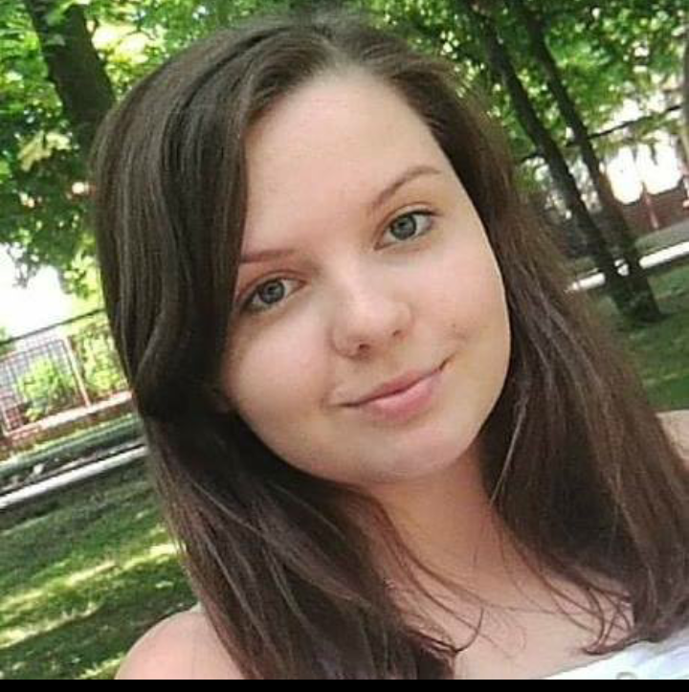
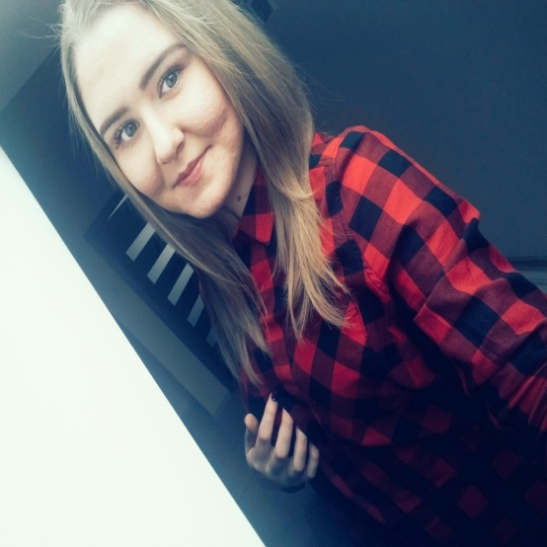
My name is Dominika. I’ m seventeen but in three months I will be eighteen years old. I live in Rozprza. I have older sister Kinga. I like animals. I’ m interested in cooking. My speciality is brownie.
My name is Kasia. I’ m seventeen years old. I live in Czarnocin. I have two sisters and two brothers. I love reading books and cooking. When I have a free time I like meet with my friends.
My name is Ola. I’ m seventeen years old. I am from Golesze in Poland. I have brother. My favourite sport is volleyball. I love do it and watch the matches. I spend a lot of time with my boyfriend.

Slide 4
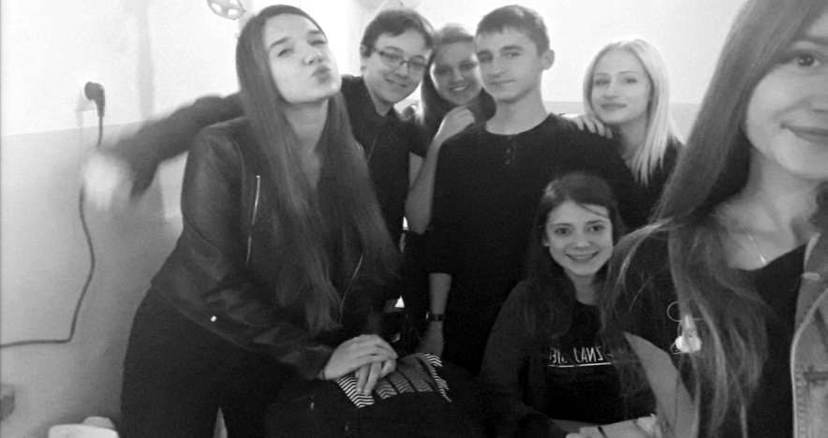
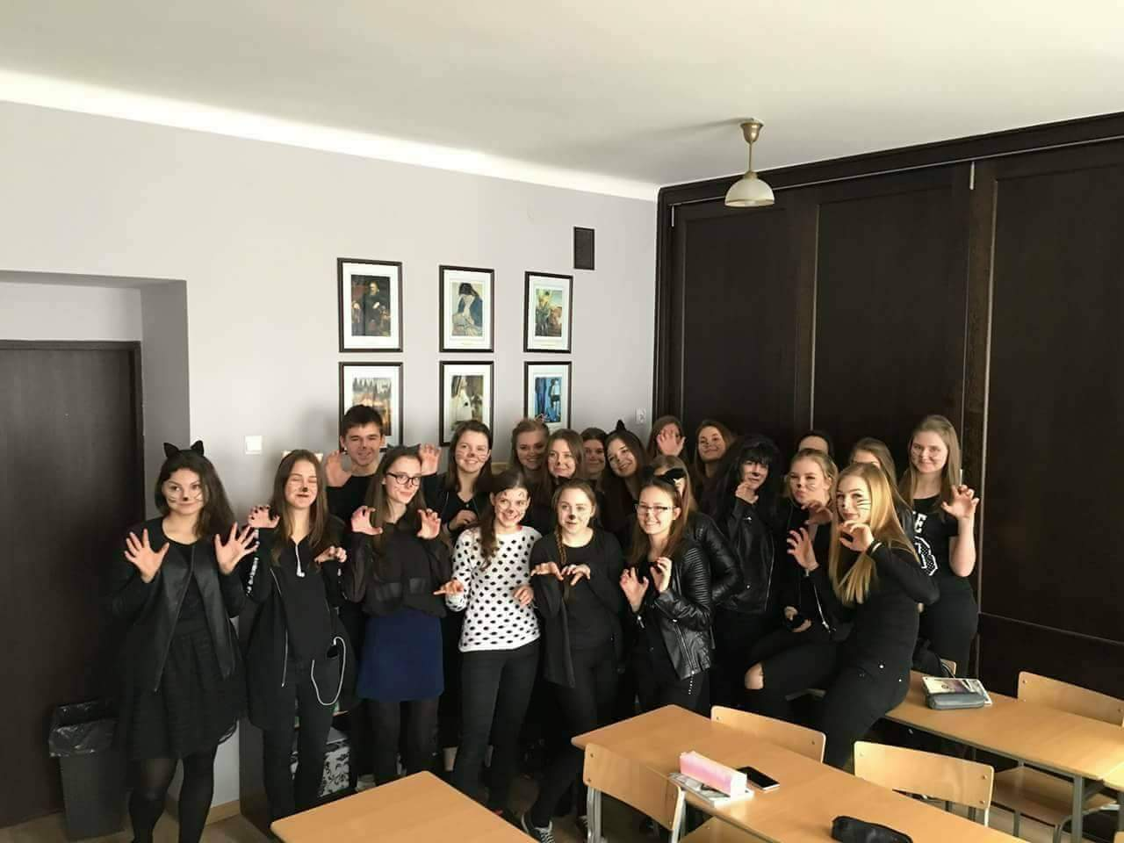
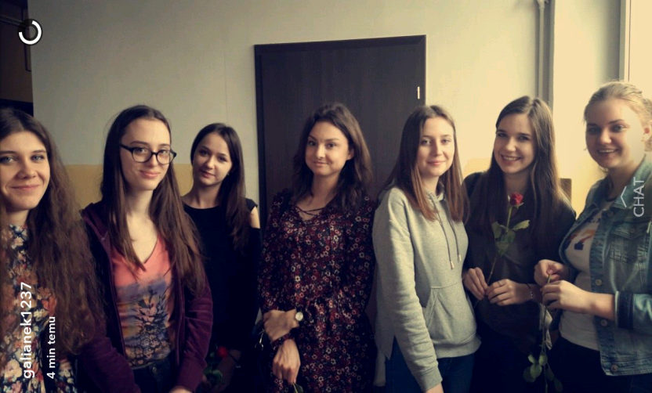
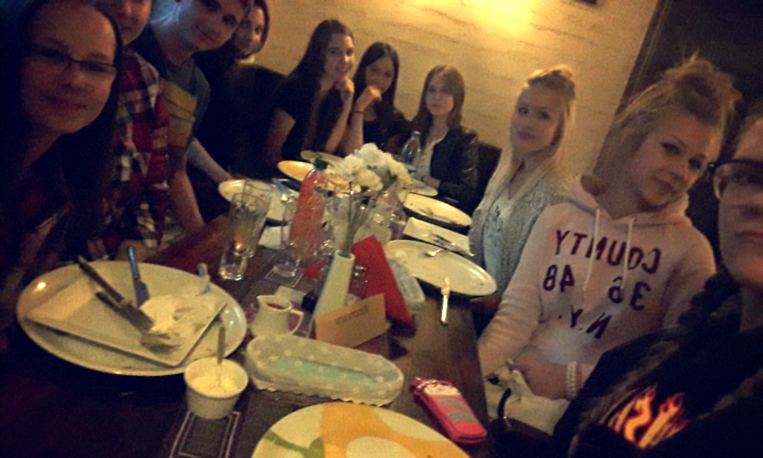
Our photos

