Slide 1
Electric and Electronic equipment in our school
W.E.E. and Air Quality
Project Erasmus + 2019-1-ES01-KA202-063878
Residuos Eléctricos y Electrónicos y Calidad del Aire
Authors: KARTAKI Maria, LIOUDAKI Stella

Slide 2
PURPOSE
Electric and Electronic equipment in our school
Register all the electric and electronic devices used in our school that can be recycled
Project Erasmus + 2019-1-ES01-KA202-063878 «Residuos Eléctricos y Electrónicos y Calidad del Aire»

Slide 3
Which devices are recyclable?
Electric and Electronic equipment in our school
Any electric or electronic device which can plug into an electrical outlet or work with batteries, including lightbulbs.
Project Erasmus + 2019-1-ES01-KA202-063878 «Residuos Eléctricos y Electrónicos y Calidad del Aire»

Slide 4
What is the Recycling of Waste Electronic and Electrical Equipment (WEEE)?
Electric and Electronic equipment in our school
It is the process of converting the waste from this equipment into products of similar or different usage while also removing any dangerous elements from them.
Project Erasmus + 2019-1-ES01-KA202-063878 «Residuos Eléctricos y Electrónicos y Calidad del Aire»

Slide 5
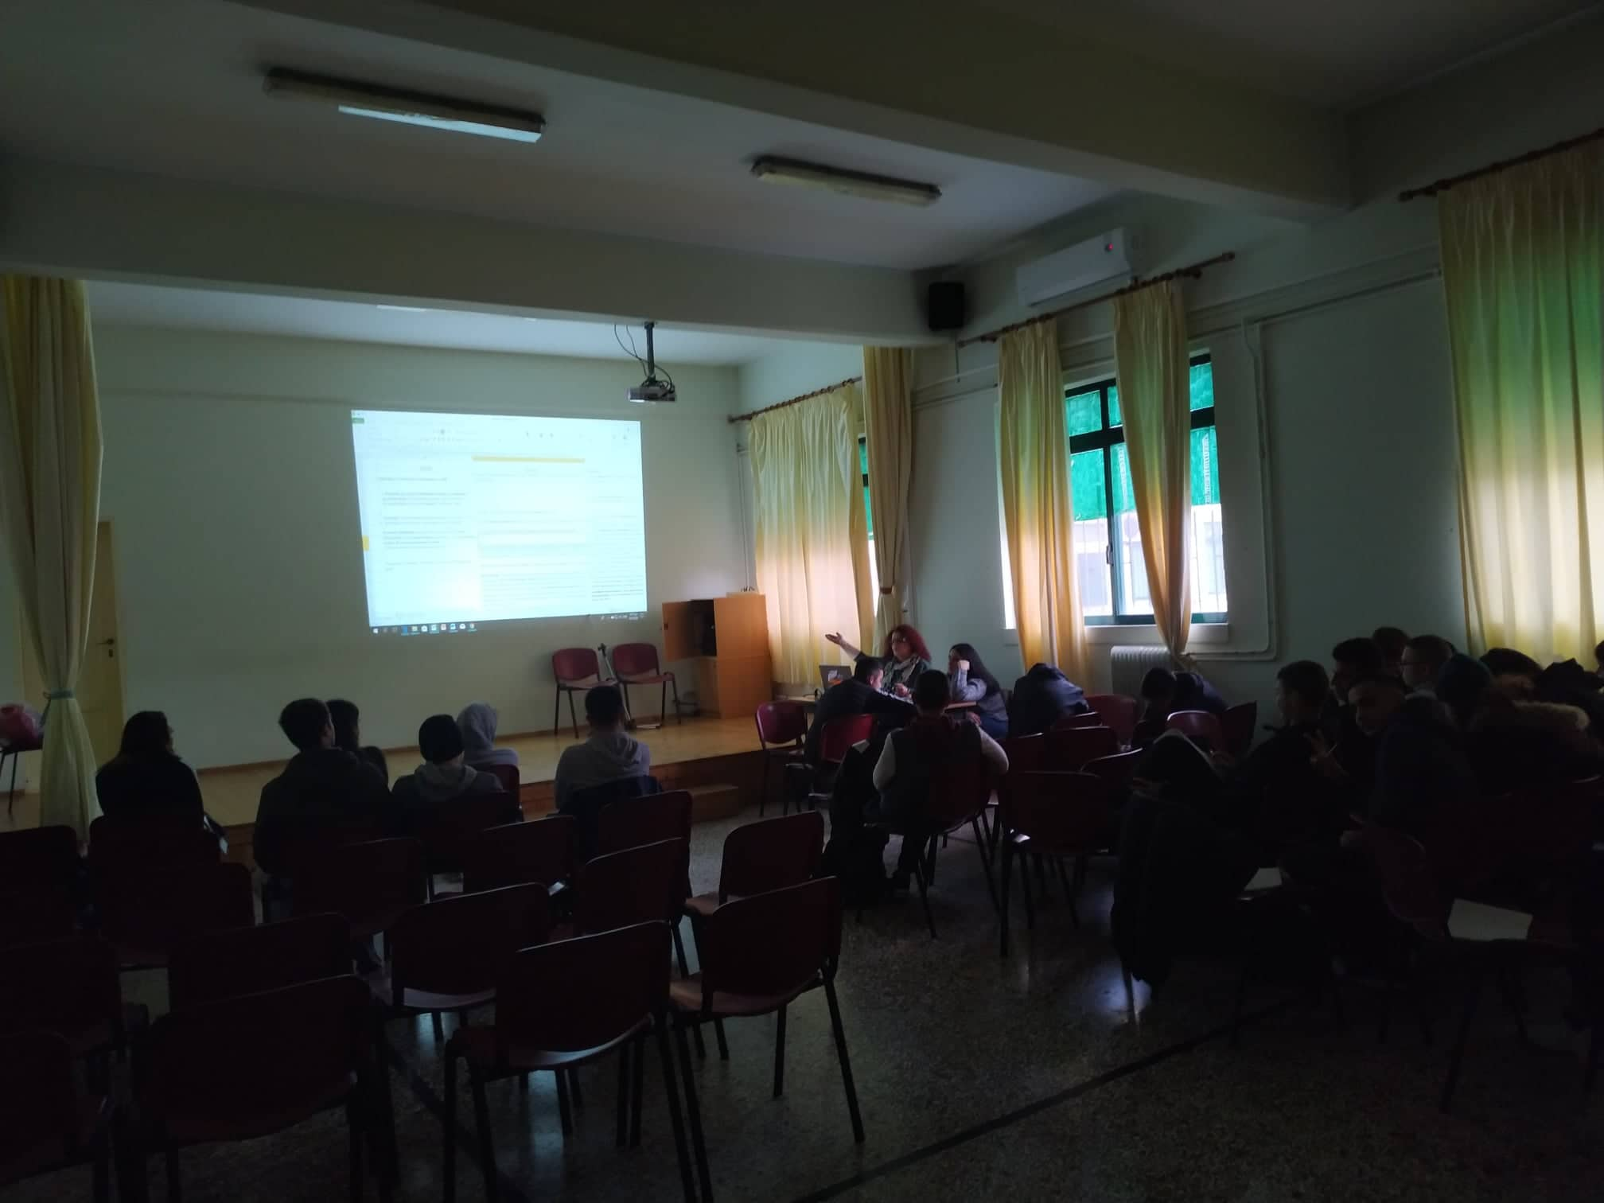
Searching and discussing
Electric and Electronic equipment in our school
Project Erasmus + 2019-1-ES01-KA202-063878 «Residuos Eléctricos y Electrónicos y Calidad del Aire»

Slide 6
PROCESSING
Electric and Electronic equipment in our school
For the registering process, we used the coding form of the E.U.
The laboratories and workshops were not registered because they fall under a different administration, not our schools.
Our school is representing the majority of schools in Greece.
Project Erasmus + 2019-1-ES01-KA202-063878 «Residuos Eléctricos y Electrónicos y Calidad del Aire»

Slide 7
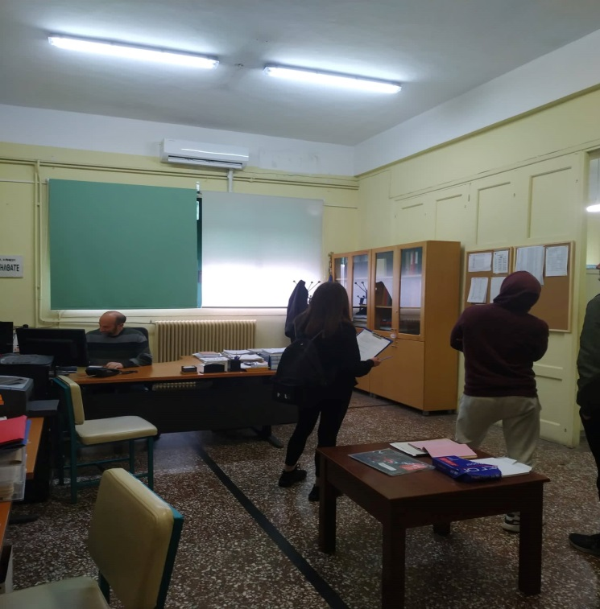
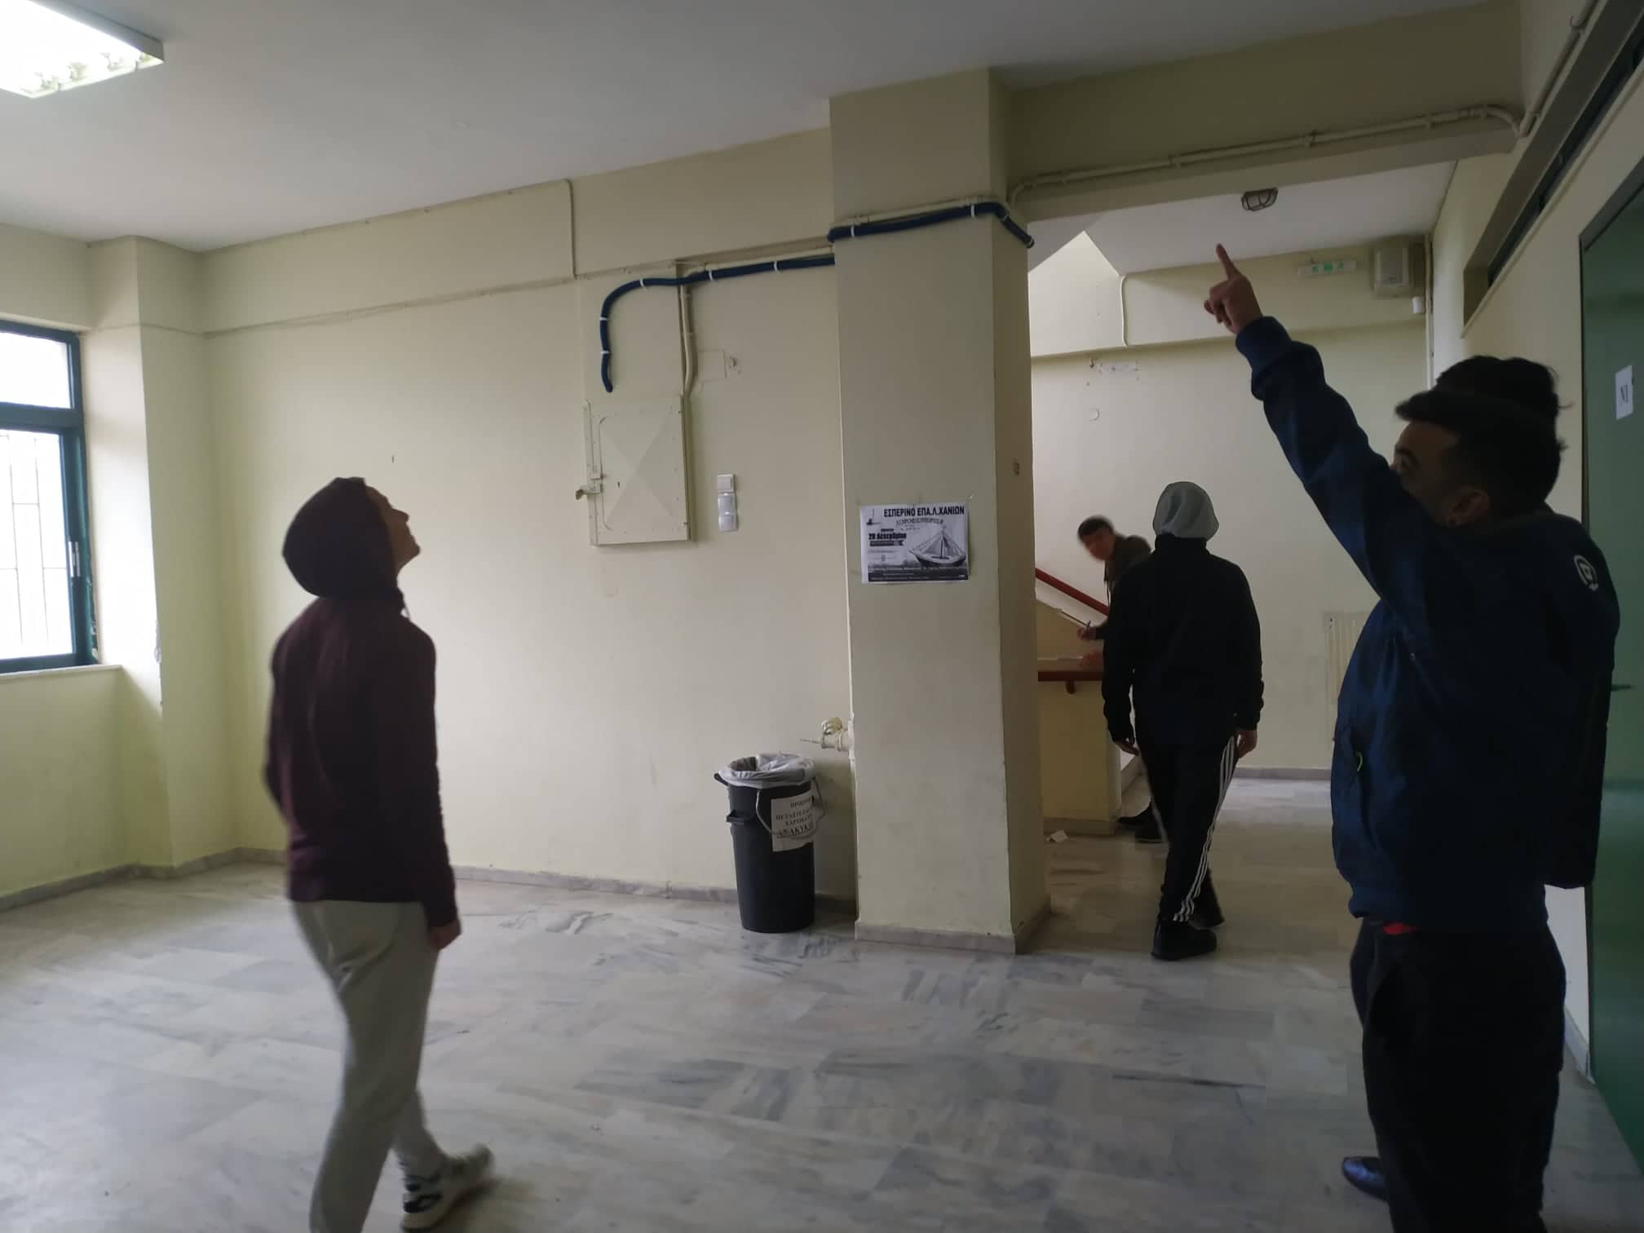
Registering Data
Electric and Electronic equipment in our school
Project Erasmus + 2019-1-ES01-KA202-063878 «Residuos Eléctricos y Electrónicos y Calidad del Aire»

Slide 8
Registered Areas
Electric and Electronic equipment in our school
 | HEADMASTER’S OFFICE | ADMINISTRATIVE AND SECRETARIAL OFFICE | LIBRARY | CLASSROOMS | EVENT HALL | WC | HALL-WAYS
BUILD- ING Α | 1 | 1 | 1 | 7 | 1 | 1 | 2
BUILD-ING B | 0 | 0 | 0 | 10 | 0 | 1 | 2
Project Erasmus + 2019-1-ES01-KA202-063878 «Residuos Eléctricos y Electrónicos y Calidad del Aire»

Slide 9
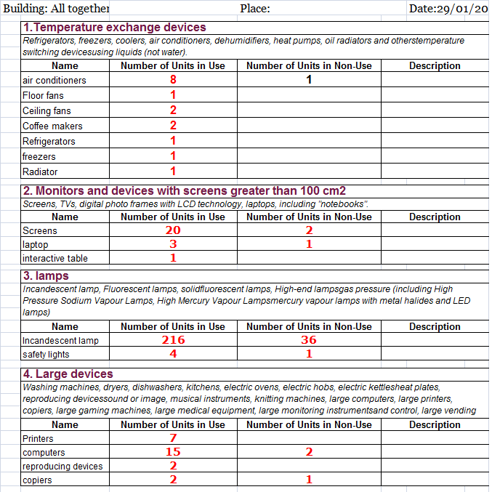
Registry Sample
Electric and Electronic equipment in our school
Project Erasmus + 2019-1-ES01-KA202-063878 «Residuos Eléctricos y Electrónicos y Calidad del Aire»

Slide 10
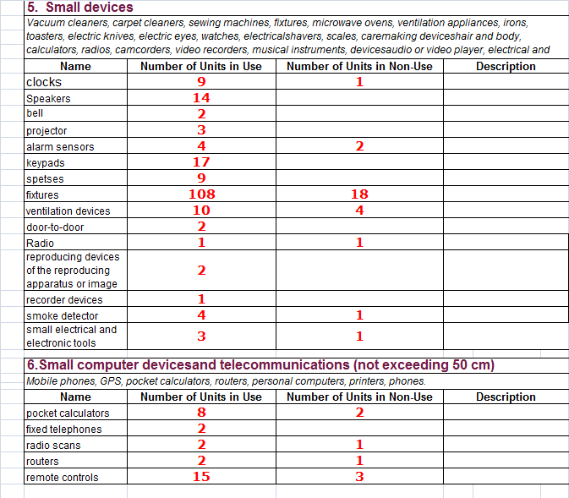
Electric and Electronic equipment in our school
Project Erasmus + 2019-1-ES01-KA202-063878 «Residuos Eléctricos y Electrónicos y Calidad del Aire»

Slide 11
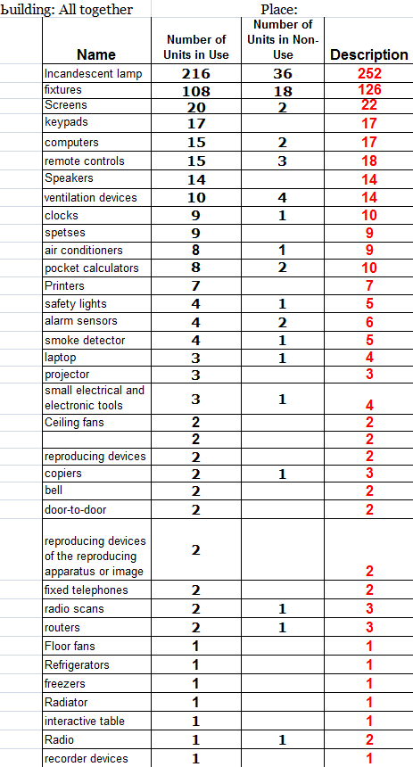
CONCENTRATED RESULTS
Electric and Electronic equipment in our school
Project Erasmus + 2019-1-ES01-KA202-063878 «Residuos Eléctricos y Electrónicos y Calidad del Aire»

Slide 12
CONCLUSIONS
Electric and Electronic equipment in our school
After the WEEE registry conducted at our school we came to the following conclusions:
Fluorescent lights are the devices most commonly used.
Following in numbers were light fixtures and screens.
The number of small appliances, as grouped by the ΕU, is much greater than the number of large appliances used.
Finally, the number of appliances not in use is almost none because in frequent intervals these devices are collected by the municipality.
Project Erasmus + 2019-1-ES01-KA202-063878 «Residuos Eléctricos y Electrónicos y Calidad del Aire»

Slide 13
Electric and Electronic equipment in our school
BIBLIOGRAPHY:
http://www.electrocycle.gr/what
http://www.electrocycle.gr/faq/79/ti-einai-anakyklosi-ton-apovliton-ilektrikoy-kai-ilektronikoy-exoplismoy-aiie
https://eur-lex.europa.eu/legal-content/EL/TXT/PDF/?uri=CELEX:32012L0019&from=EN
https://eur-lex.europa.eu/legal-content/EN/TXT/PDF/?uri=CELEX:32012L0019&from=EN
"The European Commission support for the production of this publication does not constitute an endorsement of the contents which reflects the views only of the authors, and the Commission cannot be held responsible for any use which may be made of the information contained therein".
Project Erasmus + 2019-1-ES01-KA202-063878 «Residuos Eléctricos y Electrónicos y Calidad del Aire»

Slide 14
Electric and Electronic equipment in our school
¡Muchas Gracias!
Project Erasmus + 2019-1-ES01-KA202-063878 «Residuos Eléctricos y Electrónicos y Calidad del Aire»

