Slide 1
European emission standards - EURO
Authors: ELEFTHERAKI Agelina,
KARTAKI Maria, TRAVAGIAKIS Apostolis,SARIDAKIS Emmanuil
Illustration: DOUROUNTAKI Maria, PROESTAKIS Konstantinos
Translation: ORNERAKI Georgia

Slide 2
European emission standards - EURO
The European Exhaust Emissions Standards, known as EURO cars, are protocols that set emission limits for cars sold in European Union countries.
With each new EURO, these protocols become more and more demanding in order to reduce emissions.

Slide 3
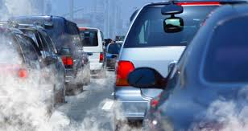
What are air pollutants?
Pollutants are chemicals that burden the environment, affecting the composition of the atmosphere, water resources or geophysics of the environment but also human health.

Slide 4
Effects of pollutants on humans
Headache and anxiety
Effects on the central nervous system
Eye irritation nose and throat, breathing problems
Respiratory effects (irritation, inflammation, chanting, COPD, lung cancer)
Cardiovascular diseases
Effects on the liver Effects on the reproductive system

Slide 5
Effects of pollutants on the environment
Air pollution:
Greenhouse effect
Weakening of its
ozone layer
Photochemical smog
Acid rain
2) Water pollution
3) Soil pollution

Slide 6
The chemical elements contained in car pollutants
CO
HC
NOx
PM

Slide 7
The beginning…
The first implementation attempt was made in the 1980s in the USA, under the name OBDI. The project was not very successful because no communication protocols and emission limits were set and they differed between the manufacturers.
In 1996, with the help of ISO and SAE, tables were drawn up with which all manufacturers agreed. Thus was created the OBDII system, which was essentially the forerunner of E-OBD.
The E-OBD system used common communication systems, for the Electronic Control Unit (ECU) as well as the use of common diagnostic, fault codes.
The Kyoto Treaty, in 1992, established the "targeting" of CO2 with the implementation of the first Euro 1 standard, reaching Euro 6 today.

Slide 8
EURO 1
It was implemented in 1992
It provided for common restrictions for both petrol and diesel vehicles.
The adaptation of the catalytic converters became mandatory and required the transition to unleaded petrol.

Slide 9
EURO 2
It was implemented in 1996
Reduce the limits of carbon monoxide unburned hydrocarbons nitrogen oxides
Introduced different levels of pollutants for petrol and diesel engines.

Slide 10
EURO 3
It started in 2001 by setting stricter limits on diesel engines
For carbon monoxide and nitrous oxide much stricter frameworks were introduced.
It forced manufacturers to use special filters to reduce microparticles (PDF).

Slide 11
EURO 1 vs EURO 3

Slide 12
EURO 4
It was implemented in 2005
It had much stricter pollution limits It focused on cleaning up emissions from diesel vehicles, in particular by reducing particulate matter (PM) and nitrogen oxides (NOx).
Some Euro 4 diesel cars were equipted with particulate filters.

Slide 13
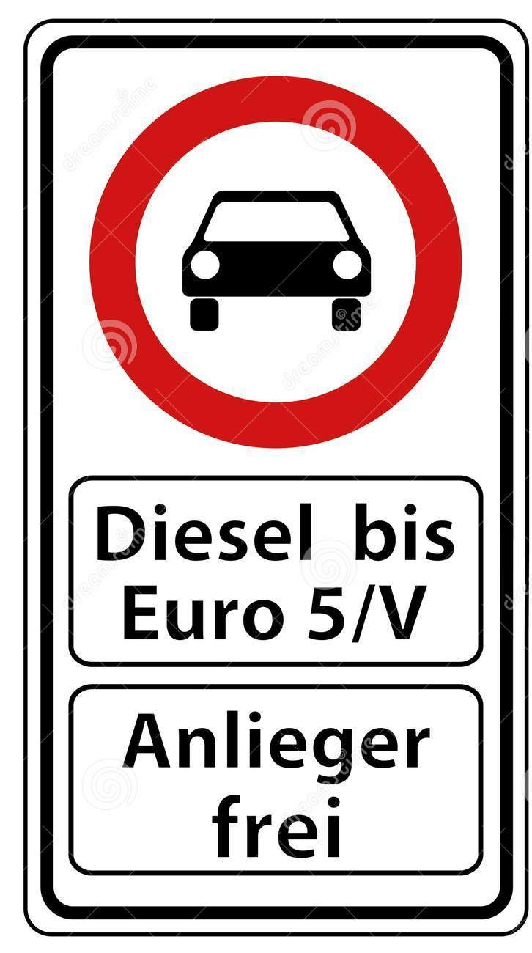
EURO 5
It entered into force in September 2009
It focused heavily on carbon dioxide emissions.
It further strengthened the limits on particulate emissions from diesel engines. There was also a reduction in NOx limits (28% reduction compared to Euro 4)
A particle limit for gasoline engines was applied for the first time.

Slide 14
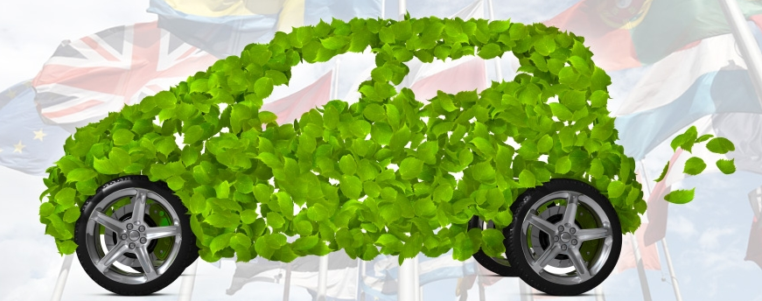
EURO 6
In 2014 with Euro 6 stricter provisions were applied.
It focuses mainly on reducing nitrogen oxide (NOx) emissions.
Euro 6 advocates an informal ban on diesel engines due to very strict limits.
Implements exhaust gas recirculation (EGR) - replacement of part of the intake air (containing 80% nitrogen) with recycled exhaust gas
Euro 5 and 6 are quite close to the specifications, with the exception of diesel..

Slide 15
Comparison of NOX emissions –PM GASOLINE ENGINES -DIESEL

Slide 16
EYRO pollutant prices 1-6

Slide 17
MORE INFORMATION
The dates of application of a Euro standard are the dates of mandatory sale of new vehicles of this type, although the car manufacturers have models of this standard much earlier.
Since 2005 in the EU The vehicles were categorized into six categories - A, B, C, D, E, F, G - which show the levels of environmental friendliness, but also the fuel consumption in relation to the amounts of carbon dioxide.
The EU takes into account the time required to renew the Union's fleet of new passenger cars and light commercial vehicles each time it sets new emission reduction targets.
By 2025, manufacturers will have to reduce total fleet emissions by 15% for both cars and trucks, compared to 2021 levels.
The EU's goal in 2030 is to ensure a socially acceptable and equitable transition to zero-emission mobility. The EU includes public and private investment in research and innovation, as well as an incentive mechanism

Slide 18
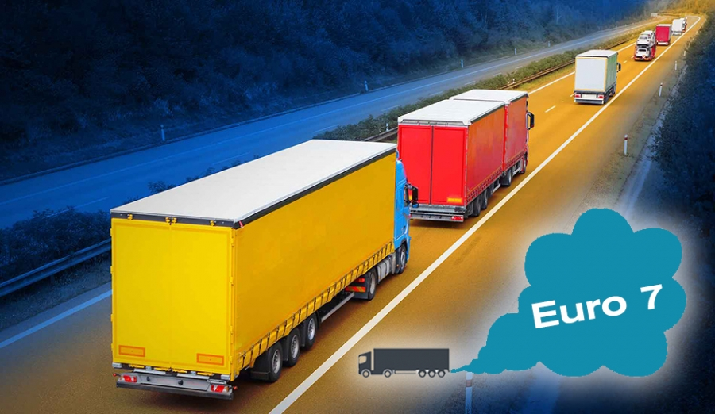
Bibliography: https://www.eea.europa.eu/themes/air/policy-context https://www.eea.europa.eu/el/simata-eop-2010/simata-2013/grafikes-plirofories/epiptoseis-tis-atmosfairikis-rypansis-stin-ygeia-2/image/image_view_fullscreen https://eur-lex.europa.eu/legal-content/EL/TXT/PDF/?uri=CELEX:32019R0631&from=EN https://ec.europa.eu/transparency/regdoc/rep/1/2019/EL/COM-2019-208-F1-EL-MAIN-PART-1.PDF https://www.brief.com.cy/oikonomia/ee/ti-allazei-me-neo-etos-stoys-kanonismoys-tis-ee https://apothesis.eap.gr/bitstream/repo/41952/1/104362_%CE%A0%CE%95%CE%A4%CE%A1%CE%99%CE%94%CE%97%CE%A3_%CE%A3%CE%A9%CE%9A%CE%A1%CE%91%CE%A4%CE%97%CE%A3.pdf https://avsautomotive.com/prwtokolla-euro/ https://blog.spotmechanic.gr/poia-autokinita-einai-euro-5-kai-euro-6-kai-pws-ta-katalavaineis/ https://el.wikipedia.org/wiki/%CE%94%CE%B9%CE%B1%CE%B3%CE%BD%CF%89%CF%83%CF%84%CE%B9%CE%BA%CF%8C%CF%82_%CE%88%CE%BB%CE%B5%CE%B3%CF%87%CE%BF%CF%82_%CE%91%CF%85%CF%84%CE%BF%CE%BA%CE%B9%CE%BD%CE%AE%CF%84%CE%BF%CF%85

Slide 19
"The European Commission support for the production of this publication does not constitute an endorsement of the contents which reflects the views only of the authors, and the Commission cannot be held responsible for any use which may be made of the information contained therein".

